Slide 1
PHY 711 Classical Mechanics and Mathematical Methods
10-10:50 AM MWF Olin 103
Plan for Lecture 28: Chap. 9 of F&W
Wave equation for sound considering both linear and non-linear effects
Sound scattering
Non-linear effects in traveling sound waves
Shocking effects

Slide 2
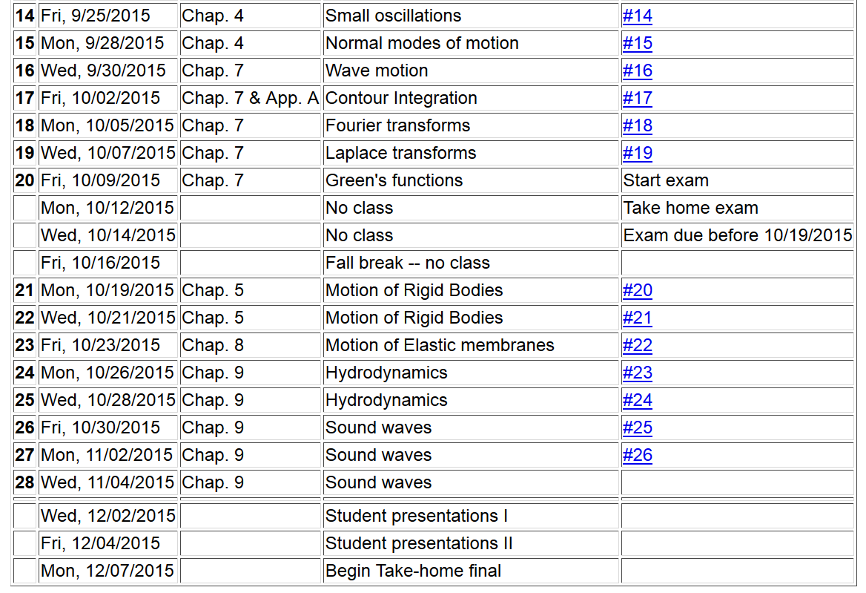

Slide 4
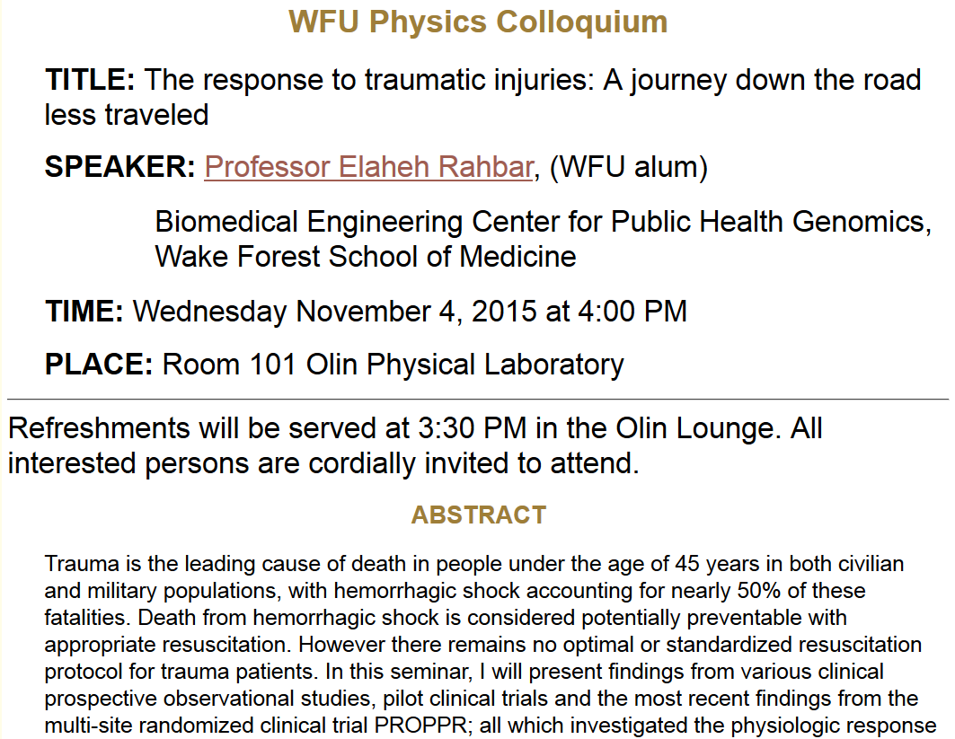

Slide 5
Solutions to linear wave equation in terms of velocity potential:

Slide 6
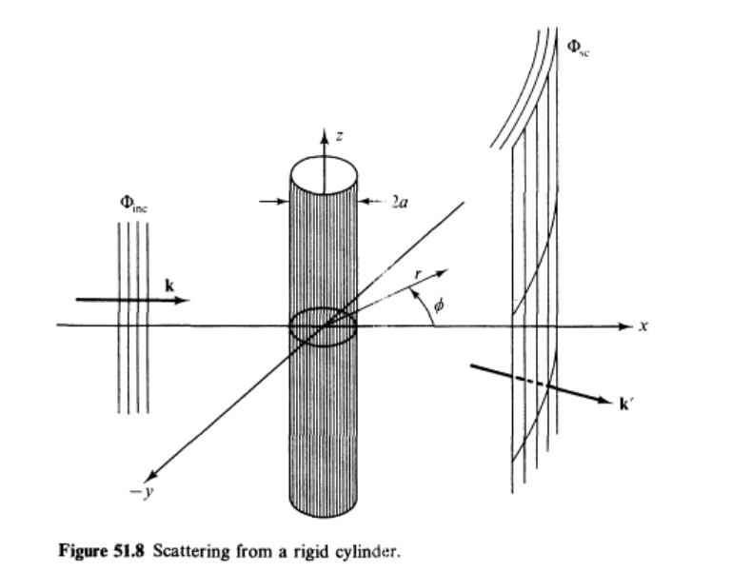
Scattering of sound waves –
for example, from a rigid cylinder
Figure from Fetter and Walecka pg. 337

Slide 7
Scattering of sound waves –
for example, from a rigid cylinder
(no z dependence)

Slide 10
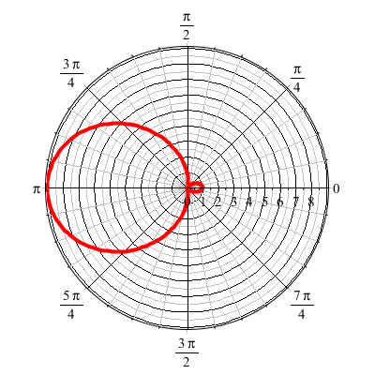
For ka << 1

Slide 11
Now consider non-linear effects in sound

Slide 12
Effects of nonlinearities in fluid equations
-- one dimensional case

Slide 18
Traveling wave solution:

Slide 19
Traveling wave solution -- continued:

Slide 20
Traveling wave solution -- full non-linear case:
w

Slide 21
Visualization continued:

Slide 22
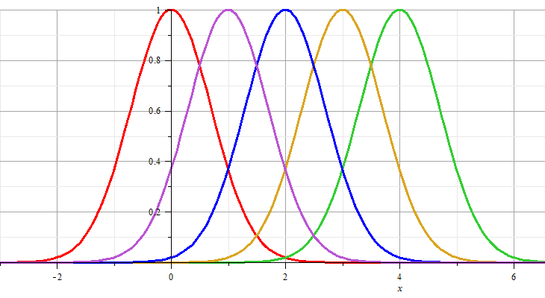
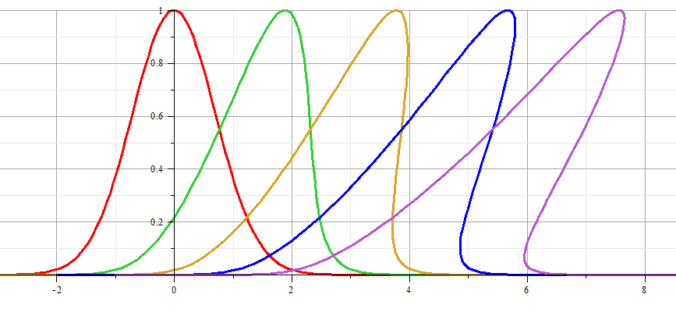
Linear wave:
Non-linear wave:

Slide 23
Linear wave
Non-linear wave

Slide 24
Analysis of shock wave
Plots of δρ
Solution becomes unphysical

Slide 25
Analysis of shock wave -- continued
After shock
t₂
δρ₂, δv₂, δp₂
Before shock
t₁
δρ₁, δv₁, δp₁
Shock front
x
u

Slide 26
Analysis of shock wave – continued
While analysis in the shock region is complicated, we can use conservation laws to analyze regions 1 and 2

Slide 27
Analysis of shock wave – continued
For adiabatic ideal gas, also considering energy and momentum conservation:

Slide 28
Analysis of shock wave – continued
For adiabatic ideal gas, entropy considerations::

