Slide 1
PHY 711 Classical Mechanics and Mathematical Methods
10-10:50 AM MWF Olin 103
Plan for Lecture 33:
Chapter 10 in F & W: Surface waves
Water waves in a channel
Wave-like solutions; wave speed

Slide 2
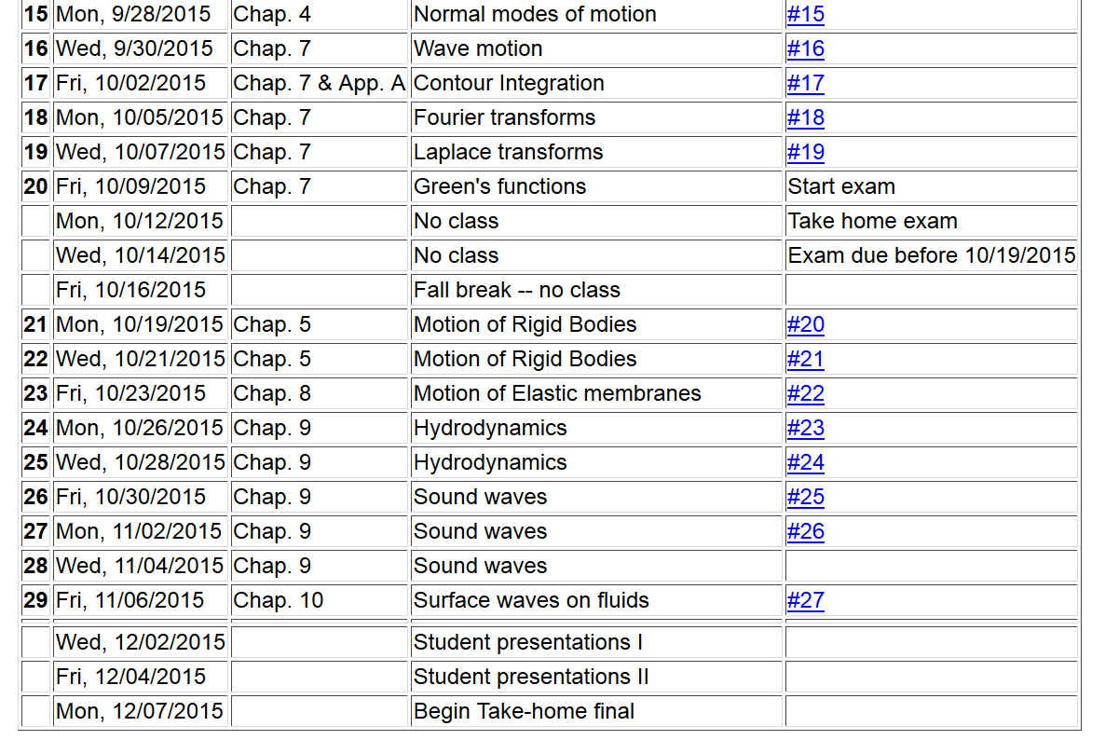

Slide 3
Physics of incompressible fluids and their surfaces
Reference: Chapter 10 of Fetter and Walecka

Slide 4
Consider a container of water with average height h and surface h+ζ(x,y,t); (h ⬅➔ z₀ on some of the slides)
p₀
ζ
z
h
y
x

Slide 6
dζ(x,y,t)/dt
z₀
v(x,y,t)
v(x+dx,y+dy,t)

Slide 7
Digression:
The form of the continuity equation given on previous (and subsequent) sides assumes that the transverse cross section of the channel is either very large or at least uniform. Your text also considers the case where there is a channel of varying width:
ζ(x,t)
v(x,t)
v(x+dx,t)
h(x)
b(x)
dx

Slide 8
For uniform channel:

Slide 9
More details: -- recall setup --
Consider a container of water with average height h and surface h+ζ(x,y,t)
p₀
ζ
z
h
y
x

Slide 10
Equations describing fluid itself (without boundaries)

Slide 11
p₀
ζ
z
h
y
x
(We have absorbed p₀ in “constant”)

Slide 12
Full equations:
(We have absorbed p₀ in “constant”)
Linearized equations:

Slide 13
For simplicity, keep only linear terms and assume that horizontal variation is only along x:

Slide 14
For simplicity, keep only linear terms and assume that horizontal variation is only along x – continued:

Slide 15
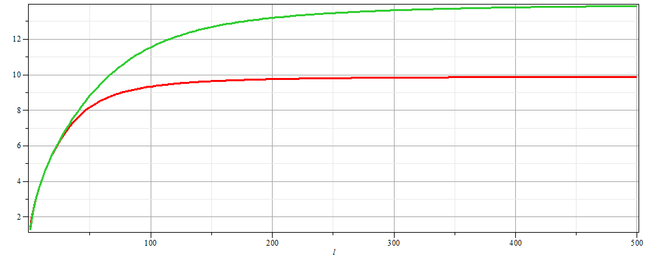
For simplicity, keep only linear terms and assume that horizontal variation is only along x – continued:
h=20 m
c
h=10 m
λ

Slide 16
For simplicity, keep only linear terms and assume that horizontal variation is only along x – continued:

Slide 17
General problem
including
non-linearities
p₀
ζ
z
h
y
x

