Slide 1
PHY 711 Classical Mechanics and Mathematical Methods
10-10:50 AM MWF Olin 103
Plan for Lecture 3:
Scattering theory – some more details
Rutherford scattering
Transformation between lab and center of mass reference frame.

Slide 2
Scattering theory:

Slide 3
b
Figure from Marion & Thorton, Classical Dynamics

Slide 4
φ
r_{min}
r(φ)

Slide 10
Relationship between φ_{max} and θ:

Slide 14
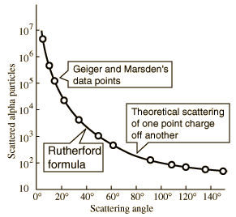
What happens as
θ →0?
From webpage: http://hyperphysics.phy-astr.gsu.edu/hbase/nuclear/rutsca2.html#c3

Slide 15
The results above were derived in the center of mass reference frame; relationship between normal laboratory reference and center of mass:
Laboratory reference frame:
Before After
m₁
m₂
u₁
v₁
ψ
u₂=0
ζ
v₂
Center of mass reference frame:
Before After
m₁
m₂
V₁
U₁
U₂
θ
θ
V₂

Slide 16
Relationship between center of mass and laboratory frames of reference
V_{CM}
U₁
V_{CM}
V₁
v₁
θ
ψ
u₁

Slide 17
Relationship between center of mass and laboratory frames of reference -- continued

Slide 18
Relationship between center of mass and laboratory frames of reference
V_{CM}
V₁
v₁
θ
ψ
For elastic
scattering

Slide 19
Digression – elastic scattering
Also note:

Slide 20
Relationship between center of mass and laboratory frames of reference – continued (elastic scattering)
V_{CM}
V₁
v₁
ψ
θ

Slide 21
Differential cross sections in different reference frames

Slide 22
Differential cross sections in different reference frames – continued:

Slide 23
Example: suppose m₁ = m₂

Slide 24
Example of cross section analysis – CM versus lab frame

