Slide 1
PHY 711 Classical Mechanics and Mathematical Methods
10-10:50 AM MWF Olin 103
Plan for Lecture 30:
    Chapter 10 in F & W: Surface waves
    -- Non-linear contributions and soliton solutions

Slide 2
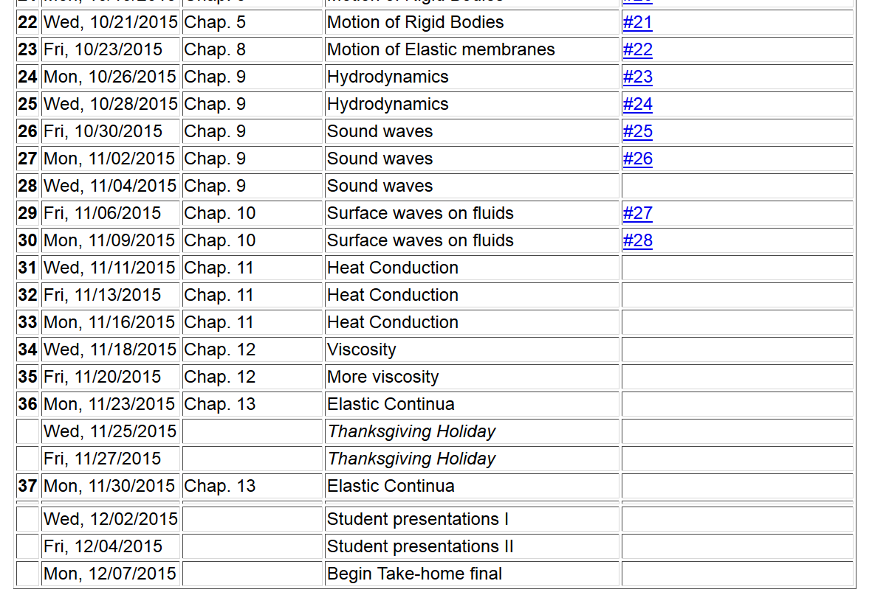

Slide 3
Surface waves in an incompressible fluid
General problem
  including
  non-linearities
p₀
ζ
z
h
y
x

Slide 4
p₀
ζ
z
h
y
x

Slide 5
Non-linear effects in surface waves:
p₀
ζ
z
h
y
z=0
x

Slide 6
Detailed analysis of non-linear surface waves
[Note that these derivations follow Alexander L. Fetter and John Dirk Walecka, Theoretical Mechanics of Particles and Continua (McGraw Hill, 1980), Chapt. 10.]
The surface of the fluid is described by z=h+ζ(x,t). It is assumed that the fluid is contained in a structure (lake, river, swimming pool, etc.) with a structureless bottom defined by the z = 0 plane and filled to an equilibrium height of z = h.

Slide 7
Defining equations for Φ(x,z,t) and ζ(x,t)
Bernoulli equation (assuming irrotational flow) and gravitation potential energy

Slide 8
Boundary conditions on functions –
Zero velocity at bottom of tank:
Consistent vertical velocity at water surface

Slide 9
Analysis assuming water height z is small relative to
variations in the direction of wave motion (x)
Taylor’s expansion about z = 0:
Note that the zero vertical velocity at the bottom ensures that all odd derivatives vanish from the
Taylor expansion . In addition, the Laplace equation allows us to convert all even derivatives with respect to z
to derivatives with respect to x.

Slide 10
Check linearized equations and their solutions:
Bernoulli equations --
Using Taylor's expansion results to lowest order

Slide 11
Analysis of non-linear equations -- keeping the lowest order nonlinear terms and include up to 4th order derivatives in the linear terms.
The expressions keep the lowest order nonlinear terms and include up to 4th order derivatives in the linear terms.

Slide 12
Note that the wave “speed” c will be consistently determined

Slide 13
Integrating and re-arranging coupled equations

Slide 14
Integrating and re-arranging coupled equations – continued --
Expressing modified surface velocity equation in terms of η(u):

Slide 15
Solution of the famous Korteweg-de Vries equation
Modified surface amplitude equation in terms of η
Soliton solution

Slide 16
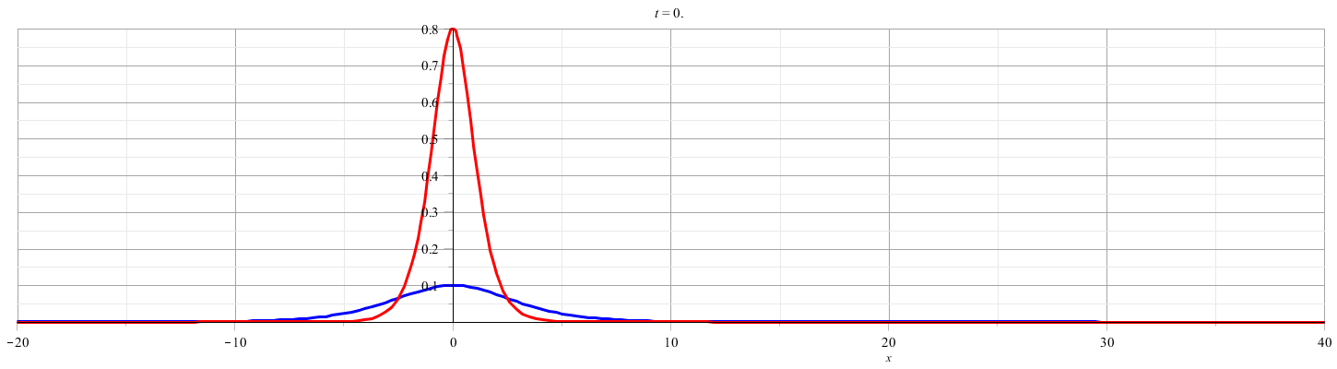

Slide 17
Relationship to “standard” form of Korteweg-de Vries equation

Slide 18
More details

Slide 19
Summary
Soliton solution

Slide 20
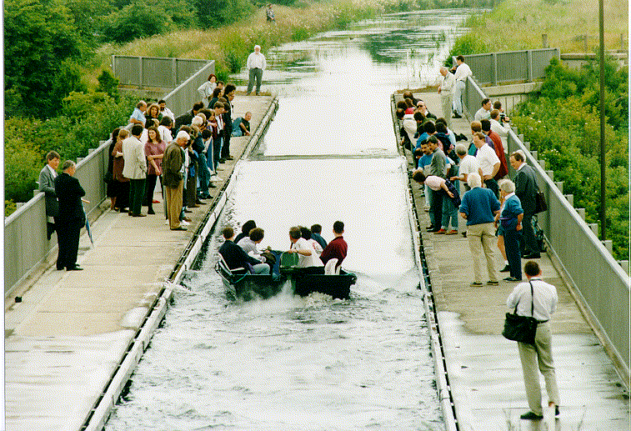
Photo of canal soliton http://www.ma.hw.ac.uk/solitons/
Some links:
Website – http://www.ma.hw.ac.uk/solitons/

