Slide 1
PHY 711 Classical Mechanics and Mathematical Methods
10-10:50 AM MWF Olin 103
Plan for Lecture 31:
    Chapter 11 in F & W:
    Heat conduction
    Basic equations
    Boundary value problems

Slide 2
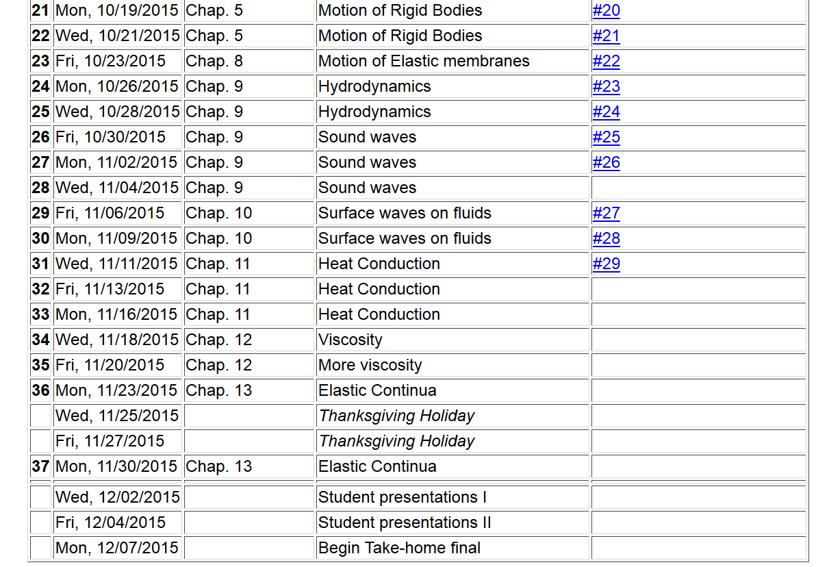

Slide 3
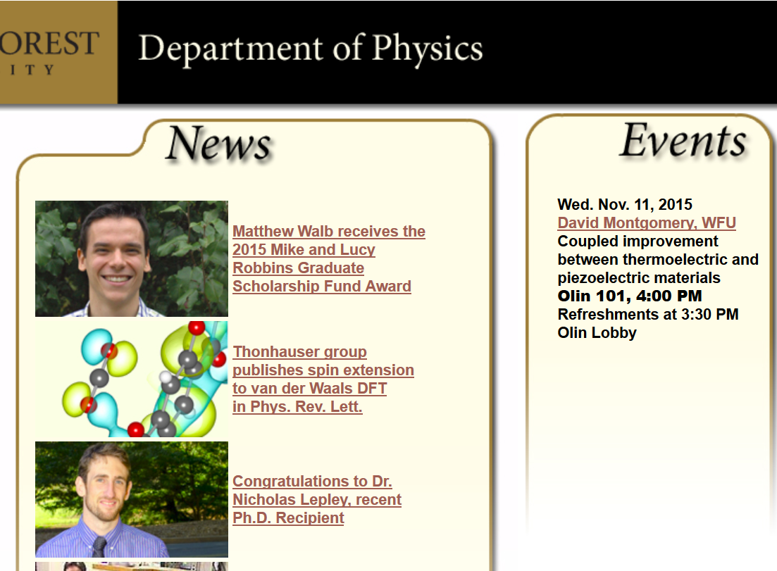

Slide 4
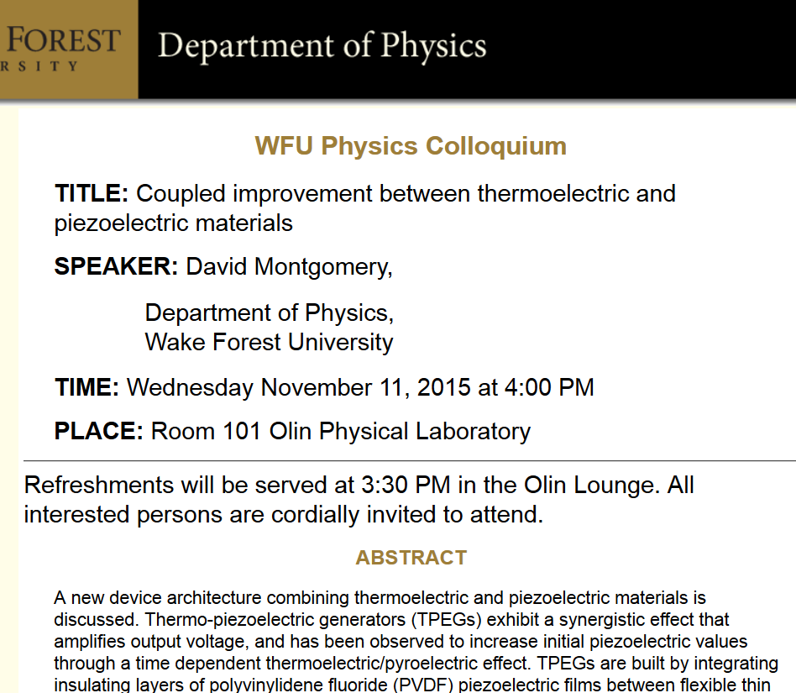

Slide 5
Conduction of heat
T(r,t)
j_{h}

Slide 6
Note that in this treatment we are considering a system at constant pressure p

Slide 7
Conduction of heat -- continued
heat flux
heat source

Slide 8
Conduction of heat -- continued
thermal diffusivity
Typical values (m²/s)
Air 2x10⁻⁵
Water 1x10⁻⁷
Copper 1x10⁻⁴

Slide 9
Boundary value problems for heat conduction
T₀
c
b
a

Slide 10
Boundary value problems for heat conduction
T₀
c
b
a
Assuming thermally insulated boundaries

Slide 11
Boundary value problems for heat conduction
T₀
c
b
a

Slide 12
Boundary value problems for heat conduction
T₀
c
b
a

Slide 13
Initial value problem in an infinite domain; Fourier transform

Slide 14
Initial value problem in an infinite domain; Fourier transform

Slide 15
Initial value problem in an infinite domain; Fourier transform

Slide 16
Heat equation in half-space

Slide 17
Heat equation in half-space -- continued

Slide 18
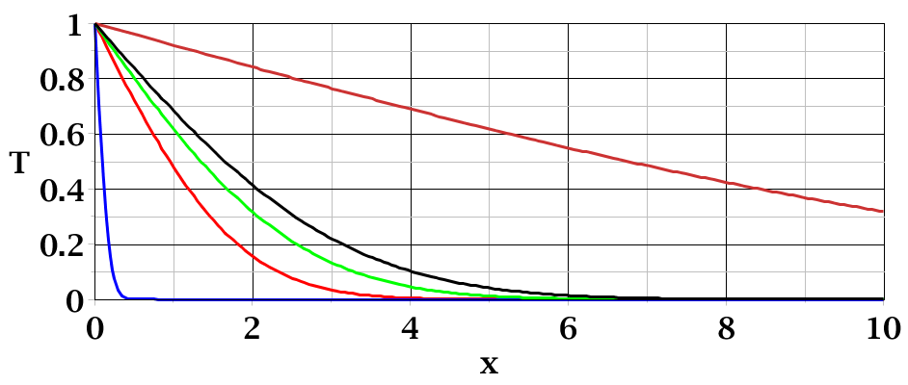
t=50
t=3
t=0.01

