Slide 1
PHY 711 Classical Mechanics and Mathematical Methods
10-10:50 AM MWF Olin 103
Plan for Lecture 32
Viscous fluids – Chap. 12 in F & W
Viscous stress tensor
Navier-Stokes equation
Example for incompressible fluid

Slide 2
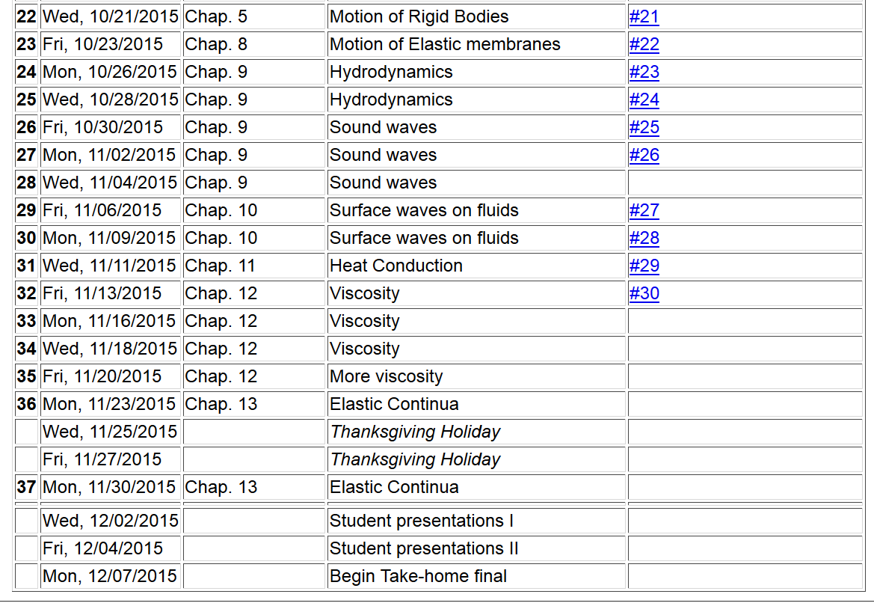
2

Slide 3
General formulation of viscosity from Chapter 12 of Fetter and Walecka

Slide 4
Note that in absence of viscous effect, the stress tensor relations are identical to the Newton-Euler and continuity equations:

Slide 5
Effects of viscosity
bulk viscosity
viscosity

Slide 6
Effects of viscosity -- continued

Slide 7
Newton-Euler equations for viscous fluids
Typical viscosities at 20º C and 1 atm:
Fluid | η/ρ (m²/s) | η (Pa s)
Water | 1.00 x 10⁻⁶ | 1 x 10⁻³
Air | 14.9 x 10⁻⁶ | 0.018 x 10⁻³
Ethyl alcohol | 1.52 x 10⁻⁶ | 1.2 x 10⁻³
Glycerine | 1183 x 10⁻⁶ | 1490 x 10⁻³

Slide 8
Example – steady flow of an incompressible fluid in a long pipe with a circular cross section of radius R

Slide 9
Example – steady flow of an incompressible fluid in a long pipe with a circular cross section of radius R -- continued
R
L
v(r)
(uniform pressure gradient)

Slide 10
Example – steady flow of an incompressible fluid in a long pipe with a circular cross section of radius R -- continued
R
L
v(r)

Slide 11
Example – steady flow of an incompressible fluid in a long pipe with a circular cross section of radius R -- continued
R
L
v(r)
Poiseuille formula;
➔Method for measuring η

Slide 12
Example – steady flow of an incompressible fluid in a long tube with a circular cross section of outer radius R and inner radius κR
R
κR
L

Slide 13
Example – steady flow of an incompressible fluid in a long tube with a circular cross section of outer radius R and inner radius κR -- continued
R
κR
L

