Slide 1
PHY 711 Classical Mechanics and Mathematical Methods
10-10:50 AM MWF Olin 103
Plan for Lecture 34
Navier-Stokes equation – Chap. 12 in F&W
Effects of viscosity on sound

Slide 2
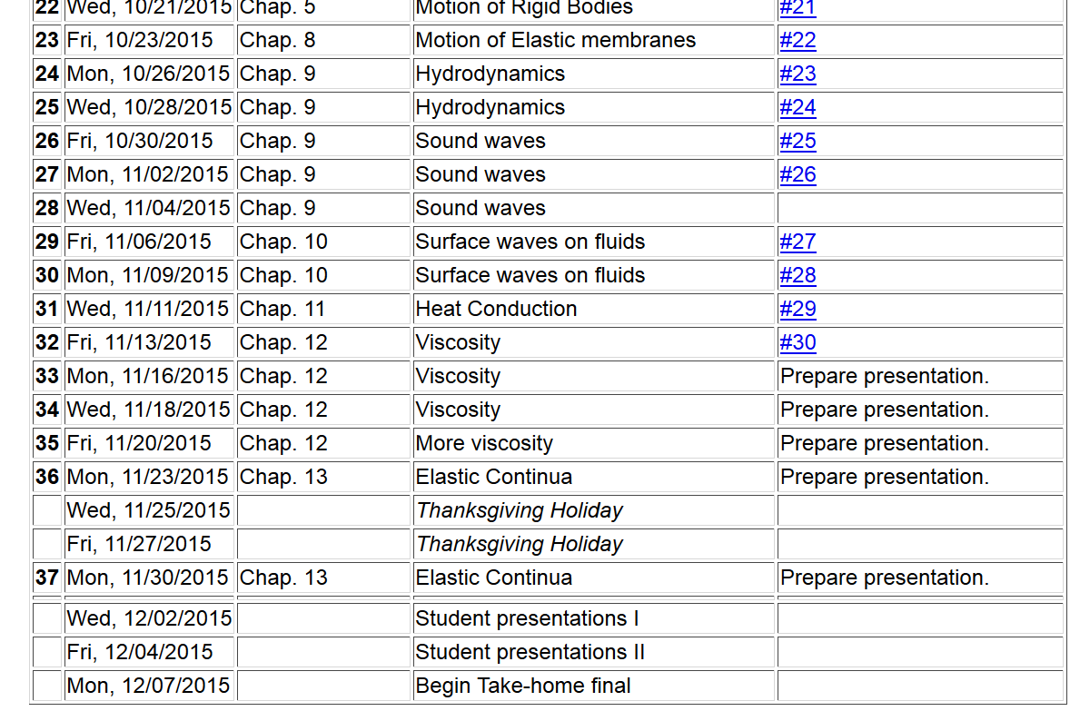
11/22/2013
PHY 711 Fall 2013 -- Lecture 34
2

Slide 4
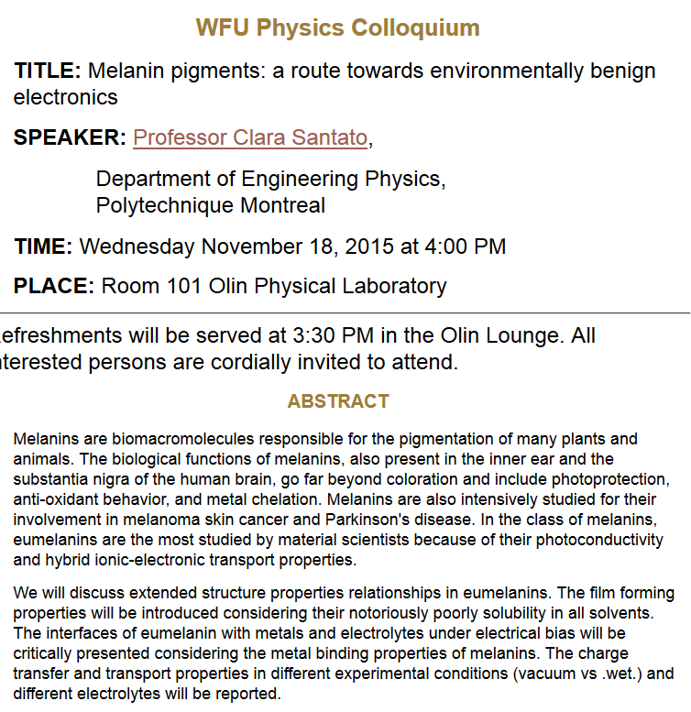

Slide 5
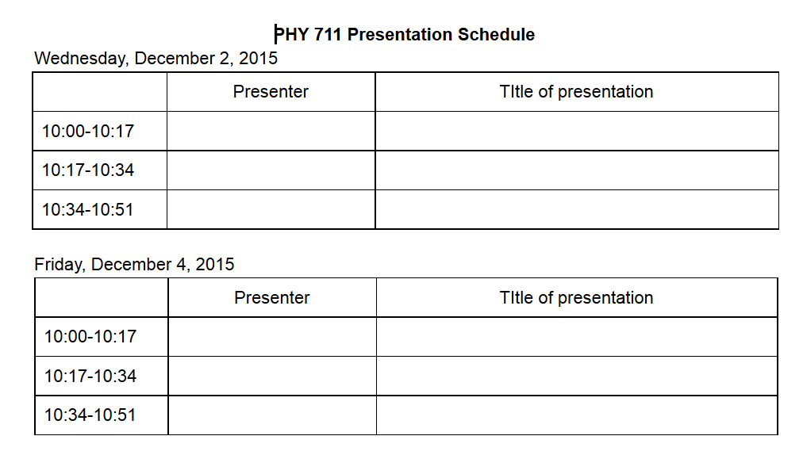
Please sign up

Slide 6
Newton-Euler equations for viscous fluids

Slide 7
Newton-Euler equations for viscous fluids – effects on sound
Without viscosity terms:

Slide 8
Sound waves without viscosity -- continued
➔Pure longitudinal harmonic wave solutions

Slide 9
Newton-Euler equations for viscous fluids – effects on sound
Recall full equations:
viscosity causes heat transfer

Slide 10
Newton-Euler equations for viscous fluids – effects on sound
Note that pressure now depends both on density and entropy so that entropy must be coupled into the equations

Slide 11
Newton-Euler equations for viscous fluids – linearized equations

Slide 12
Newton-Euler equations for viscous fluids – linearized equations
heat capacity at constant volume

Slide 13
Newton-Euler equations for viscous fluids – linearized equations

Slide 14
Newton-Euler equations for viscous fluids – effects on sound
Linearized equations (with the help of various thermodynamic relationships):

Slide 15
Linearized hydrodynamic equations

Slide 16
Linearized hydrodynamic equations; plane wave solutions:
➔Entropy and mechanical modes are independent

Slide 17
Linearized hydrodynamic equations; full plane wave solutions:

Slide 18
Linearized hydrodynamic equations; full plane wave solutions:

Slide 19
Linearized hydrodynamic equations; full plane wave solutions:

