Slide 1
PHY 711 Classical Mechanics and Mathematical Methods
10-10:50 AM MWF Olin 103
Plan for Lecture 35
Physics of elastic continua –
Chap. 13 in F & W
Stress and strain
Waves in elastic media

Slide 2
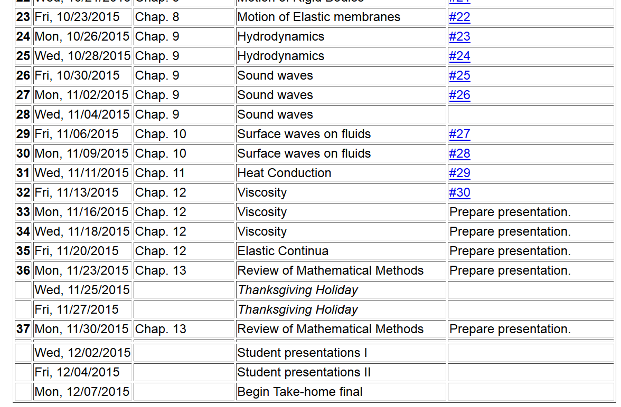
11/22/2013
PHY 711 Fall 2013 -- Lecture 34
2

Slide 3
Brief introduction to elastic continua
r₁
r₁’
reference
deformation

Slide 4
Brief introduction to elastic continua
rotation of material
elastic strain tensor

Slide 5
Brief introduction to elastic continua
r₁
r₁’
reference
deformation

Slide 6
Deformation
b
b’
a
a’

Slide 7
Brief introduction to elastic continua
X

Slide 8
Stress tensor

Slide 9
Stress tensor -- continued

Slide 13
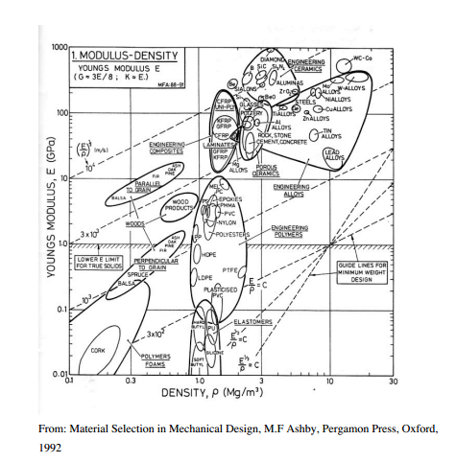

Slide 14
Dynamical equations of elastic continuum

Slide 15
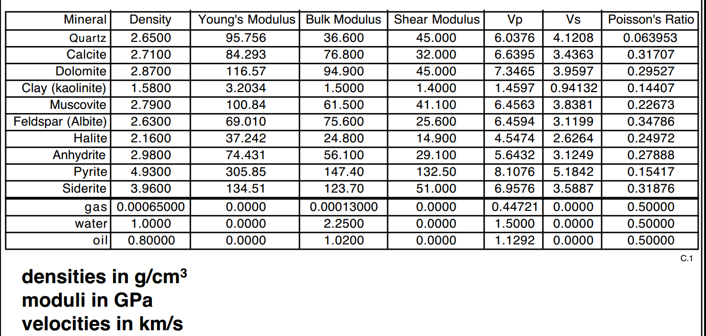
from: https://pangea.stanford.edu/courses/gp262/Notes/5.Elasticity.pdf

