Slide 1
PHY 711 Classical Mechanics and Mathematical Methods
10-10:50 AM MWF Olin 103
Plan for Lecture 36
Review of Mathematical Methods
More details on Green’s function methods
Special functions

Slide 2
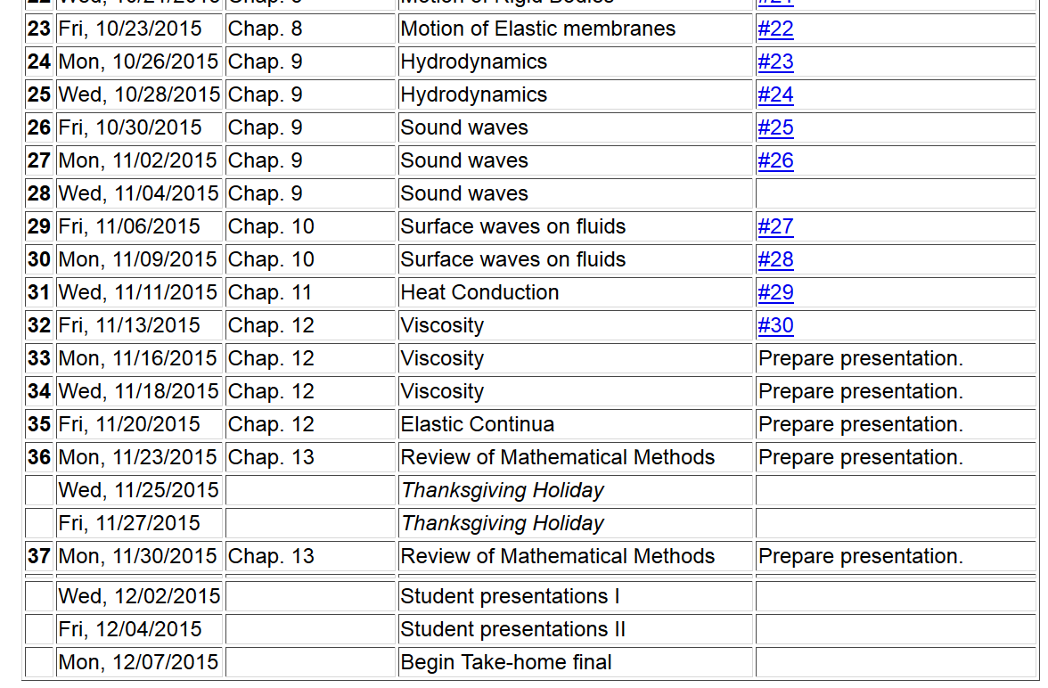
11/22/2013
PHY 711 Fall 2013 -- Lecture 34
2

Slide 3
Linear second-order ordinary differential equations
Sturm-Liouville equations
given functions
applied force
solution to be determined

Slide 4
Solution to inhomogeneous problem by using Green’s functions
Solution to homogeneous problem

Slide 5
General method of constructing Green’s functions using homogeneous solutions to Sturm-Liouville equations

Slide 6
Digression:

Slide 9
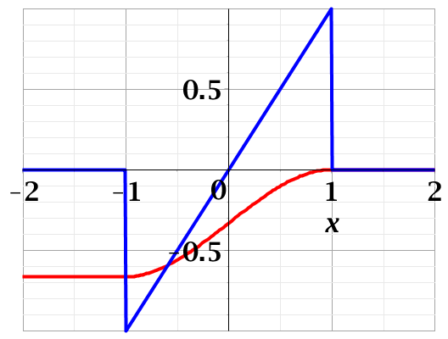
Example:

Slide 13
Eigenfunction solution methods of Sturm-Liouville equations (assume all functions and constants are real):
It is possible to prove several properties of the
eigenfunctions f_{n}(x) – including orthogonality and
completeness.

Slide 15
Solution to inhomogeneous problem by using Green’s functions
Solution to homogeneous problem

Slide 16
Example:

Slide 18
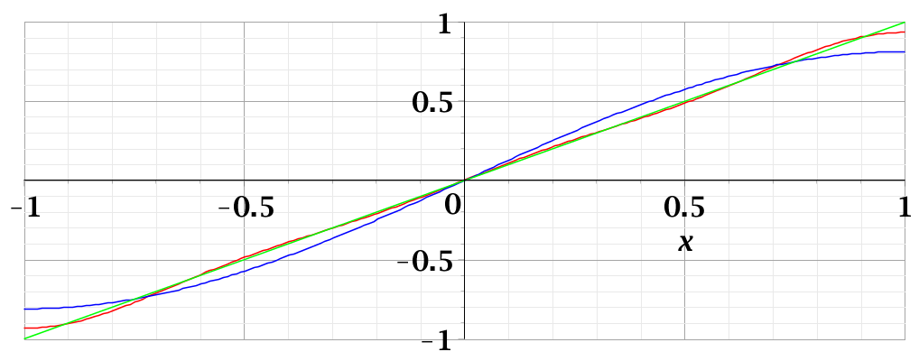
Digression – convergence of Fourier series representation of ρ(x) itself:
3 terms
1 term

