Slide 1
PHY 711 Classical Mechanics and Mathematical Methods
10-10:50 AM MWF Olin 103
Plan for Lecture 37
Review of Mathematical Techniques – Green’s function methods
Methods for two and higher dimensions
Examples
Course evaluation forms

Slide 2
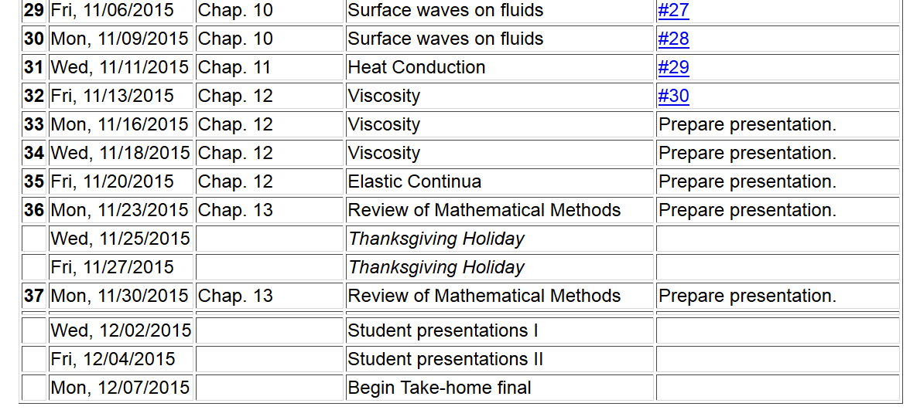
**Note: The final exam has the take-home form similar to that of the mid-term. In order to accommodate your schedules, it will be available on 12/04 and will be due before 9 AM on 12/14.
11/22/2013
PHY 711 Fall 2013 -- Lecture 34
2

Slide 4
Some guidelines about the presentations
In your presentations, please make sure to acknowledge all of your sources.
We have allotted 17 minutes including questions for each presentation.
In order to encourage participation, points will be awarded for questions from the audience.
For efficiency, you may wish to email me your talk an use my computer for the presentation.
At the end each session, please email me your presentations and any supplementary materials.

Slide 5
Green’s function solution methods for one-dimensional second order (Sturm-Liouville) differential equations:
Solution to problem with F(x)=0

Slide 6
Green’s function construction method #1 -- using homogeneous solutions to Sturm-Liouville equations

Slide 7
Green’s function construction method #2 -- using eigenfunctions ot the Sturm-Liouville equations

Slide 8
Green’s function solution methods for one-dimensional second order (Sturm-Liouville) differential equations -- comparison of method #1 and #2
Single discontinuous integral for evaluating full solution
Only works in one dimension
Infinite series of continuous integrals for evaluating full solution
Can be extended to multiple dimensions

Slide 9
Green’s function methods in multiple dimensions --
Example system – Poisson equation
Charge density
Electrostatic potential
Boundary value terms

Slide 10
z
y
x

Slide 11
Green’s function using method #2 in all three dimensions

Slide 12
Green’s function using method #2 in all two dimensions and method #1 in the third dimension

Slide 13
z
Example
c
a
y
b
x

Slide 14
z
Example
continued
c
a
y
b
x

Slide 15
Other examples of Green’s function constructions
spherical Hankel function
spherical Bessel function

