Slide 1
PHY 711 Classical Mechanics and Mathematical Methods
10-10:50 AM MWF Olin 103
Plan for Lecture 8:
Continue reading Chapter 3 & 6
D’Alembert’s principle
Hamilton’s principle
Lagrange’s equations in presence of magnetic fields

Slide 2
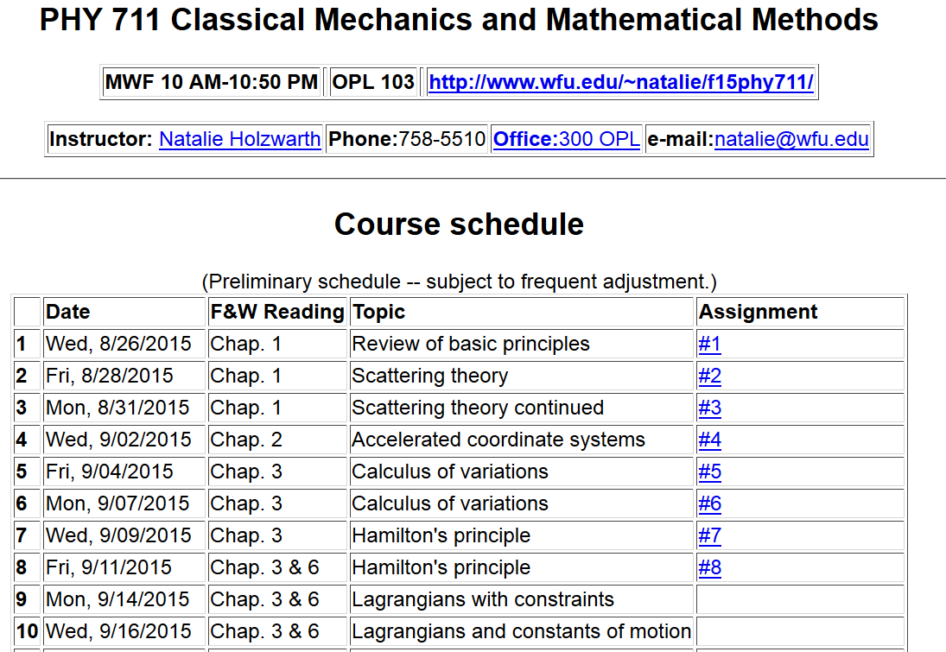

Slide 3
Hamilton’s principle:

Slide 4
D’Alembert’s principle -- notion of virtual work:

Slide 5
Some details --

Slide 6
D’Alembert’s principle -- notion of virtual work:

Slide 7
D’Alembert’s principle -- notion of virtual work:

Slide 8
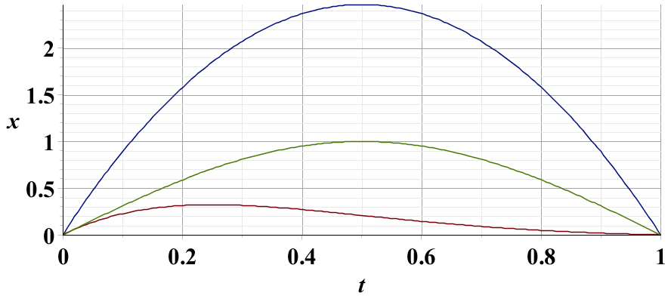
Example – simple harmonic oscillator
x₁
x₂
x₃

Slide 9
Note: in “proof” of Hamilton’s principle:

Slide 10
Lorentz forces:

Slide 11
Lorentz forces, continued:

Slide 12
Lorentz forces, continued:

Slide 13
Lorentz forces, continued:

Slide 14
Example Lorentz force

Slide 15
Example Lorentz force -- continued

Slide 16
Example Lorentz force -- continued

Slide 17
Example Lorentz force -- continued

Slide 18
Example Lorentz force -- continued

