Slide 1
PHY 752 Solid State Physics
11-11:50 AM MWF Olin 103
Plan for Lecture 1:
Reading: Chapter 1 in GGGPP; Electronic Structure
Bloch’s Theorem
Eigenstates of a simple model potential

Slide 2
Text book

Slide 3
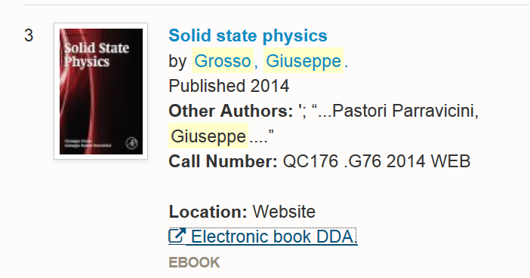
Available from zsr; may also be purchased from Barnes and Noble, etc.

Slide 5
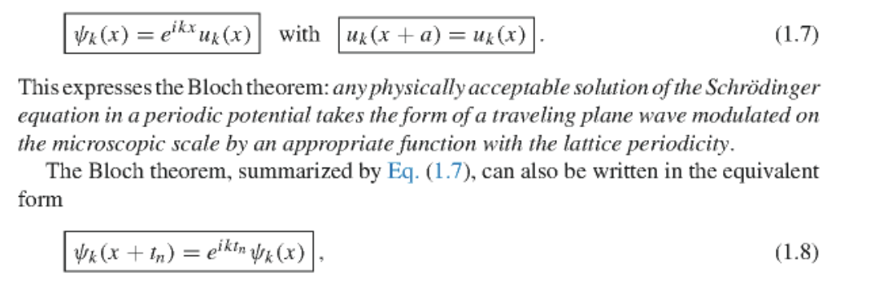
for integer m.

Slide 6
Consider an electron moving in a one-dimensional model potential (Kronig and Penney, Proc. Roy. Soc. (London) 130, 499 (1931)
a
V₀

Slide 7
a
V₀

Slide 8
a
V₀

Slide 9
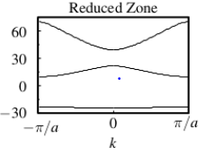
a
V₀
Band gap
E(k)

Slide 10
What causes band gaps in the electronic structure?
Consider a single potential well
Spectrum
E

Slide 11
a
V₀
b

Slide 12
a
V₀
b

Slide 13
a
V₀
b

Slide 14
v
Forbidden states
f
v
Forbidden states

Slide 15
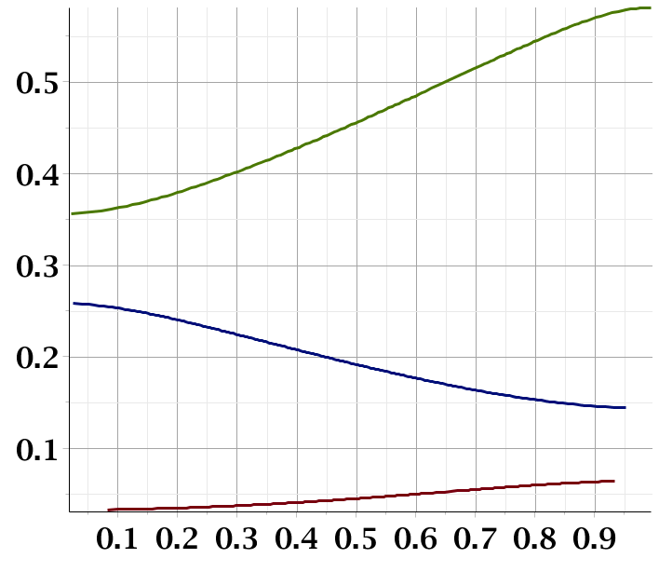
f
Band gap
Band gap
ka/π

Slide 16
Electrons in the presence of a weak periodic potential
V₀
x

Slide 18
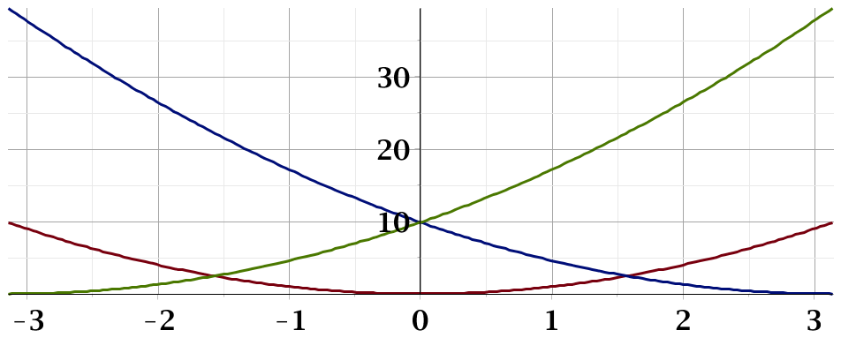
ka

