Slide 1
PHY 752 Solid State Physics
11-11:50 AM MWF Olin 103
Plan for Lecture 10:
Reading: Chap. 4 in GGGPP;
Free electron theory of metals
Density of states for free-electron model
Fermi-Dirac statistics
Chemical potential and electronic specific heat

Slide 2
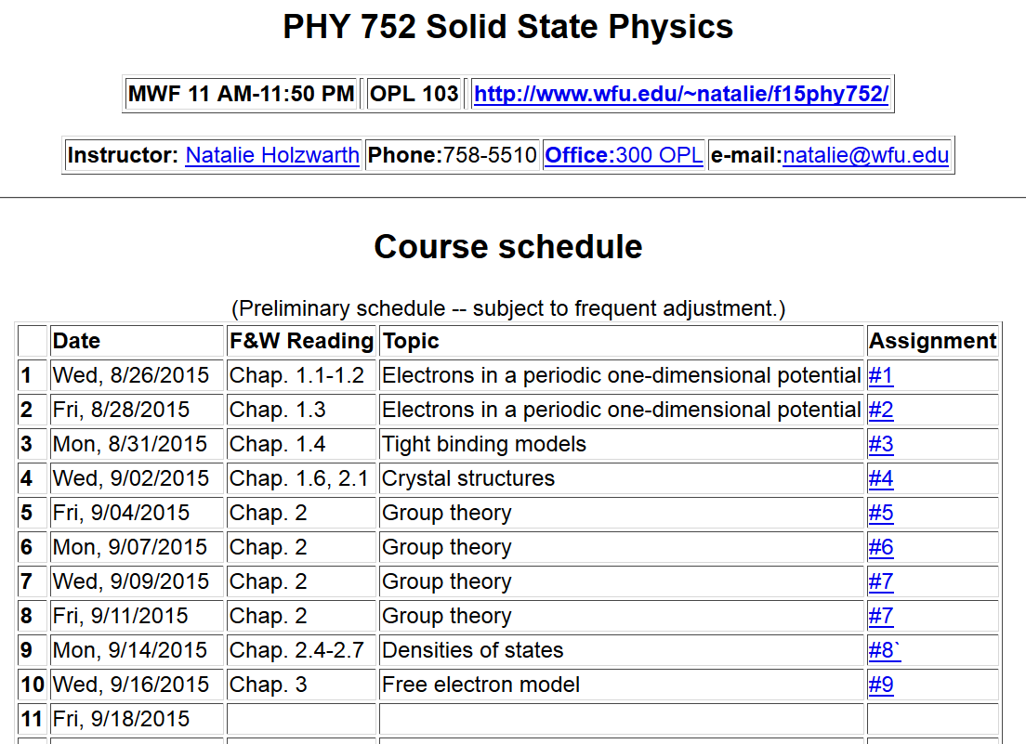

Slide 5
Quantum Theory of materials
Electronic coordinates
Atomic coordinates
Born-Oppenheimer approximation
Born & Huang, Dynamical Theory of Crystal Lattices, Oxford (1954)

Slide 6
Quantum Theory of materials -- continued
(Often treated classically)
Effective nuclear interaction provided by electrons

Slide 7
Terms neglected in Born-Oppenheimer approximation

Slide 8
First consider electronic Hamiltonian
Replace by “jellium”
Independent electron contributions

Slide 9
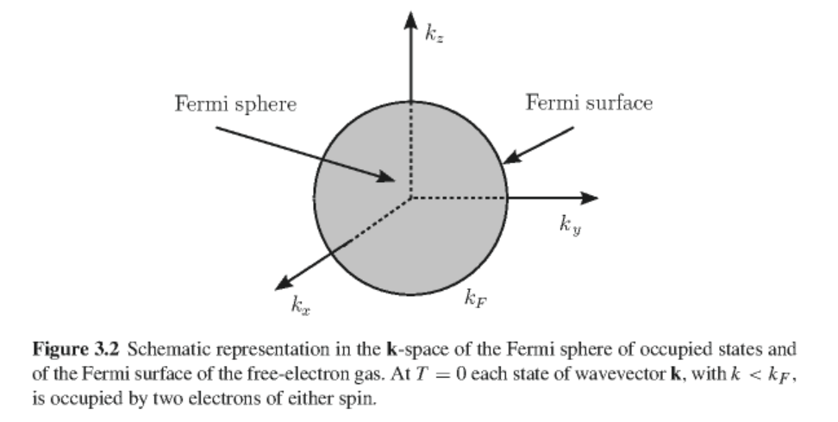
Jellium model of metals
Nuclear potential represented by a uniform background of positive charge with charge density n₀=Z/V (V representing volume per atom)
Electrons represented as independent free electrons occupying free-electron states
Figure from GGGPP

Slide 10
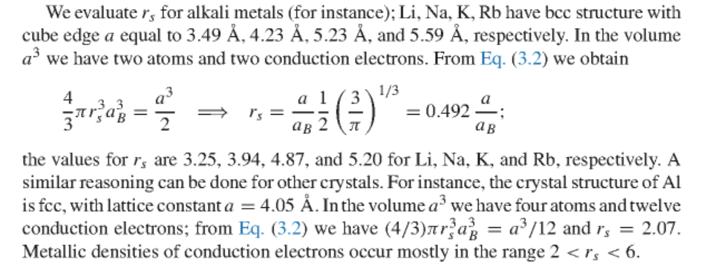
Determination of Fermi radius in terms of electron density
n=N/V where N=Z Note: in practice only valence electrons are included in this model and the compensating nuclear background charge is adjusted accordingly.
Wigner-Seitz radius
Bohr radius
0.529177 Angstroms

Slide 11
Calculation of the Fermi level

Slide 12
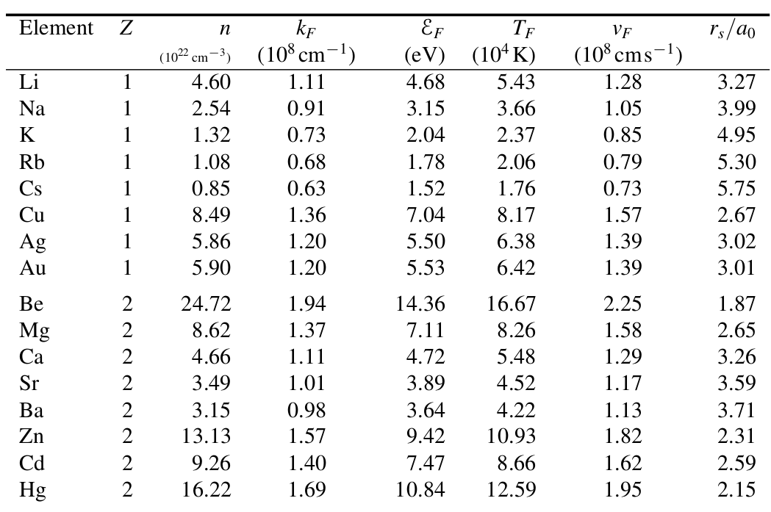
From Marder’s text

Slide 13
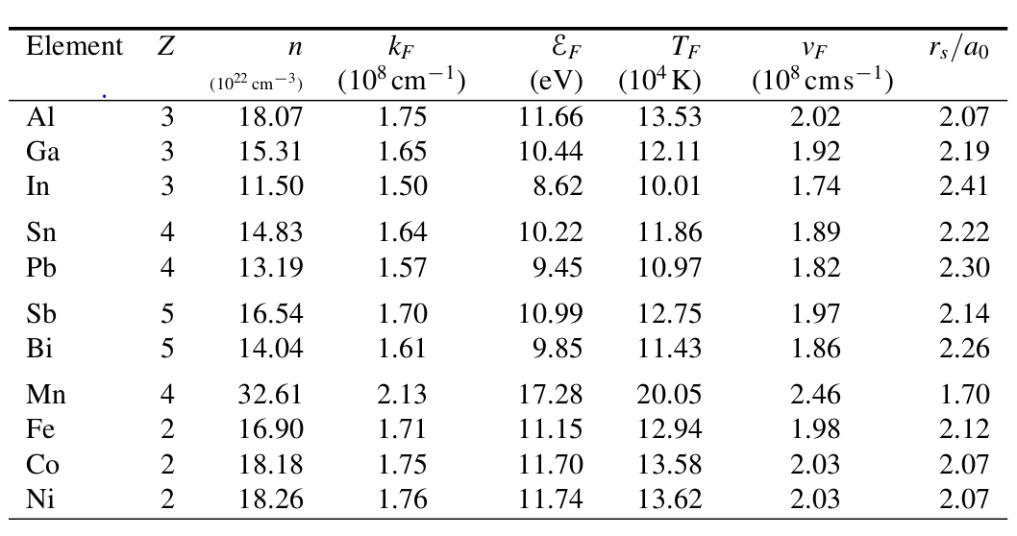
Jellium analysis of some metals

Slide 14
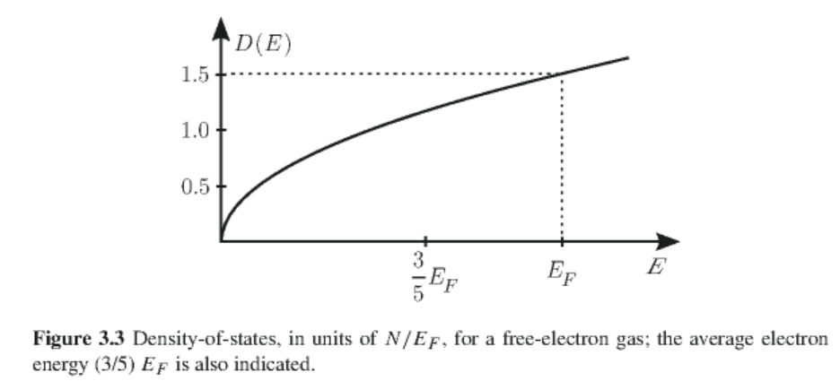
Density of states analysis of free electron gas

Slide 15
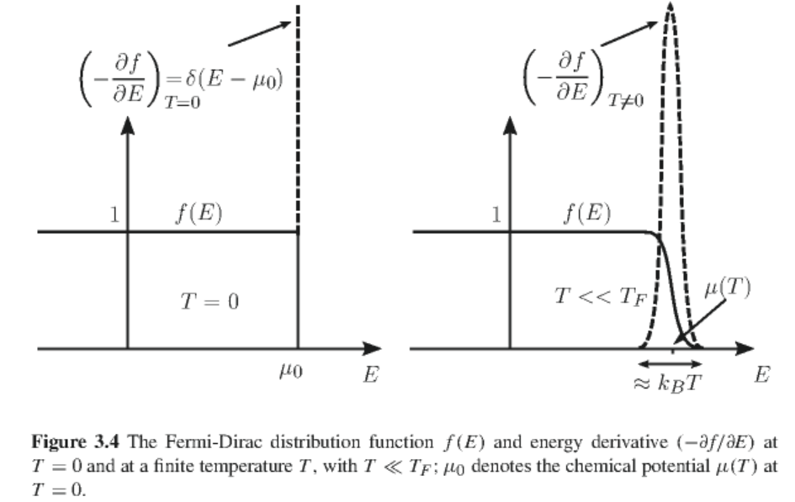
Temperature dependence of the Free-electron gas – Fermi-Dirac distribution

Slide 16
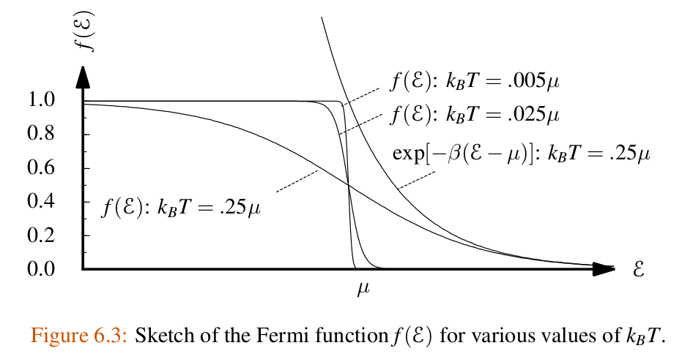

Slide 17
Temperature dependence of the chemical potential
Justification for this result; consider the following integral
Taylor’s expansion

Slide 18
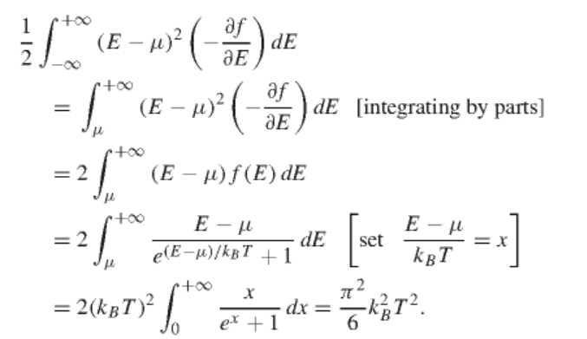
Evaluating the integrals

Slide 19
Evaluation of the integrals continued
Now suppose that

Slide 20
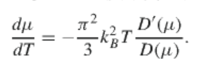
Taking temperature derivative:

Slide 21
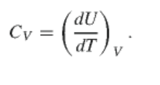
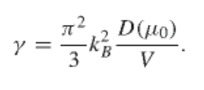
Specific heat of Free electron gas

Slide 22
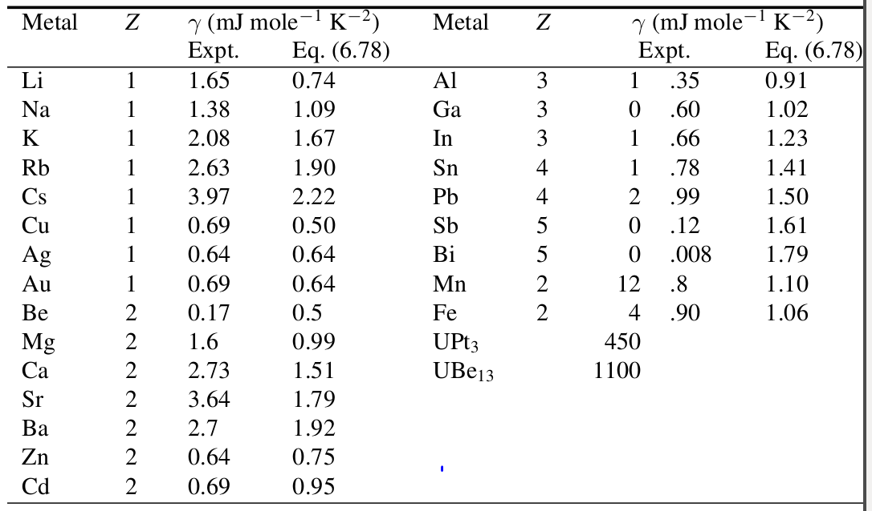
Specific heat table from Marder’s text:

