Slide 1
PHY 752 Solid State Physics
11-11:50 AM MWF Olin 103
Plan for Lecture 11:
Reading: Chap. 4 in GGGPP;
One-electron approximations to the many electron problem
Hartree approximation
Hartree-Fock approximation

Slide 2
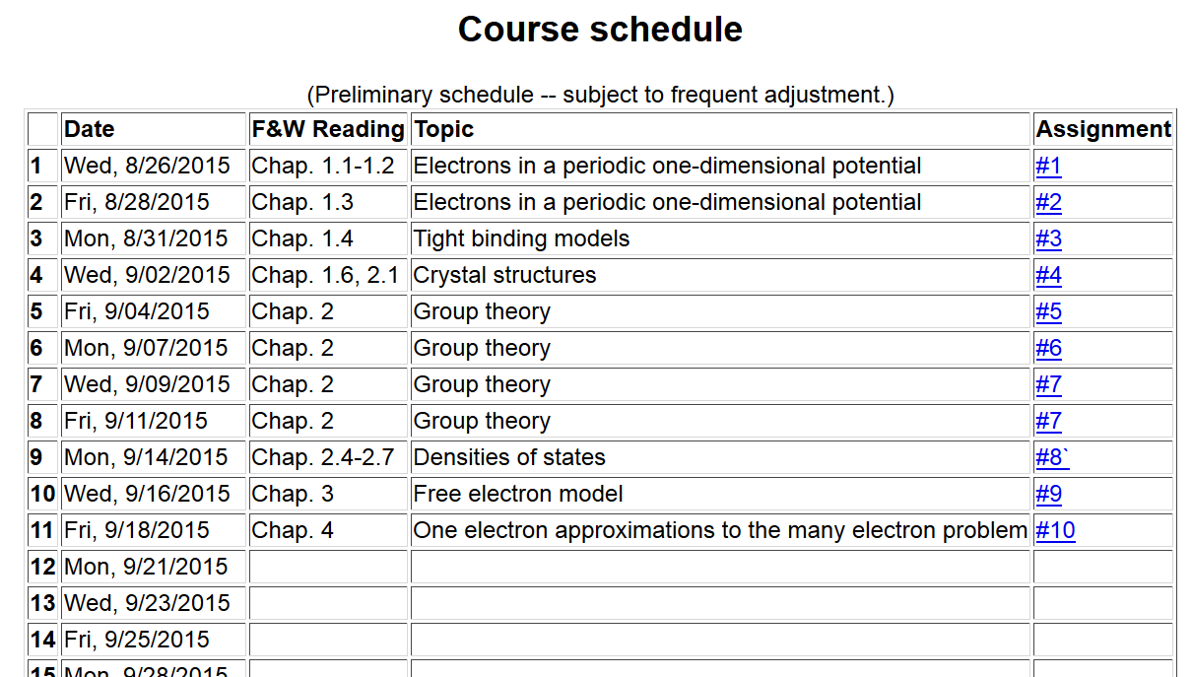

Slide 3
Electronic coordinates
Atomic coordinates
Quantum Theory of materials
Born-Oppenheimer approximation
Born & Huang, Dynamical Theory of Crystal Lattices, Oxford (1954)

Slide 4
Quantum Theory of materials -- continued
(Often treated classically)
Effective nuclear interaction provided by electrons

Slide 5
Consider electronic Hamiltonian
Electron-electron interaction term prevents exactly separable electron wavefunction

Slide 6
Hartree approximation to electronic wavefunction

Slide 7
Variational equation for Hartree approximation -- continued
Note: In principle, the self interaction term should be omitted from V_{ee}(r), but often it is included.

Slide 8
Hartree approximation -- continued
In practice, the equations must be solved self-consistently

Slide 9
Hartree approximation -- continued

Slide 10
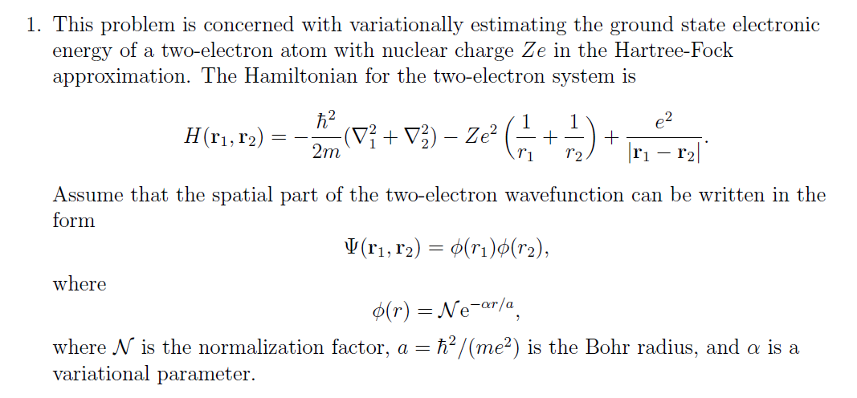
Comment about homework problem

Slide 11
Comment about homework problem -- continued

Slide 12
Comment about electron-electron interaction in the Hartree approximation

Slide 13
Hartree-Fock approximation to electronic wavefunction

Slide 14
Hartree-Fock approximation to electronic wavefunction
Second quantization formalism
See Appendix B of GGGPP

Slide 15
Hartree-Fock approximation to electronic wavefunction
-- continued

Slide 16
Variational equation for Hartree-Fock approximation -- continued
Note that in the Hartree-Fock formalism, there is no spurious electron self-interaction.

Slide 17
Hartree-Fock approximation – continued
As for the Hartree formulation, the Hartree-Fock equations
must be solved iteratively. At convergence, the Hartree-Fock electronic energy can be calculated from the one-electron orbitals and the charge density

