Slide 1
PHY 752 Solid State Physics
11-11:50 AM MWF Olin 107
Plan for Lecture 13:
Reading: Chapter 4 in GGGPP
Approximations to the many electron problem --Density functional theory
General theorem
Practical calculation scheme
Some results

Slide 2


Slide 3


Slide 4
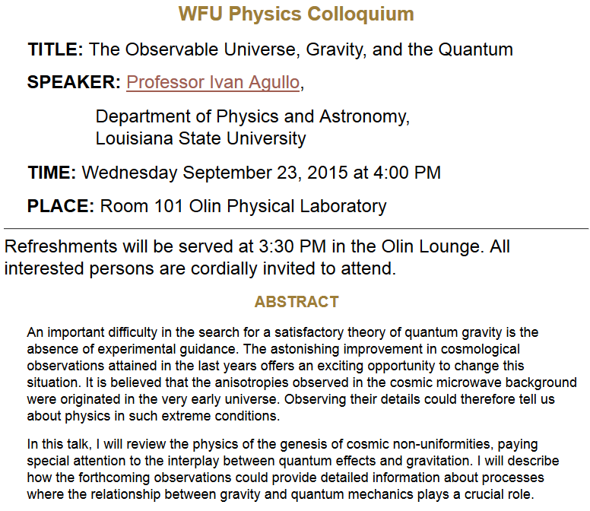

Slide 5
Density functional theory
Describes the relationship between the many electron problem and independent electron treatments.
Proof of theorem
Estimates of F[n].

Slide 6
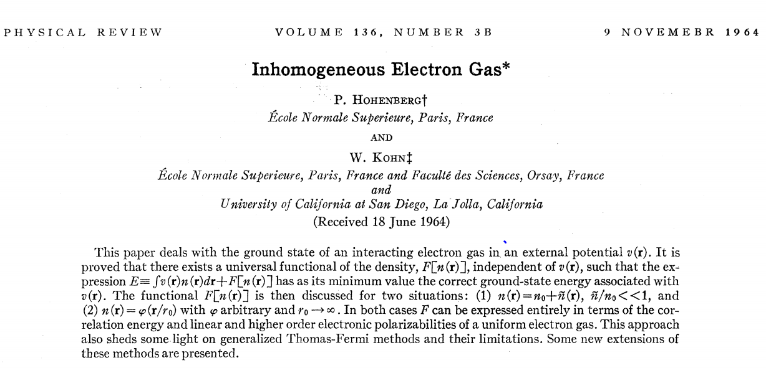
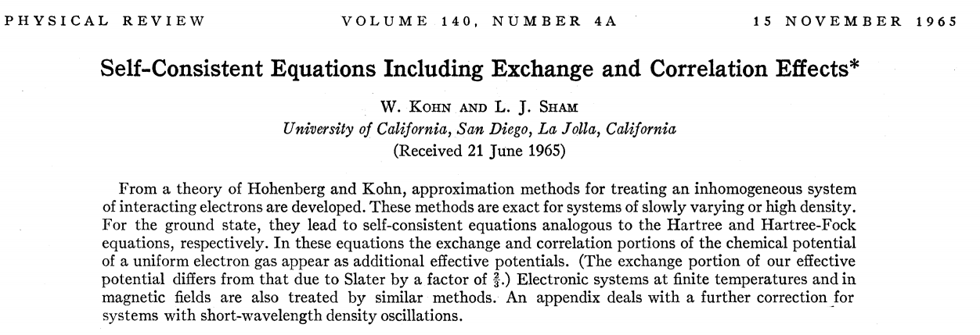
Density functional theory -- continued

Slide 7
Hohenberg and Kohn: formal proof of basic theorem
Kinetic energy
External potential
Coulomb interaction

Slide 8
Theorem: The density n(r) of the ground state of the system is a unique functional of the external potential v(r).
Proof: Consider two Hamiltonians H and H’ differing only by external potentials v and v’.

Slide 9
We can also show:

Slide 10
The theorem implies that the ground state energy E can be considered as a functional of the density n(r)
Thus, the determination of the ground state energy E is transformed into a minimization of the functional with respect to the density n(r), transforming a many particle minimization into a single particle minimization.
In practice, the functional form of F[n] is not known, but if it were, we could use optimization methods to determine the ground state energy E_{v}[n].

Slide 11
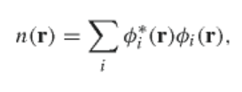



Kohn-Sham scheme to find ground state energy E_{v}[n]
Assume that the electron density can be expressed in terms of N independent electron orbitals
For a given external potential v_{ext}(r) the ground state energy is given by
E
E_{H}[n]=

Slide 12
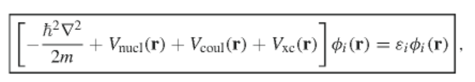


Kohn-Sham equations
where

Slide 13
Estimate of the exchange-correlation contribution

Slide 14
Digression on spatially varying electron density
i
j
k
l

Slide 15
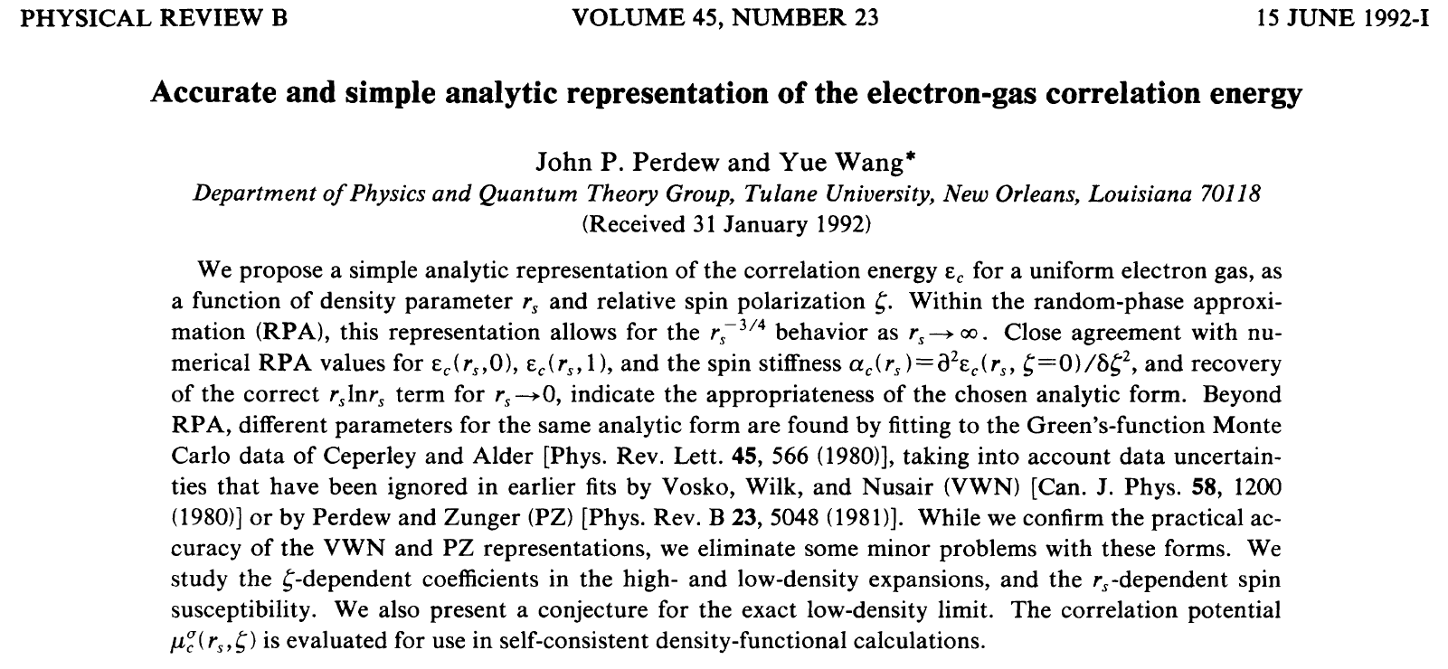
Correlation functionals
Local density approximation (LDA)

Slide 16
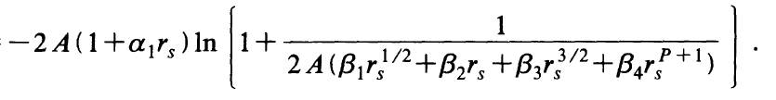
Interpolation function for LDA:
E_{c}[n]=

Slide 17
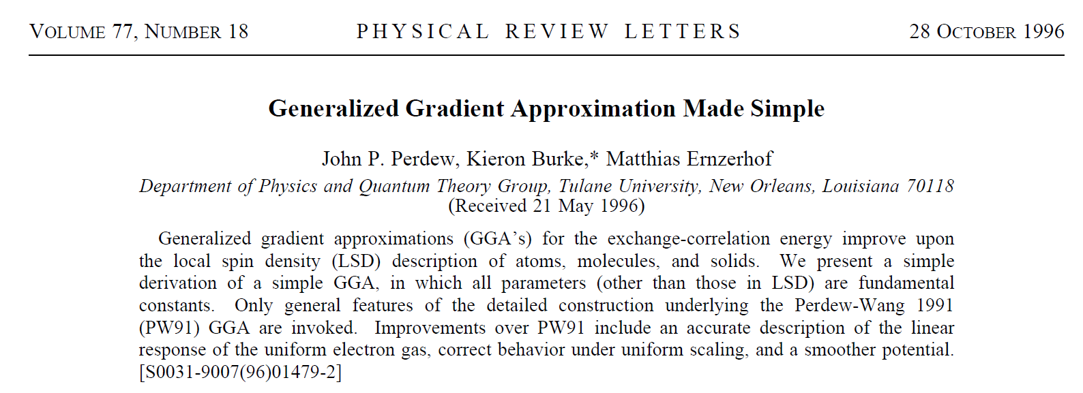

More complicated exchange-correlation functionals

Slide 18
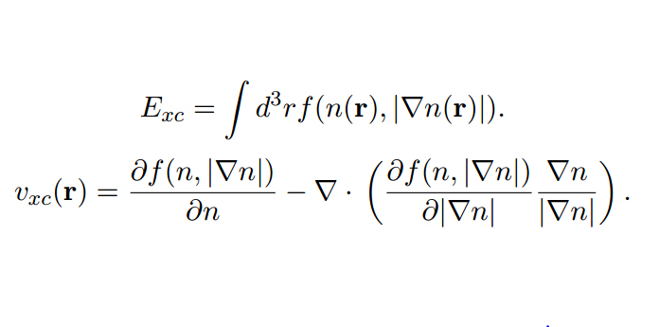
Some details of the Generalized Gradient Approximation

Slide 19
Summary: Kohn-Sham formulation of density functional theory

Slide 20
Self-consistent solution

Slide 21
Kohn-Sham formulation of density functional theory
Results of self-consistent calculations
Some remaining issues
Theory for E_{exc}[n] still underdevelopment
This formalism does not access excited states
Strongly correlated electron systems are not well approximated

Slide 22
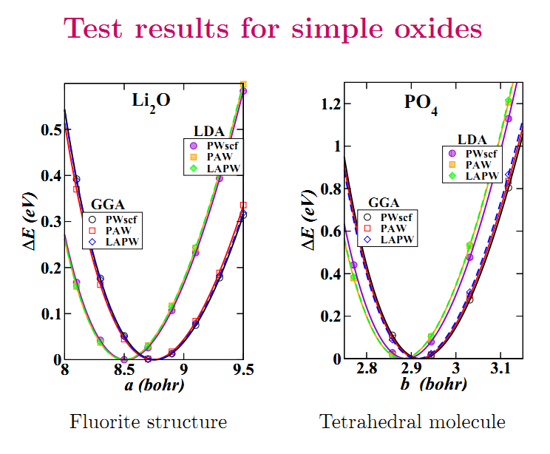
Comparison of LDA and GGA binding energy curves

Slide 23
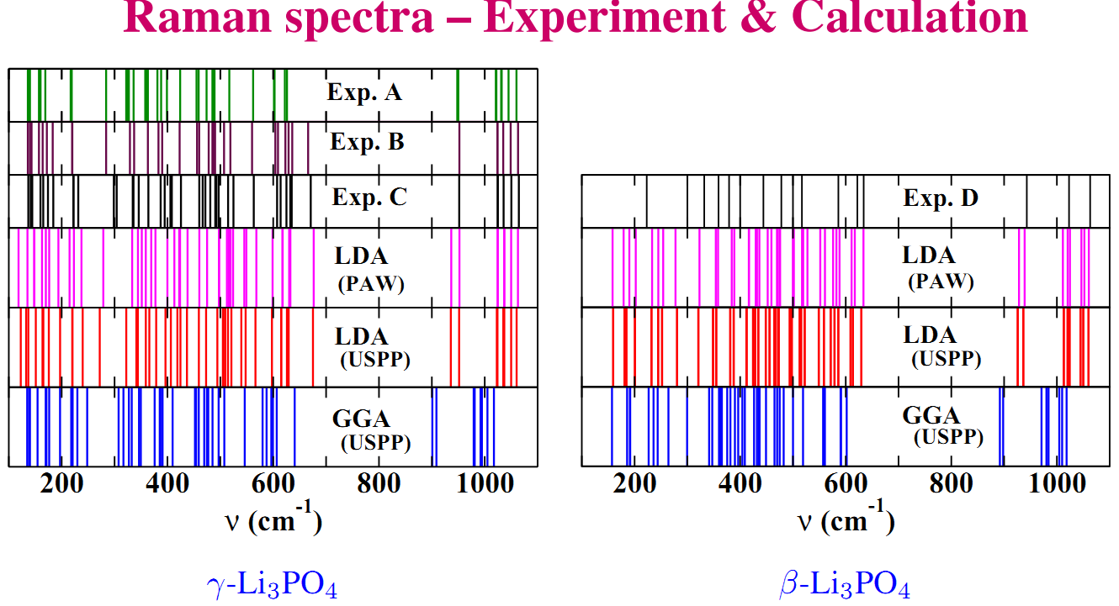
LDA vs GGA performance wrt normal modes of vibration
A: B. N. Mavrin et al, J. Exp. Theor. Phys. 96,53 (2003); B: F. Harbach and F. Fischer, Phys. Status Solidi B 66, 237 (1974) – room temp. C: Ref. B at liquid nitrogen temp.; D: L. Popović et al, J. Raman Spectrosc. 34,77 (2003).

