Slide 1
PHY 752 Solid State Physics
11-11:50 AM MWF Olin 103
Plan for Lecture 14:
Reading: Chapter 5 in GGGPP
Numerical Realizations of Density functional theory
Electronic structure of atoms
Integration of the radial equations
Frozen core approximation

Slide 2
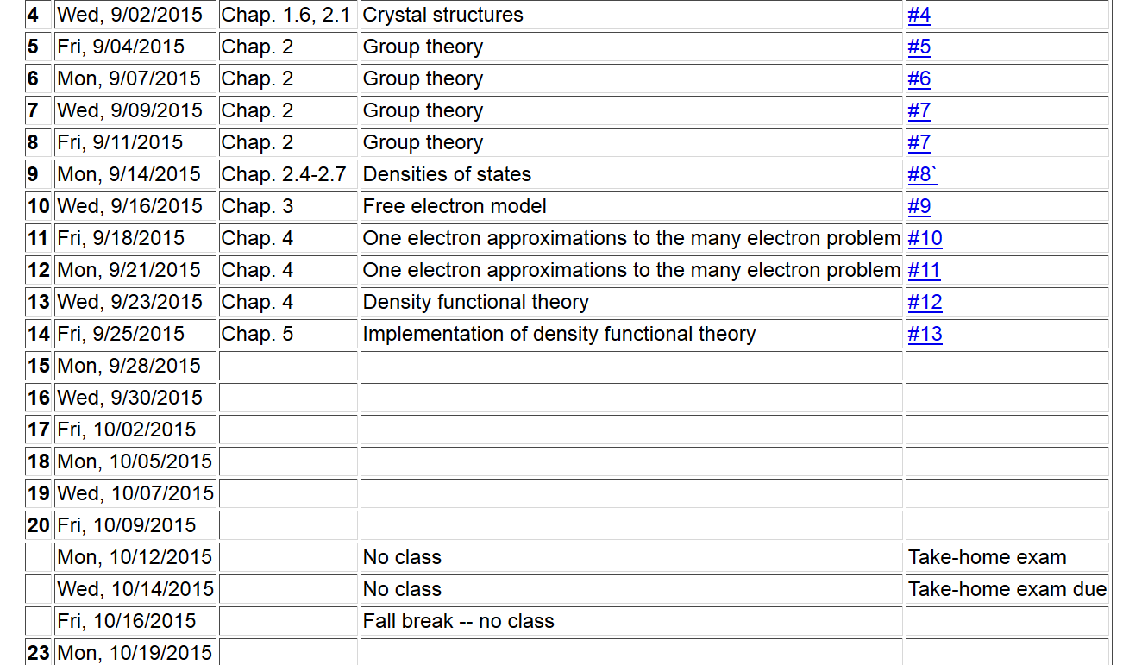

Slide 3
Numerical methods for solving the Kohn-Sham equations

Slide 4
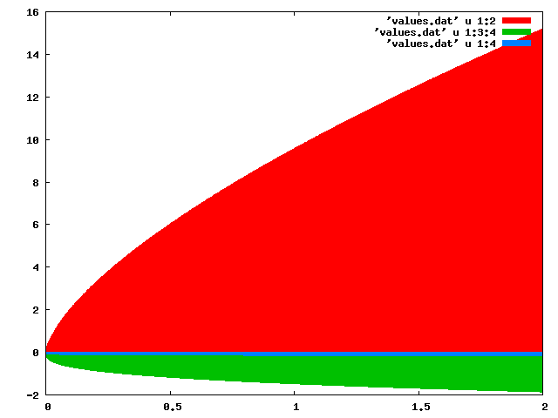
Digression: Jellium energies
E (Ryd) →
T[n]
E_{c}[n]
E_{ex}[n]
n (bohr)⁻³ →

Slide 5
Numerical methods for solving the Kohn-Sham equations
Self-consistent solution

Slide 6
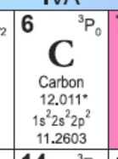
Numerical methods for solving the Kohn-Sham equations –
Consider the case of a single atom, choosing the coordinate system at the center of the nucleus. We will further assume that the atom is spherically symmetric, averaging over the multiplet configurations.

Slide 7
Kohn-Sham equations for spherical atom

Slide 8
Kohn-Sham equations for spherical atom -- continued

Slide 9
Kohn-Sham equations for spherical atom -- continued

Slide 10
Kohn-Sham equations for spherical atom -- continued
Notes on numerical integration of differential equations

Slide 11
Digression on numerical integration
Numerical results from second-order approximation:
 | N=4 | N=8 | Exact
ν=1 | 9.54915028 | 9.7697954 | 9.869604404
ν=2 | 34.54915031 | 37.9008002 | 39.47841762
Numerical results from Numerov approximation:
 | N=4 | Exact
ν=1 | 9.863097625 | 9.869604404
ν=2 | 39.04581620 | 39.47841762

Slide 12
Some details:
Set up matrix problem for (N-1) unknown values;
s²E_{v} are matrix eigenvalues

Slide 13
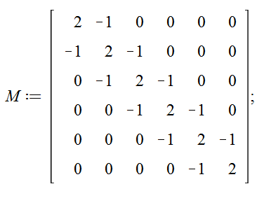
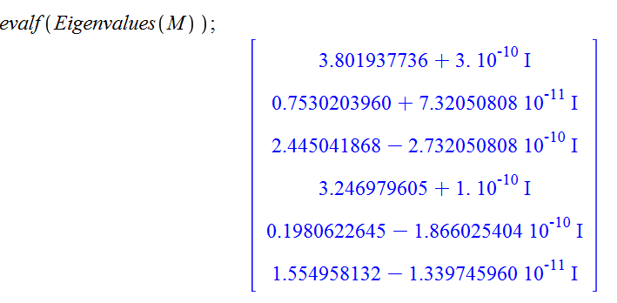
Example for N=7:

Slide 14
Example for N=7: -- continue
ν | λ | λ/s² | E_{v}
1 | 0.1980622645 | 9.7050509605 | 9.869604401
2 | 0.7530203960 | 36.897999404 | 39.47841760
3 | 1.554958132 | 76.192948468 | 88.82643960
4 | 2.445041868 | 119.80705153 | 157.9136704
5 | 3.246979605 | 159.10200064 | 246.7401100
6 | 3.801937736 | 186.29494906 | 355.3057584

