Slide 1
PHY 752 Solid State Physics
11-11:50 AM MWF Olin 1073
Plan for Lecture 15:
    Reading: Chapter 5 in GGGPP
    Numerical Realizations of Density functional theory
      Electronic structure of atoms
      Integration of the radial equations
      Frozen core approximation
      Extension of formalism to multi-center analysis

Slide 2
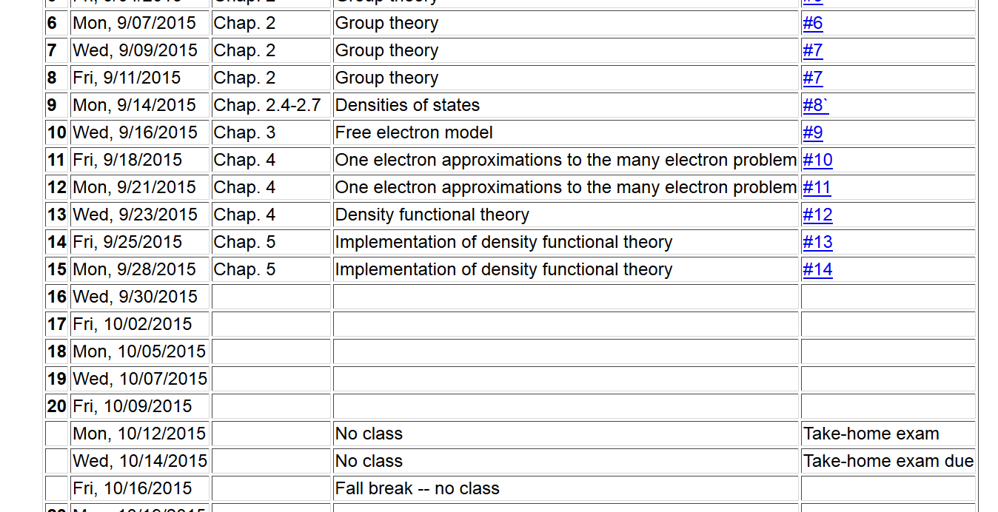

Slide 3
Kohn-Sham equations for spherical atom

Slide 4
Numerical methods for solving the Kohn-Sham equations
Self-consistent solution

Slide 5
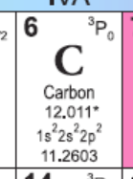
Example for carbon

Slide 6
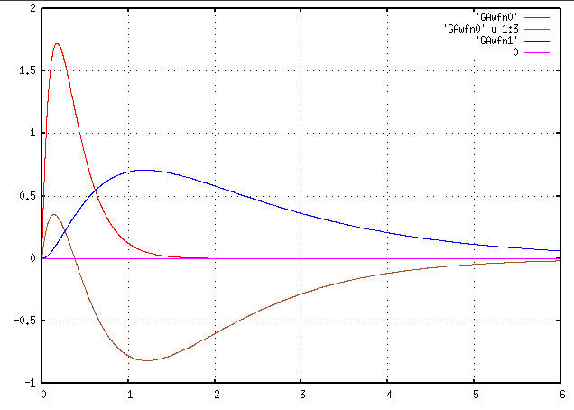
Results for carbon
1s
2p
P_{nl}(r)
2s
r (Bohr)

Slide 7
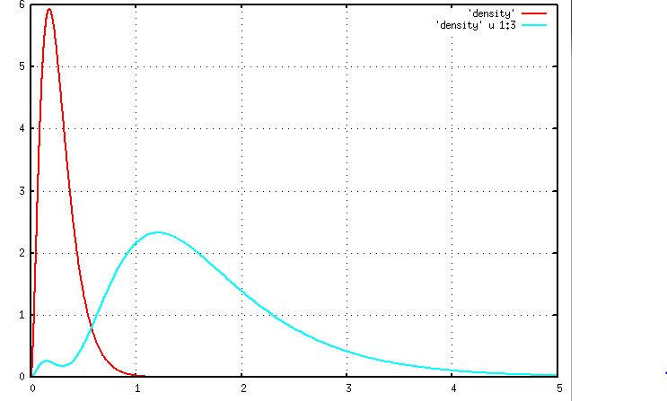
n_{core}(r)
n r²/4π
n_{val}(r)
r (Bohr)

Slide 8
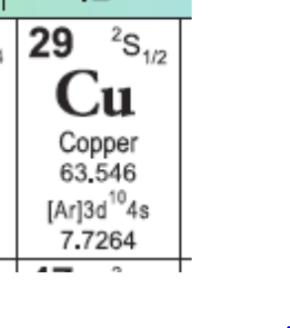
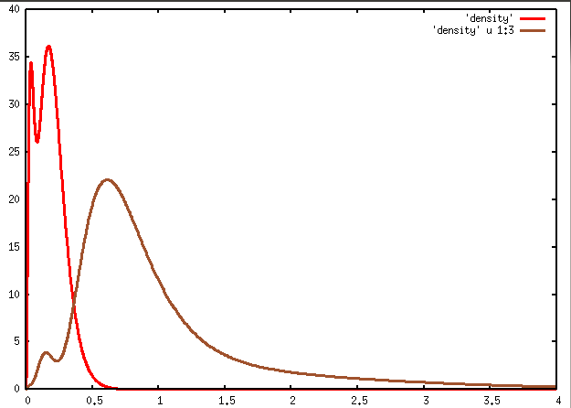
Example for Cu
1s²2s²2p⁶3s²3p⁶3d¹⁰4s¹
n_{core}(r)
n r²/4π
n_{vale}(r)
r (Bohr)

Slide 9
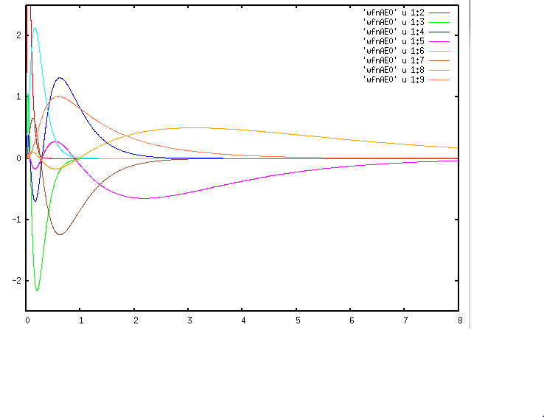
Results for Copper
3s
3d
4p
P_{nl}(r)
4s
3p
r (Bohr)

Slide 10
Frozen core approximation
Example for Cu
1s²2s²2p⁶3s²3p⁶3d¹⁰4s¹
n_{core}(r)
n r²/4π
n_{vale}(r)
r (Bohr)

Slide 11
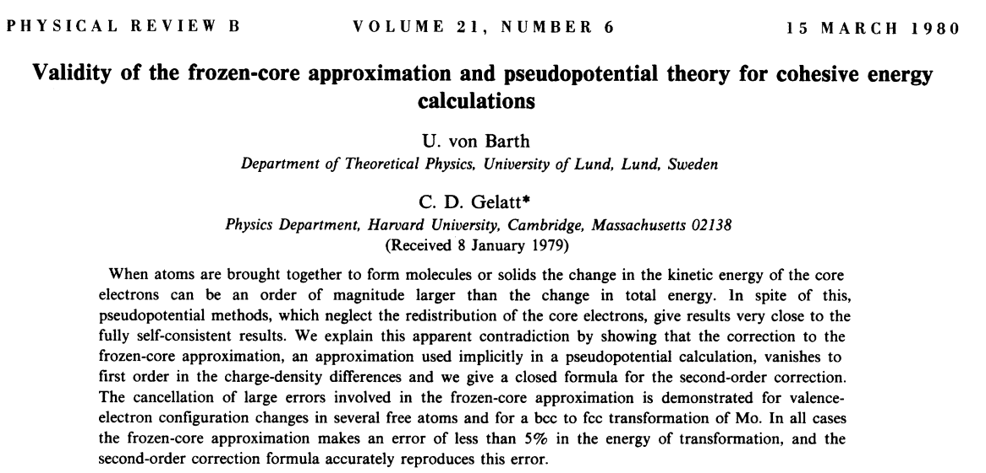
Systematic study of frozen core approximation in DFT
http://journals.aps.org/prb/abstract/10.1103/PhysRevB.21.2222

Slide 12
Variational relations for DFT in frozencore approximation (Kohn-Sham formulation)

Slide 13
Practical solution to Kohn-Sham equations for single particle orbitals:

Slide 14
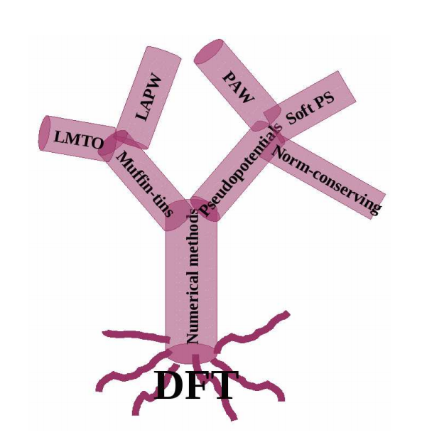
Practical solution of Kohn-Sham equations in solids

Slide 15
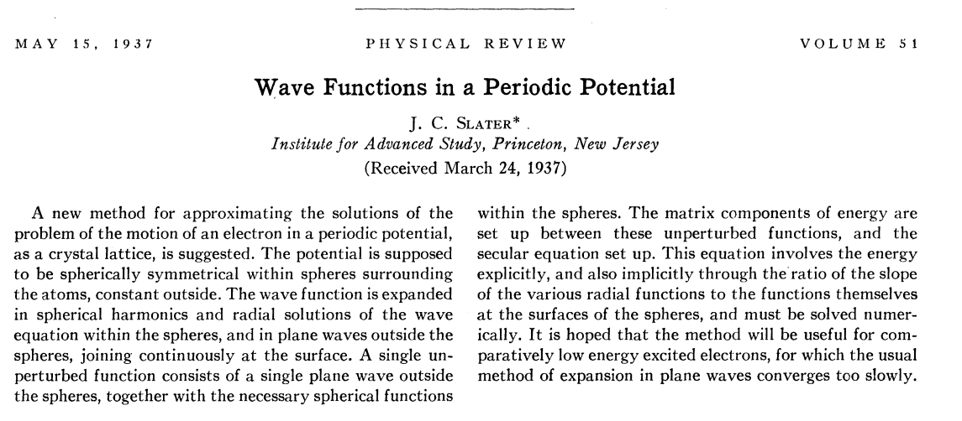
Muffin tin potential construction
http://journals.aps.org/pr/abstract/10.1103/PhysRev.51.846
Augmented Plane Wave (APW) approximation

Slide 16
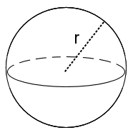
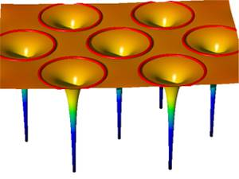
Muffin tin potential construction
http://www.jara.org/de/research/jara-hpc/forschung/details/simlab-ai/performance-modeling-for-linear-algebra-in-fleur/

Slide 17
Muffin tin model continued:
Problems with APW and KKR Green’s function schemes
  Difficult numerically to find Kohn-Sham energies ε_{i}
  Potential form unrealistic especially for covalent materials
➔Linearized equations – O. K. Andersen
http://journals.aps.org/prb/abstract/10.1103/PhysRevB.12.3060

Slide 18
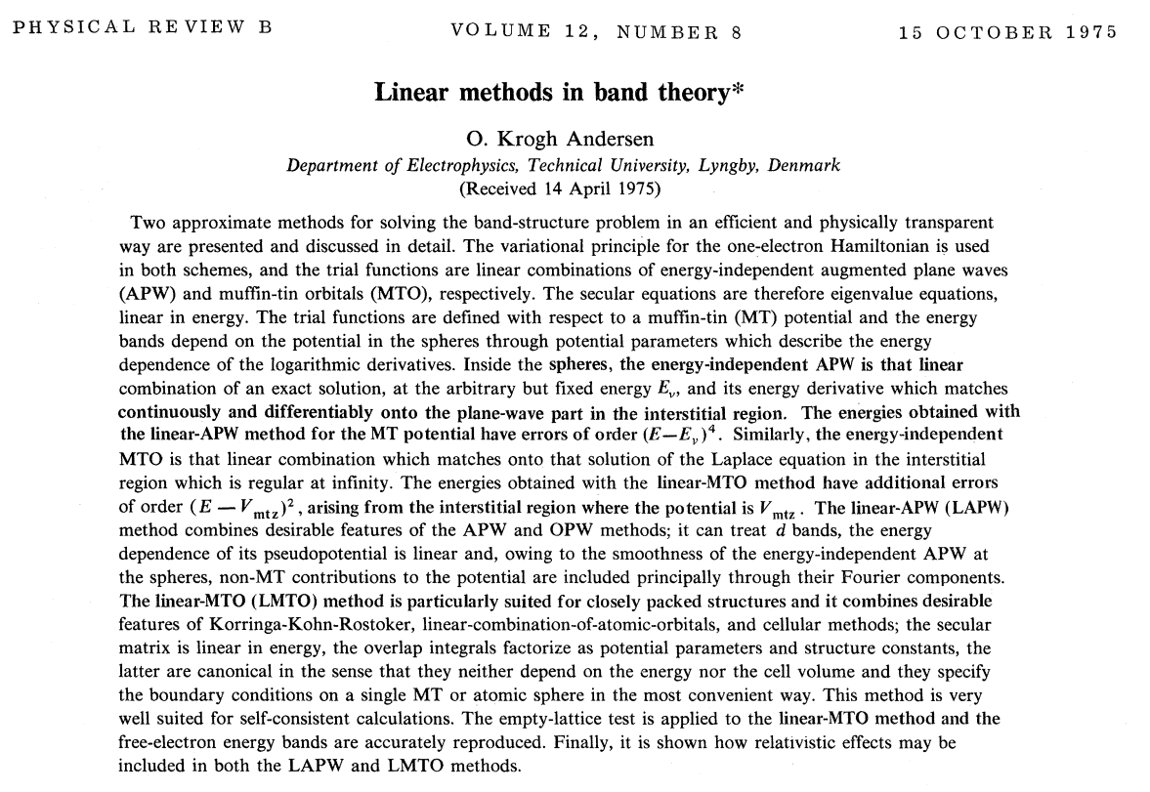

Slide 19
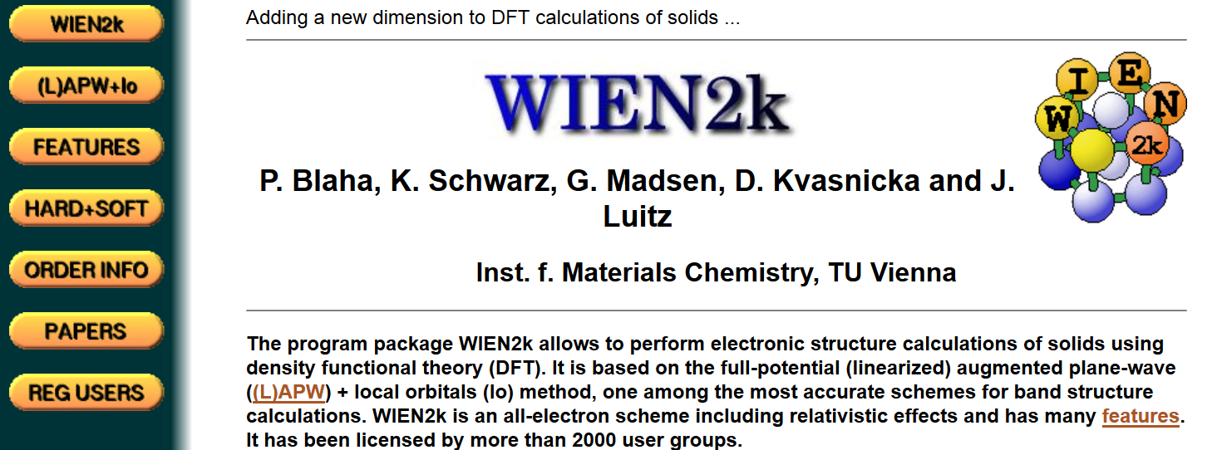
Modern software based on LAPW method --
http://www.wien2k.at/

Slide 20

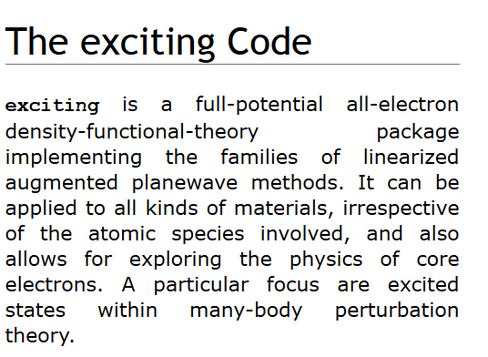
http://elk.sourceforge.net/
http://exciting-code.org/

Slide 21
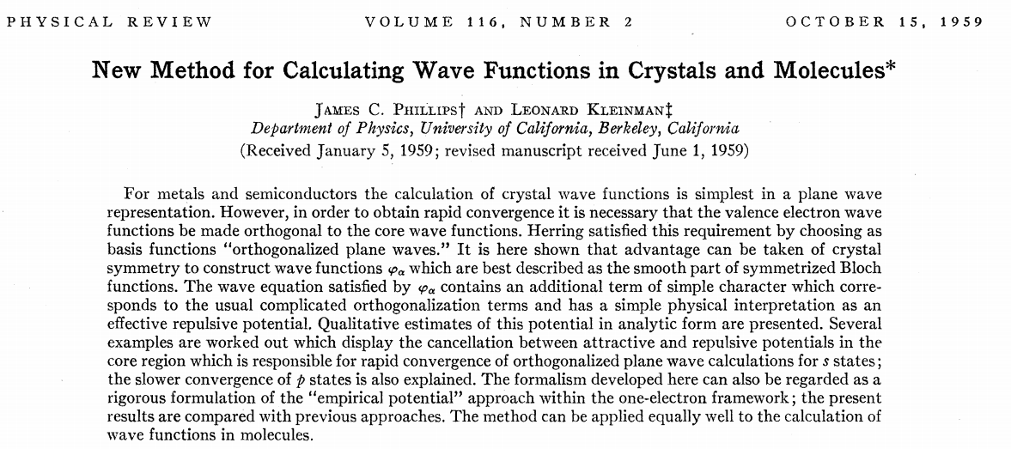
Motivation/justification for pseudopotential formalism

Slide 22
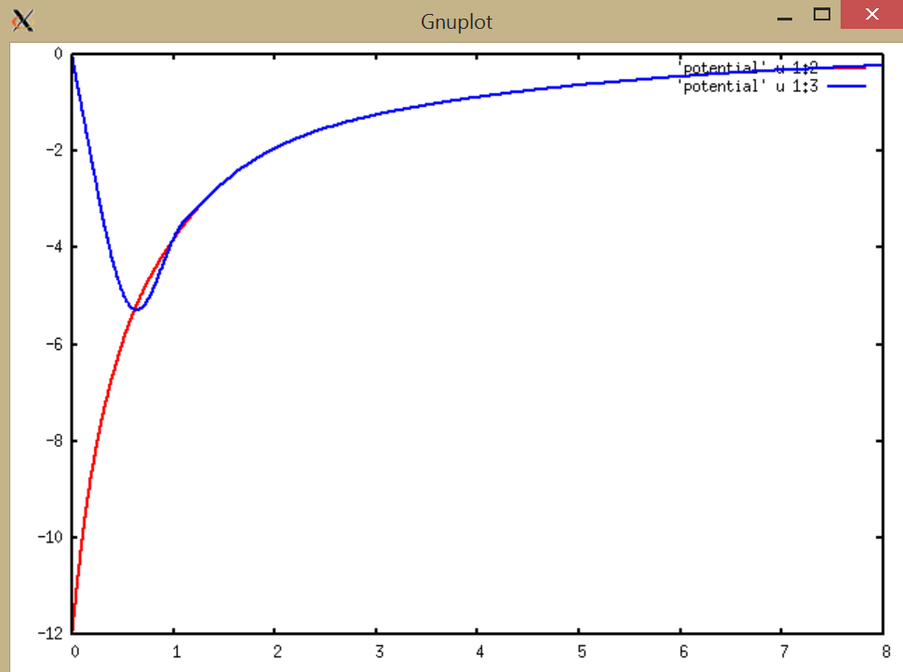
Local pseudopotential for C
rV(r) (Bohr * Ry
Self-consistent full potential for C
r (Bohr)

Slide 23
Some practical considerations in electronic structure calculations

Slide 24
Kohn-Sham equations (assuming “local” potential)

Slide 25
Digression on evaluation of the Fourier transform of the effective potential

Slide 26
Digression on evaluation of the Fourier transform of the effective potential

Slide 27
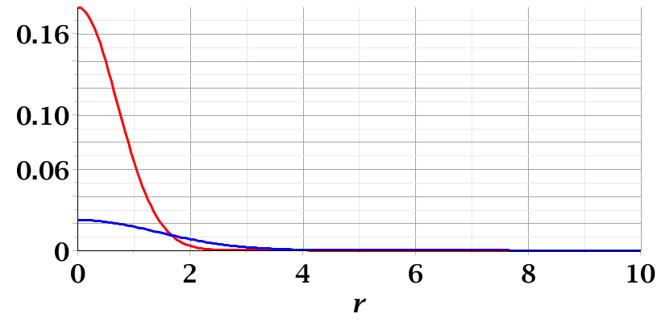
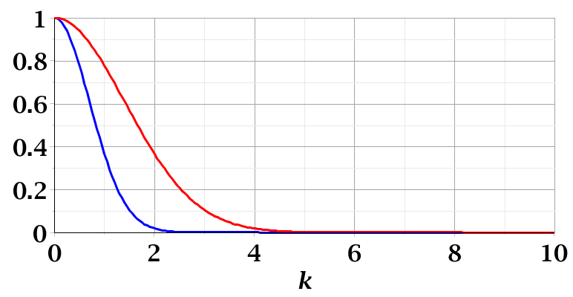
Examples of convergence of Fourier transforms:

Slide 28
Convergence of plane wave expansions

Slide 29
Some practical tricks
Fourier space representation of density can be determined by inverse FFT

Slide 30
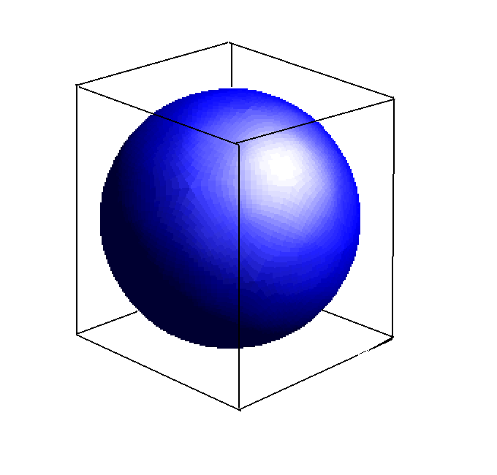
FFT grid size
Enclosing parallelepiped

Slide 31
FFT equations http://www.fftw.org/

Slide 32
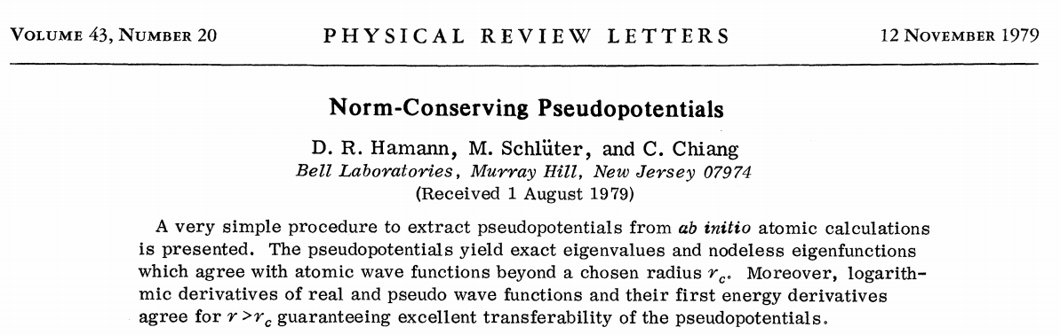
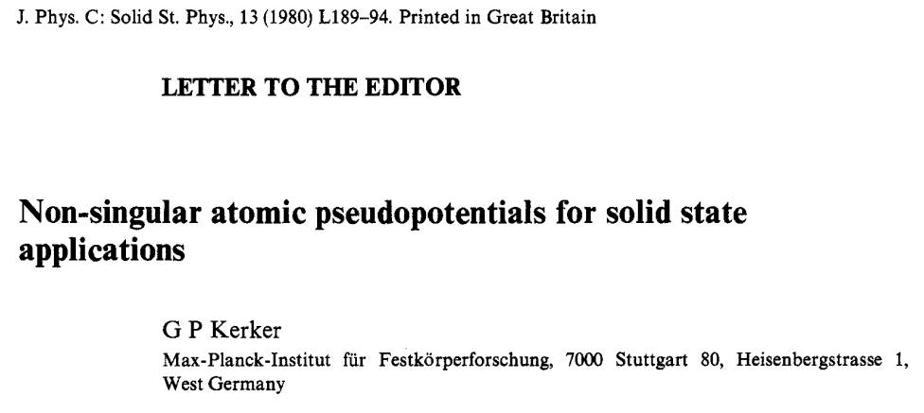
How can we construct a pseudopotential?
  Norm-conserving pseudopotentials

