Slide 1
PHY 752 Solid State Physics
11-11:50 AM MWF Olin 103
Plan for Lecture 16:
Reading: Chapter 5 in GGGPP
Ingredients of electronic structure calculations
Plane wave basis sets
Construction of pseudopotentials
Projector Augmented Wave (PAW) method

Slide 2
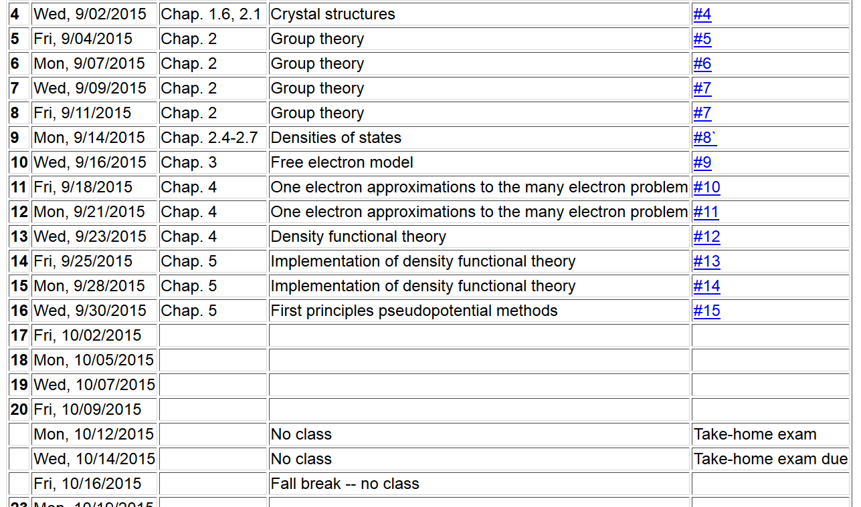

Slide 3
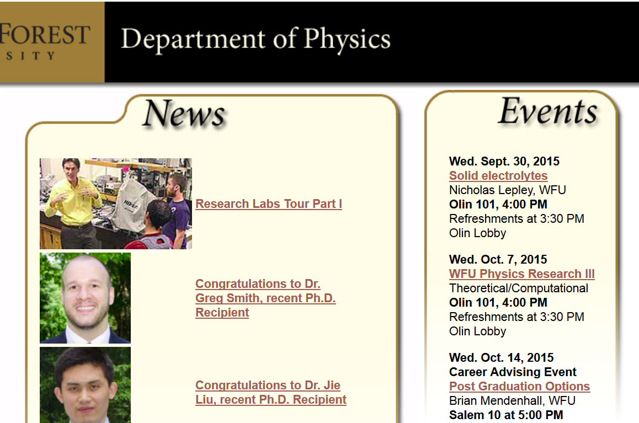

Slide 4
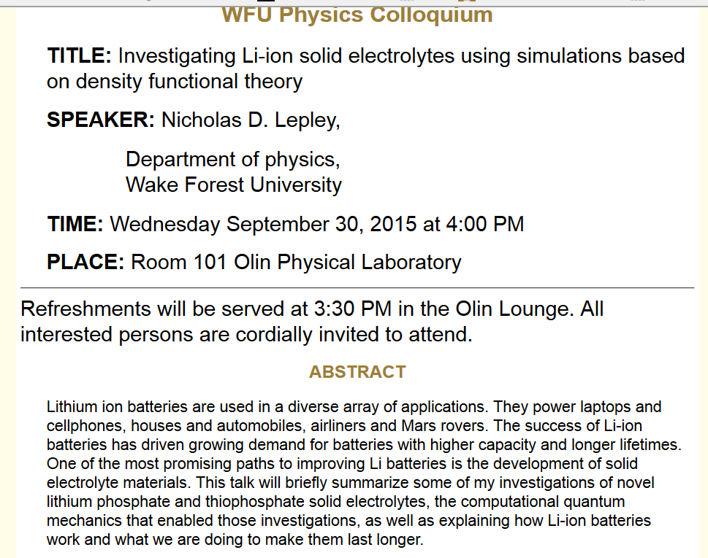

Slide 5
Some practical considerations in electronic structure calculations

Slide 6
Kohn-Sham equations (assuming “local” potential)
➔Strong motivation for the development of pseudopotentials

Slide 7
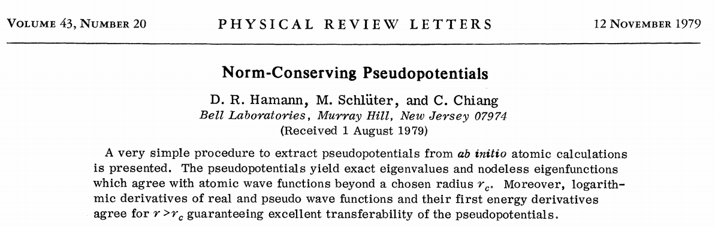
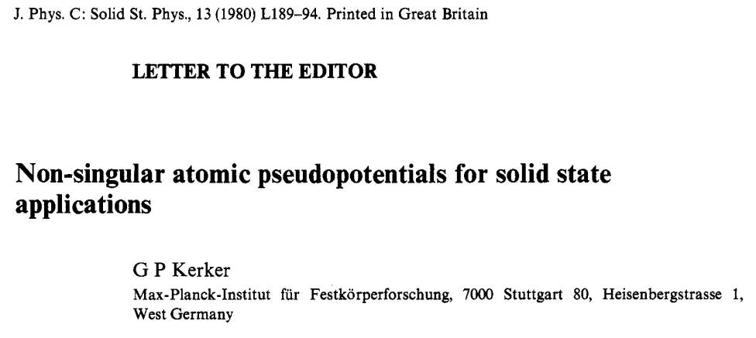
How can we construct a pseudopotential?
Norm-conserving pseudopotentials

Slide 8
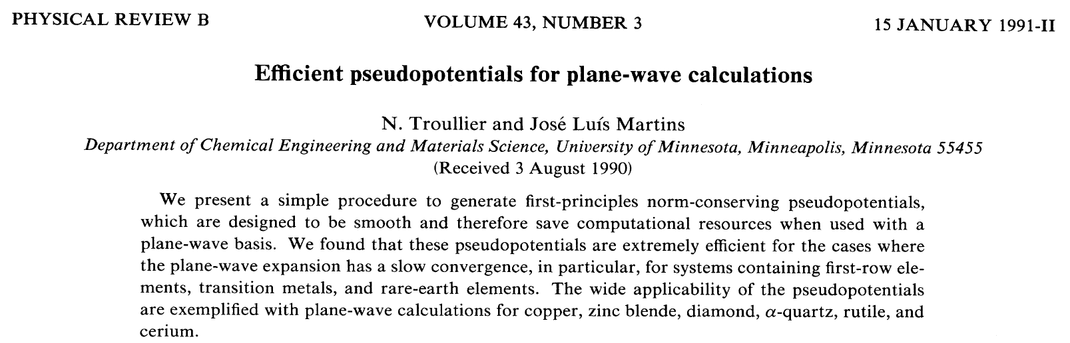

Slide 9
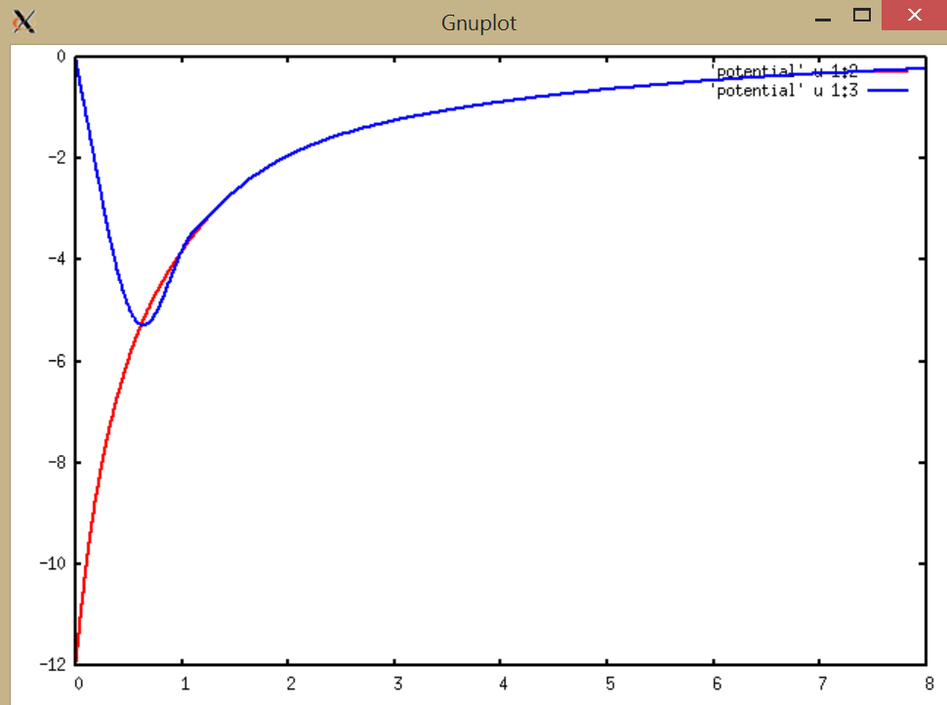
Local pseudopotential for C
rV(r) (Bohr * Ry
Self-consistent full potential for C
r (Bohr)

Slide 10
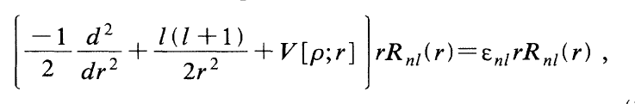
Some details of pseudopotential construction from Troullier and Martins
Atomic Kohn-Sham equation for all-electron potential (atomic (Hartree) units
AE
AE
AE
Corresponding atomic Kohn-Sham equation for pseudoptential
PP
PP
PP

Slide 11



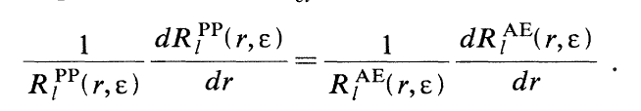
Conditions of AE and PP functions:

Slide 12
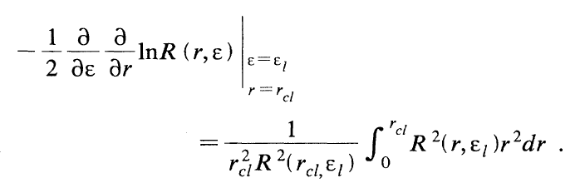
Benefit of these conditions
➔Pseudo-wavefunction accurately represents correct functional form in valence region
➔Kohn-Sham equations correctly solved at energy of reference state and its neighborhood

Slide 13
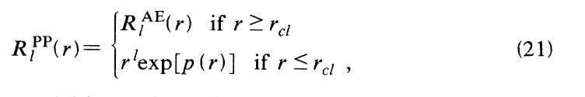
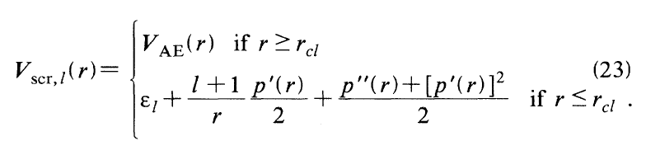
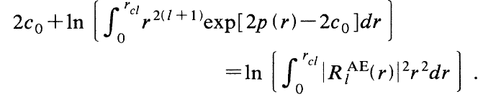
Troullier-Martins recipe
Conditions to determine coefficients c_{n}

Slide 14
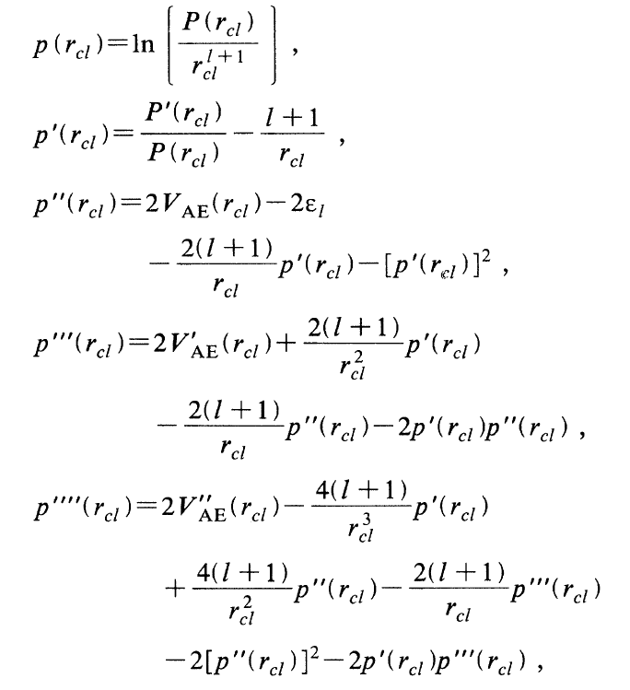
Conditions on coeffients, continued:

Slide 15
Example of Troullier-Martin pseudopotential for C
Local pseudopotential for C
rV(r) (Bohr * Ry
Self-consistent full potential for C
r (Bohr)

Slide 16
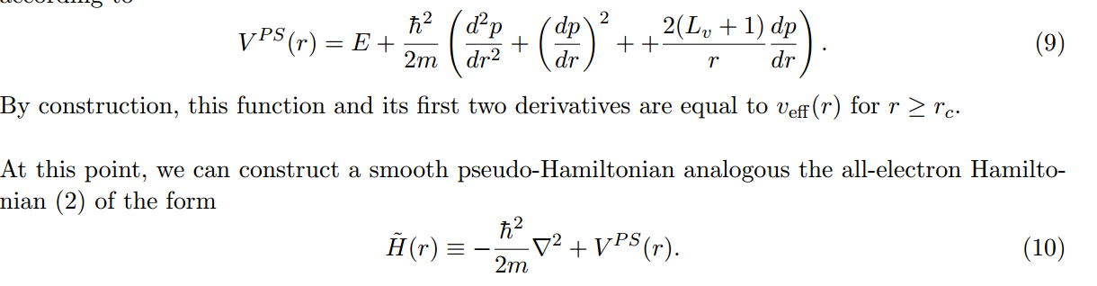
Pseudopotential form in terms of polynomial p(r):
Properties of pseudopotential and corresponding pseudo-wavefunctions
➔Correct logarithmic derivatives at energy E and at nearby energies

Slide 17
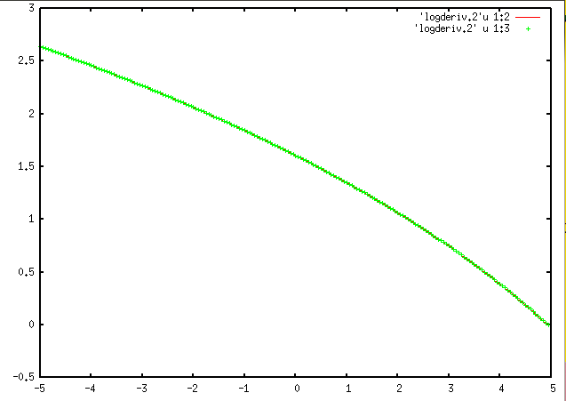
L[P]
E (Ry)
Construction energy

Slide 18
The construction ensures that
➔PS and AE have same log derivatives near E
➔What about other partial waves? (Non-local contributions to pseudopotential)

Slide 19

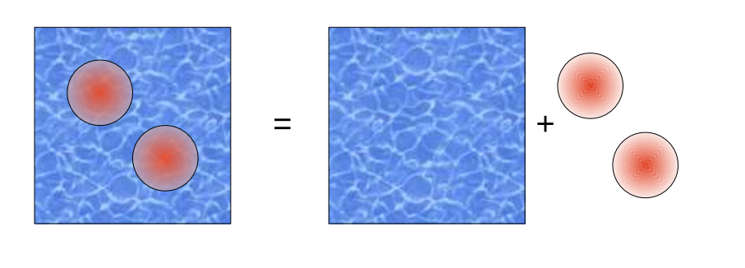
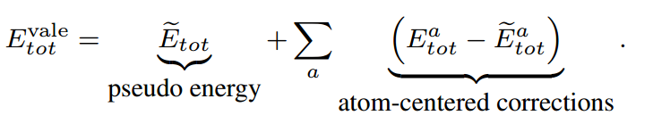
PAW representation of Kohn-Sham orbitals
Evaluation of the energy of the system

Slide 20
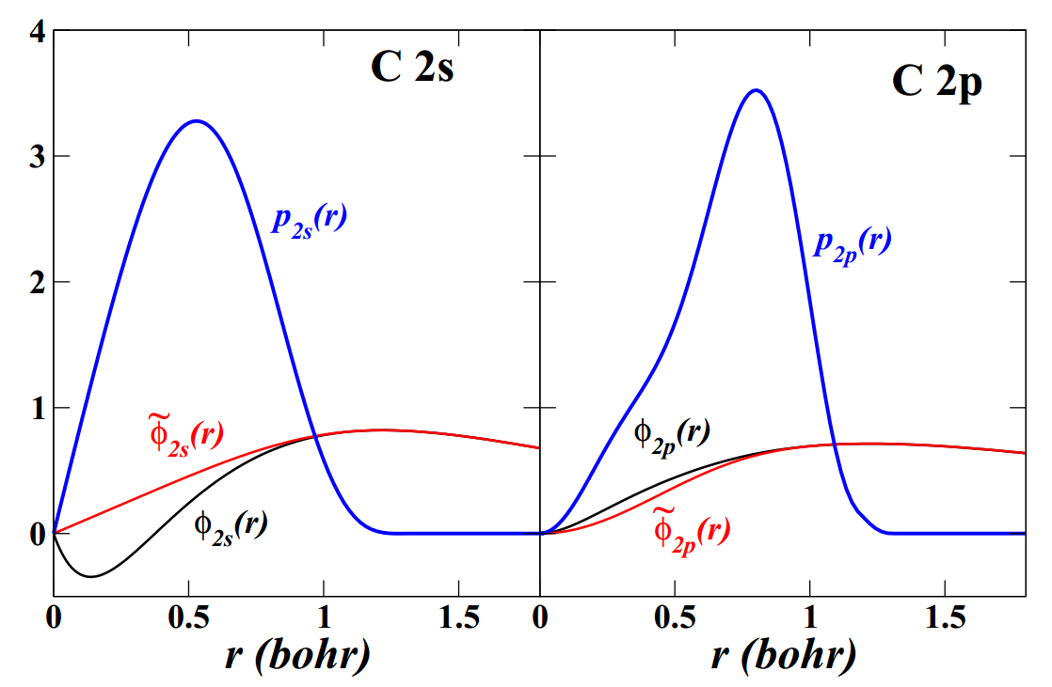
Example of atomic basis and projector functions

Slide 21
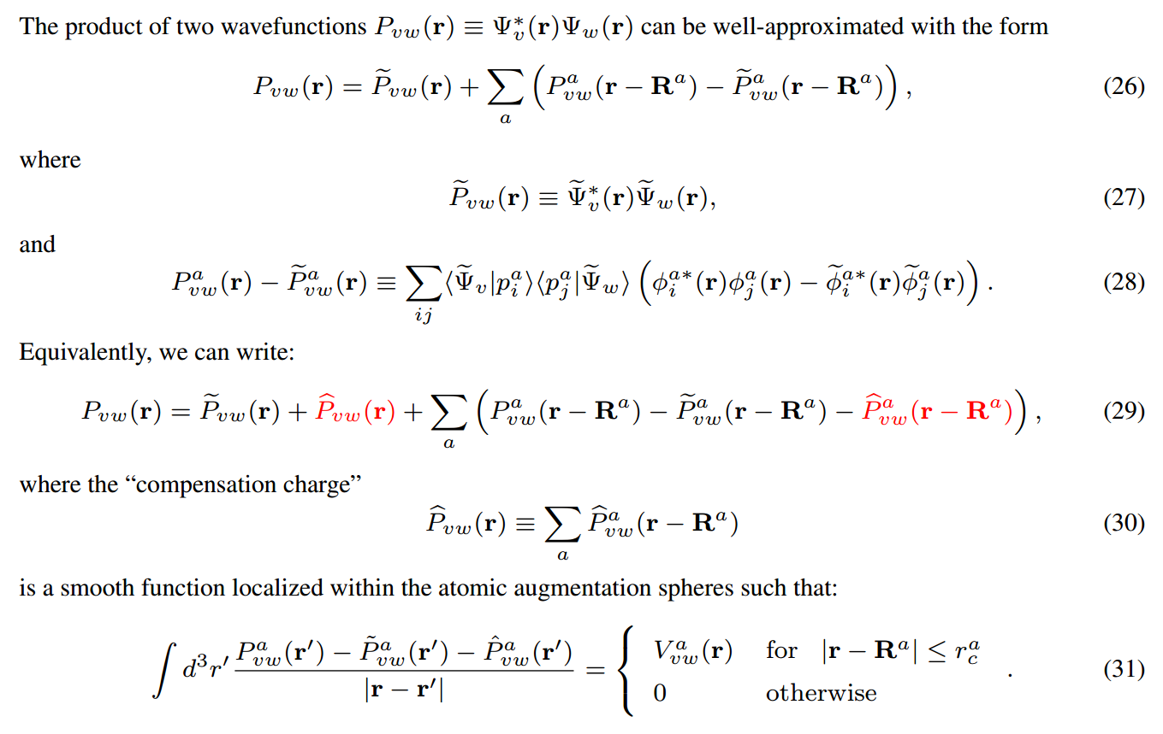
Clever secret of PAW method; partitioning of planewave and one center contributions

Slide 22
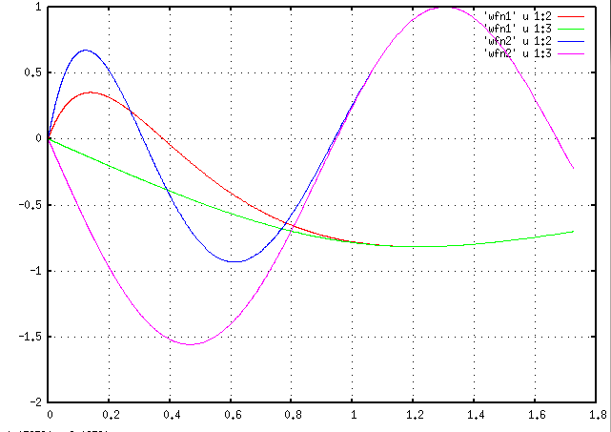
Construction of atom centered basis and projector functions:
r_{c}
r

Slide 23
Construction of atom centered basis and projector functions – continued (scheme developed by David Vanderbilt for ultra-soft pseudopotentials; for each l channel at at time):

Slide 24
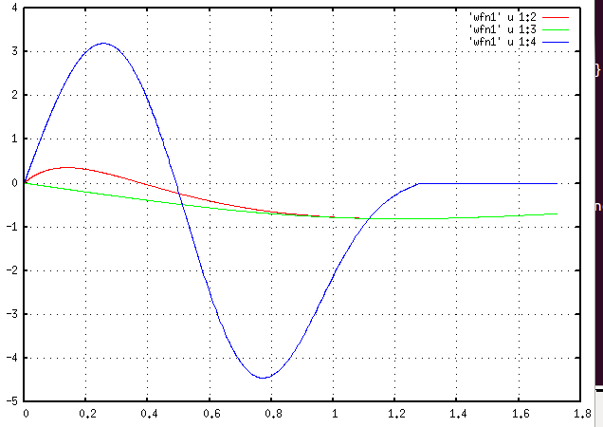
Example for C
r

Slide 25
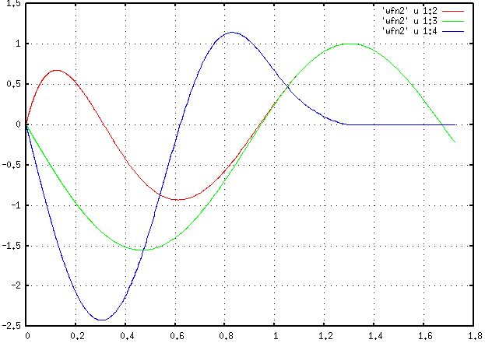
Example for C -- continued

Slide 26
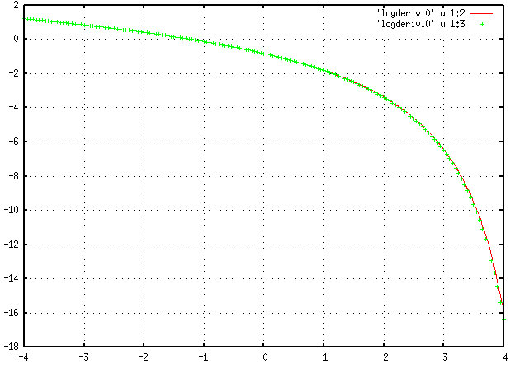
Example for C -- continued
log derivatives for l=0
E

Slide 27
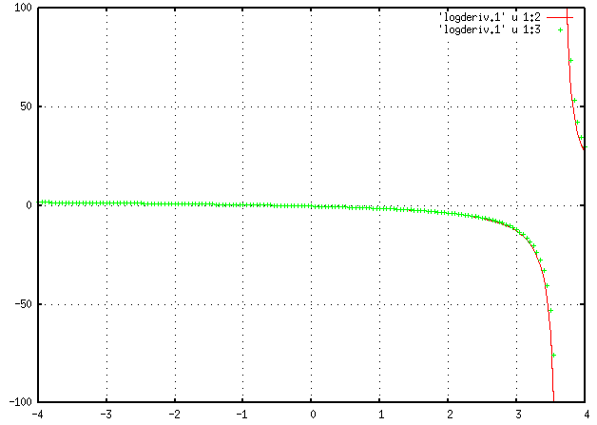
Example for C -- continued
log derivatives for l=1
E

Slide 28
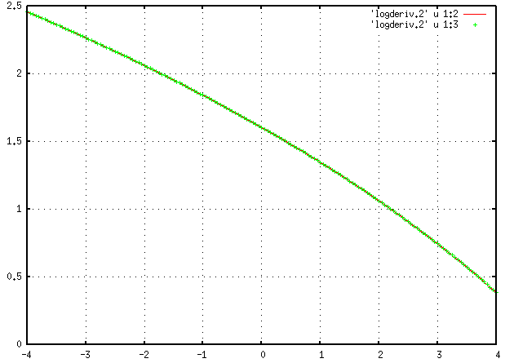
Example for C -- continued
log derivatives for l=2
E

