Slide 1
PHY 752 Solid State Physics
11-11:50 AM MWF Olin 103
Plan for Lecture 17:
Reading: Chapter 6 in GGGPP
Electronic properties of selected materials
Rare-gas solids
Ionic crystals

Slide 2
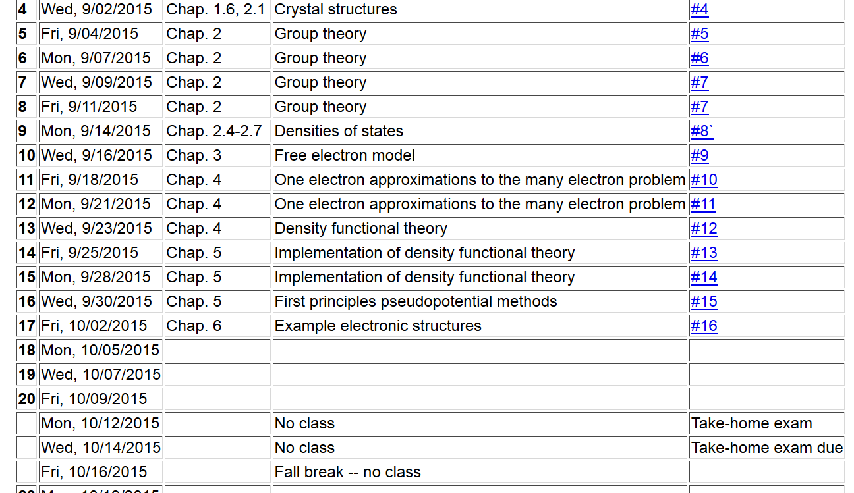

Slide 3
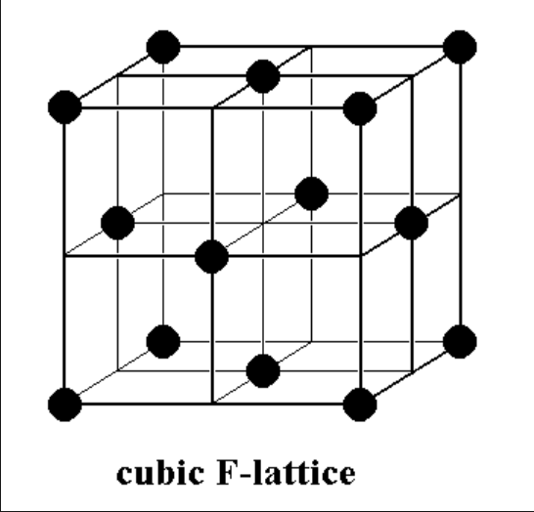
Electronic structures of rare gas solids -- fcc structure

Slide 4
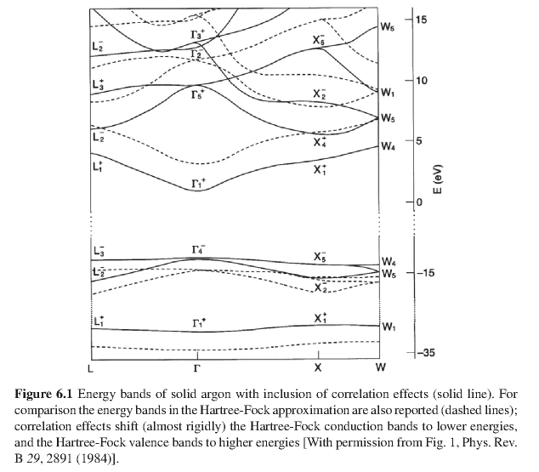

Slide 5
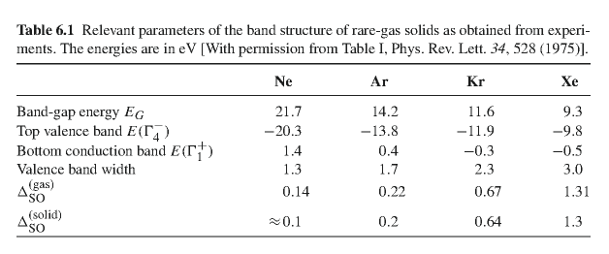
Summary of band gaps and widths

Slide 6
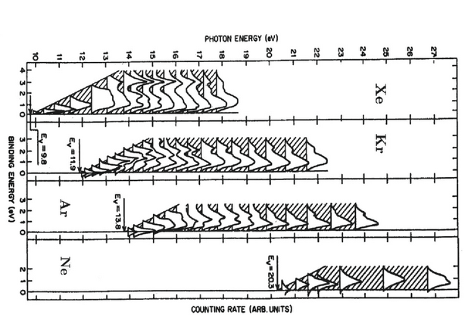
Photo emission spectrum

Slide 7
Simple model of cohesive energy of rare-gas solids
Lennard-Jones model between each pair of atoms
Cohesive energy of the solid
For fcc lattice:

Slide 8
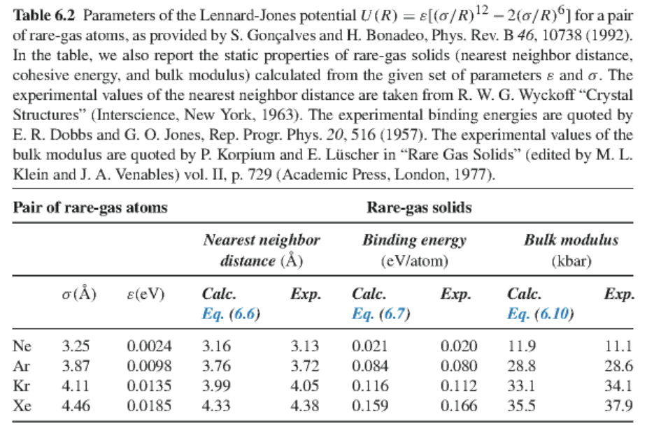

Slide 9
Some details

Slide 10
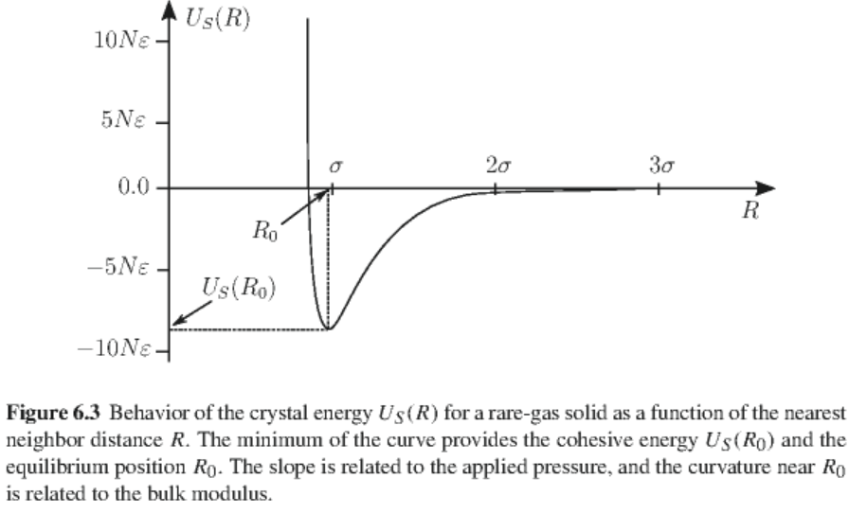
Plot of Lennard-Jones potential

Slide 11
Bulk modulus
For this case:

Slide 12
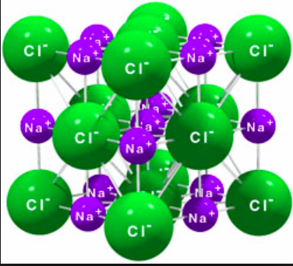
Ionic solids

Slide 13
Ewald summation methods -- motivation

Slide 14
Ewald summation methods – exact results for periodic systems
See lecture notes for details.

