Slide 1
PHY 752 Solid State Physics
11-11:50 AM MWF Olin 103
Plan for Lecture 18:
Reading: Chapter 6 in GGGPP
Electronic properties of selected materials
Ionic crystals – Ewald summation and binding energy
Band structure

Slide 2
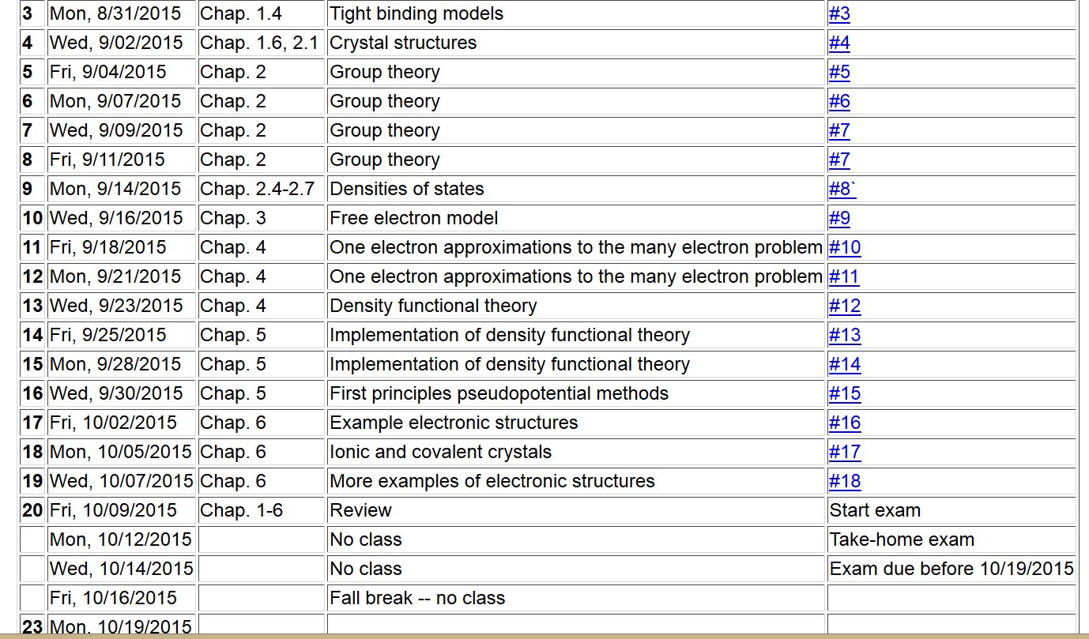

Slide 3
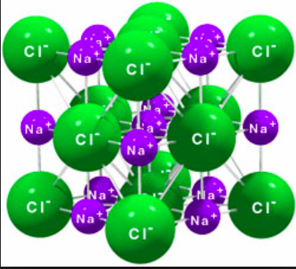
Ionic solids
Example -- NaCl

Slide 4
Ewald summation methods -- motivation

Slide 5
Ewald summation methods – exact results for periodic systems
See lecture notes for details.

Slide 6
Summary of Ewald summation for electrostatic energy
Using identity:
Electrostatic energy becomes:
Summation in reciprocal space
Summation in real space
N

Slide 7
Some details for singular term

Slide 8
Ewald expansion formula:

Slide 9
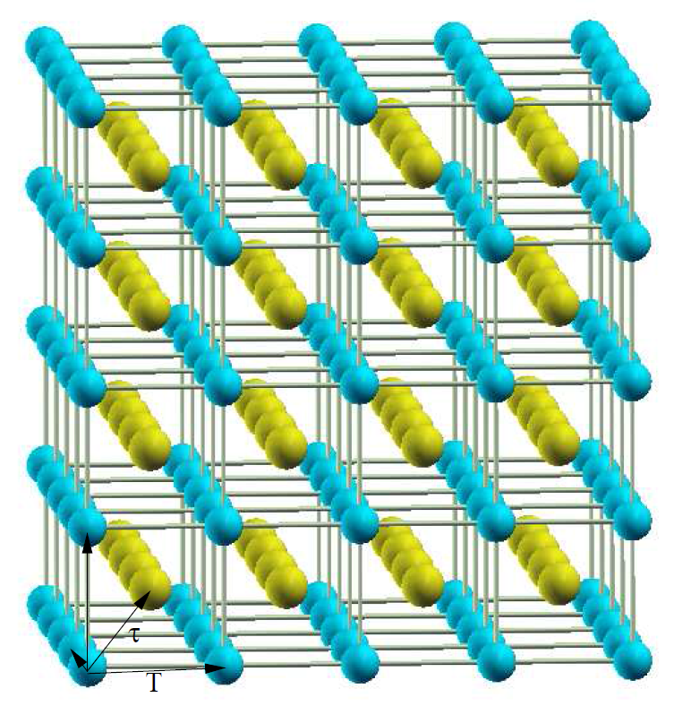
Example for CsCl structure

Slide 10
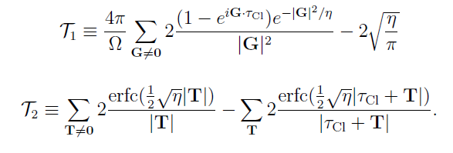
Evaluation of summation

Slide 11
Maple expressions
See Maple sheet
lattice constant
nearest neighbor

Slide 12
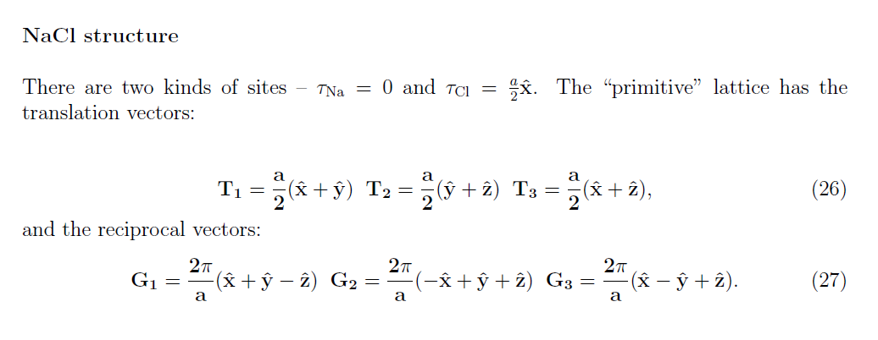

Slide 13
Summary of Coulomb interaction energies
Note: In the rest of the lecture notes, we will resume the cgs Gaussian units used in your textbook

Slide 14
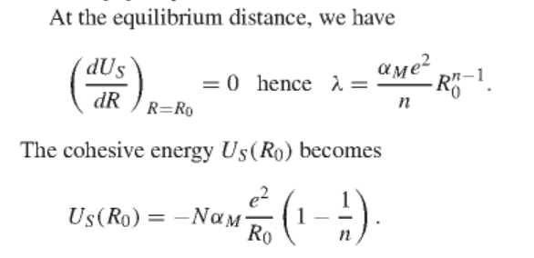
Simple interaction model for ionic crystals
Bulk modulus
For NaCl structure

Slide 15
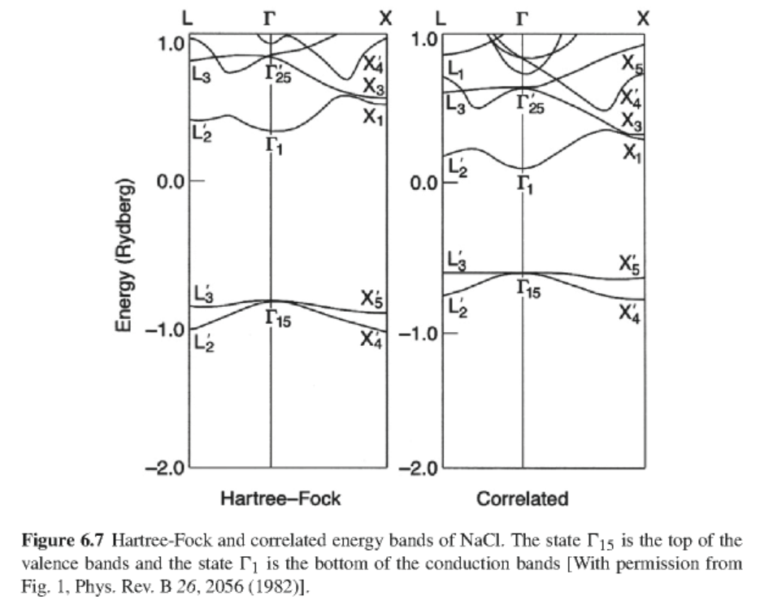
Band structure
for NaCl
Empty Na bands
Filled Cl bands

Slide 16
How do you know if a material is ionic?
Atomic configurations (neutral)
Na: 1s² 2s² 2p⁶ 3s
Cl: 1s² 2s² 2p⁶ 3s² 3p⁵
6 valence electrons

Slide 17
Band structure
for NaCl
Empty Na bands
Na 3s¹ → 3s⁰
Filled Cl bands;
accommodate 6 electrons
Cl 3p⁵ → 3p⁶

Slide 18
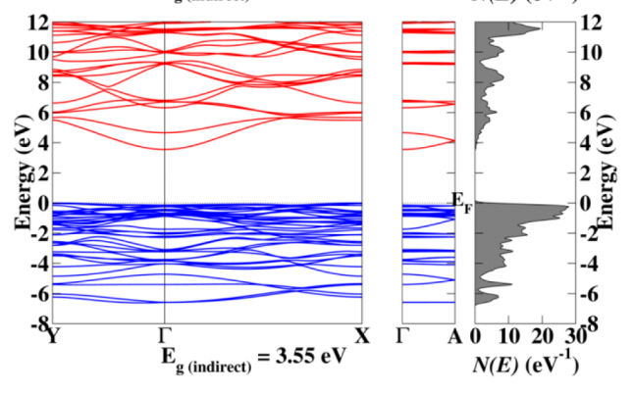
Electronic structure of
Li₂SnO₃
Note: Valence bands must accommodate 72 valence electrons from 8 Li 2s¹ , 4 Sn 5s²5p², and 12 O 2p⁴ atoms per unit cell

Slide 19
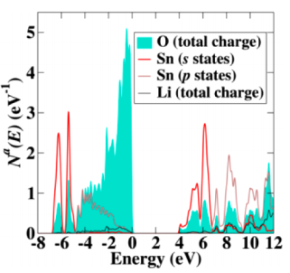
Partial density of states for Li₂SnO₃

Slide 20
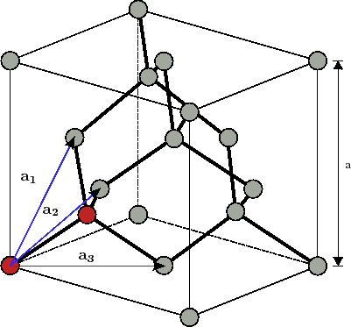
Example of a non-ionic material
Diamond lattice (2 C atoms per unit cell)

Slide 21
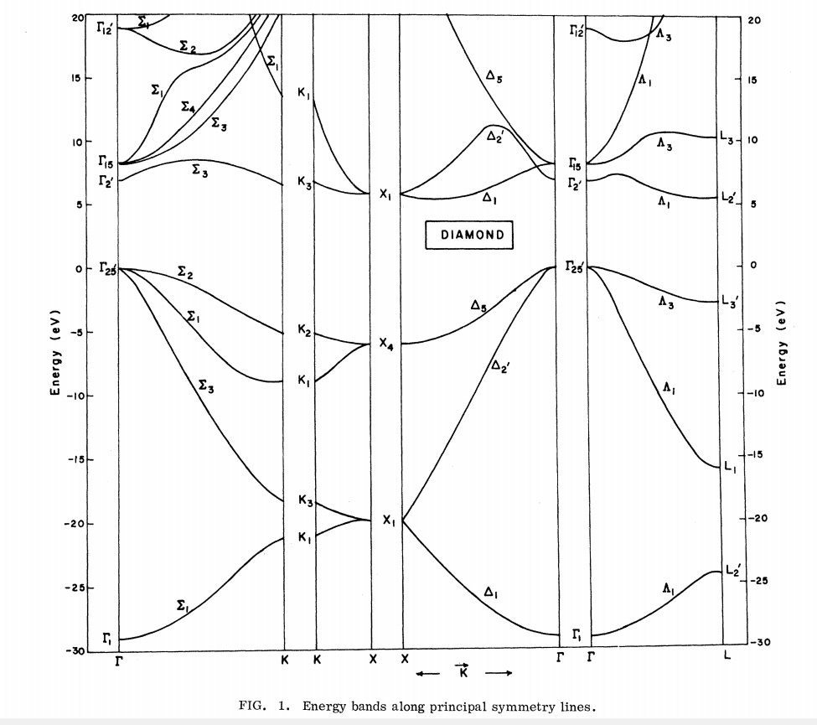
Ref. PRB 2, 2054 (1970)
Note: Valence bands must accommodate 8 valence electrons from two C 1s²2s²2p² atoms per unit cell

Slide 22
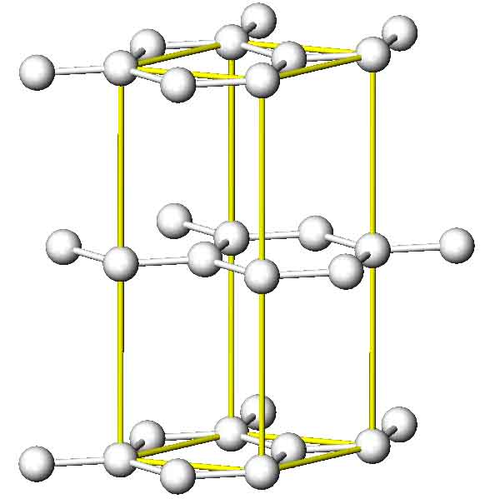
Crystal structure of graphite (4 atoms per unit cell)

Slide 23
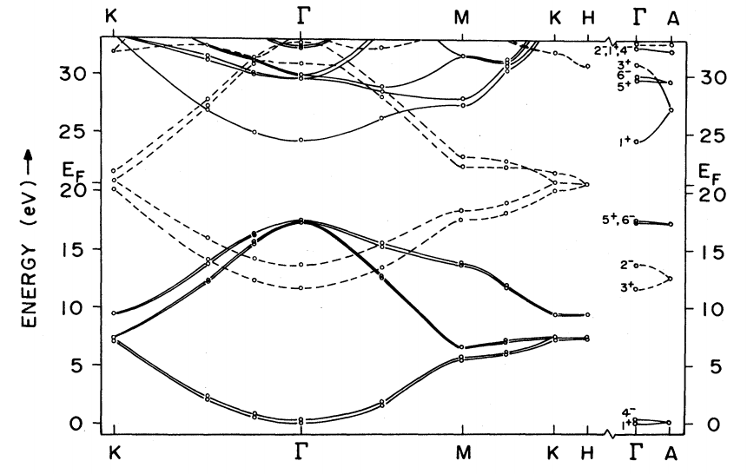
Note: Valence bands must accommodate 16 valence electrons from four C 1s²2s²2p² atoms per unit cell
Ref. PRB 26, 5382 (1982)
Band diagram for graphite

