Slide 1
PHY 752 Solid State Physics
11-11:50 AM MWF Olin 103
Plan for Lecture 19:
Reading: Chapter 6 in GGGPP
Electronic properties of selected materials
Covalent crystals – diamond and graphite
Metallic crystals

Slide 2
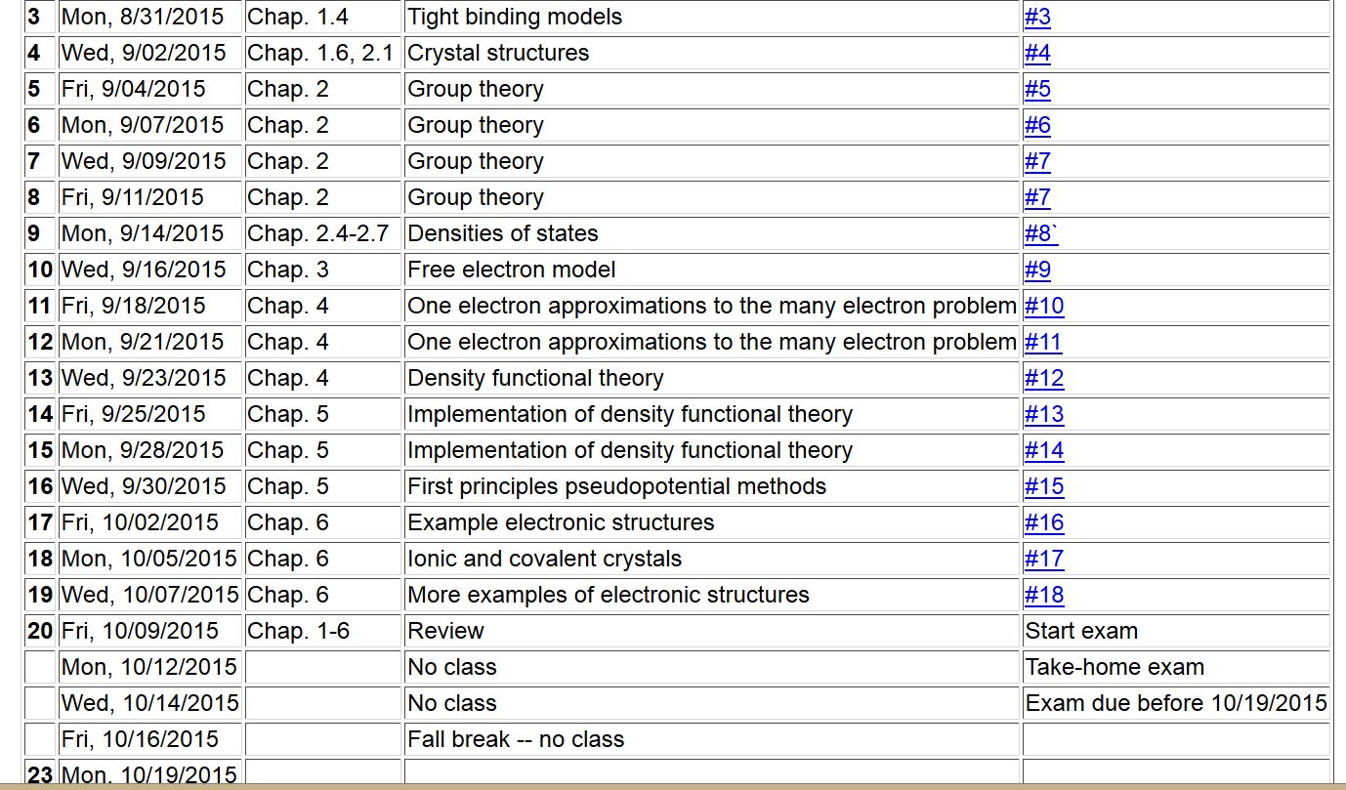

Slide 4
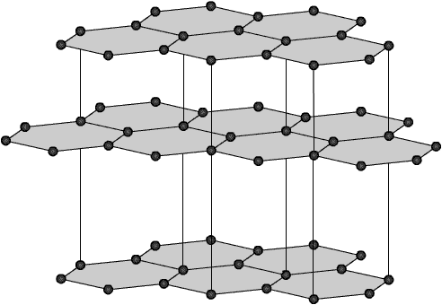
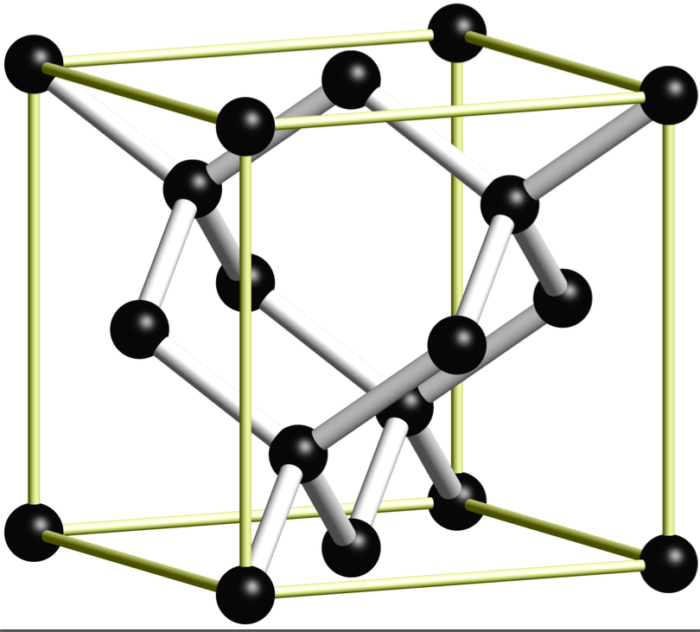
Covalent crystals
graphite
diamond

Slide 5
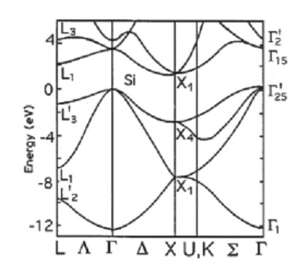
Band structure diagram of Si in diamond structure
Si 3s² 3p² → 3sp³
4 bands; accommodates 8 electrons

Slide 6
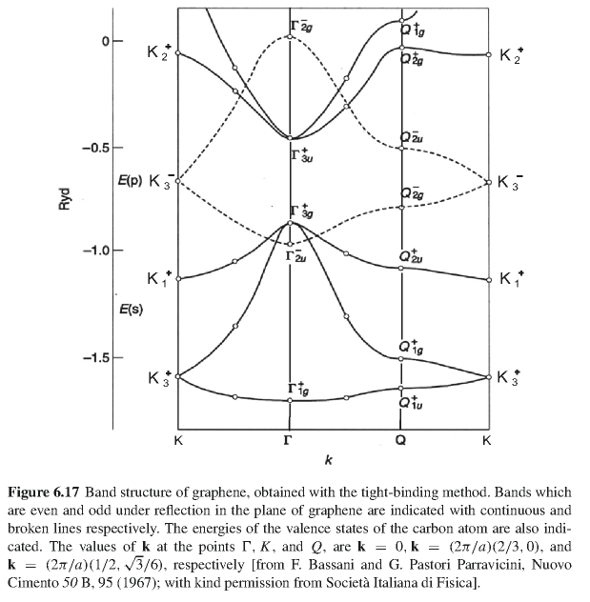
Band structure of graphene
C 2s² 2p² → 2sp² + 2pπ
pπ band
3 bands accommodate 6 electrons

Slide 7
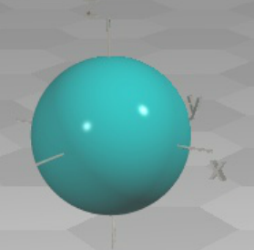
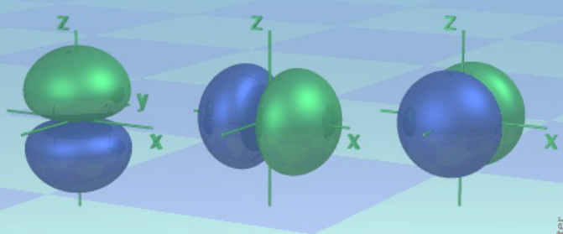
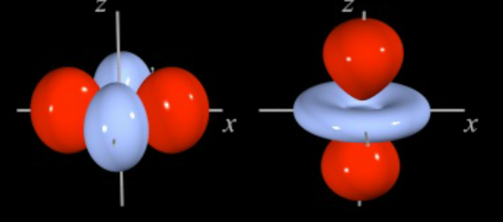
Atomic orbitals for analyzing covalent materials
http://winter.group.shef.ac.uk/orbitron/
l=0
l=1
l=2

Slide 8
Orbital description of covalent bond --
While, for atoms the “z” axis is an arbitrary direction, for diatomic molecules and for describing bonds, it is convenient to take the “z” axis as the bond direction.
Atom
symbol
l=0 m=0 s
l=1 m=0 p
m= ±1 p
l=2 m=0 d
m= ± 1 d
m= ± 2 d
Bond
symbol
l=0 λ=0 σ
l=1 λ=0 σ
λ=1 π
l=2 λ=0 σ
λ=1 π
λ= 2 δ

Slide 9
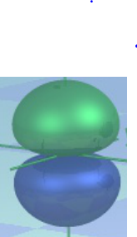
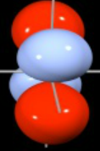
Atomic orbital bond types
ssσ
ppσ
ppπ
ddπ

Slide 10
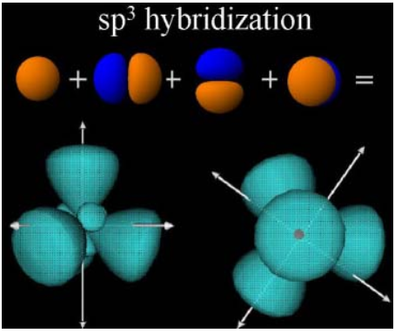
Linus Pauling’s notion of hybrid bonds
http://butane.chem.uiuc.edu/pshapley/GenChem2/A6/index.html

Slide 11
http://butane.chem.uiuc.edu/pshapley/GenChem2/A6/index.html
sp³ hybrid bonds

Slide 12
http://butane.chem.uiuc.edu/pshapley/GenChem2/A6/index.html
sp² hybrid bonds

Slide 13
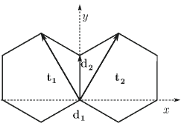
Some details of the band structure of graphene, focusing on the pπ bands alone.
Approximate wavefunction based on linear combination of π orbitals

Slide 14
Hamiltonian in the basis of the π orbitals for sites 1 & 2:
where t is a matrix element between sites 1 & 2 and

Slide 15
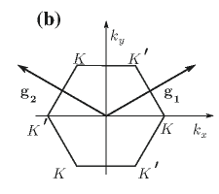
Brillouin zone for graphene

Slide 16
Brillouin zone for graphene

Slide 17
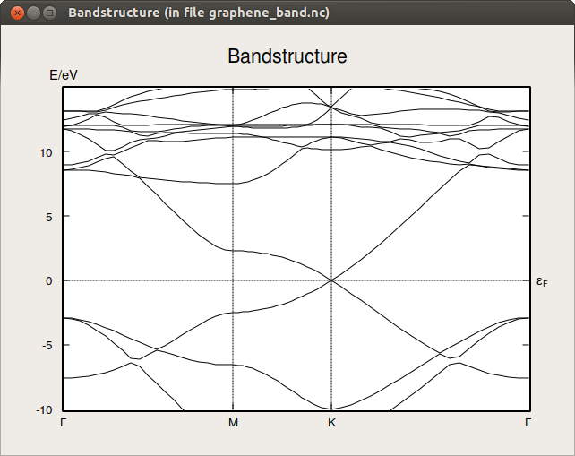
approximately linear dispersion

Slide 18
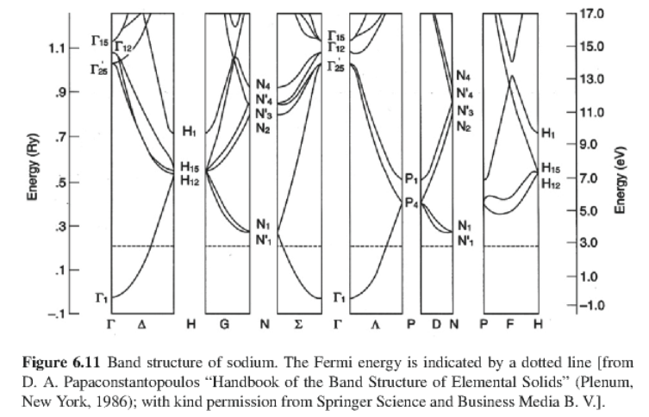
Examples of bands from your textbook

Slide 19
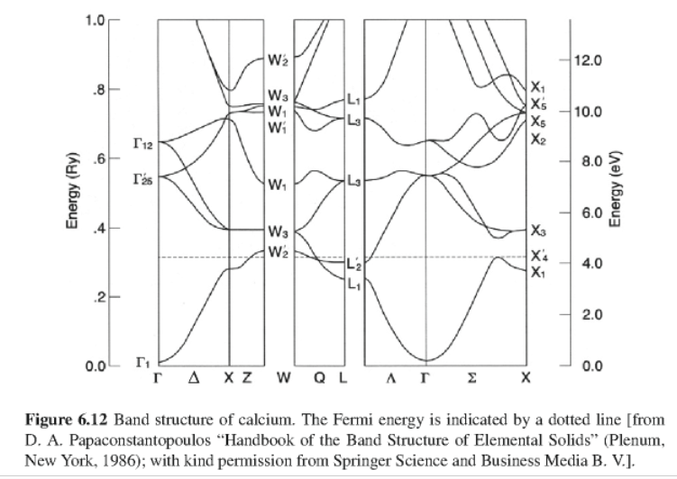

Slide 20
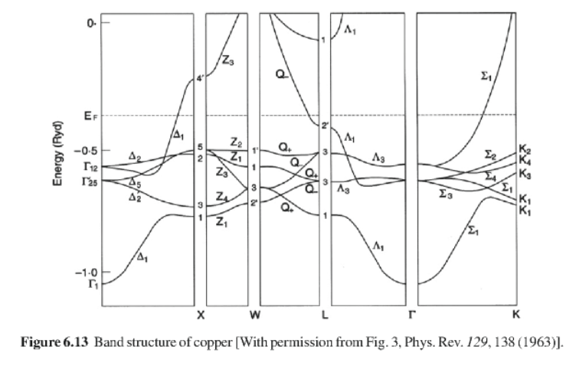

Slide 21
