Slide 1
PHY 752 Solid State Physics
11-11:50 AM MWF Olin 103
Plan for Lecture 2:
Reading: Continue reading Chapter 1 in GGGPP; Electrons in one-dimensional periodic potentials
Review of Bloch’s Theorem
Kronig-Penny model potential from the viewpoint of scattering or tunneling

Slide 2
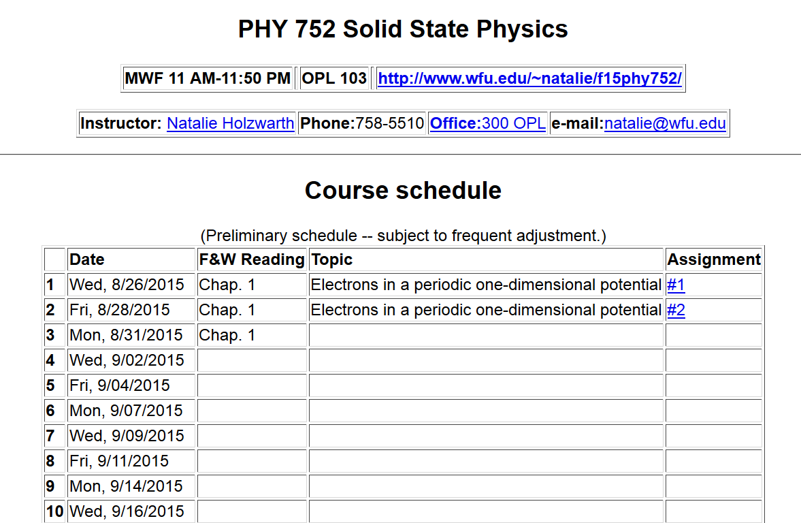

Slide 4
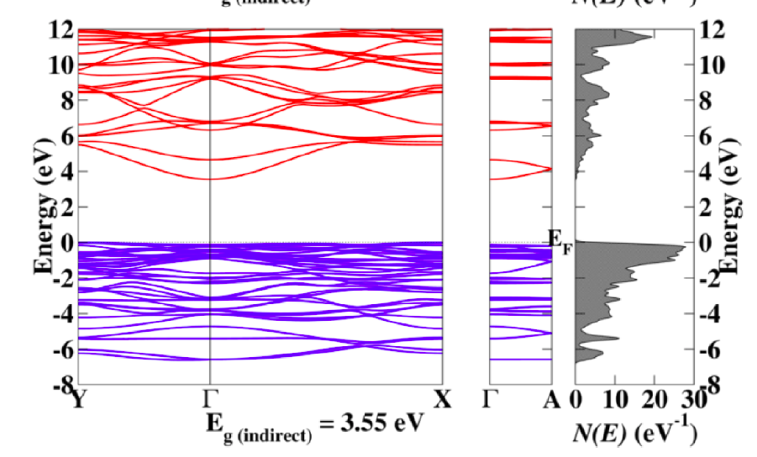
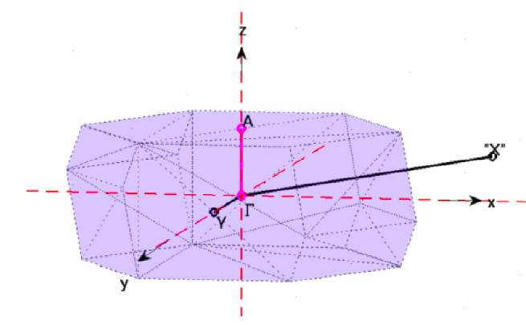
Li₂SnO₃

Slide 5
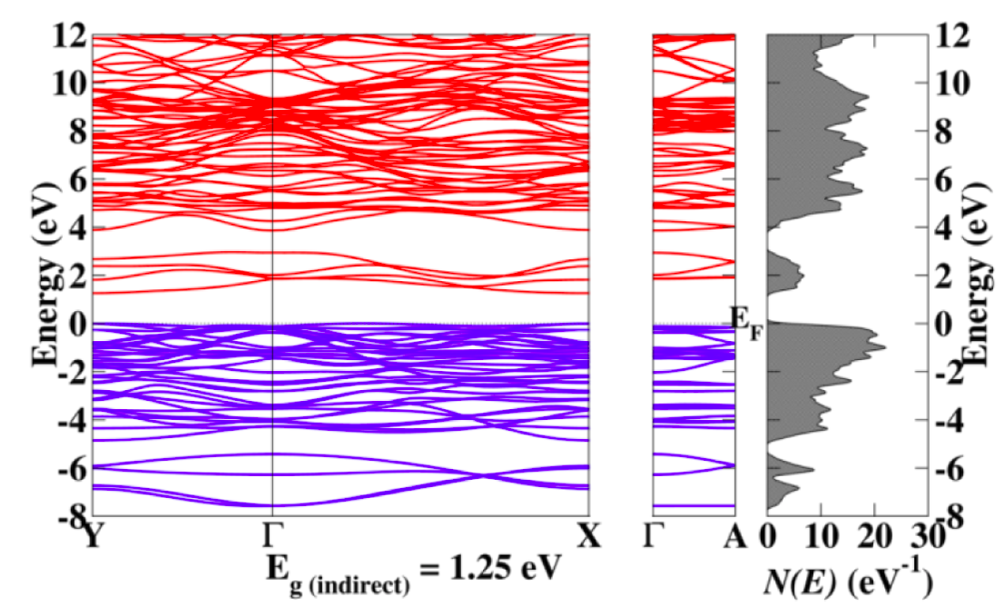
Li₂SnS₃

Slide 6
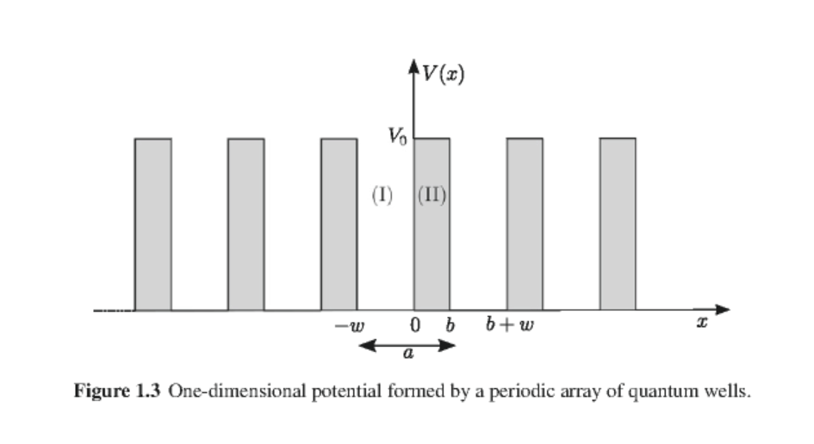
Bloch theorem:

Slide 7
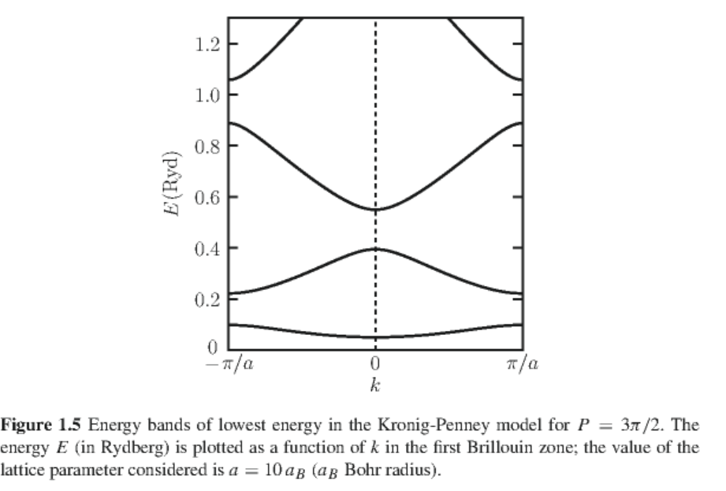
Eigenvalue solutions to Kronig-Penny model

Slide 9
From wavefunction matching conditions:
Condition for non-trivial solution:
Simplified result:

Slide 11
v
Forbidden states
f
v
Forbidden states

Slide 12
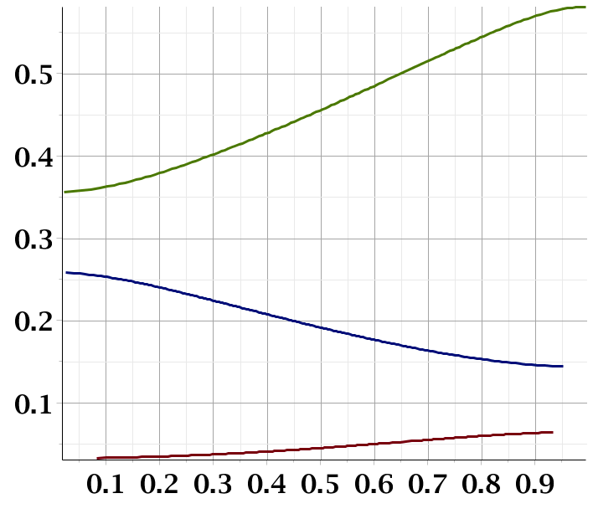
f
Band gap
Band gap
ka/π

Slide 13
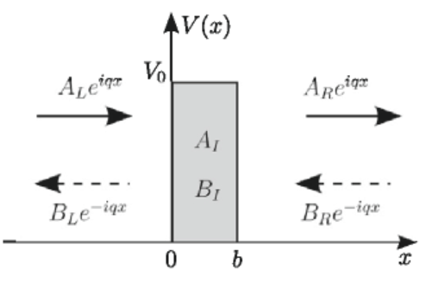
Treatment of same problem in terms of transmission and reflection from a periodic barrier. First consider a single barrier:
Matrix for determining coefficients:

Slide 14
Matching conditions for wavefunction coefficients:

Slide 15
Solving for transfer matrix elements:

Slide 16
Transmittance

Slide 17
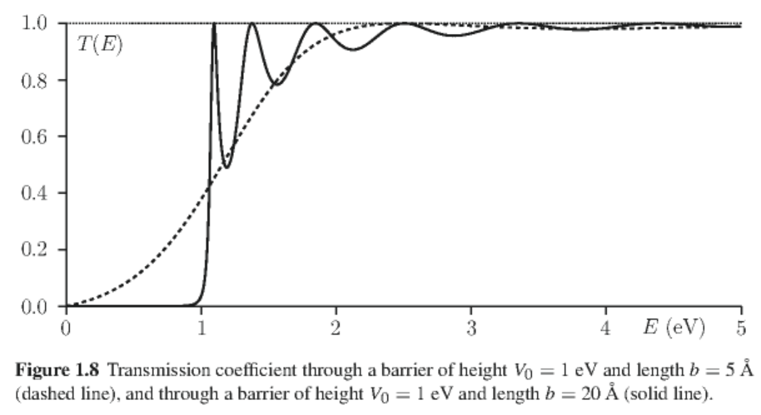
After some algebra:

Slide 18
Electron transmission through a one-dimensional periodic barrier
Because of Bloch theorem:

Slide 19
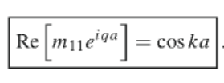
Bloch theorem & transmission coefficients:
Condition for solution:

