Slide 1
PHY 752 Solid State Physics
11-11:50 AM MWF Olin 103
Plan for Lecture 20:
Review: Chapters 1-6 in GGGPP
Bloch theorem
Kronig-Penny model
Group theory

Slide 2
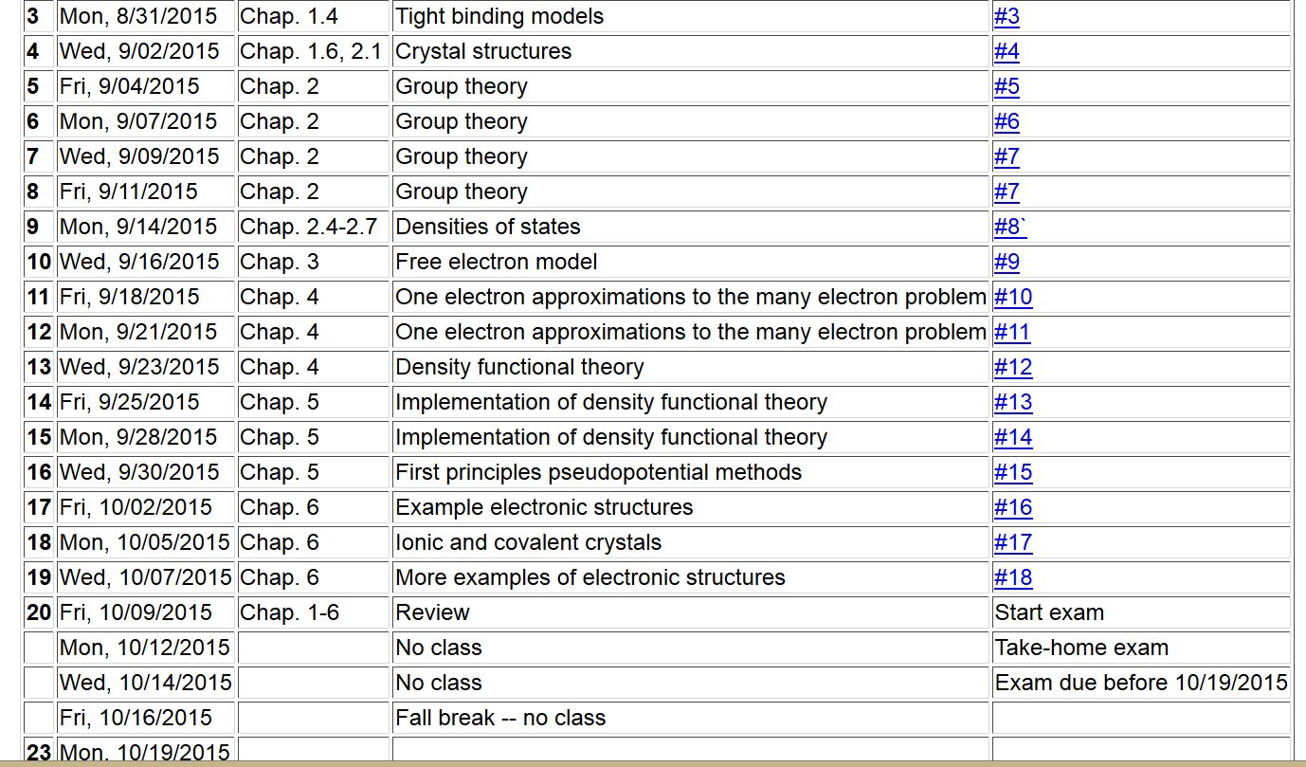

Slide 3
Consider an electron moving in a one-dimensional model potential (Kronig and Penney, Proc. Roy. Soc. (London) 130, 499 (1931)
a
V₀

Slide 4
a
V₀
b

Slide 5
a
V₀
b

Slide 6
v
Forbidden states
f
v
Forbidden states

Slide 7
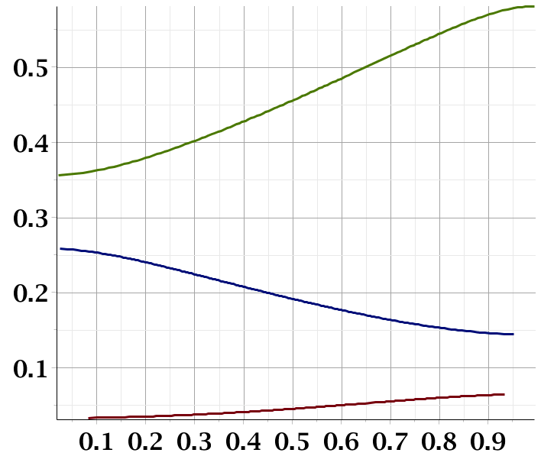
f
Band gap
Band gap
ka/π

Slide 8
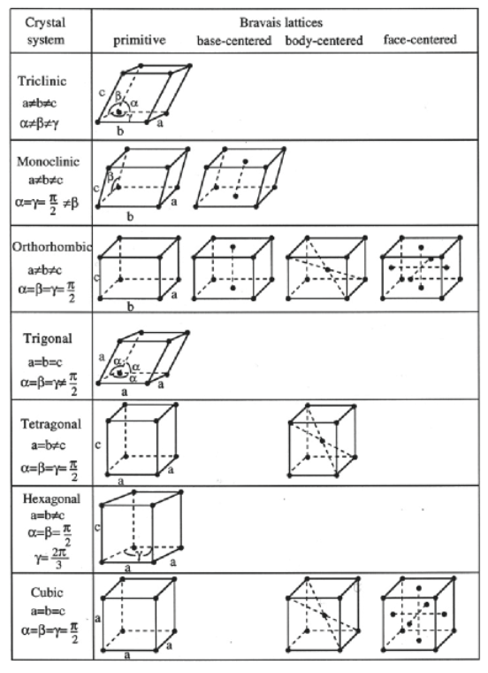
Classification of lattice types –
14 Bravais lattices
230 space groups

Slide 9
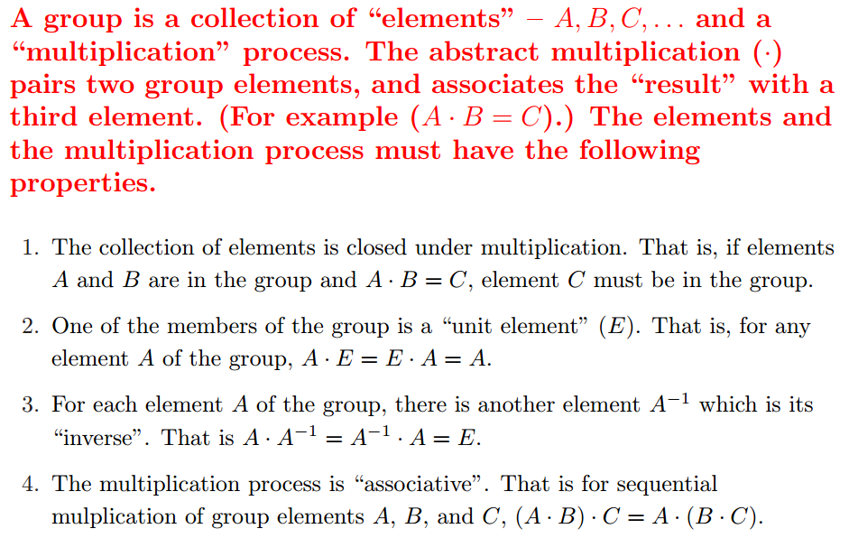
Short digression on abstract group theory
What is group theory ?

Slide 10
Group theory – some comments
The elements of the group may be abstract; in general, we will use them to describe symmetry properties of our system
Representations of a group

Slide 11
The great orthogonality theorem
Note: only irreducible representations are used.

Slide 12
Simplified analysis in terms of the “characters” of the representations
Character orthogonality theorem
Note that all members of a class have the same
character for any given representation i.

Slide 13
Reciprocal lattice
real lattice
reciprocal lattice
Unit vectors of the reciprocal lattice
General reciprocal lattice vector

Slide 14
Reciprocal lattice
real lattice
reciprocal lattice
Unit vectors of the reciprocal lattice
General reciprocal lattice vector

Slide 15
Quantum Theory of materials
Electronic coordinates
Atomic coordinates
Born-Oppenheimer approximation
Born & Huang, Dynamical Theory of Crystal Lattices, Oxford (1954)

Slide 16
Quantum Theory of materials -- continued
(Often treated classically)
Effective nuclear interaction provided by electrons

Slide 17
First consider electronic Hamiltonian
Replace by “jellium”
Independent electron contributions

Slide 18
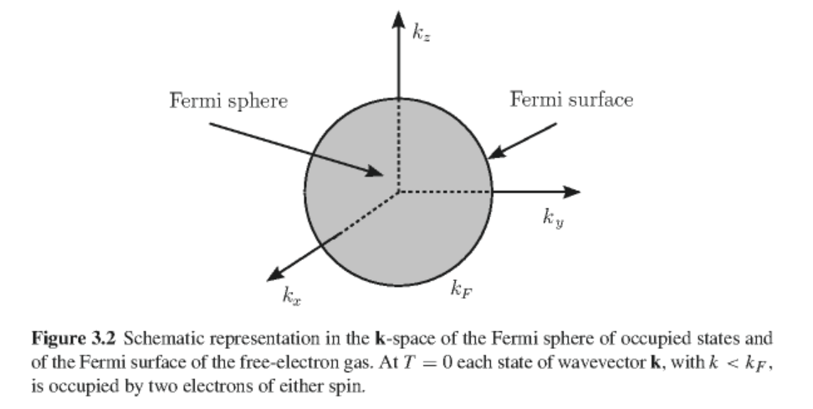
Jellium model of metals
Nuclear potential represented by a uniform background of positive charge with charge density n₀=Z/V (V representing volume per atom)
Electrons represented as independent free electrons occupying free-electron states
Figure from GGGPP

Slide 19
Calculation of the Fermi level for jellium

Slide 20
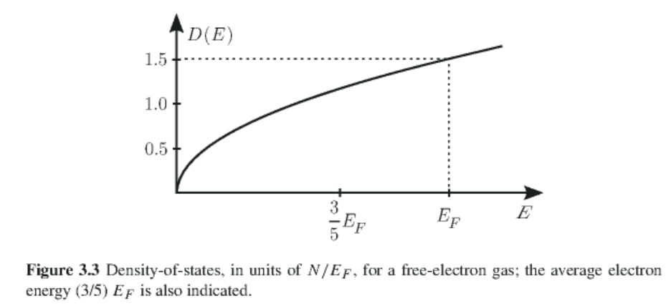
Density of states analysis of free electron gas

Slide 21
Practical modeling schemes – based on density functional theory
Kohn-Sham formulation of density functional theory
Results of self-consistent calculations
Some remaining issues
Theory for E_{exc}[n] still underdevelopment
This formalism does not access excited states
Strongly correlated electron systems are not well approximated

Slide 22
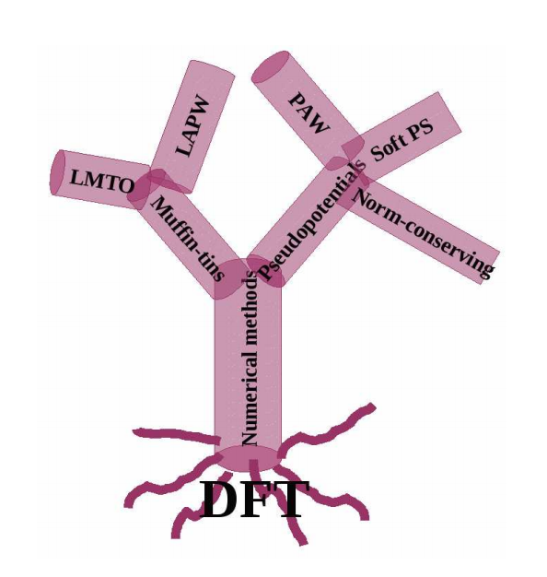
Practical solution of Kohn-Sham equations in solids

