Slide 1
PHY 752 Solid State Physics
11-11:50 AM MWF Olin 103
Plan for Lecture 21:
      X-ray and neutron diffraction in solids (Chap. 10 in GGGPP)
        Bragg law
        Intensity relationships
        Sensitivity to atomic parameters

Slide 2
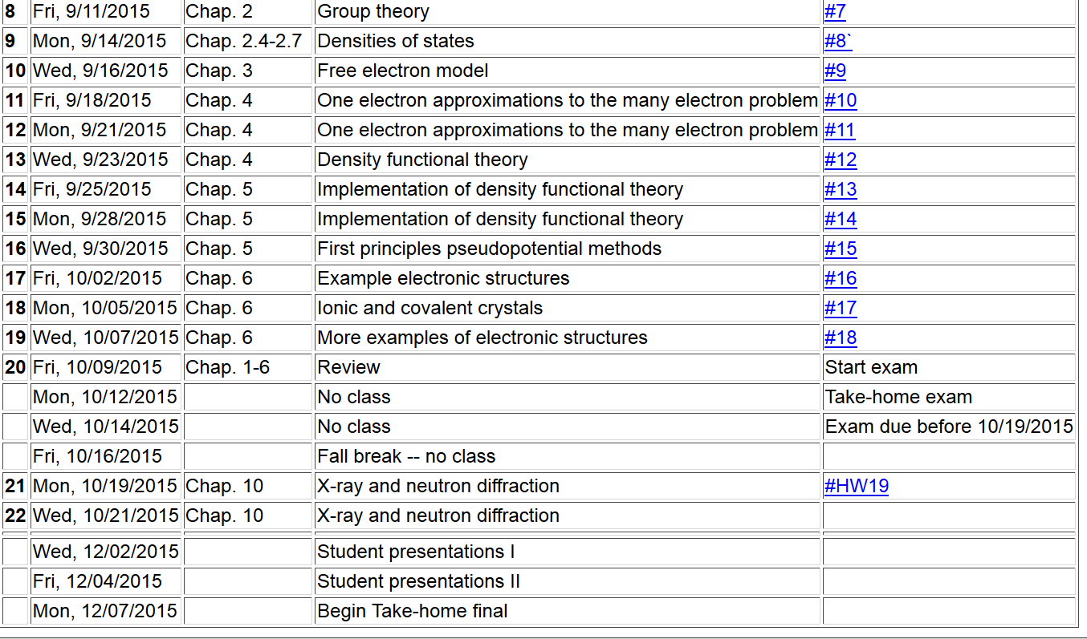

Slide 3
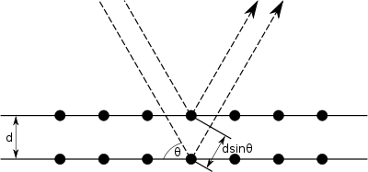
Bragg diffraction
incident beam
defracted beam
k_{scat}
In terms of wave vectors
k_{inc}
Δk
2θ

Slide 4

Relationship of normal distance between diffracting planes to Bravais lattice
a₃
a₁
a₂

Slide 5
Comes from Born approximation describing the interaction between scattering particle and material.
Intensity profile

Slide 6
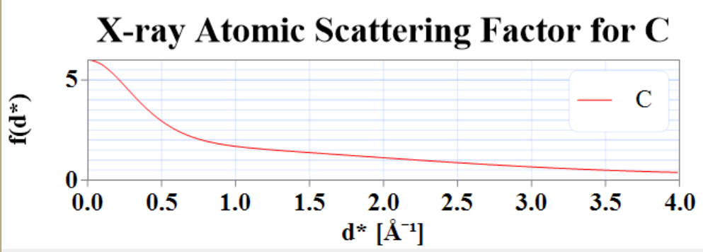
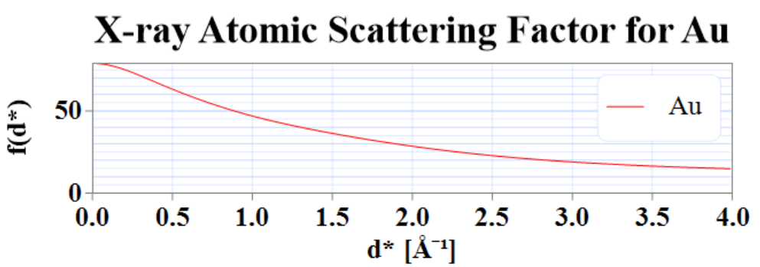
Atomic structure factors
For X-ray scattering; Fourier transform of electronic density
(these are from
crystaldiffract)

Slide 7
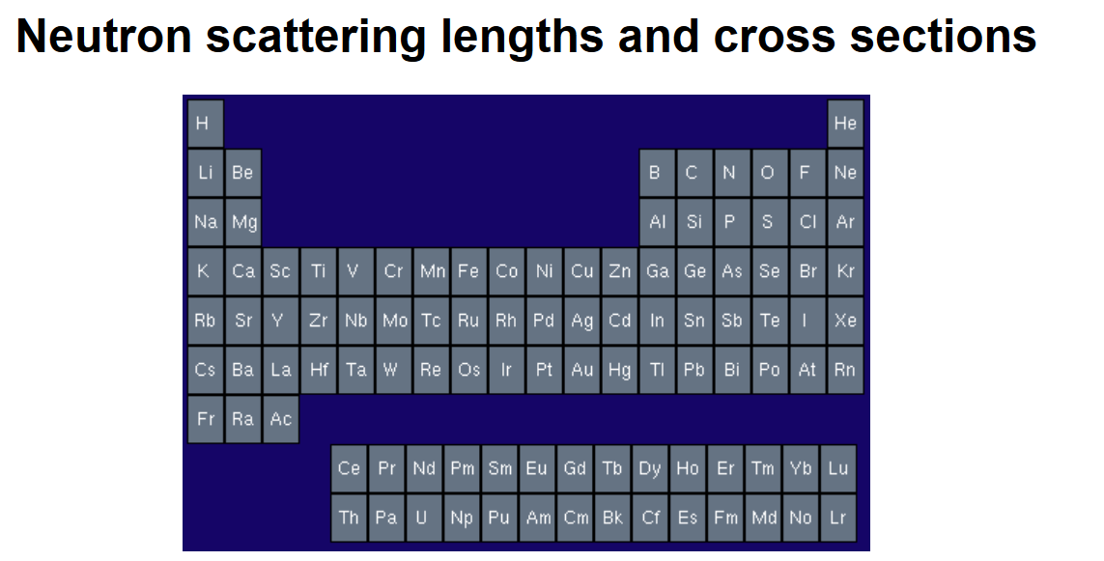
Atomic structure factors
http://www.ncnr.nist.gov/resources/n-lengths/

Slide 8
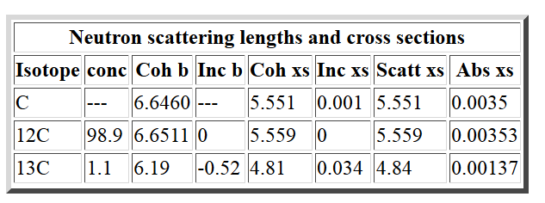
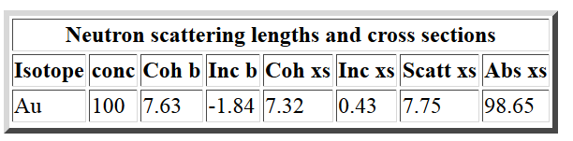
scattering length in 10⁻¹⁵ m

Slide 9
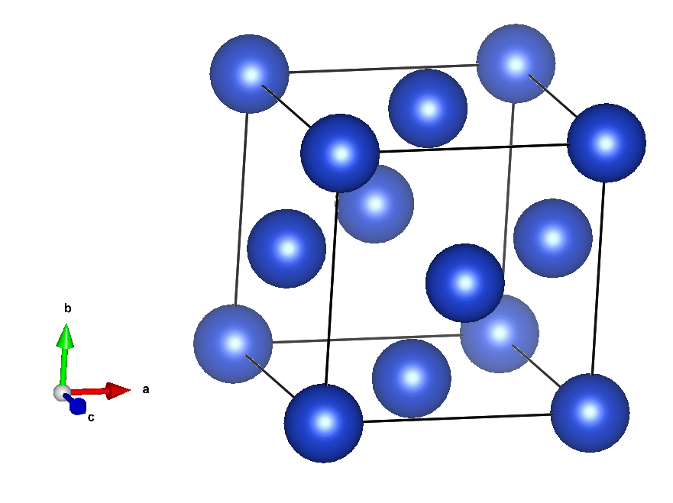
Cu (fcc)

Slide 10
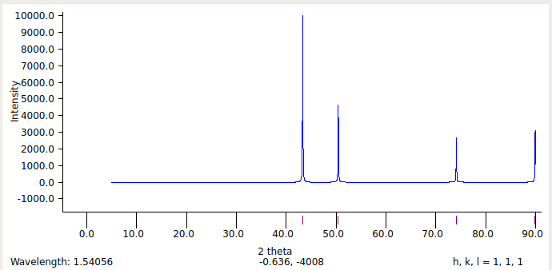

X-ray powder diffraction pattern for Cu (fcc)
what is lattice constant a?
3.615 Angstroms

Slide 11
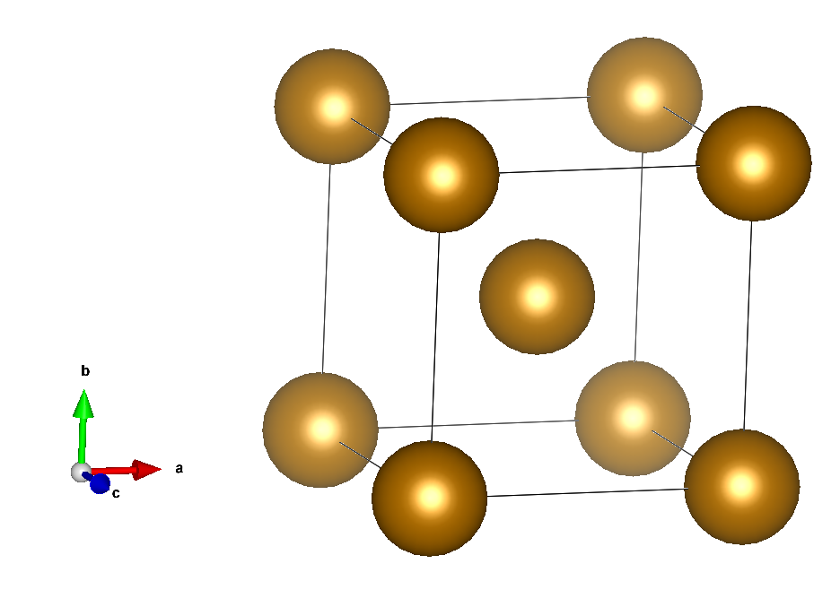
Fe (bcc)

Slide 12
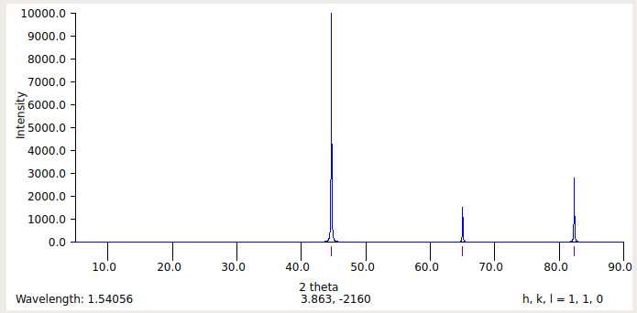

Fe (bcc)
2.8665 Angstroms
What is a ?

Slide 13
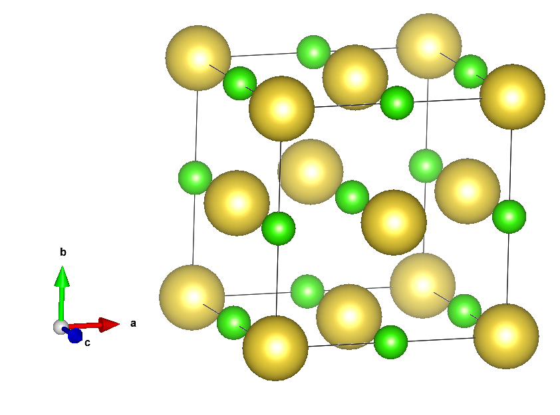
NaCl

Slide 14
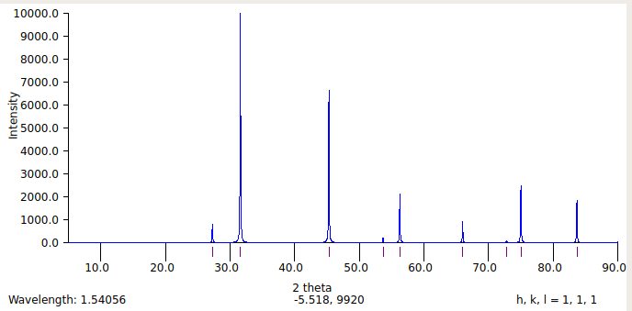
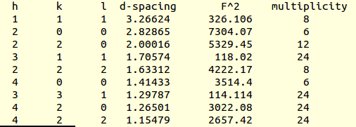
NaCl
a=5.6573 Angstroms

Slide 15
Comparison of X-ray and Neutron diffraction
time of flight
path length

Slide 16
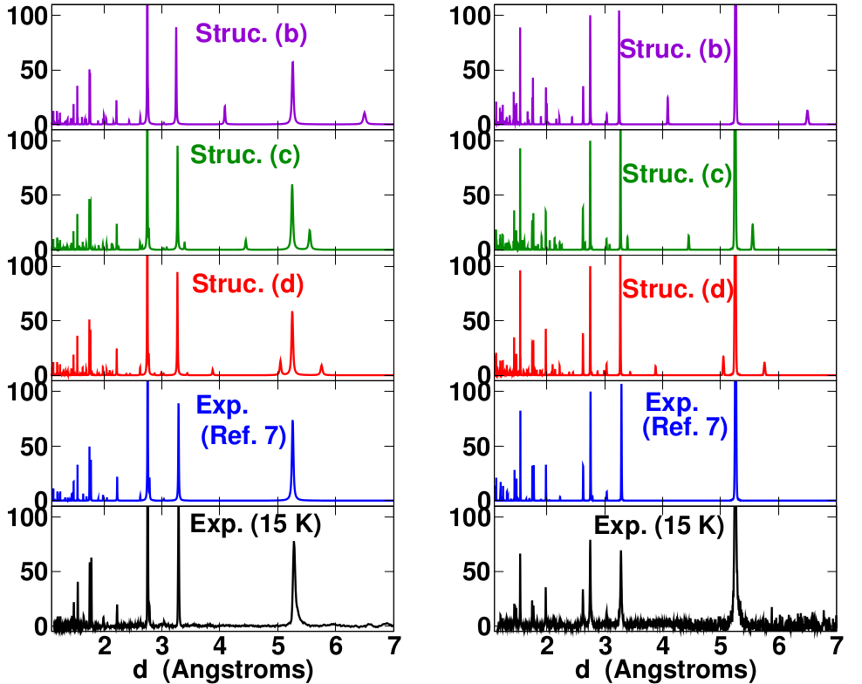
X-ray
Neutron

Slide 17
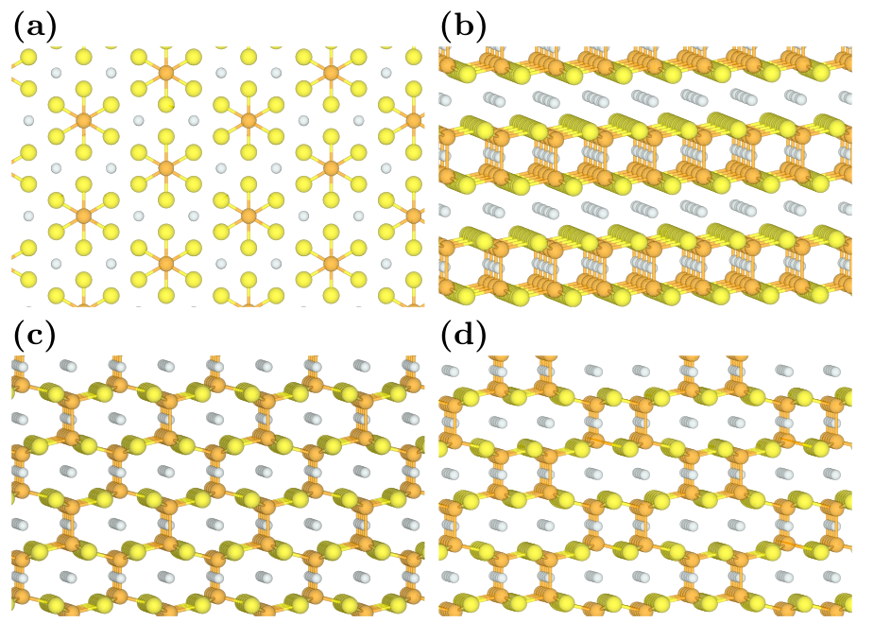

Slide 18
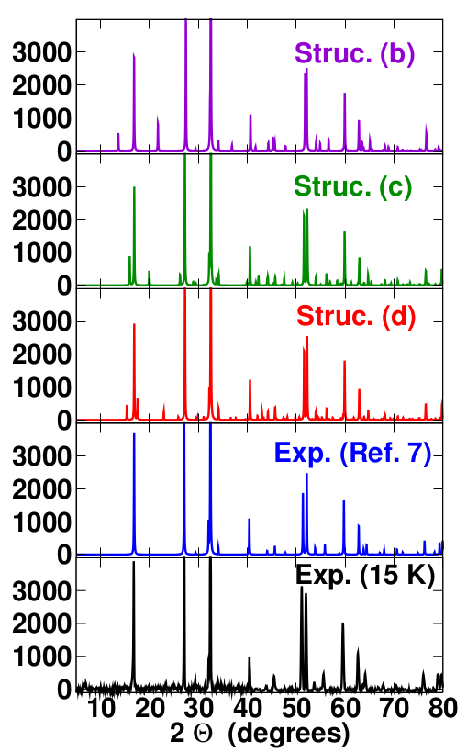
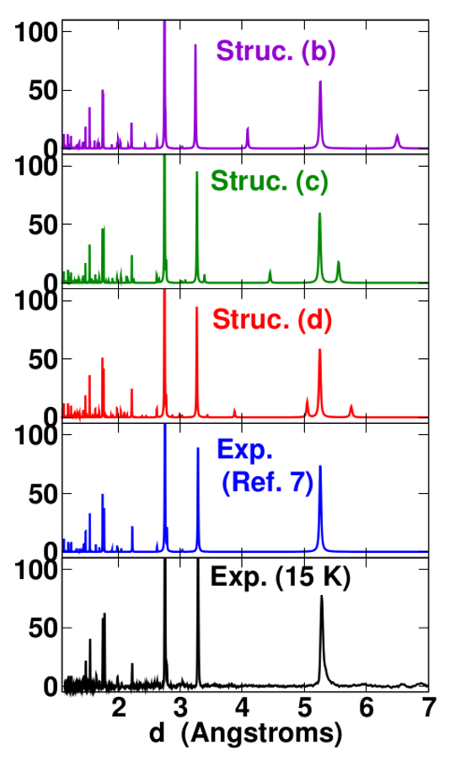
X-ray

Slide 19
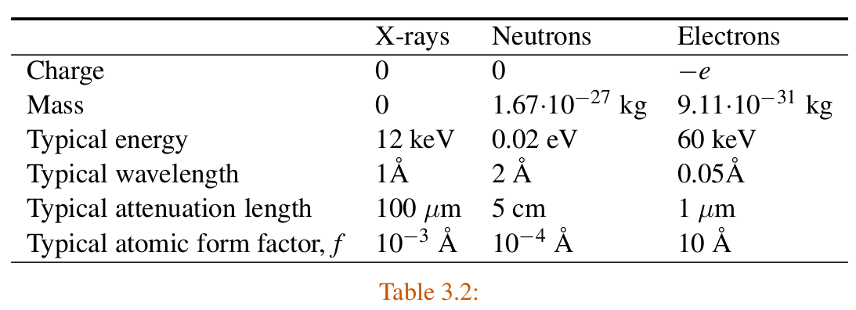
Properties of scattering particles
from pg. 61 of Marder’s text

Slide 20
