Slide 1
PHY 752 Solid State Physics
11-11:50 AM MWF Olin 103
Plan for Lecture 22:
Scattering of particles by crystals (Chap. 10 in GGGPP)
Photon scattering
Electron scattering
Neutron scattering
Effects of lattice vibrations

Slide 2
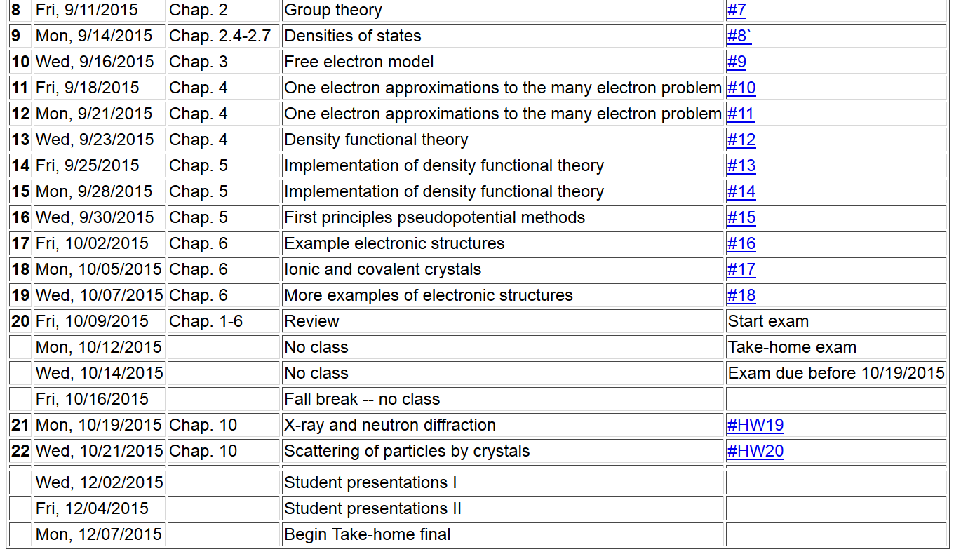

Slide 4
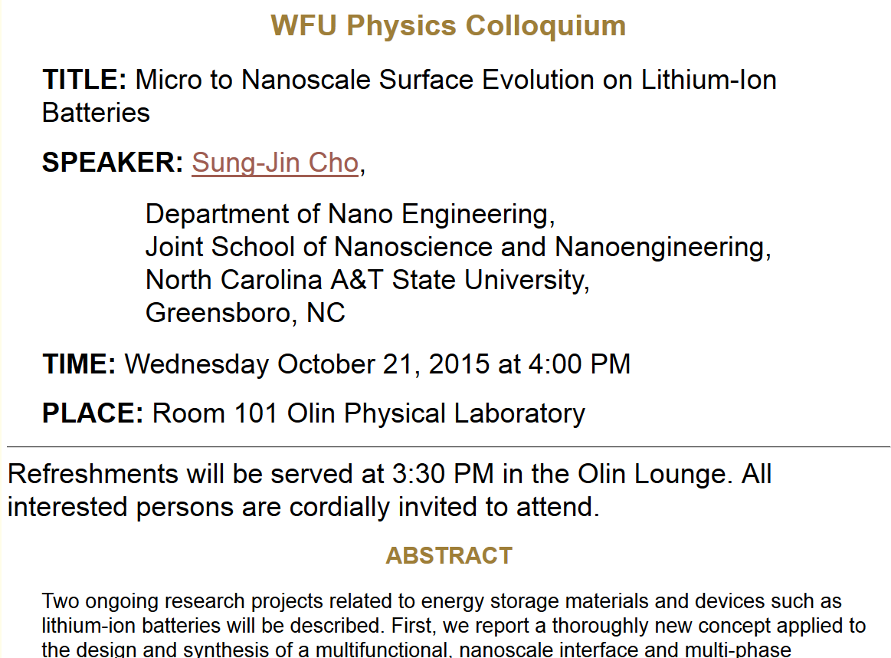

Slide 5
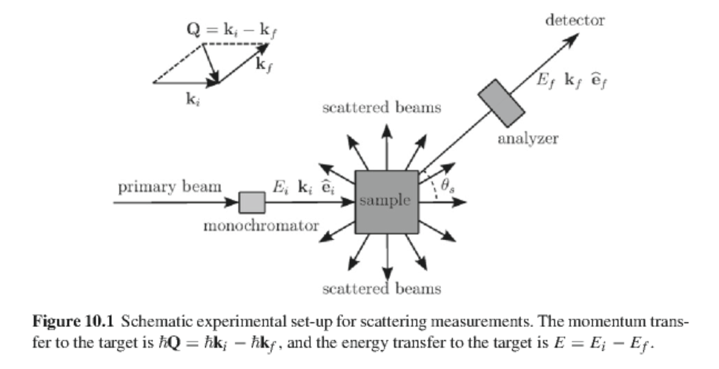
General considerations of particle scattering experiments

Slide 6
Photon scattering
Elastic scattering of X-rays proceeds primarily by Thompson scattering by “free” electrons
Consider incident electric field of X-ray:
Response by electron:

Slide 7
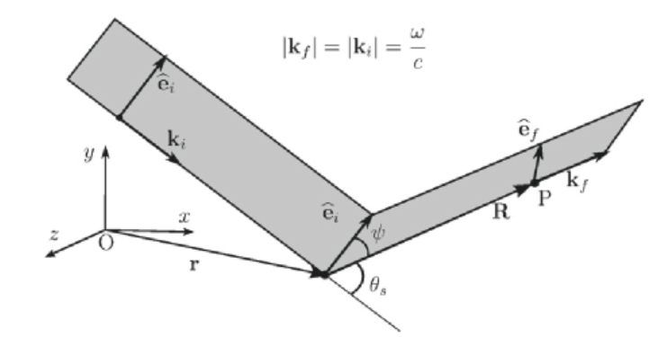
Photon scattering -- continued
Radiation by excited electron:

Slide 8
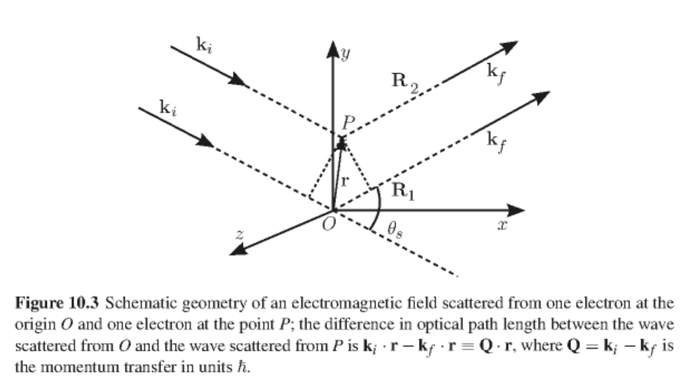
Photon scattering -- continued
Intensity of scattered
Corresponding scattering cross section averaging over polarizations of incident radiation:

Slide 9
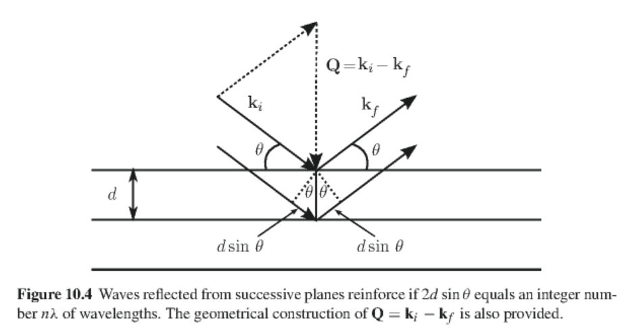
Extending analysis to scattering by many electrons characterized by electron density n_{el}(r)
For periodic system

Slide 10
Corrections to Thompson scattering –
Compton scattering – correction for electron recall
Other competing effects
Photon excitation processes
Phonons

Slide 11
Neutron scattering
Effective potential for interaction of neutron with nucleus:
neutron scattering length
Probability of neutron interaction with nuclei at positions R_{m}:
In terms of scattering cross section:
=

Slide 12
Neutron scattering --- continued
Some details –
Effects of lattice vibrations
Zero phonon contributions; elastic scattering
Debye-Waller factor

Slide 13
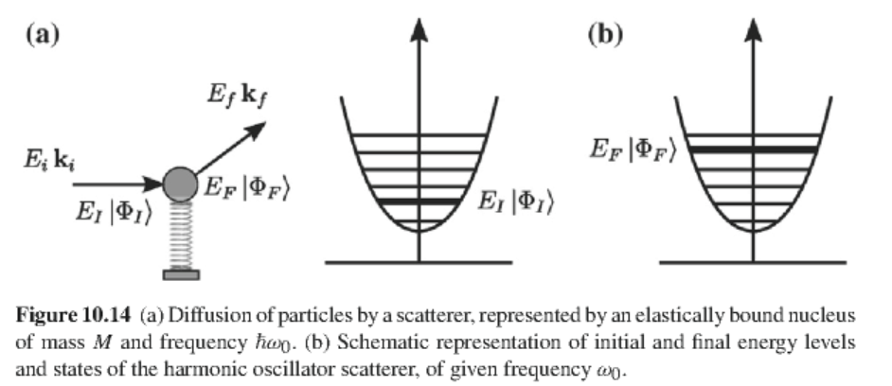
Digression on analysis of thermal averages of lattice vibrations (Appendix A of Chapter 9 in GGGPP)

Slide 14
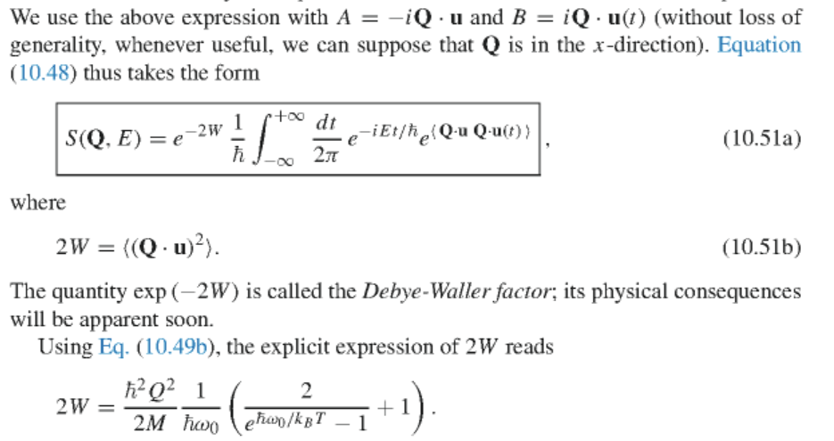
Convenient identity:

Slide 15
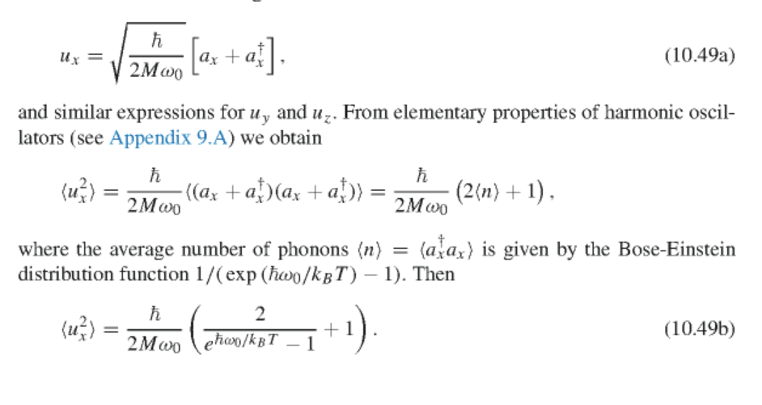
Some steps:

Slide 16
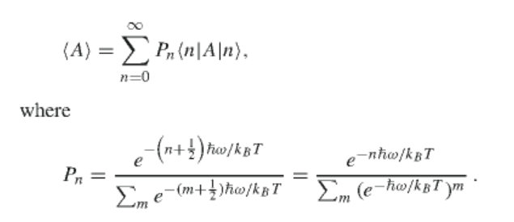
Averaging over lattice vibrations at constant T:
Some clever tricks:

Slide 17
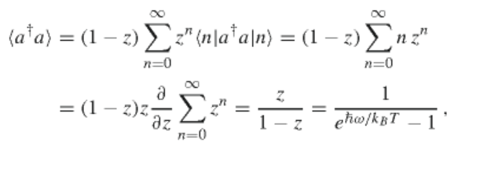
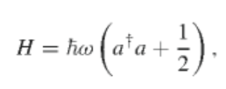
Example:
Harmonic oscillator operators:
Eigenstates:

