Slide 1
PHY 752 Solid State Physics
11-11:50 AM MWF Olin 103
Plan for Lecture 23:
Optical and transport properties of metals (Chap. 11 in GGGPP)
Macroscopic theory
Drude model
Note: Debye-Waller discussion postponed
to consideration of Chapter 9.

Slide 2
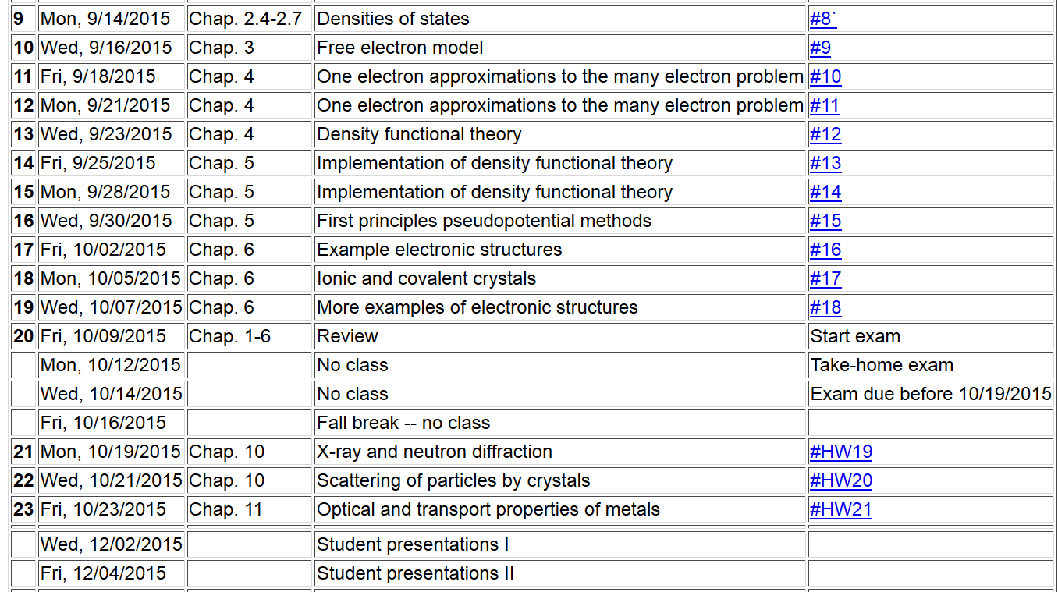

Slide 3
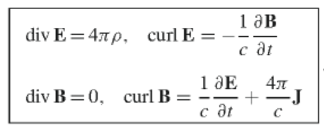
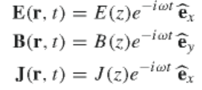
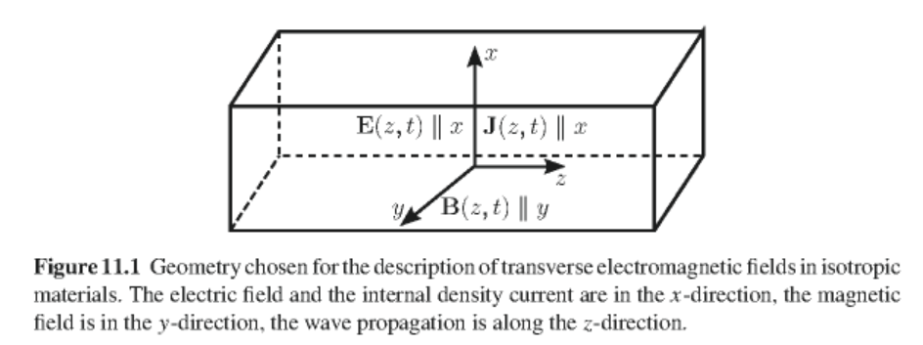
Maxwell’s Equations (cgs Gaussian units)

Slide 4
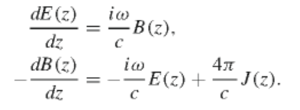
Assume linear response of the electric field to produce the conductivity in terms of conductivity:
For our geometry:
with:

Slide 5
Taking Fourier transform in space and time:
For spatially uniform conductivity response, the q-dependence is trivial:
For

Slide 6
Writing complex refractive index in terms of real functions
N(ω)=n(ω)+ik(ω)

Slide 7
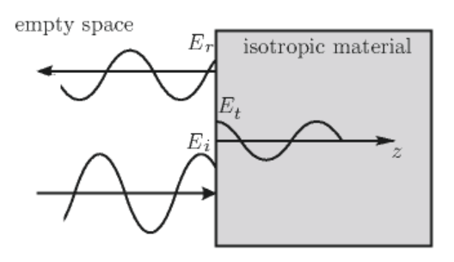
In terms of complex conductivity:
Reflection of electromagnetic wave at a planar interface at normal interface
N(ω)

Slide 8
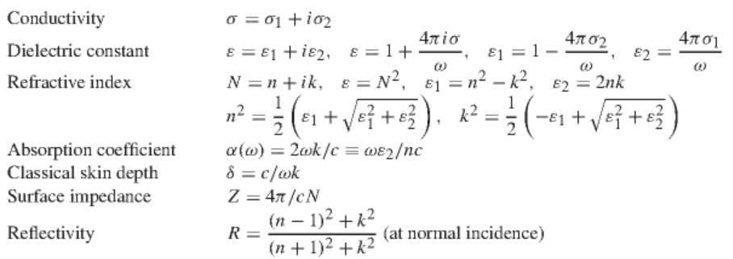
Reflectivity:
Summary of relationships

Slide 9
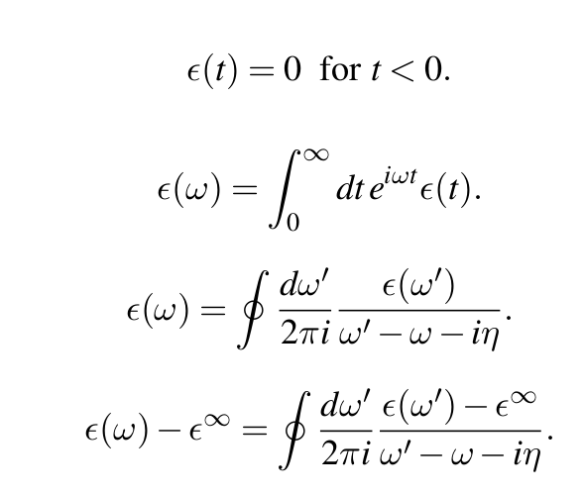
Analytic properties of dielectric function
Here η represents a small infinitesimal imaginary contribution

Slide 10
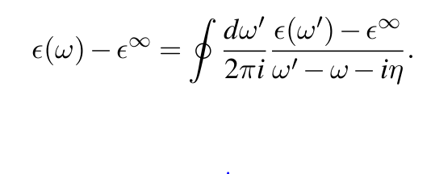
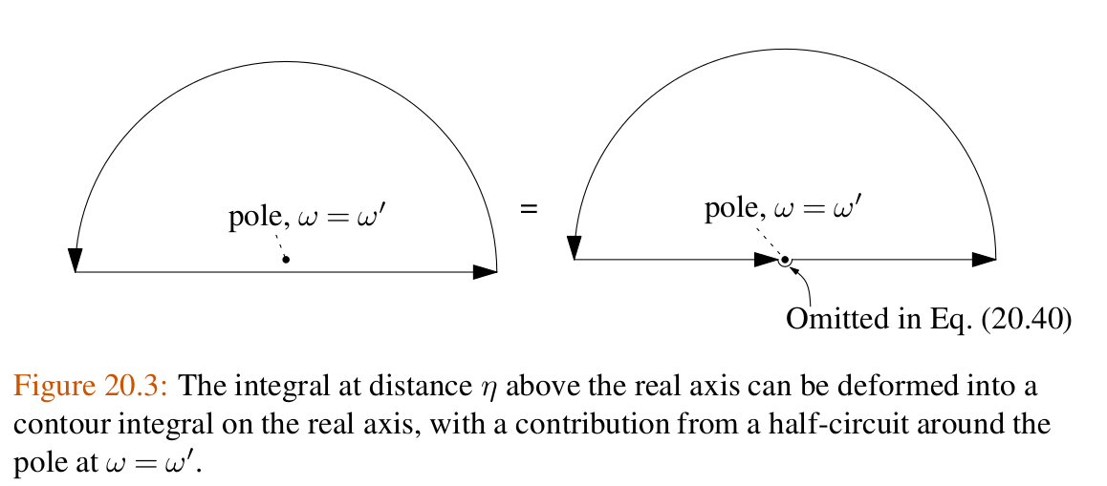
Evaluation using Cauchy integral theorem

Slide 11
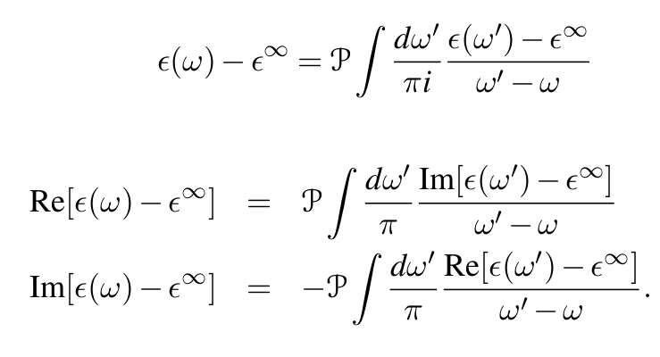
In terms of principle parts integral over negative and positive frequencies

Slide 12
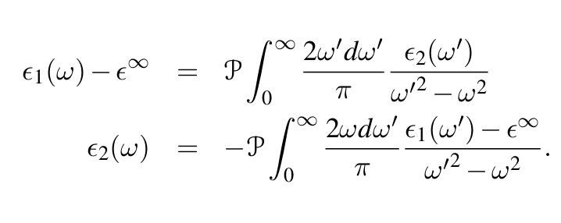
In terms of positive frequencies only

Slide 13
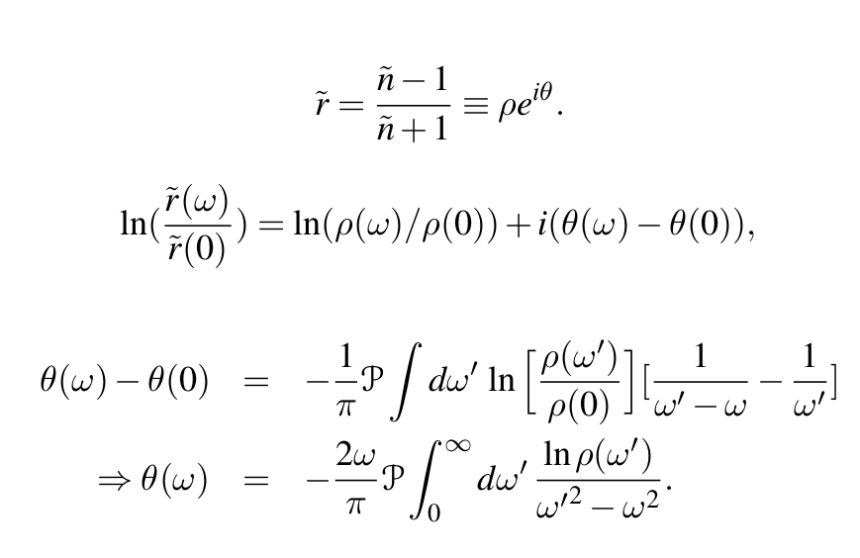
Analysis of reflectivity data

Slide 14
Some more detailed notes:
Analytic properties of the dielectric function (in the Drude model or from “first principles” -- Kramers-Kronig transform
Im(z)
α
Re(z)

Slide 15
Kramers-Kronig transform -- continued
Im(z)
α
Re(z)
=0

Slide 16
Kramers-Kronig transform -- continued

Slide 17
u
a u_{s} b

Slide 18
Kramers-Kronig transform -- continued
To be justified from Drude model --

Slide 19
Kramers-Kronig transform – for dielectric function:

Slide 20
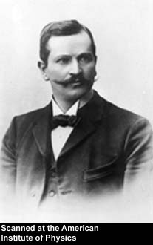
Paul Karl Ludwig Drude 1863-1906
http://photos.aip.org/history/Thumbnails/drude_paul_a1.jpg

Slide 21
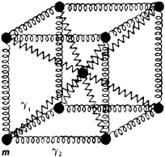
Drude model:
Vibrations of charged particles near equilibrium:
δr
http://img.tfd.com/ggse/d6/gsed_0001_0012_0_img2972.png

Slide 22
Drude model:
Vibration of particle of charge q and mass m near equilibrium:
δr
http://img.tfd.com/ggse/d6/gsed_0001_0012_0_img2972.png
Note that:
γ > 0 represents dissipation of energy.
ω₀ represents the natural frequency of the vibration; ω₀=0 would represent a free (unbound) particle

Slide 23
Drude model:
Vibration of particle of charge q and mass m near equilibrium:
δr
http://img.tfd.com/ggse/d6/gsed_0001_0012_0_img2972.png

Slide 24
Drude model:
Vibration of particle of charge q and mass m near equilibrium:
δr
http://img.tfd.com/ggse/d6/gsed_0001_0012_0_img2972.png

Slide 25
Drude model:
Vibration of particle of charge q and mass m near equilibrium:
δr
http://img.tfd.com/ggse/d6/gsed_0001_0012_0_img2972.png

Slide 26
Drude model dielectric function:

Slide 27
Drude model dielectric function:

Slide 28
Drude model dielectric function – some analytic properties:

Slide 29
Drude model dielectric function – some analytic properties:

Slide 30
Analysis for Drude model dielectric function:

Slide 31
Analysis for Drude model dielectric function – continued --
Analytic properties:

