Slide 1
PHY 752 Solid State Physics
11-11:50 AM MWF Olin 103
Plan for Lecture 24:
Optical and transport properties of metals (Chap. 11 in GGGPP)
Drude model for metals
Boltzmann treatment of transport in metals

Slide 2
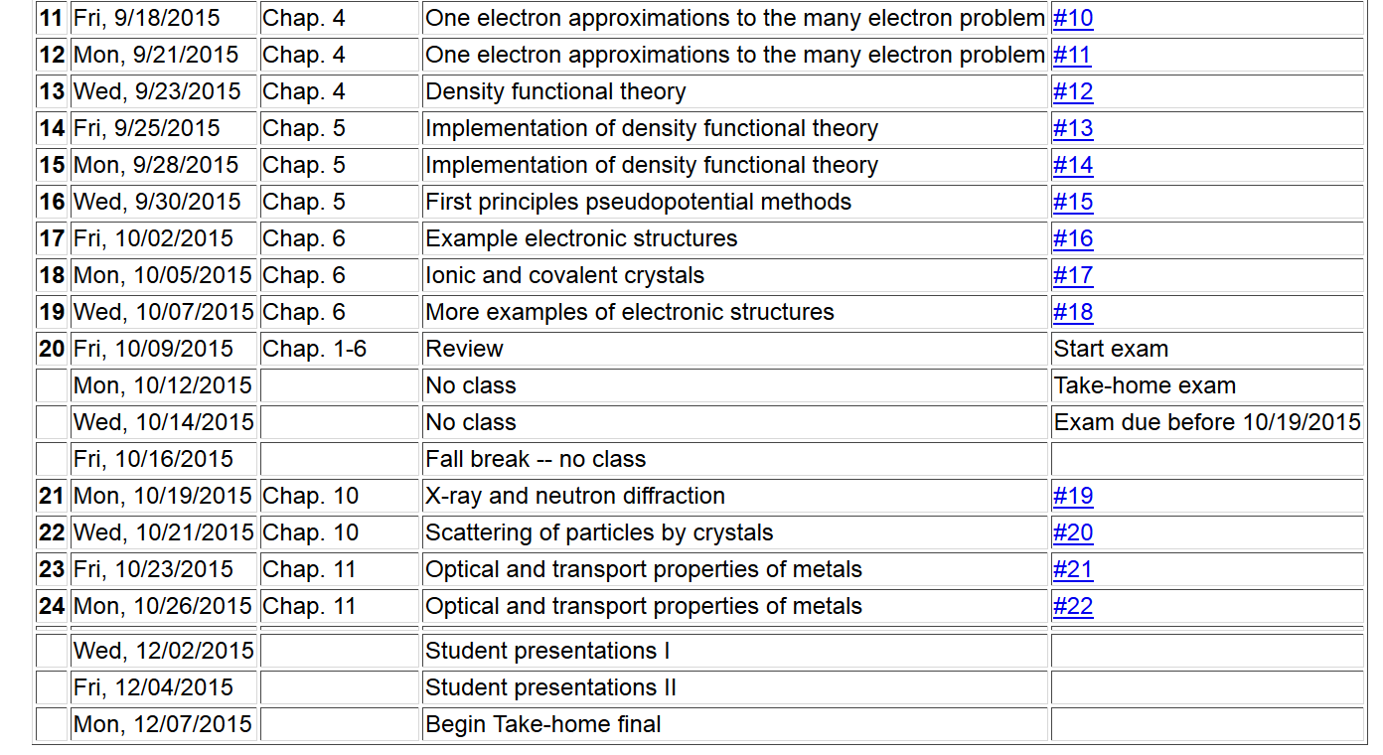

Slide 3
Drude model for free electrons in the presence of a harmonic uniform electric field:
electron density

Slide 4
Drude model for free electrons -- continued

Slide 5
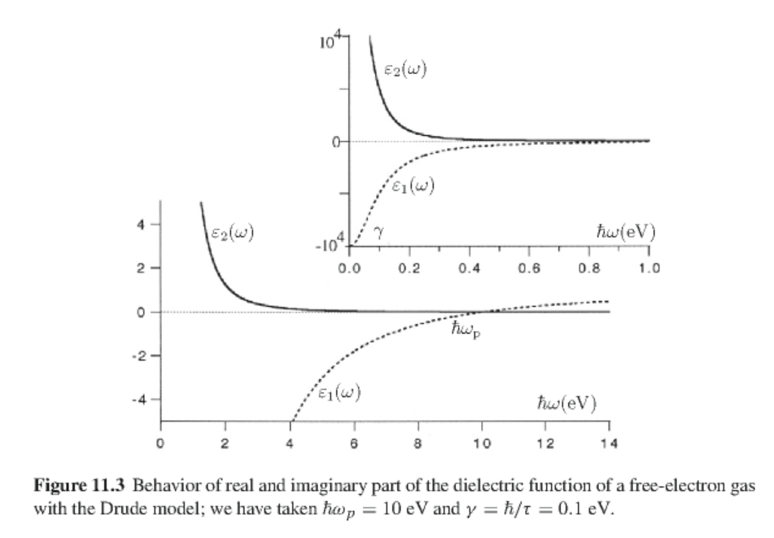

Slide 7
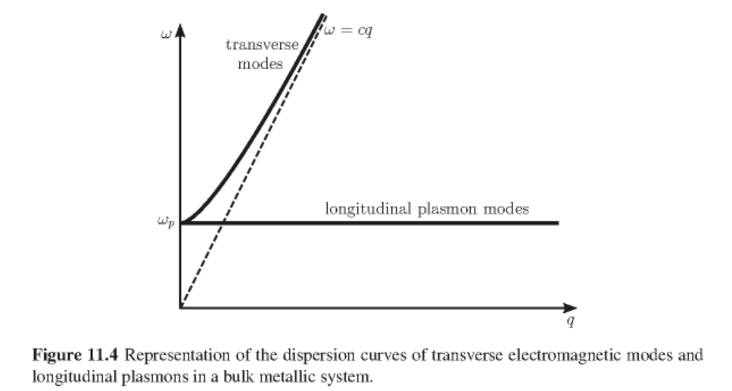

Slide 8
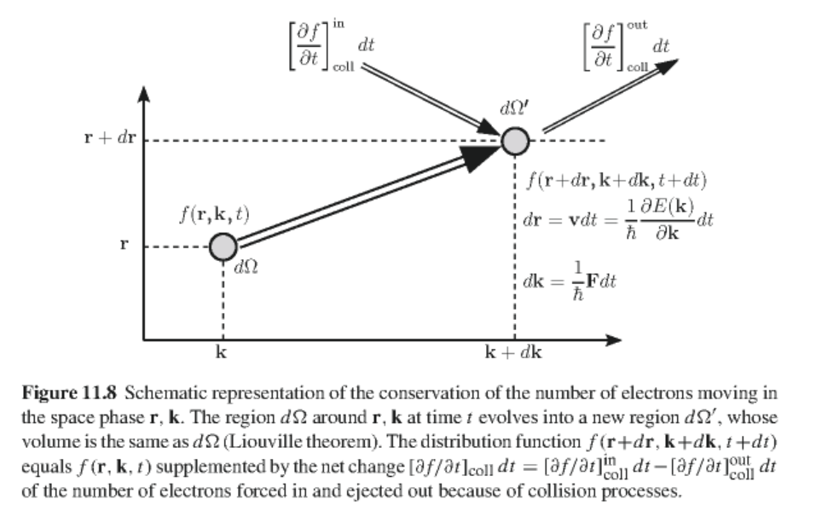
More accurate treatment using the Boltzmann Equation

Slide 9
Determining physical quantities in terms from the distribution function
Current charge density:
Energy density:

Slide 10
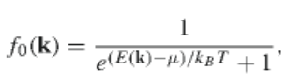
with:
Equilibrium distribution:
Boltzmann equation:

Slide 11
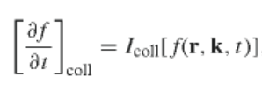
Evaluating the collision term:
Relaxation time approximation:

Slide 12
Solution of the Boltzmann equation in the relaxation time approximation:
For F=0 and =0:

Slide 13
Static conductivity for uniform material
Bolzmann equation
-eE
assumed 0
assumed 0

Slide 14
Static conductivity for uniform material – continued:
For isotropic case ( J parallel to E)

Slide 15
Mean free path
For the parabolic band:

Slide 16
Frequency and wavevector dependent conductivity of a uniform material -- linear approximation
assume:

Slide 17
Frequency and wavevector dependent conductivity of a uniform material -- linear approximation -- continued

Slide 18
Frequency and wavevector dependent conductivity of a uniform material -- linear approximation -- continued
After some algebra:

