Slide 1
PHY 752 Solid State Physics
11-11:50 AM MWF Olin 103
Plan for Lecture 25:
Optical and transport properties of metals (Chap. 11 in GGGPP)
Boltzmann treatment of electrical transport in metals
Thermal transport

Slide 2
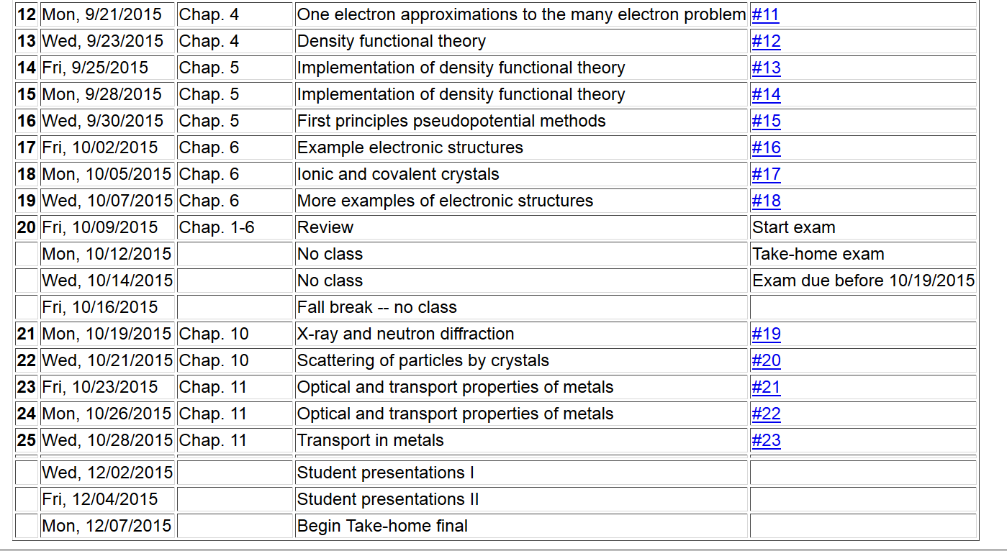

Slide 4
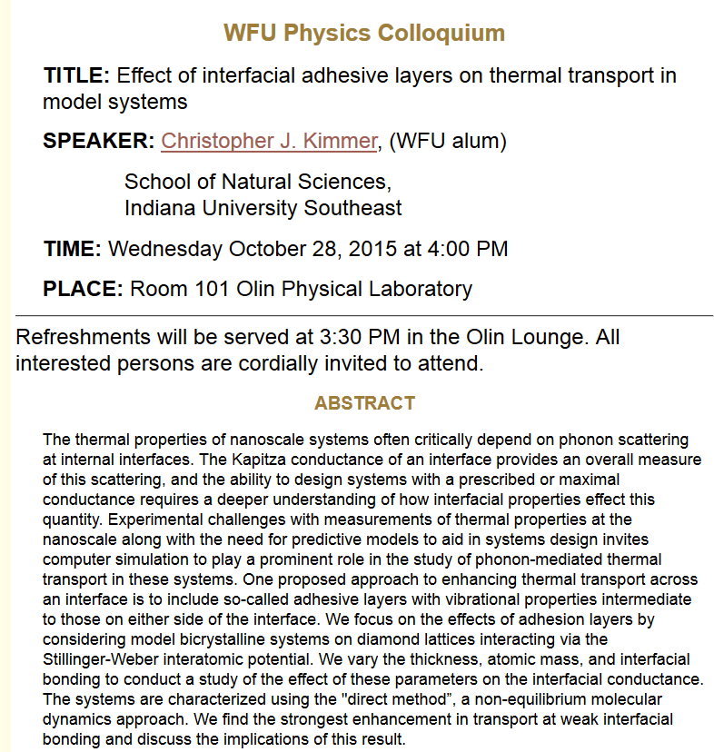

Slide 5
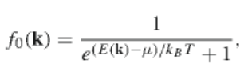
Boltzmann distribution function:
f(r,k,t)
Number of electrons per phase space volume at the phase space point r, k, and time t
Equilibrium distribution:
Assumed isothermal conditions at temperature T.

Slide 6
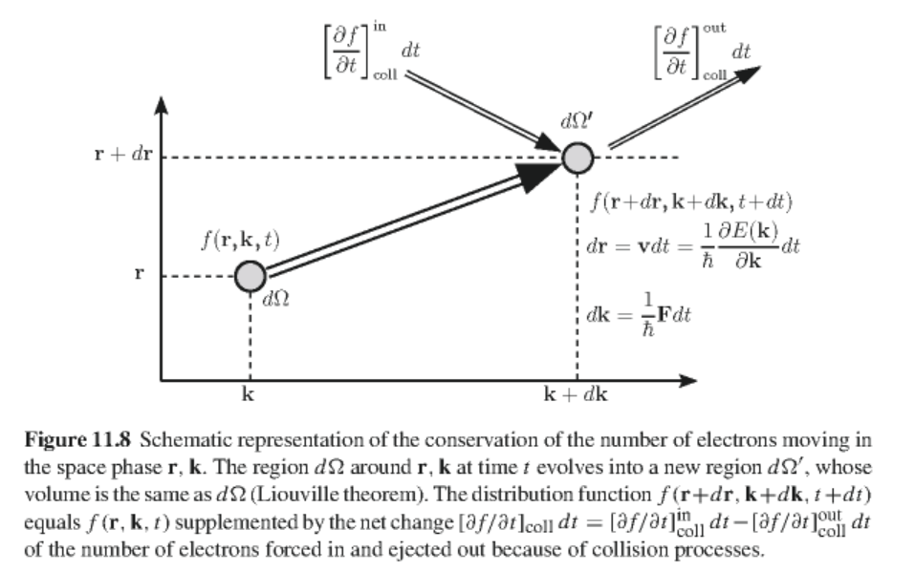
Two-body collision in Boltzmann equation

Slide 7
Determining physical quantities in terms from the distribution function
Current charge density:
Energy density:

Slide 8
with:
Equilibrium distribution:
Boltzmann equation:

Slide 9
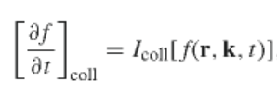
Evaluating the collision term:
Relaxation time approximation:

Slide 10
Solution of the Boltzmann equation in the relaxation time approximation:
For F=0 and =0:

Slide 11
Static conductivity for uniform material
Bolzmann equation
-eE
assumed 0
assumed 0

Slide 12
Static conductivity for uniform material – continued:
For isotropic case ( J parallel to E)

Slide 13
Mean free path
For the parabolic band:

Slide 14
Frequency and wavevector dependent conductivity of a uniform material -- linear approximation
assume:

Slide 15
Frequency and wavevector dependent conductivity of a uniform material -- linear approximation -- continued

Slide 16
Frequency and wavevector dependent conductivity of a uniform material -- linear approximation -- continued
After some algebra:

Slide 18
Transport in presence of spatially varying temperature T(r)
Spatially varying temperature
Spatially varying chemical potential

Slide 19
First order solution:

Slide 20
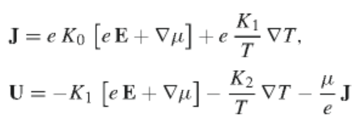
Evaluation of integrals for the isotropic case:
where
Electric field direction

Slide 21
Regrouping terms:
Seebeck coefficient

Slide 22
Expression for the power dissipated
Energy flux
Electron thermal conductivity

Slide 23
Evaluation of expression for various configurations
Isothermal conditions
(here E_{F}=μ)

Slide 24
Effects of thermal gradients
Assume open circuit conditions J=0

Slide 25
