Slide 1
PHY 752 Solid State Physics
11-11:50 AM MWF Olin 103
Plan for Lecture 26:
Optical properties of semiconductors and insulators (Chap. 12 in GGGPP)
Dielectric function
Band-to-band optical transitions

Slide 2
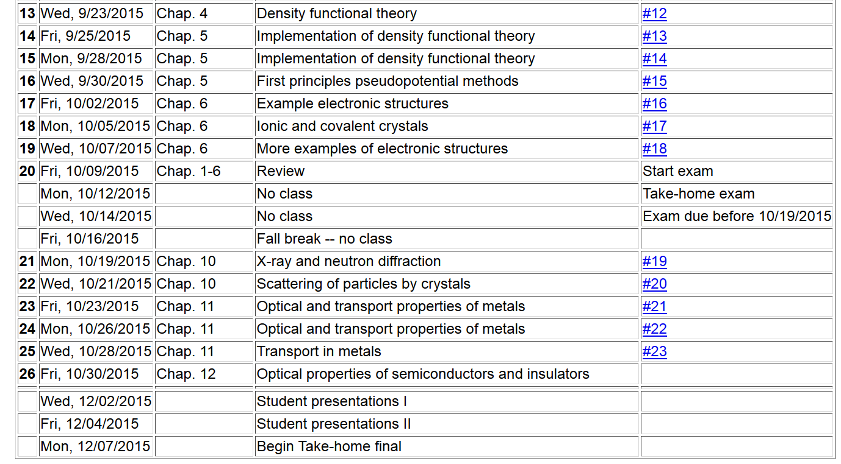

Slide 3
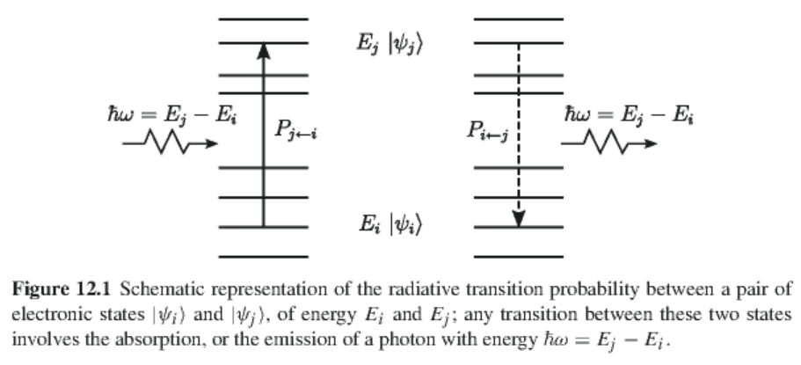
Optical transitions between states of a quantum system

Slide 4
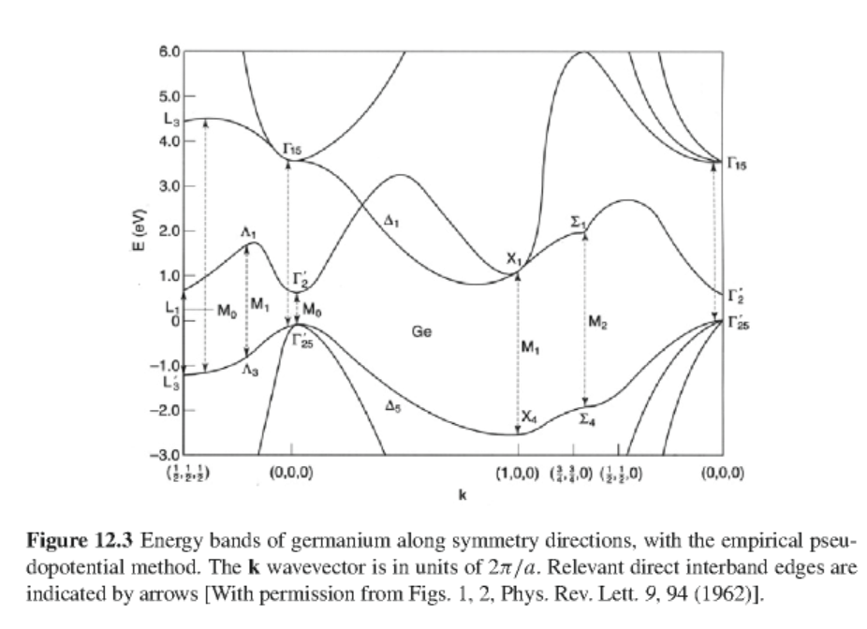
Example -- Ge
unoccupied
occupied

Slide 5
Analysis
Ground state Hamiltonian
Hamiltonian with electromagnetic field
Including linear terms in electromagnetic field

Slide 6
Fermi Golden Rule for one-photon absorption
Fermi Golden Rule for one-photon emission
Transition rate

Slide 7
Viewing transition rate in terms of the system’s linear response to the electromagnetic field, it can be related to the dielectric function:
Explicitly:
Using the Kramers-Kronig transform:

Slide 8
Complex dielectric function
with
Explicit form:

Slide 9
Details of optical transitions
Effects of wavevector
Non-trivial matrix element when

Slide 10
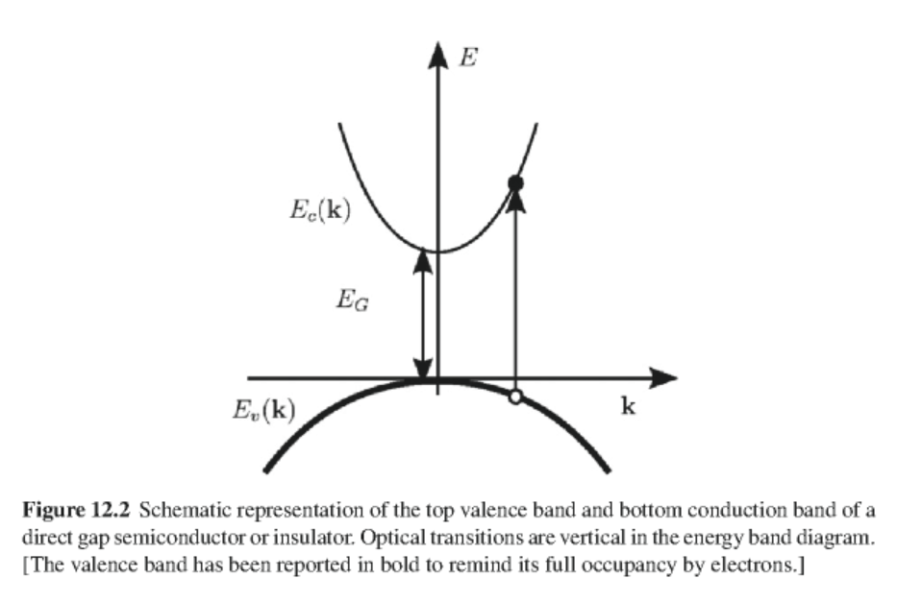

Slide 11
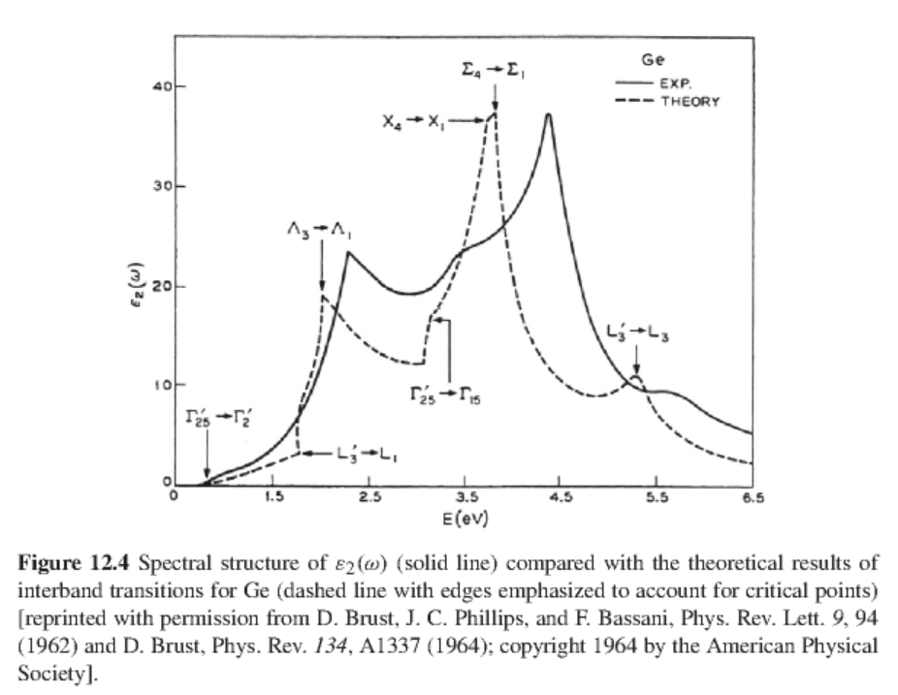
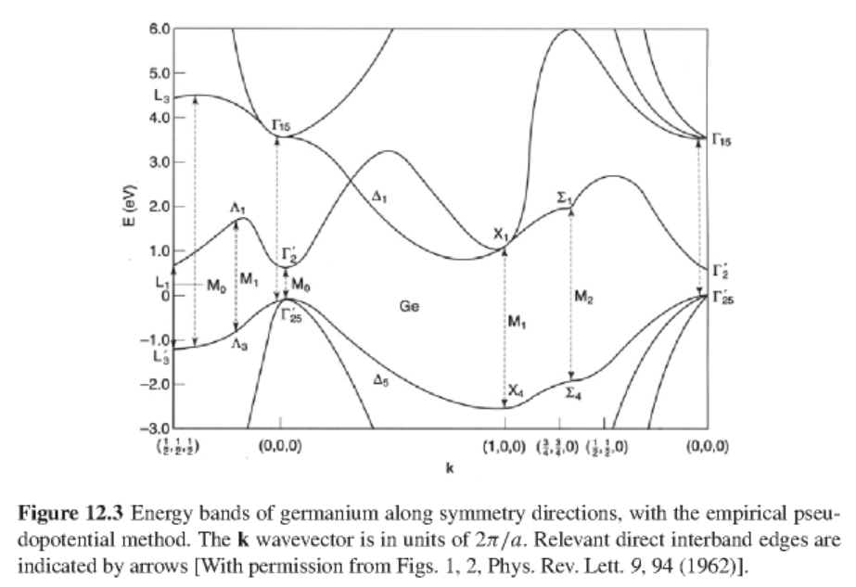
In general the matrix element M_{cv}(k) is a smooth function of k and the joint density of states often determines the frequency dependence of the optical properties:

Slide 12
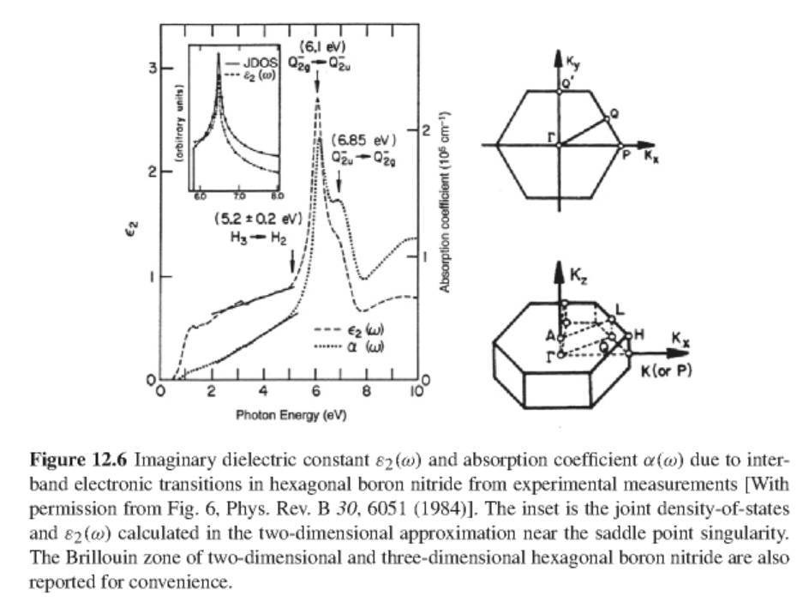
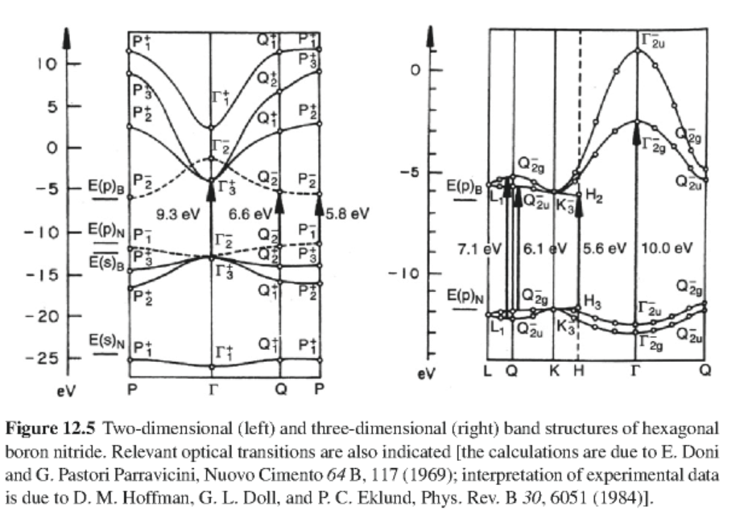
Another example – BN in the hexagonal structure

Slide 13
Example – simple two-band semiconductor

Slide 14
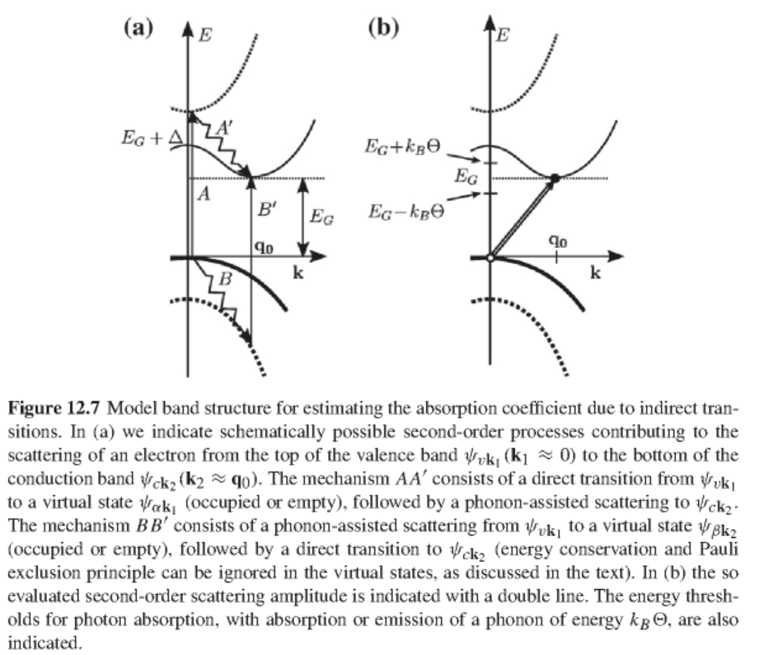
Non-vertical transitions – effects of phonons

Slide 15
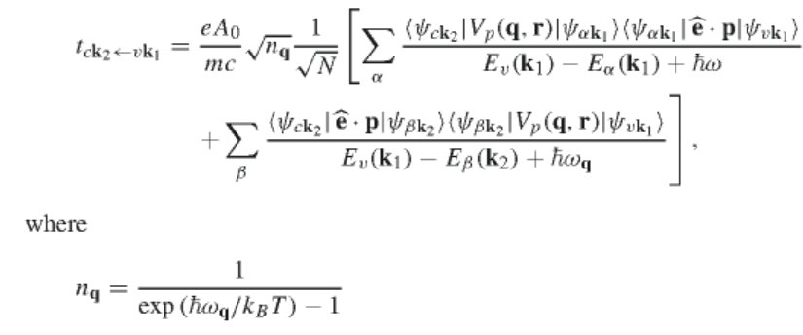
Electron-phonon coupling Hamiltonian
Probability of absorbing both photon and phonon:

Slide 16
Summing the probability over all initial and final states and assuming that the matrix elements are weakly dependent on wavevector, the rate of phonon-assisted transitions depends on the density of states for phonon absorption:
where
For parabolic valence and conduction bands:

Slide 17
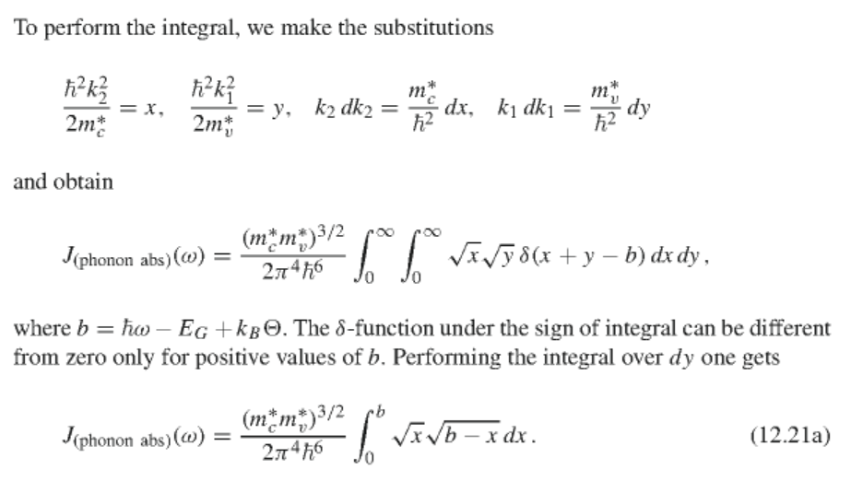

Slide 18
Similar expression holds for phonon emission
Form of optical absorption coefficient with both phonon absorption and emission:

Slide 19
