Slide 1
PHY 752 Solid State Physics
11-11:50 AM MWF Olin 103
Plan for Lecture 27:
Optical properties of semiconductors and insulators (Chap. 7 & 12 in GGGPP)
Excitons

Slide 2
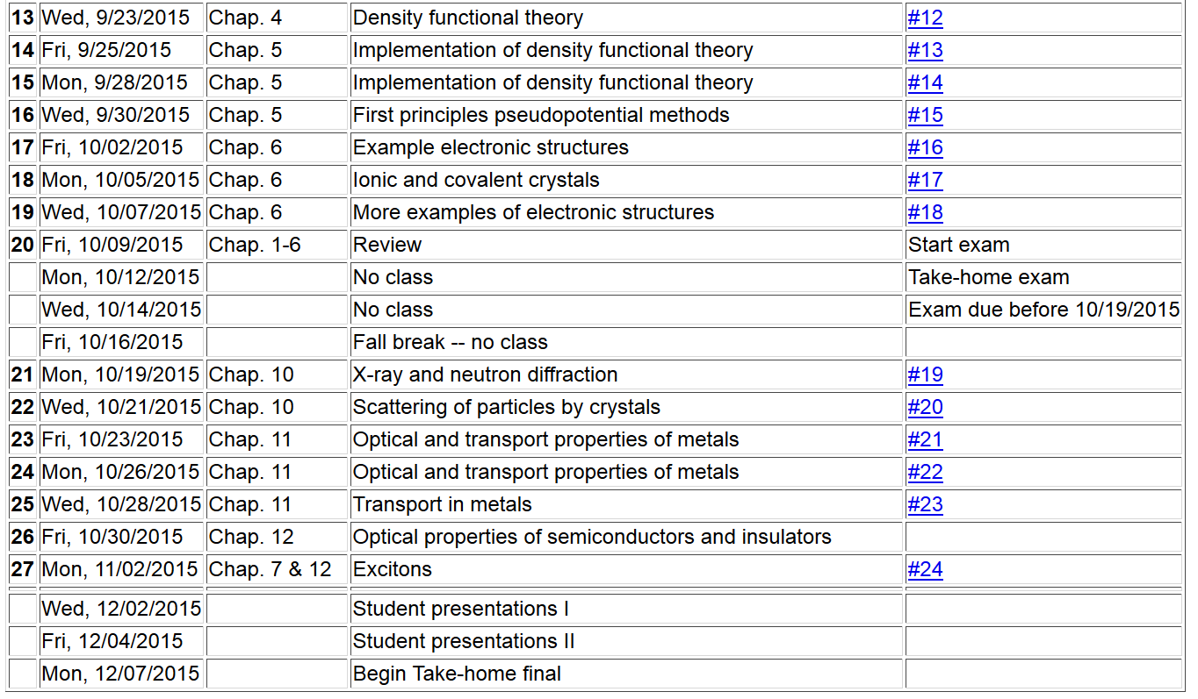

Slide 3
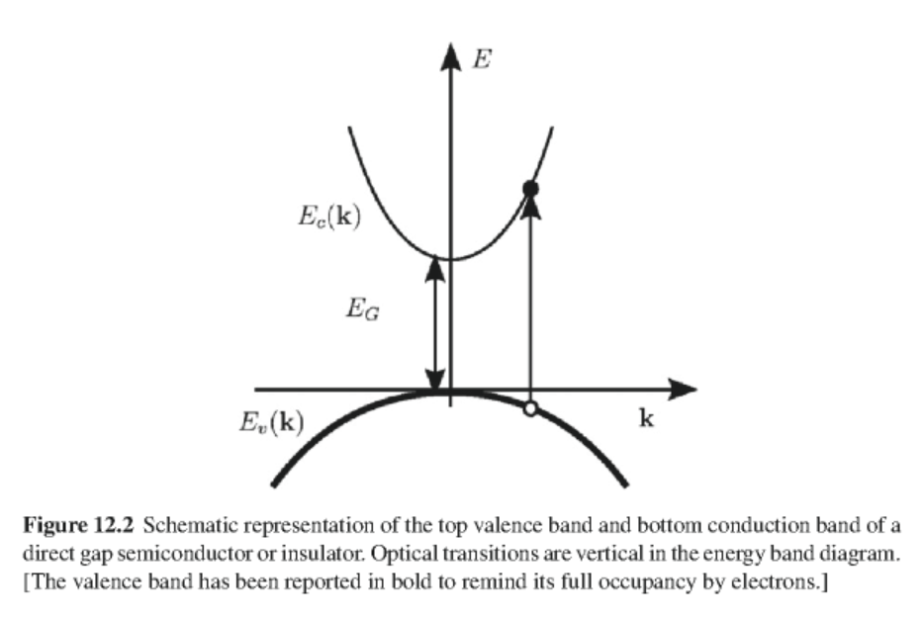
Interband transitions

Slide 4
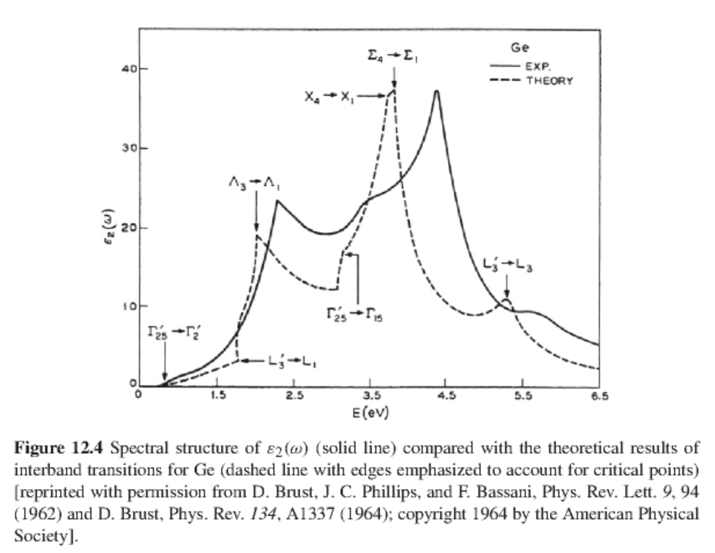
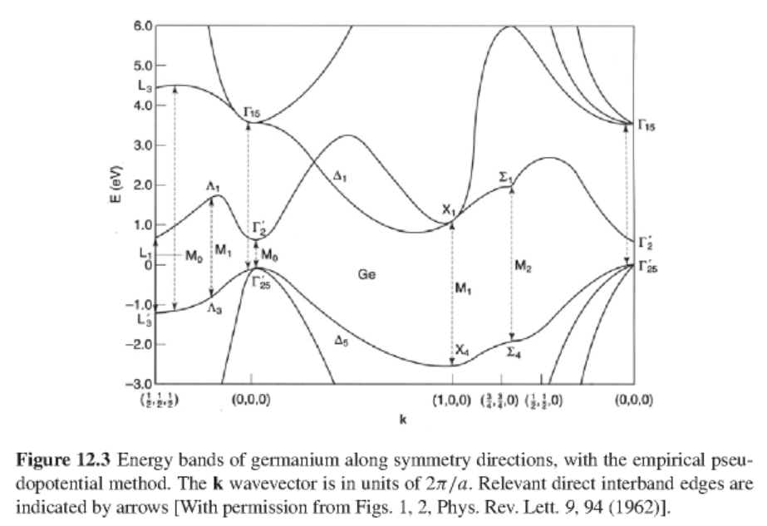
In general the matrix element M_{cv}(k) is a smooth function of k and the joint density of states often determines the frequency dependence of the optical properties:

Slide 5
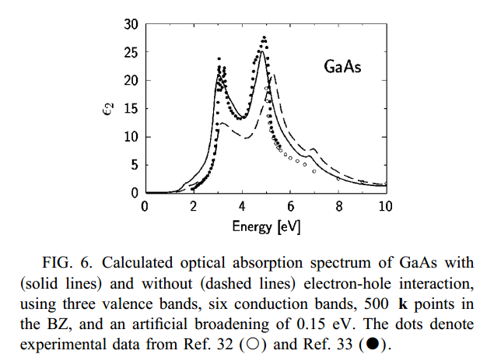
Real spectra and more complete analysis
From Michael Rohlfing and Steven Louie, PRB 62 4927 (2000)

Slide 6
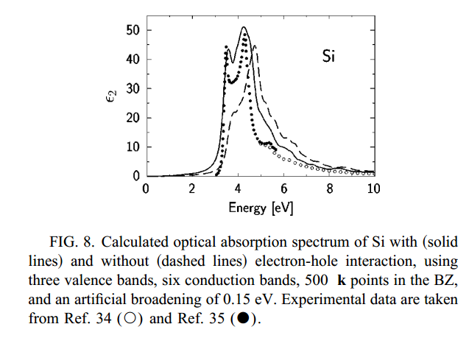
Real spectra and more complete analysis
From Michael Rohlfing and Steven Louie, PRB 62 4927 (2000)

Slide 7
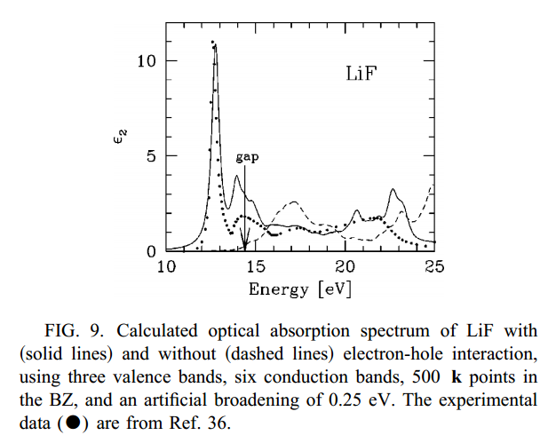
Real spectra and more complete analysis
From Michael Rohlfing and Steven Louie, PRB 62 4927 (2000)

Slide 8
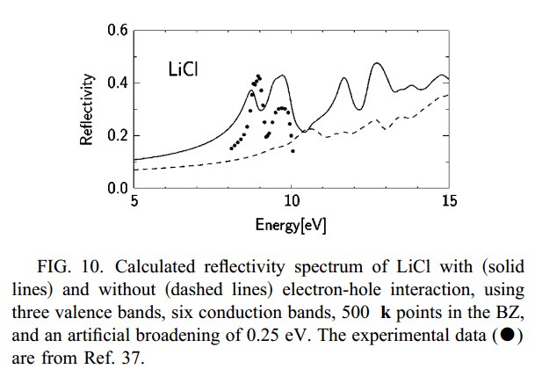
Real spectra and more complete analysis
From Michael Rohlfing and Steven Louie, PRB 62 4927 (2000)

Slide 9
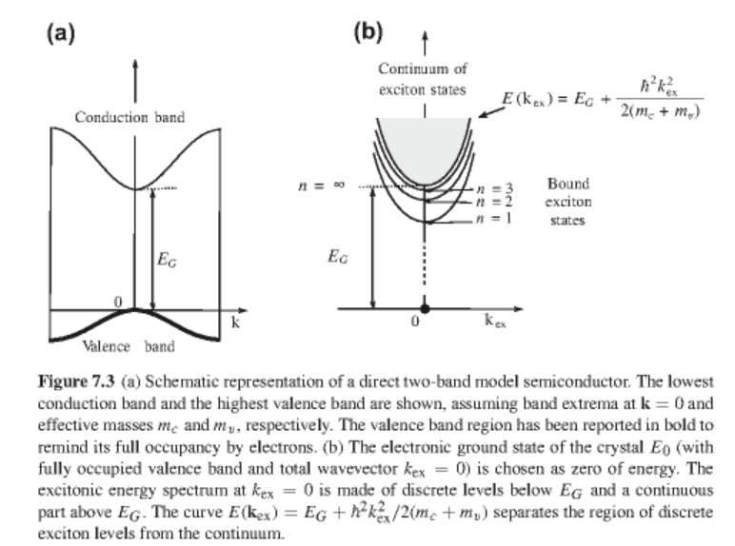
Simple treatment of exciton effects in a two-band model

Slide 10
Electronic Hamiltonian
Ground state wavefunction
Excited state from two-band model summing over wavevectors k’
Solving Schroedinger equation in this basis:

Slide 11
Exciton equations -- continued
where:
After several steps:
Ignoring U₂ for the moment --

Slide 12
Equation for k_{ex}=0:
Define an envelope function

Slide 13
Introduced electron-hole screening
Hydrogen-like eigenstates:

Slide 14
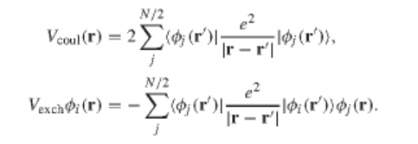
Some details –
Considered a closed shell system with N electrons
We can write the effective Hamiltonian:
with

Slide 15
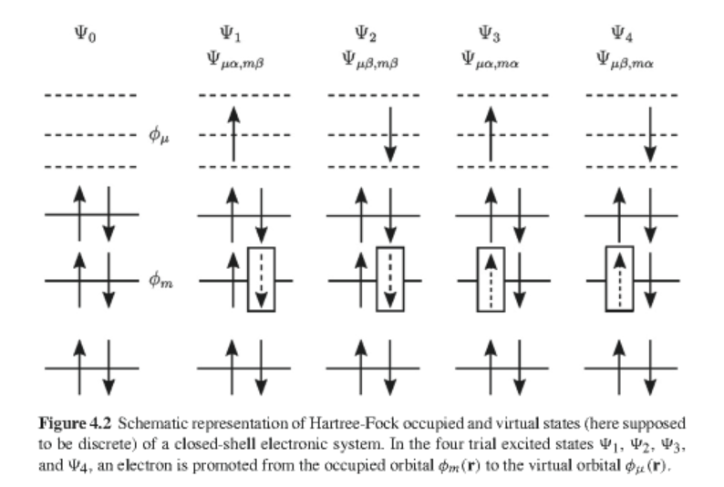

Slide 16
Define:
Eigenstates:

Slide 17
More detailed treatment of U₂ (J) term:
➔
Effective dipole moment:

Slide 18
Resulting equation for envelope function:
Relationships of envelope function:

Slide 19
Summary of Wannier exciton analysis
Hydrogen-like eigenstates:
Wannier analysis is reliable for loosely bound excitons found in semiconductors; for excitons in insulators (such as LiF) Frenkel exciton analysis applies.

Slide 20
Optical absorption due to excitons (Chap. 12)
Transition probability from ground state
with

Slide 21
For spherically symmetric excitons (“first class” transitions)
For p-like excitons (“second class” transitions)

Slide 22
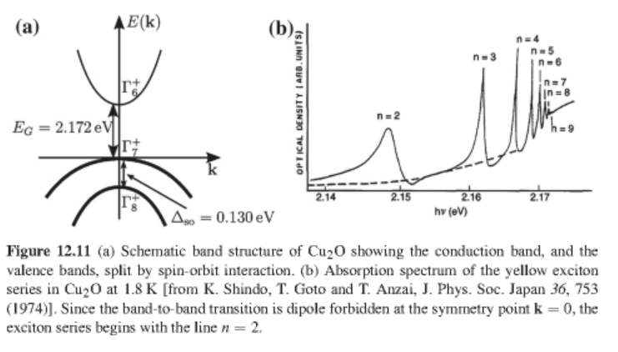
Example of Cu₂O:

