Slide 1
PHY 752 Solid State Physics
11-11:50 AM MWF Olin 103
Plan for Lecture 28: Chap. 9 of GGGPP
Lattice dynamics of crystals
Normal modes of one-dimensional lattices
Normal modes of three-dimensional lattices

Slide 2
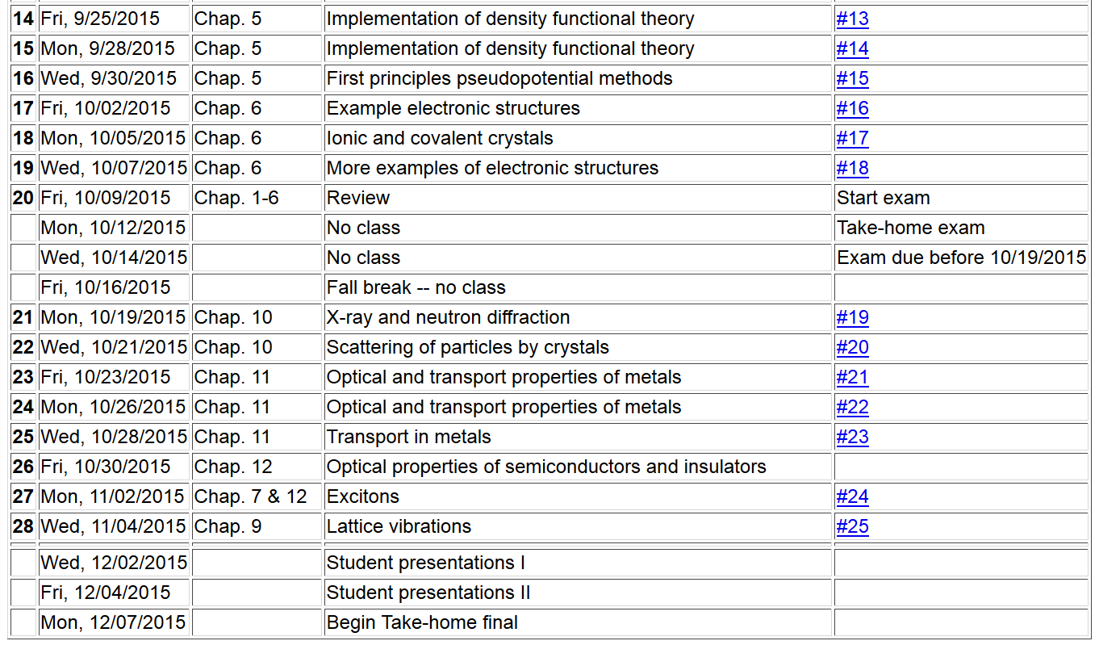

Slide 4
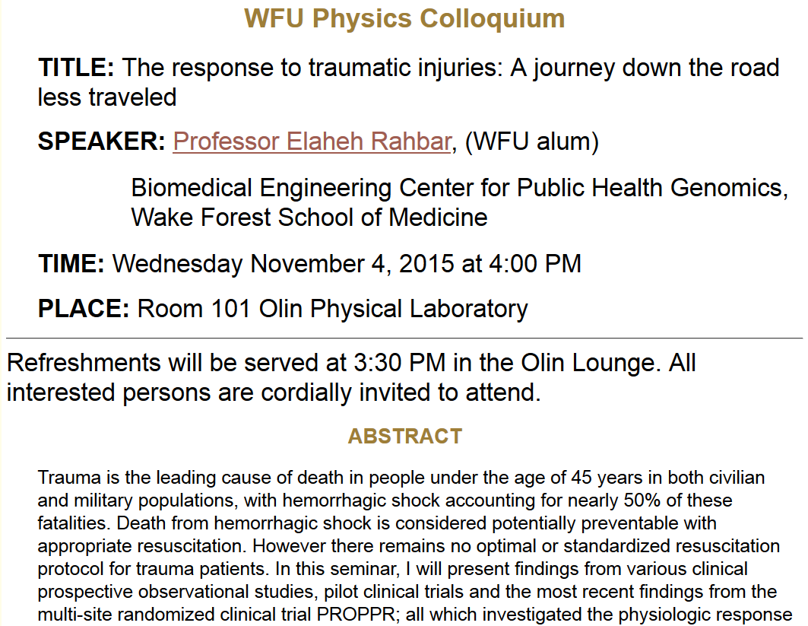

Slide 5
Thanks to the Born-Oppenheimer approximation, the nuclei of a material in equilibrium move in the potential field provided by the ground electronic state of the system

Slide 6
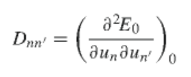
For one-dimensional case:
Relationships:

Slide 7
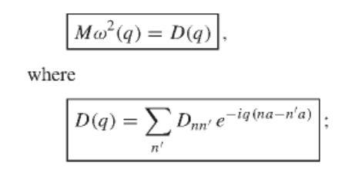
Classical equations of motion:
Solution

Slide 8
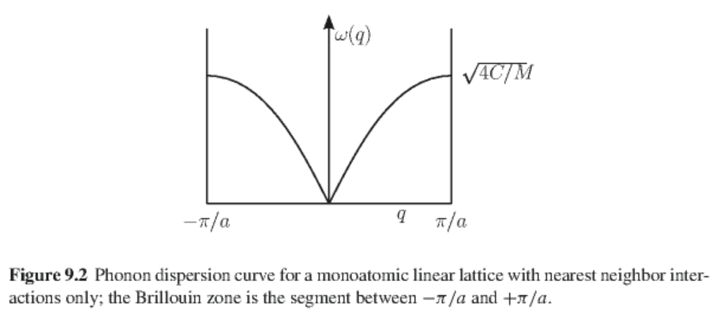
Analytic result for monoatomic chain with only nearest neighbor interactions
➔

Slide 9
velocity of sound in the material

Slide 10
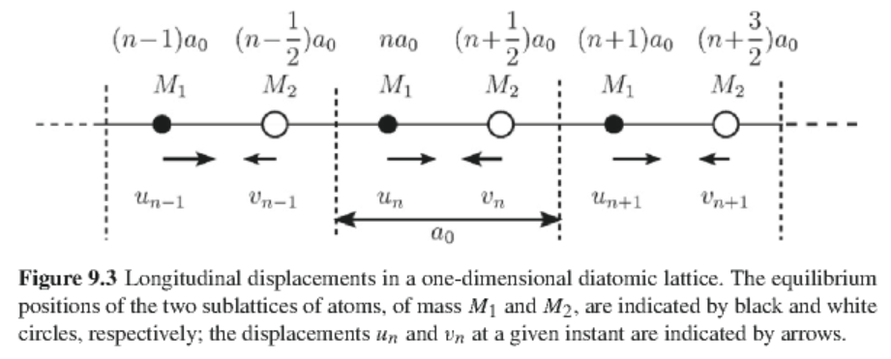
One-dimensional diatomic lattice
Equations of motion for this case:

Slide 11
Solution:
convenient constant
Necessary condition for non-trivial solution:

Slide 12
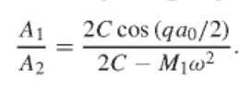
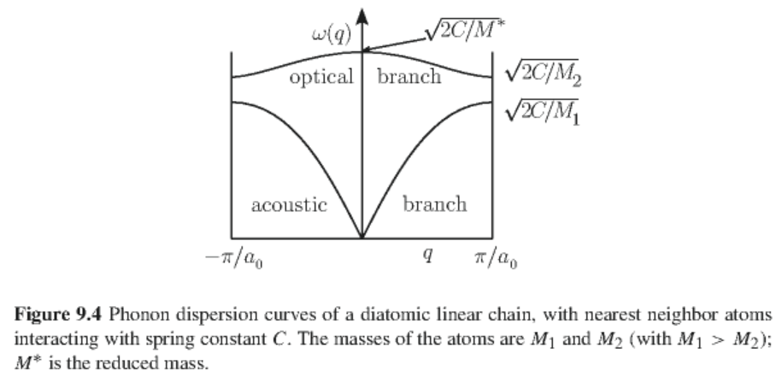
One-dimensional diatomic lattice -- continued
Normal modes

Slide 13
Lattice modes of general three-dimensional crystals
Relationships:

Slide 14
Lattice modes of general three-dimensional crystals -- continued
Equations of motion
Solution

Slide 15
Lattice modes of general three-dimensional crystals -- continued
Some special values
Orthogonality of normal modes

Slide 16
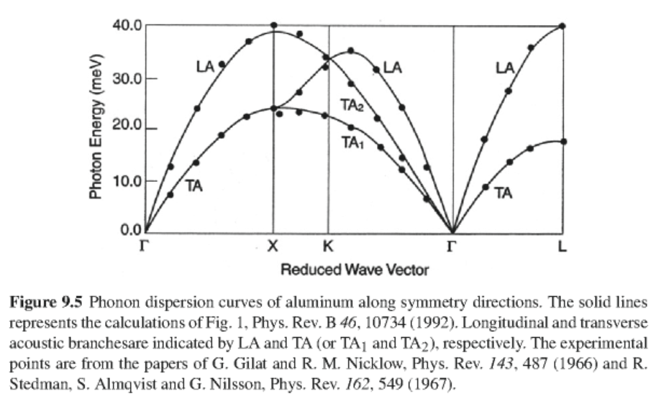
Example for fcc Al lattice

Slide 17
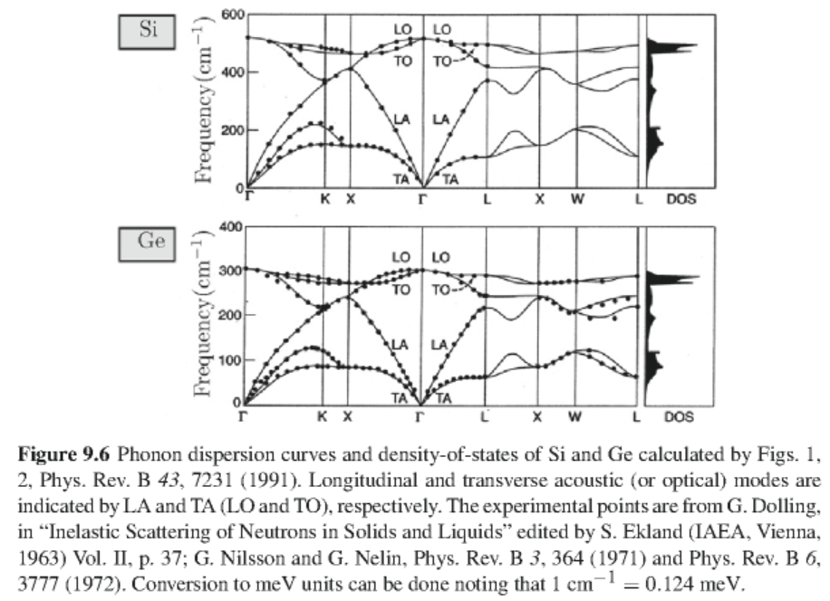
Example for Si and Ge lattices

Slide 18
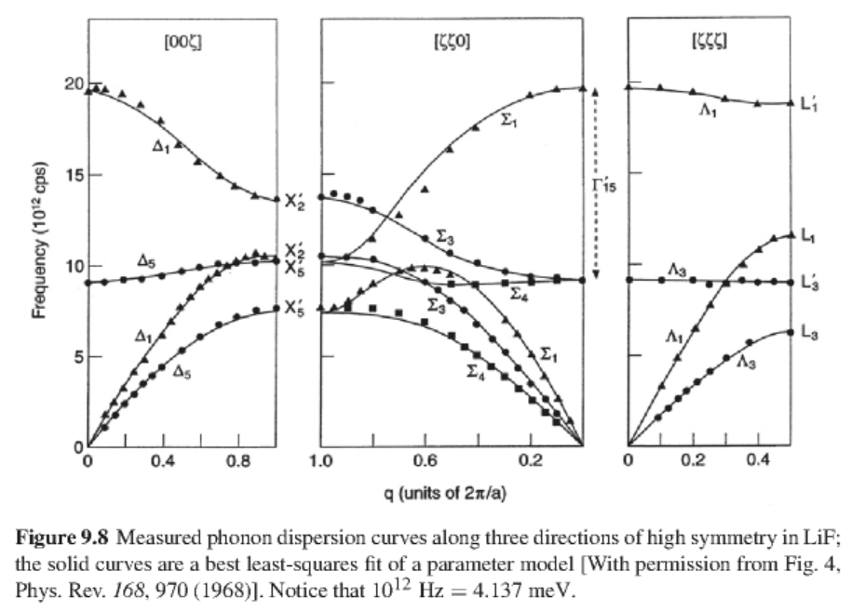
Example for LiF

Slide 19
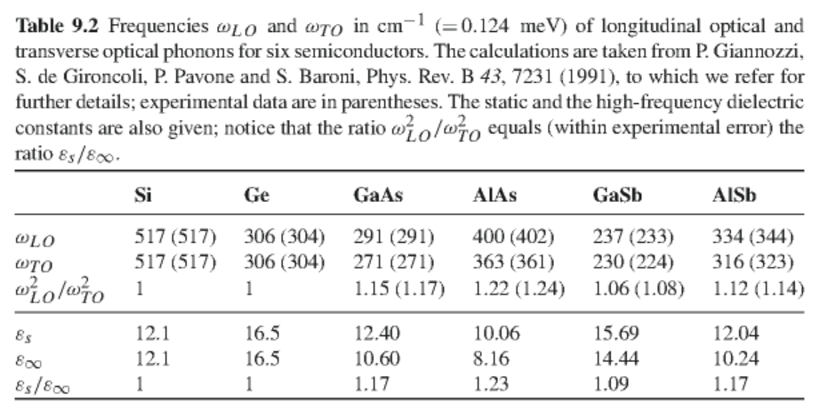
Summary from various semiconductors

