Slide 1
PHY 752 Solid State Physics
11-11:50 AM MWF Olin 103
Plan for Lecture 29: Chap. 9 of GGGPP
Lattice dynamics of crystals
Quantum treatment of lattice vibrations
Statistical mechanics of lattice vibrations
Lecture notes prepared using materials from GGGPP text.

Slide 2
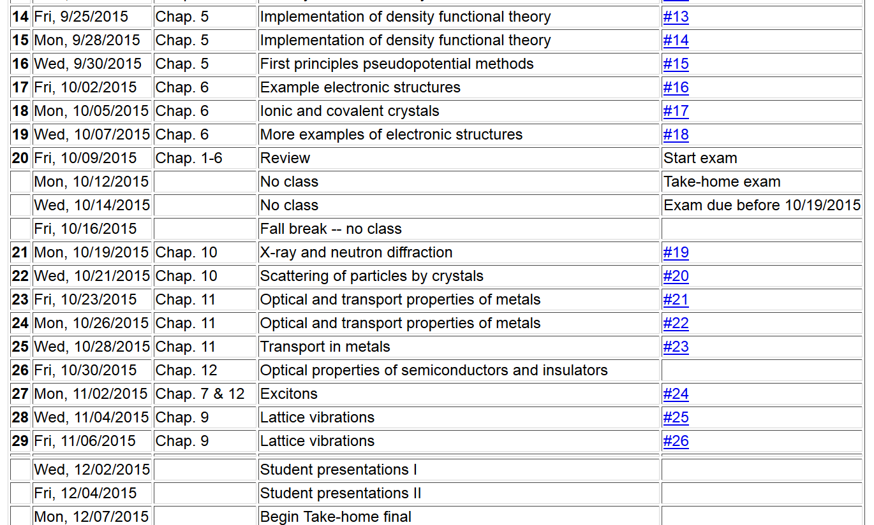

Slide 3
Quantum treatment of one-dimensional harmonic crystal
Hamiltonian:
Commutation relations:

Slide 4
Fourier transformation relationships:

Slide 5
Hamiltonian in terms of Fourier transformed variables
where

Slide 6
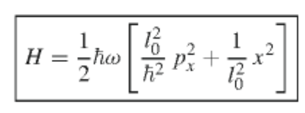
Mathematical digression
Transformation to creation and annihilation operators -- Appendix A (one dimensional case)
Define
Creation and annihilation operators

Slide 7
Inverse transformation
Commutation relationships
In general:
Normalized states

Slide 8
Properties of operators and states:
Hamiltonian

Slide 9
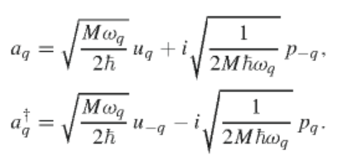
Using creation and annhilation operators for operators in Fourier space
Commutation relations:

Slide 10
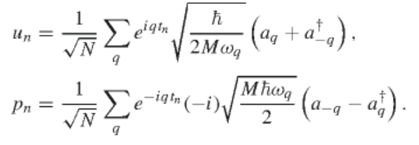
In terms of site operators:
Hamiltonian

Slide 11
Statistical mechanics treatment of vibrational motions at constant temperature T
Average vibrational energy:

Slide 12
Statistical mechanics treatment of vibrational motions at constant temperature T
index for distinct modes (for each degree of freedom)
Specific heat

Slide 13
Evaluation of summation over q:
Debye approximation to D(ω):

Slide 14
Debye approximation continued

Slide 15
