Slide 1
PHY 752 Solid State Physics
11-11:50 AM MWF Olin 103
Plan for Lecture 3:
Reading: Chapter 1.4 & 1.6 in GGGPP – tight binding model & electron dynamics
Atom
Molecule
Solid
Linear combination of atomic orbital (LCAO) or tight binding method
Electron dynamics

Slide 2
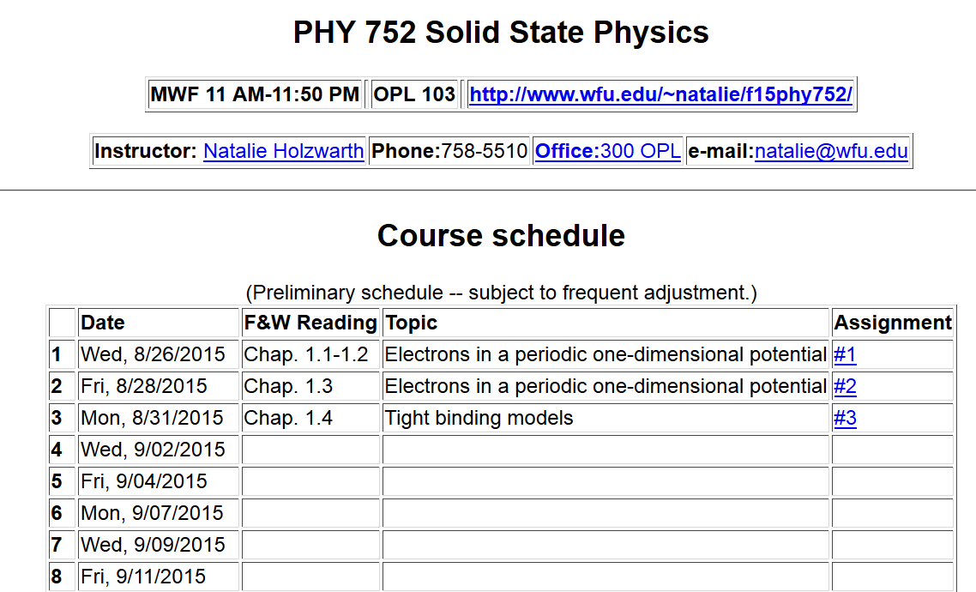

Slide 3
Electronic structure of an atom
For simplicity we will first consider a single electron system; a H-like ion with atomic charge Ze
E₁₀₀=-13. 60569253 Z² eV
a₀ = 0. 52917721092 Å

Slide 5
Electronic structure of H-like molecular ion
(within Born-Oppenheimer approximation)
-e
r_{B}
r_{A}
R_{AB}
Z_{A}e
Z_{B}e

Slide 6
Electronic structure of H-like molecular ion – continued
Ref. Pauling and Wilson, Introduction to Quantum Mechanics (1935) (now published by Dover)

Slide 7
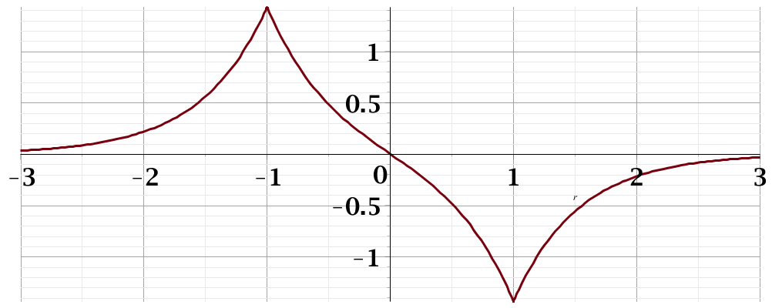
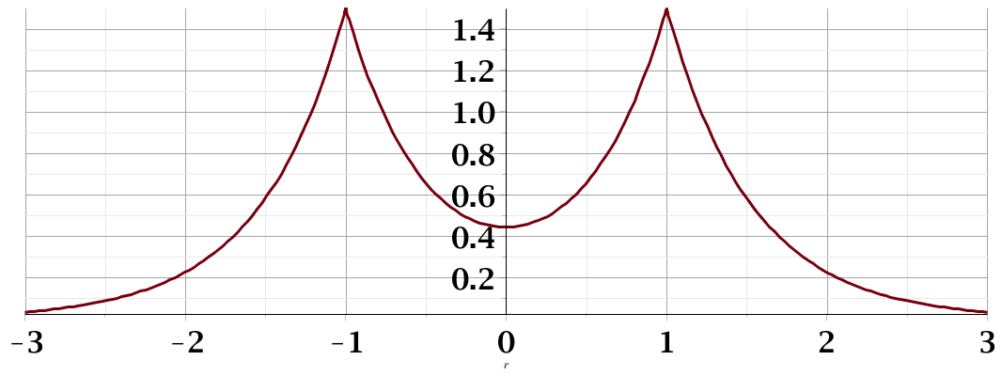
Electronic structure of H-like molecular ion – continued
E₋
Ψ₋
H_{AA}
H_{BB}
E₊
Ψ₊

Slide 8
Extension of approximate “linear combination of atomic orbital” idea to larger systems
N=2
N=3
N=4
4β
…………….

Slide 9
Extension of approximate “linear combination of atomic orbital” idea to larger systems – some details

Slide 10
Digression –
eigenvalues/eigenvectors of a tridiagonal matrix

Slide 12
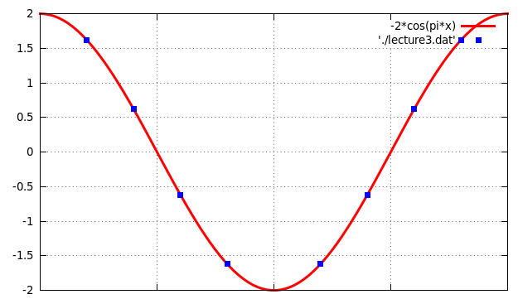
E-α
−π
0
π
qa
Plot for β=-1

Slide 13
Extension of approximate “linear combination of atomic orbital” idea to larger systems – more details

Slide 14
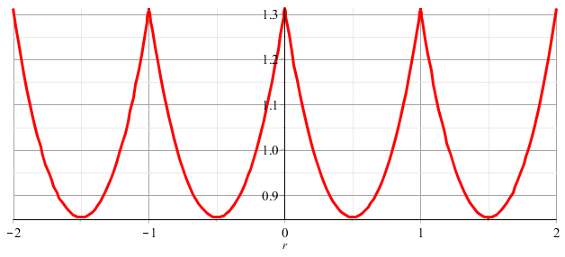
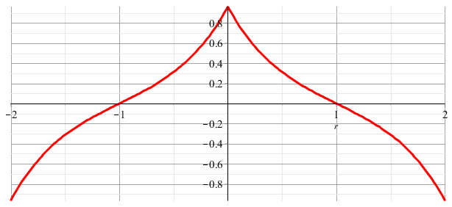
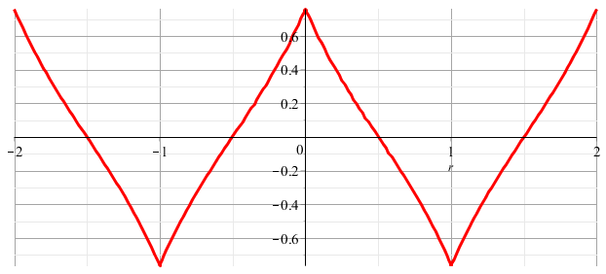
Comment on tight-binding Bloch states
k=0
k=π/2a
k=π/a

Slide 15
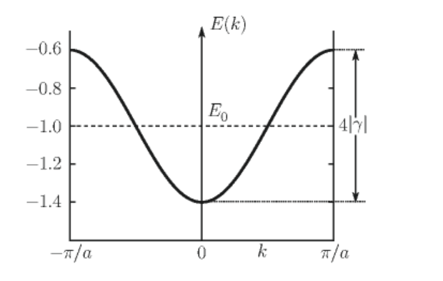
Energy spectrum tight-binding Bloch states

Slide 16
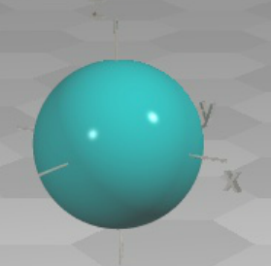
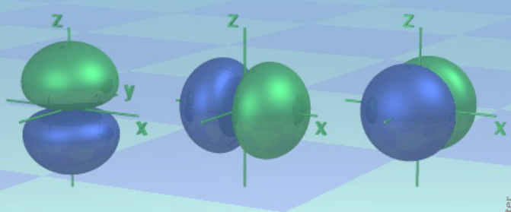
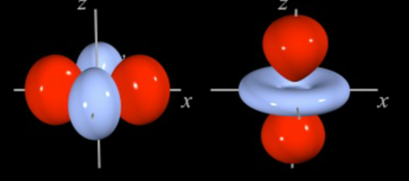
LCAO methods -- continued – angular variation
http://winter.group.shef.ac.uk/orbitron/
l=0
l=1
l=2

Slide 17
LCAO methods -- continued – angular variation
While, for atoms the “z” axis is an arbitrary direction, for diatomic molecules and for describing bonds, it is convenient to take the “z” axis as the bond direction.
Atom
symbol
l=0 m=0 s
l=1 m=0 p
m= ±1 p
l=2 m=0 d
m= ± 1 d
m= ± 2 d
Bond
symbol
l=0 λ=0 σ
l=1 λ=0 σ
λ=1 π
l=2 λ=0 σ
λ=1 π
λ= 2 δ

Slide 18
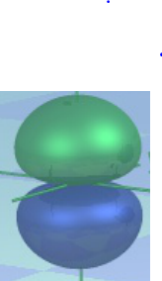
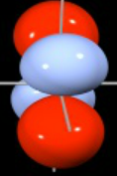
LCAO methods -- continued – bond types
ssσ
ppσ
ppπ
ddπ

Slide 19
More details of LCAO and tight-binding methods will be covered in Chapter 5 ….
Electron velocity:
➔Band dispersion is related to electron velocity

Slide 20
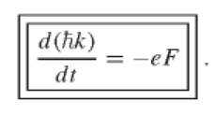
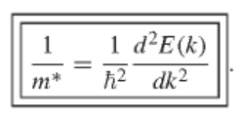
Electron effective mass from semi-classical analysis
For applied force F
1/m*

