Slide 1
PHY 752 Solid State Physics
11-11:50 AM MWF Olin 103
Plan for Lecture 30: Chap. 13 of GGGPP
Basic properties of semiconductors
Estimates of electron and hole concentrations in intrinsic semiconductors
Impurity states
Lecture notes prepared using materials from GGGPP text.

Slide 2
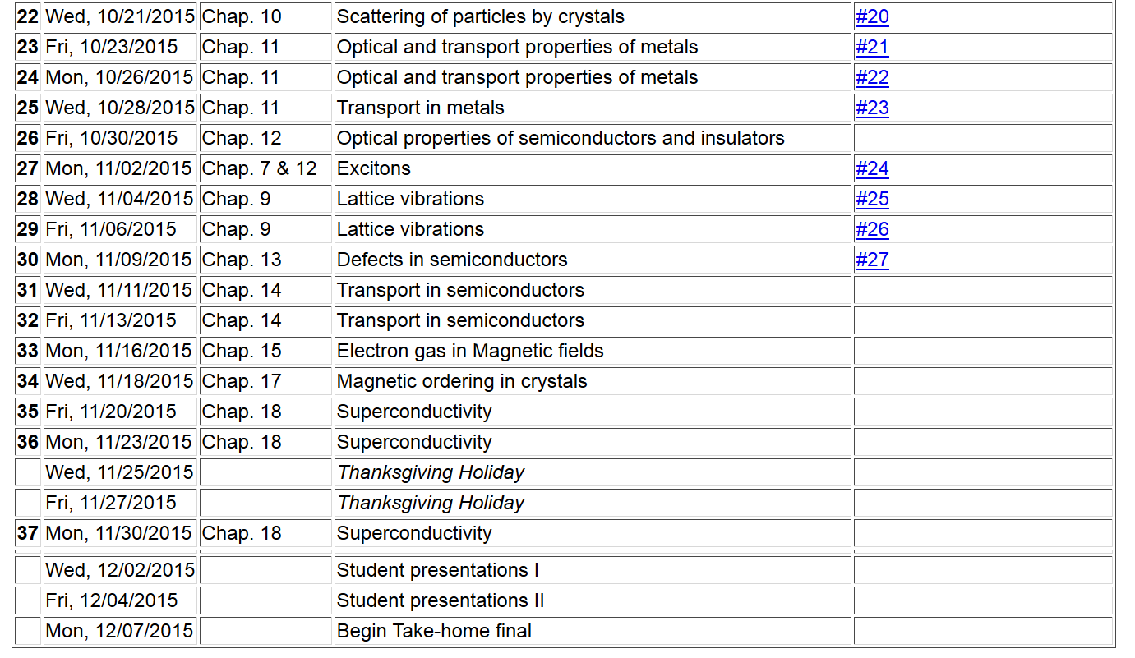

Slide 3
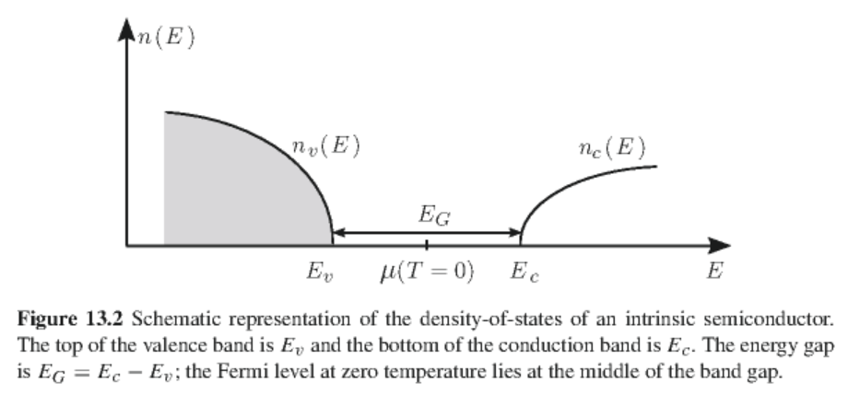
Semiconductor properties
valence band
conduction band

Slide 4
Boltzmann distribution for Fermi particles of energy E
chemical potential
Density of electrons in the conduction band at temperature T:
Density of holes in the conduction band at temperature T:

Slide 5
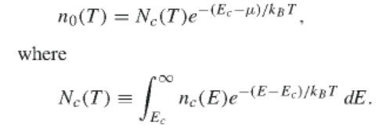
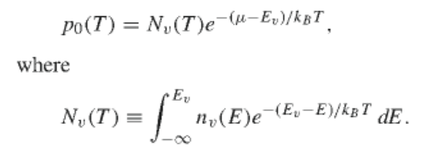
For an intrinsic semiconductor:
Simplification of analysis for

Slide 6
Chemical potential for intrinsic semiconductor
➔
Mass action relationship:

Slide 7
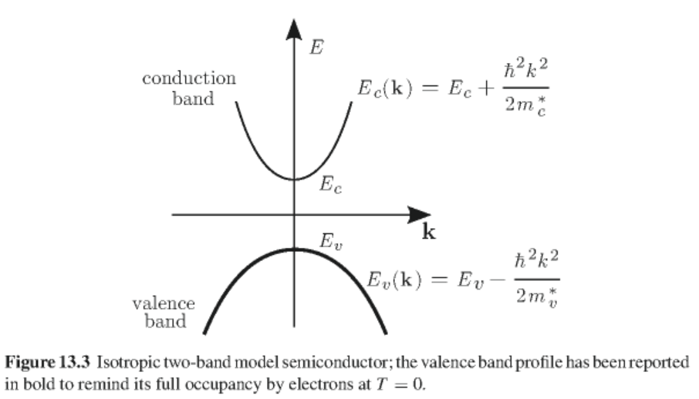
Two parabolic band model

Slide 8
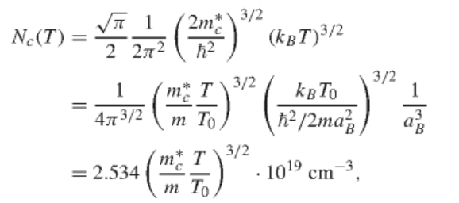
Two parabolic band model -- continued
For T₀ =300 K

Slide 9
Two parabolic band model -- continued
Similar analysis of valence band:
Chemical potential

Slide 10
Effects of impurities
Bloch states of perfect lattice
Schroedinger equation for system with impurities
Expression of impurity wavefunction in terms of Bloch states:

Slide 11
Effects of impurities -- continued
where
For two parabolic band model
Case for impurity states near conduction band

Slide 12
Case for impurity states near conduction band -- continued
≈
Define envelope function

Slide 13
Case for impurity states near conduction band -- continued
approximation to V_{I}
Bound states – donor levels

Slide 14
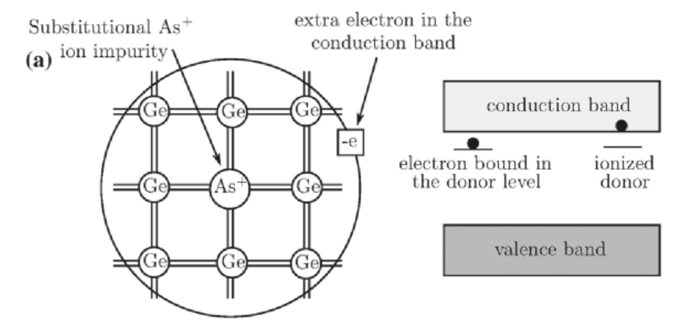
Example of donor impurity states

Slide 15
Case for impurity states near valence band
Bound state solutions for accepter impurity levels

Slide 16
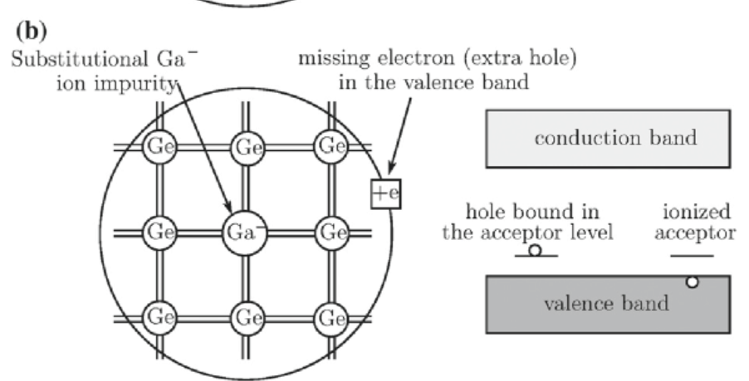
Example of acceptor impurity states

Slide 17
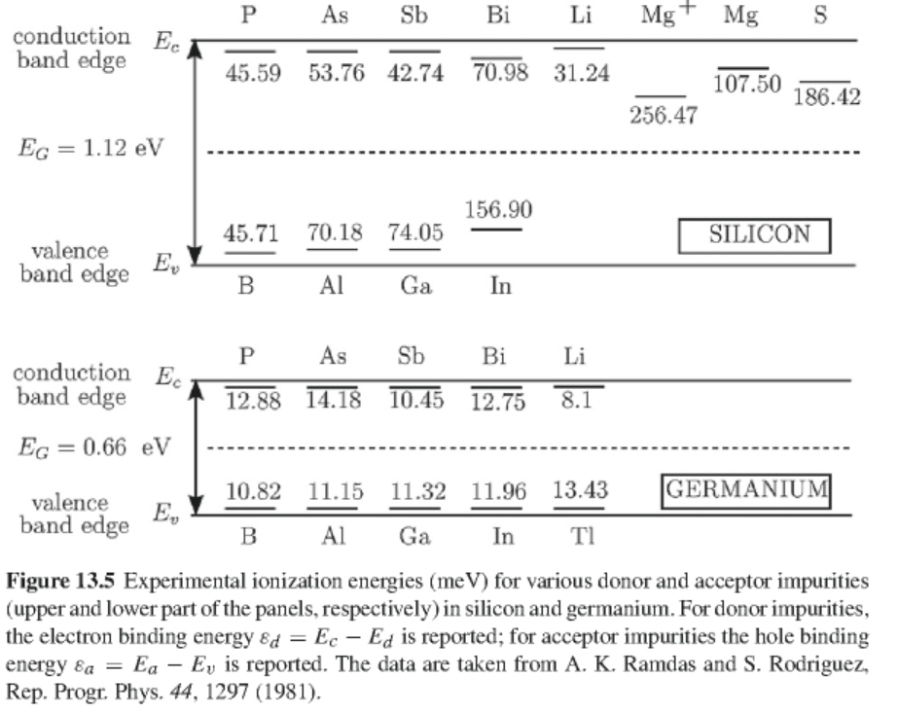

Slide 18
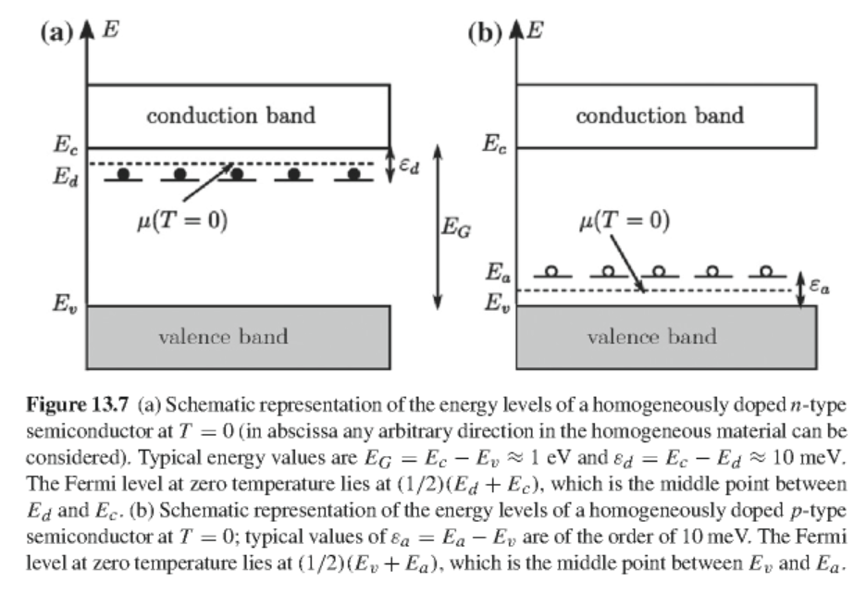
Mobile electrons and holes in doped semiconductors as a function of temperature

Slide 19
Probability that E_{d} is occupied by an electron of either spin
Density of electrons in conduction band
At low temperature:

Slide 20
At moderate temperatures

Slide 21
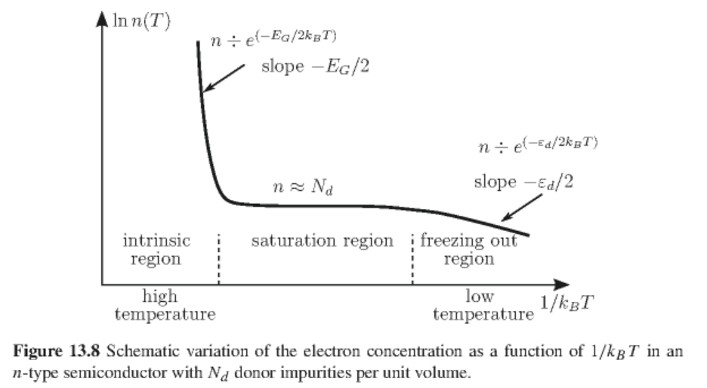

Slide 22
Note that similar analysis applies to the acceptor levels; in general a given semiconductor can have concentrations of both N_{d} donors and N_{a} acceptors.

