Slide 1
PHY 752 Solid State Physics
11-11:50 AM MWF Olin 103
Plan for Lecture 31:
Chapter 14 in GGGPP:
Inhomogeneous semiconductors
p-n junctions
Metal-semiconductor junctions
Lecture notes prepared with materials from GGGPP textbook

Slide 2
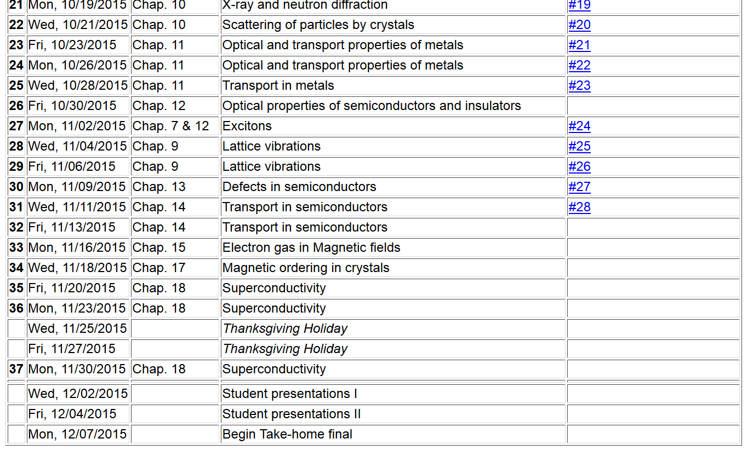

Slide 5
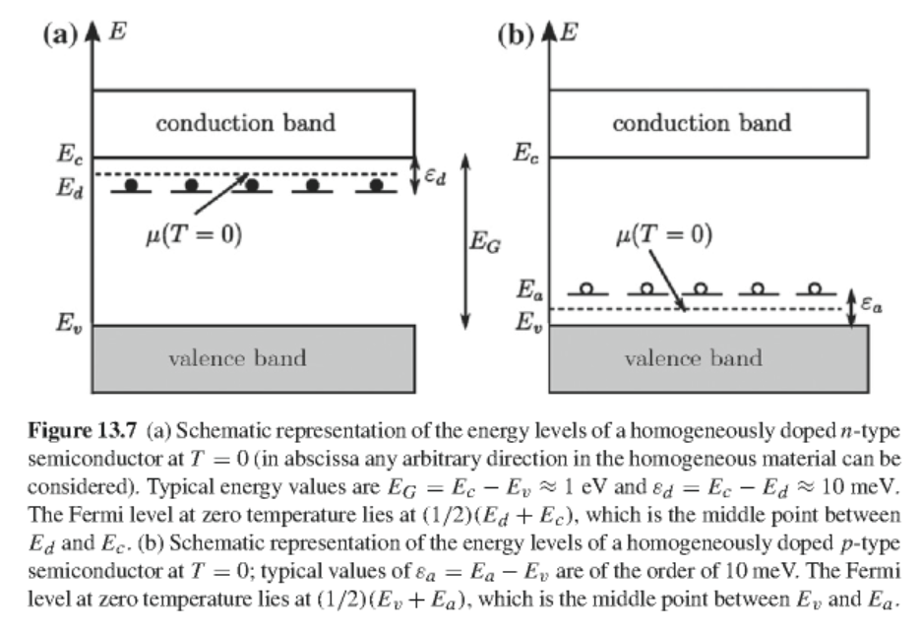
Impurity states in doped semiconductors at T=0 K
Donor impurities
n-type
Acceptor impurities
p-type

Slide 6
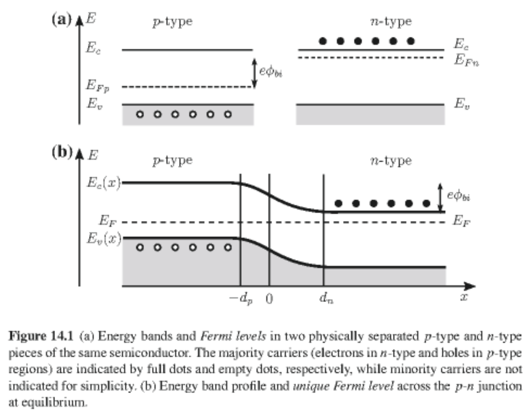
Composite p- and n- type semiconductor at T>0 K -- distribution of ionized impurity states

Slide 7
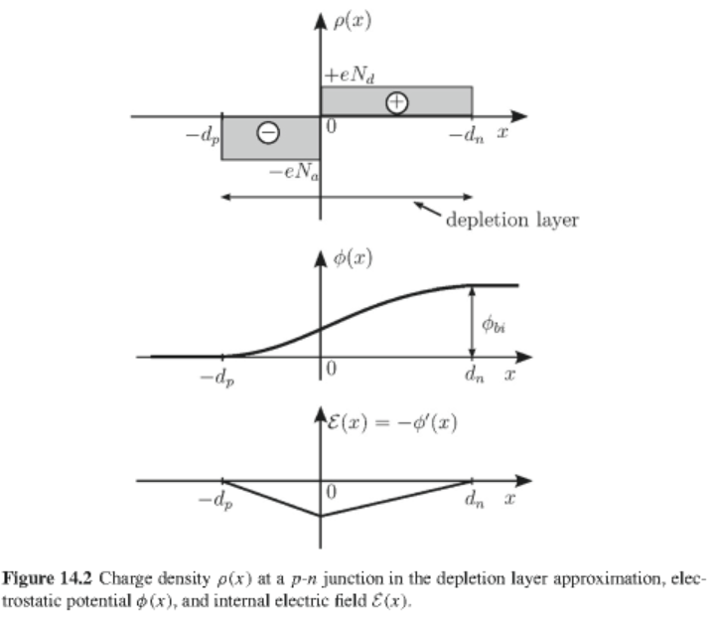
Composite p- and n- type semiconductor -- electrostatic effects

Slide 8
Model electrostatic configuration due to ionized impurities
Poisson’s equation for resulting electrostatic potential

Slide 9
Model p-n junction -- continued
Relationship of depletion layer lengths to built-in potential
Total width of the depletion layer:

Slide 10
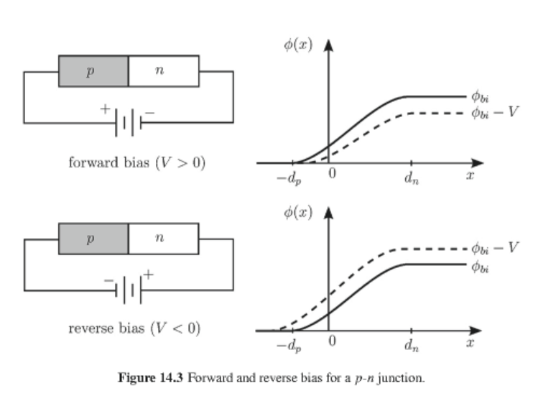
p-n junction in the presence of external voltage V

Slide 11
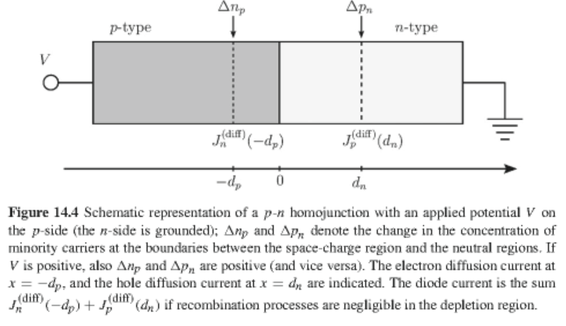
p-n junction in the presence of external voltage V

Slide 12
Distribution of electrons and holes near p-n junction
Comparison of of electron and concentrations at boundaries of depletion zone:

Slide 14
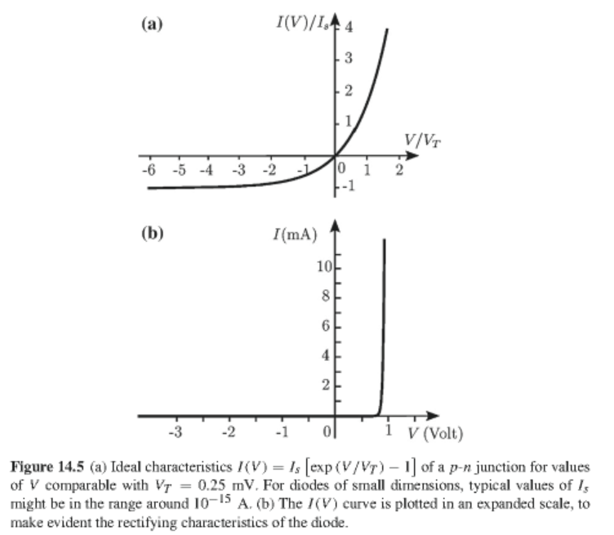
Current-voltage characteristics of p-n junction

Slide 15
Some details (covered in Chap. 13)
Electron and hole current densities in the presence of an electric field E within Drude model
Electron and hole current densities due to both an electric field and a concentration gradient
diffusion constants

Slide 16
Electron and hole transport in p-n junction – continued
Boltzmann equation for electrons:
electron generation and recombination
Boltzmann equation for holes:
hole generation and recombination

Slide 17
Electron and hole transport in p-n junction – continued
Boltzmann equations in terms of applied field and density gradients

Slide 18
Electron and hole transport in p-n junction – continued

Slide 19
Electron and hole transport in p-n junction – continued

Slide 20
Electron and hole transport in p-n junction – continued

