Slide 1
PHY 752 Solid State Physics
11-11:50 AM MWF Olin 103
Plan for Lecture 32:
Chapter 15 in GGGPP:
Electron Gas in Magnetic Fields
Energy levels for 2-d electron gas
Energy levels for 3-d electron gas
Lecture notes prepared with materials from GGGPP textbook

Slide 2
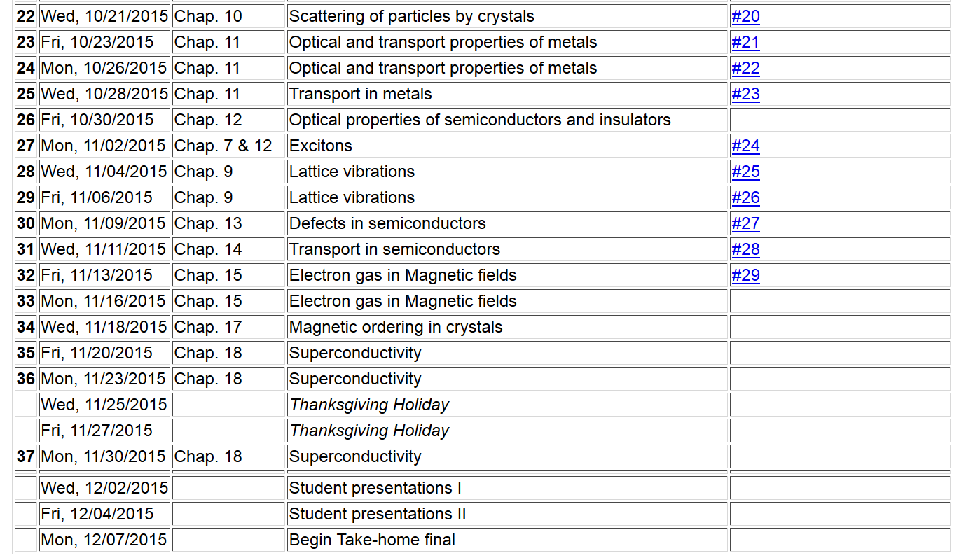

Slide 3
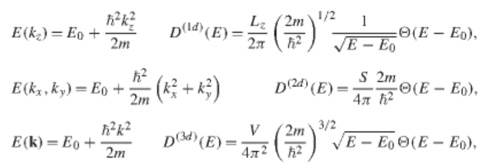
Digression – densities of states for one, two, or three
dimensional free electron gas

Slide 4
Consider a system of electrons confined to move in the x-y plane. In the absence of an external magnetic field, the energy levels are given by:
Consider the effects of a uniform magnetic field along the z-axis
Effective Hamiltonian:

Slide 5
Effective potential -- continued
Taking into account constants of the motion
Eigenstates:

Slide 6
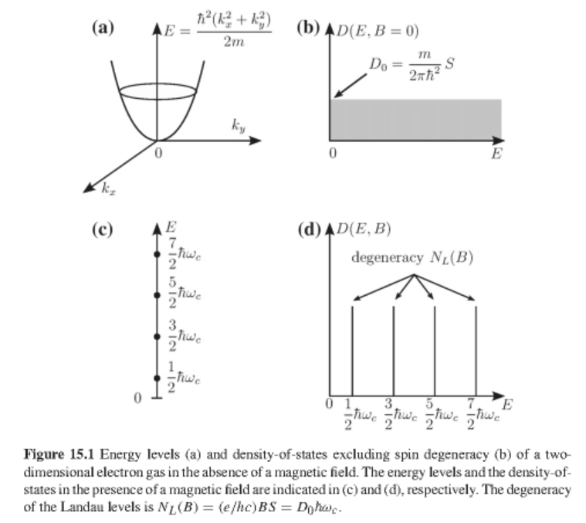

Slide 7
Degeneracy of Landau levels
# occupied Landau levels

Slide 8
B>0
B>>0
B=0
n=2
n=4
E_{F}
n=3
E_{F}
E_{F}
n=2
n=1
n=1
n=0
n=0
E=0
E=0
E=0

Slide 9
Eigenstates:

Slide 10
Magnetic field effects on 3-dimensional electron gas

Slide 11
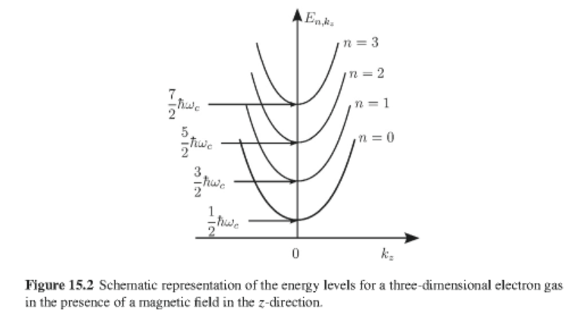

Slide 12
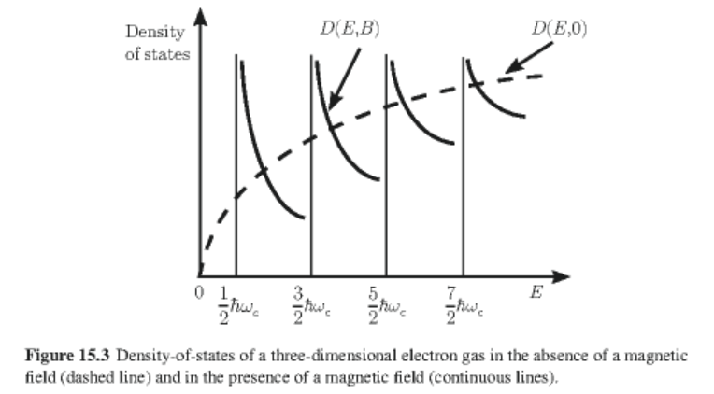
Density of states for 3-dimensional system

Slide 13
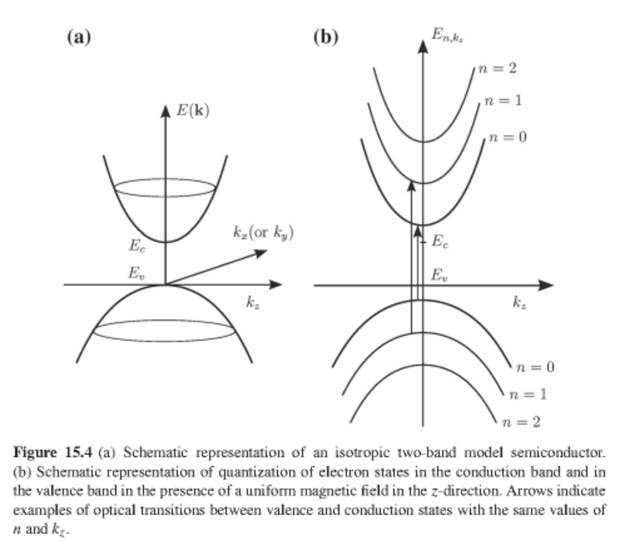
Optical absorption in presence of Magnetic field; transitions between conduction and valence bands

Slide 14
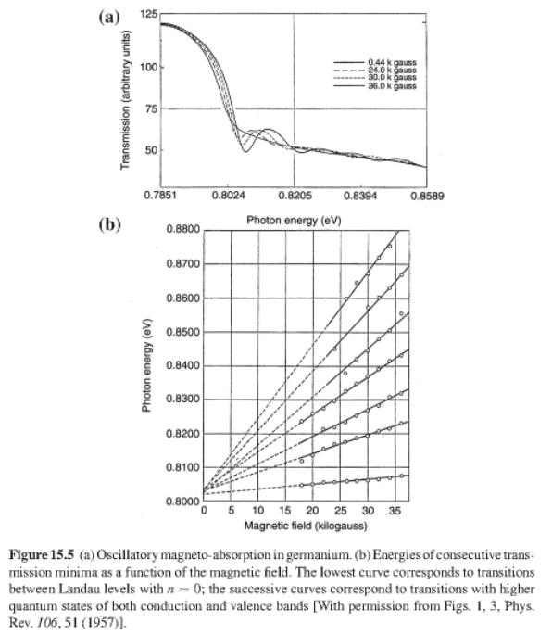

Slide 15
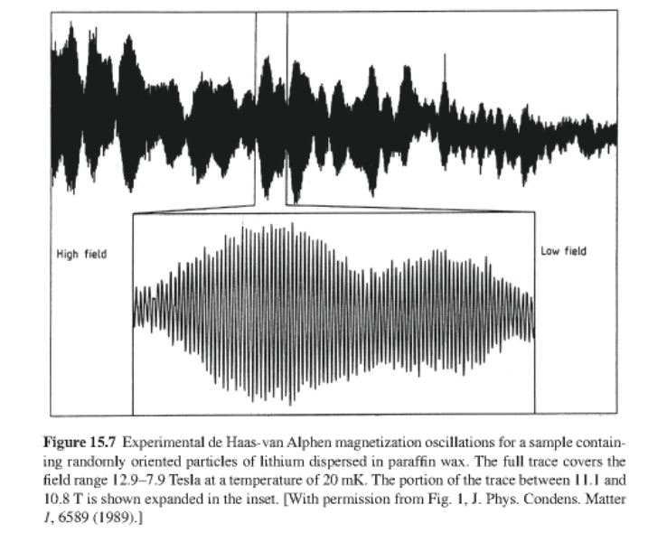
Next lecture – de Haas-van Alphen effect
Oscillator 1/B behavior of free energy of free electron gas

