Slide 1
PHY 752 Solid State Physics
11-11:50 AM MWF Olin 103
Plan for Lecture 33:
Chapter 15 in GGGPP -- continued:
Electron Gas in Magnetic Fields
Landau diamagnetism and de Haas-van Alphen effect
Hall effect
Lecture notes prepared with materials from GGGPP textbook

Slide 2
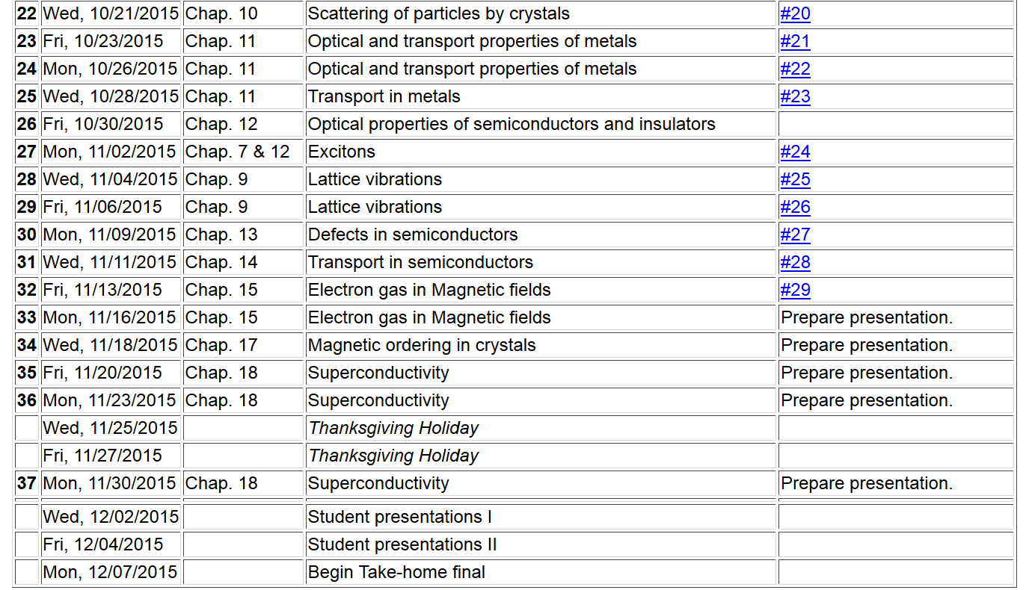

Slide 3
Results from last lecture --
Magnetic field effects on 3-dimensional electron gas
Note: the effects of electron spin have been ignored in this treatment; inclusion of the intrinsic electron spin changes some of the details, but the general phenomenon remains the same.

Slide 4
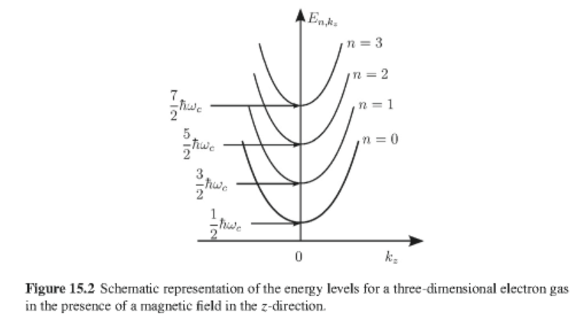

Slide 5
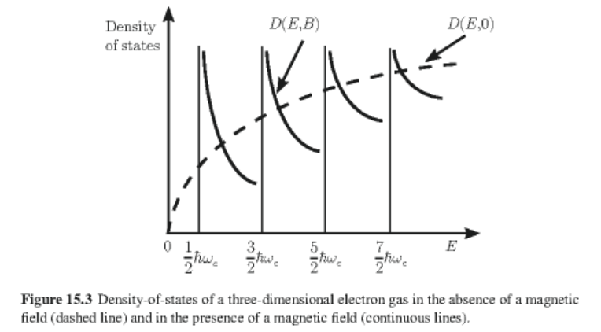
Density of states for 3-dimensional system

Slide 6
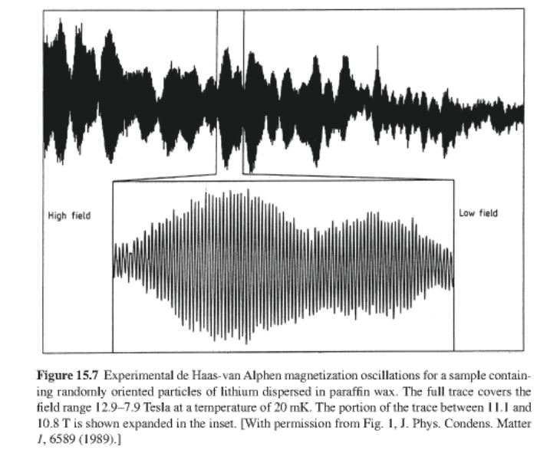
As a result of the Landau levels, there is an oscillatory
behavior of free energy of free electron gas:

Slide 7
Some steps in the evaluation of the free energy of the
electron gas in a magnetic field; summation of the contributions of the Landau levels (Thanks to appendix of Chapter 15 of GGGPP.)
Poisson sum formula
For a well-behaved function f(x)

Slide 8
Integrating by parts
Poisson sum becomes

Slide 9
For convenience, assume that we have shifted the energy scale so that the range of energies of interest are 0<E<μ where μ denotes the chemical potential. In terms of the density of states D(E), we can define:
where (the number of electrons)
Similarly, we can define
The ground state energy of the system of N electrons is given by

Slide 10
Evaluating the free energy of our system
In terms of the density of states:
which can be integrated by parts:

Slide 11
Using the results for the 3-dimensional free electron gas
For B=0
For B>0
Evaluating the “second primitive function”

Slide 12
Using Poisson sum formula with

Slide 13
Collecting terms:
Free energy at T=0 K

Slide 14
Free energy at T>0 K
Some tricks

Slide 15
Free energy at finite temperature

Slide 16
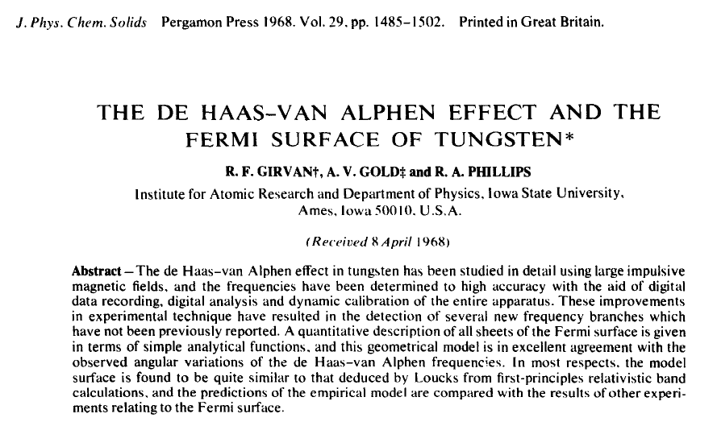

Slide 17
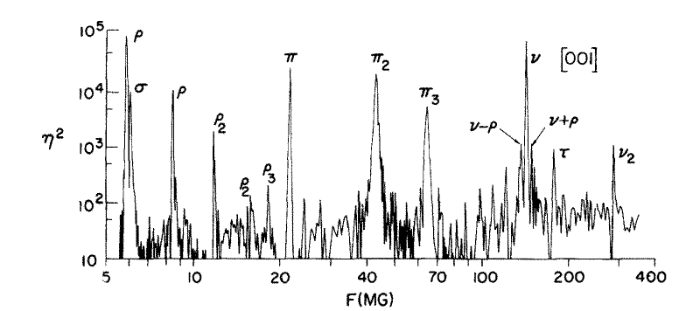

Slide 18
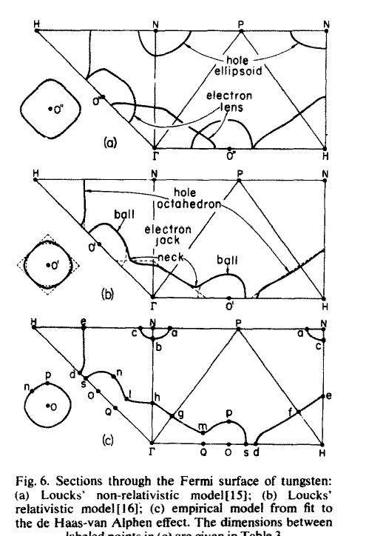
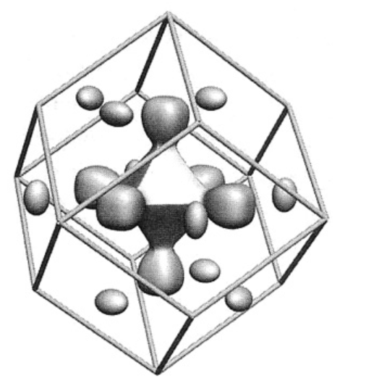
http://physics.oregonstate.edu/~minote/COURSES/ph671_2008/

Slide 19
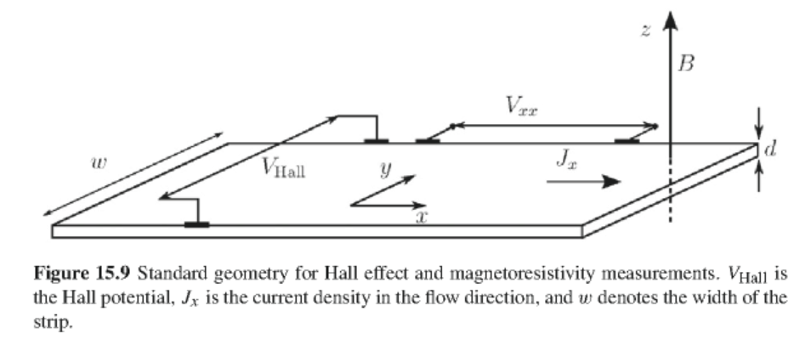
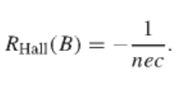
Hall effect

Slide 20
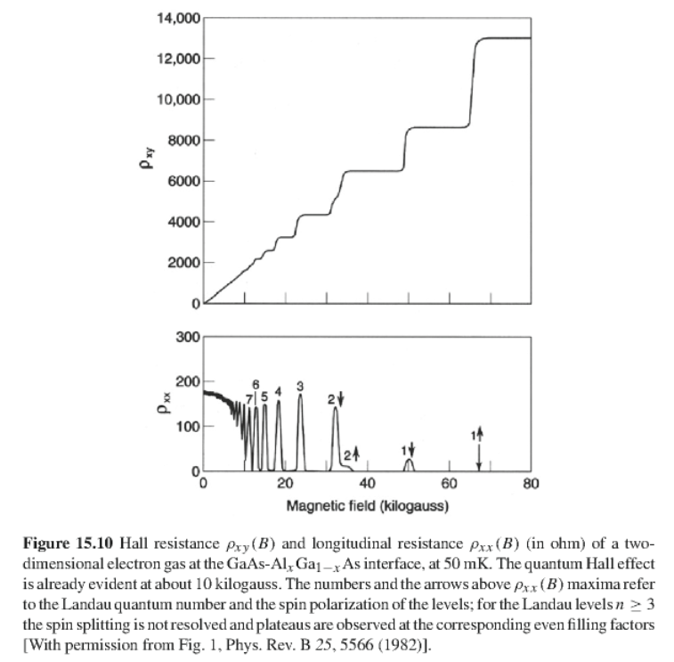
Quantum Hall effect

