Slide 1
PHY 752 Solid State Physics
11-11:50 AM MWF Olin 103
Plan for Lecture 34
Intrinsic spin effects -- Hubbard model
(Chap. 16 & 17 in GGGPP)
Exact analysis of 2-site system
Periodic one-dimensional system

Slide 2
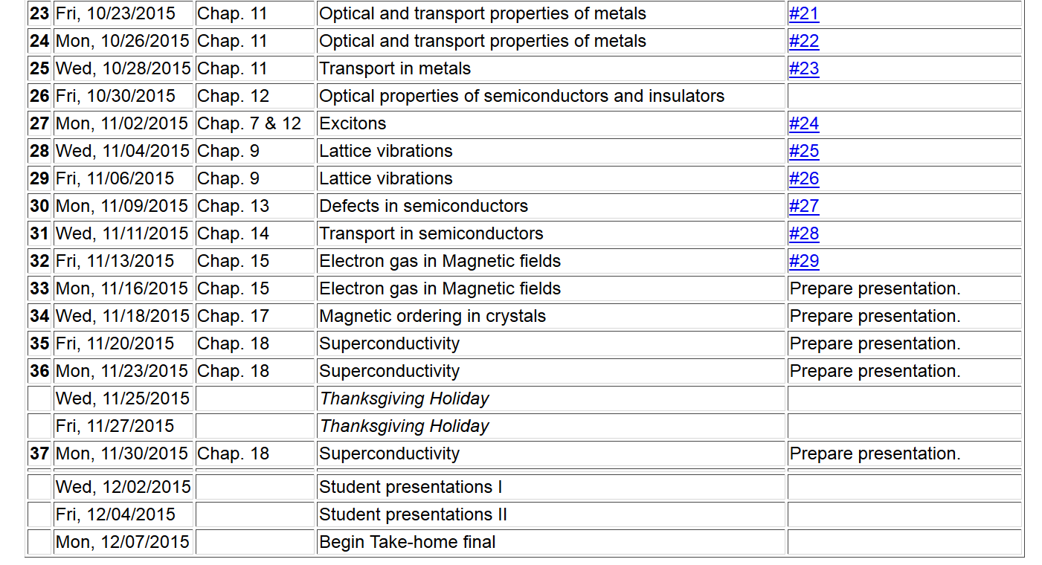
11/22/2013
PHY 711 Fall 2013 -- Lecture 34
2

Slide 4
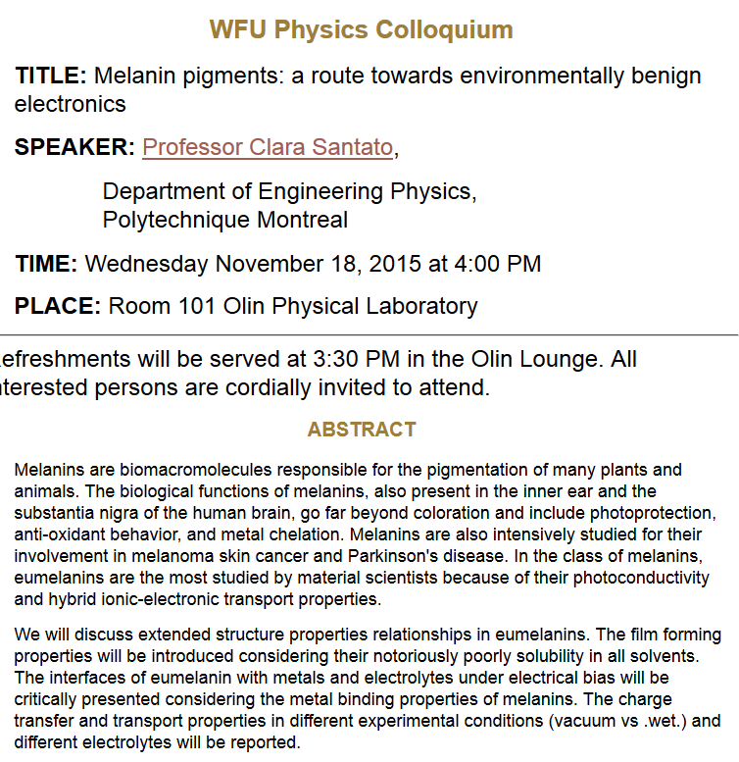

Slide 6
Intrinsic spin of an electron
Short hand notation for eigenstates σ of σ_{z}

Slide 7
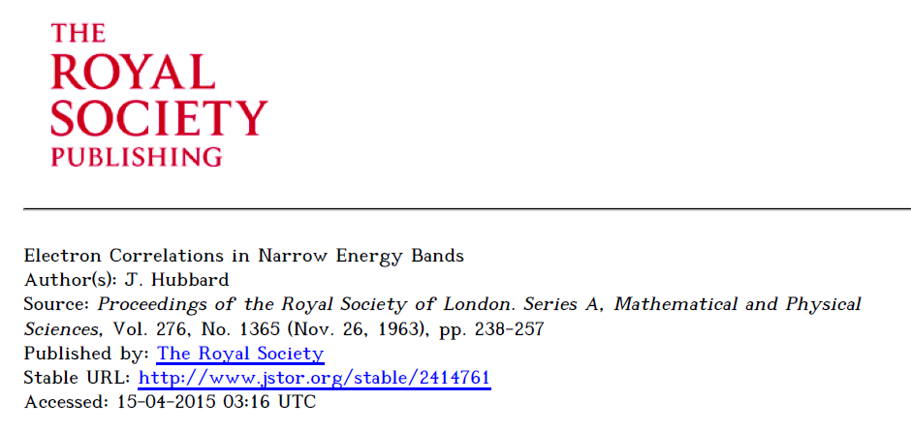
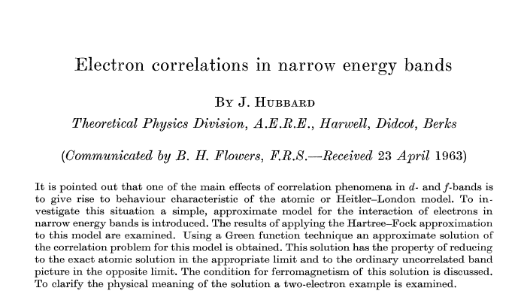

Slide 8
The Hubbard Hamiltonian:
single particle contribution
two particle contribution
anti-commutator for Fermi particles

Slide 9
l = 1 2 3 4
Possible configurations of a single site

Slide 10
Hubbard model -- continued
t represents electron “hopping” between sites, preserving spin
U represents electron repulsion on a single site

Slide 11
Two-site Hubbard model
Note that total spin Σ = 0,1 and the z-component of the total spin Σ_{z}=-1,0,1 commute with H and are good eigenvalues of the states of the system. For Σ = 1, there are 3 values of Σ_{z}=-1,0,1 which have the same eigenvalues.

Slide 12
Two-site Hubbard model -- continued

Slide 13
Two-site Hubbard model

Slide 14
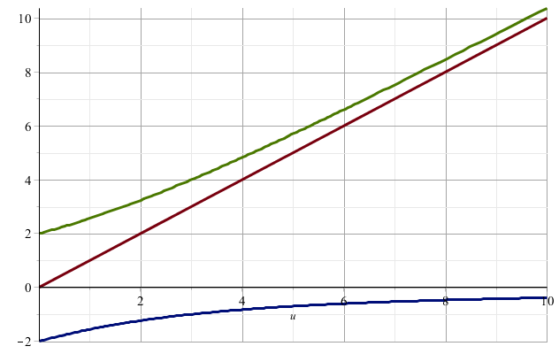
Eigenvalues of the Hubbard model

Slide 15
Two-site Hubbard model
Ground state of the two-site Hubbard model
Single particle limit (U →0)

Slide 16
In the following slides, u represents U/t:

Slide 17
ε_{k} = -2 cos(ka)
ε_{k}
k
−π/a
-k_{F}
k_{F}
π/a

Slide 18
In the k-basis, the Hubbard model takes the form:

Slide 19
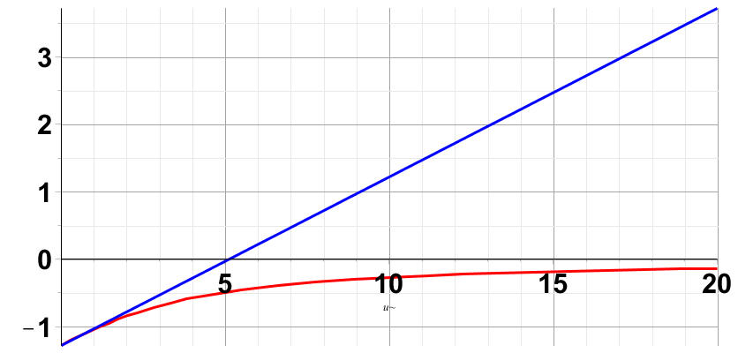
note that k_{F}=π/(2a)
Hartree-Fock
Exact

Slide 20
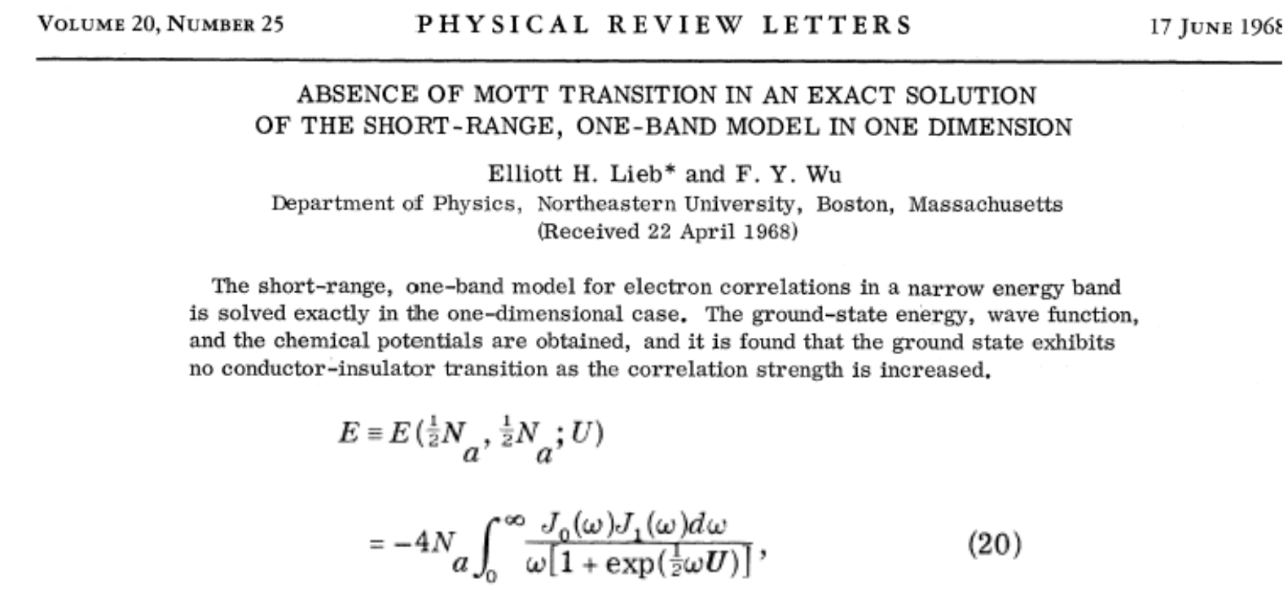
One-dimensional Hubbard chain

Slide 21
Approximate solutions in terms of single particle states; “broken symmetry” Hartree-Fock type solutions

Slide 22
Broken symmetry Hartree-Fock solution
m=0
m=1

Slide 24
Spin density wave solution -- continued

Slide 25
Spin density wave solution -- continued

Slide 26
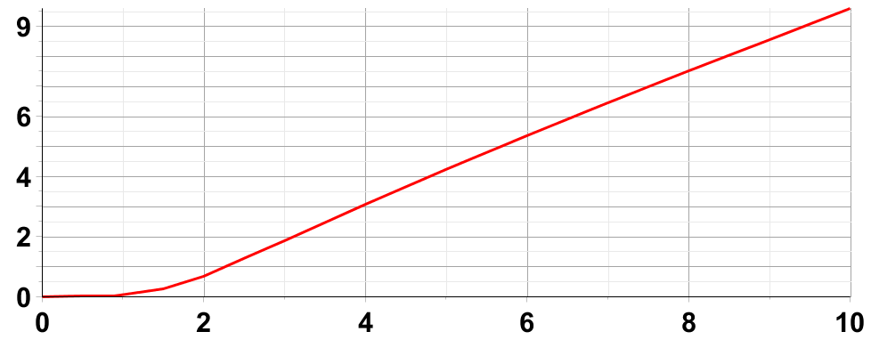
Spin density wave solution -- continued
Δ
u

Slide 27
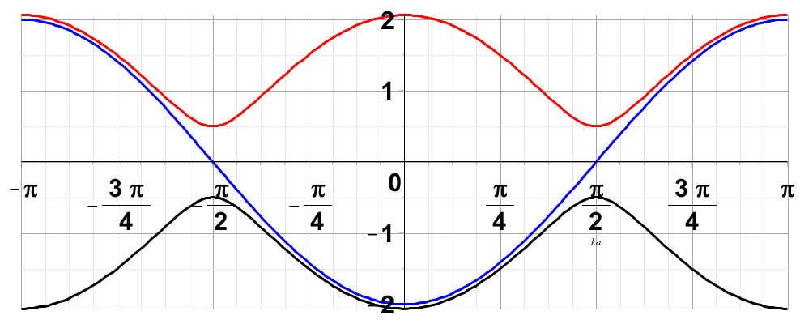
Spin density wave solution -- continued
Effects on single particle states

Slide 28
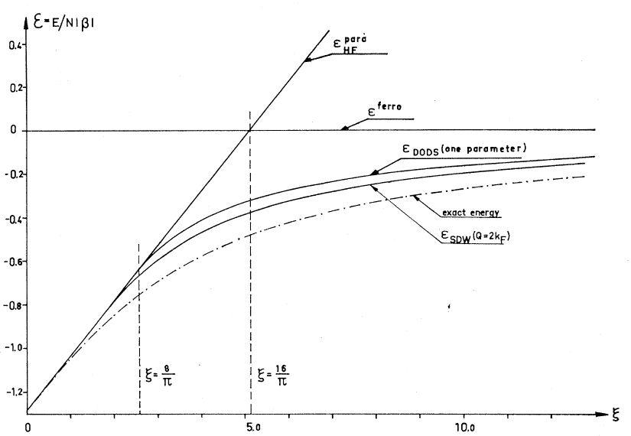
Spin density wave solution -- continued

Slide 29
SDW form:
a
For spin ↑
(x cos θ_{k})
For spin ↓
(x sin θ_{k})

