Slide 1
PHY 752 Solid State Physics
11-11:50 AM MWF Olin 103
Plan for Lecture 35
Superconductivity
(Chap. 18 in GGGPP)
Phenomenological aspects
London model
Some slides contain materials from GGGPP text.

Slide 2
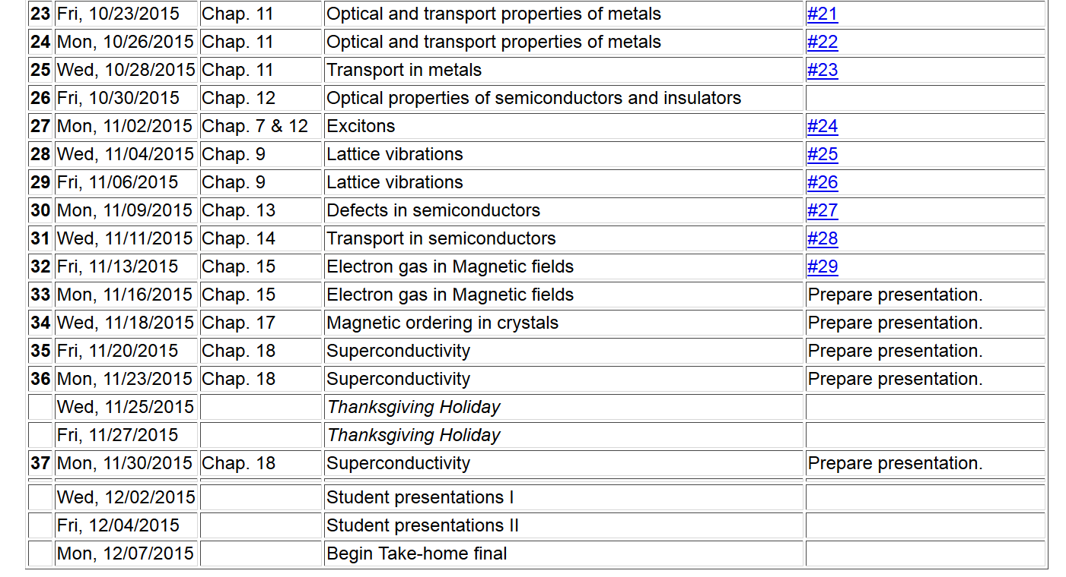
2

Slide 3
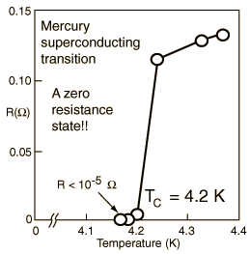
Special topic: Electromagnetic properties of superconductors
Ref:D. Teplitz, editor, Electromagnetism – paths to research,
Plenum Press (1982); Chapter 1 written by Brian Schwartz and Sonia Frota-Pessoa
History:
1908 H. Kamerlingh Onnes successfully liquified He
1911 H. Kamerlingh Onnes discovered that Hg at 4.2 K has vanishing resistance
1957 Theory of superconductivity by Bardeen, Cooper, and Schrieffer

Slide 4
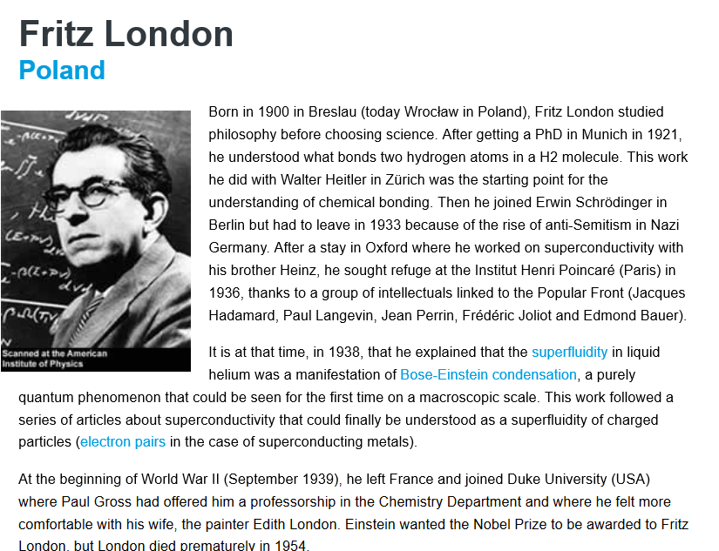

Slide 5
Some phenomenological theories < 1957

Slide 6
Some phenomenological theories < 1957

Slide 7
London model – continued

Slide 8
London model – continued
λ_{L}
x

Slide 9
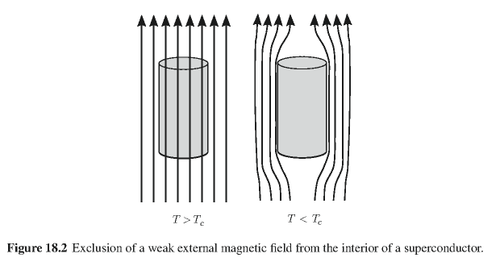
Behavior of magnetic field lines near superconductor
normal
state:
superconducting state:

Slide 10
Magnetization field

Slide 11
Magnetization field (for “type I” superconductor)
B
H
H_{C}
-4πM
H
H_{C}
G_{S}-G_{N}
H_{C}
H

Slide 12
Behavior of superconducting material – exclusion of magnetic field according to the London model
λ_{L}
x

Slide 13
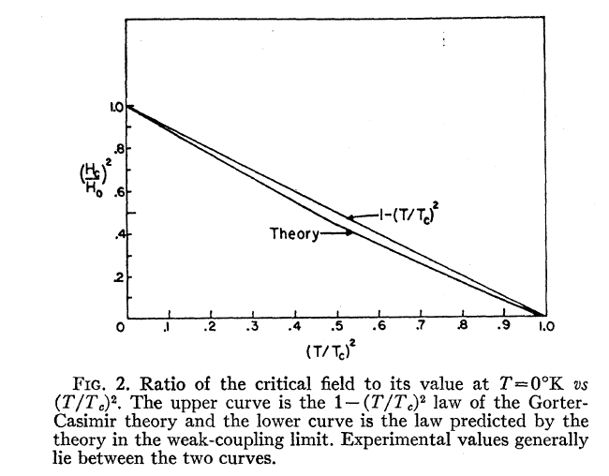
Temperature dependence of critical field
From PR 108, 1175 (1957)
Bardeen, Cooper, and Schrieffer, “Theory of Superconductivity”
characteristic phonon energy
density of electron states at E_{F}
attraction potential between electron pairs

Slide 14
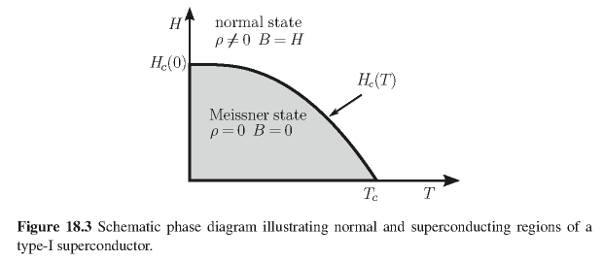
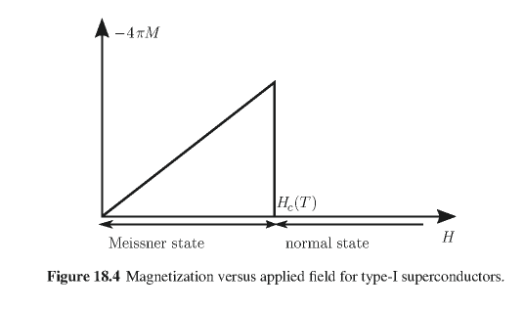
Type I superconductors:

Slide 15
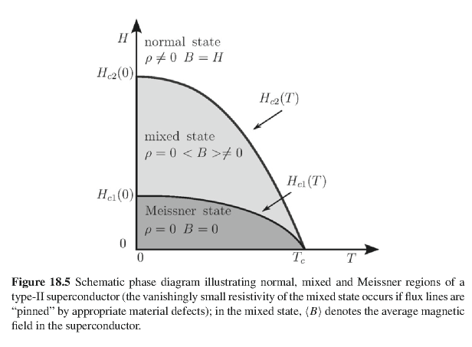
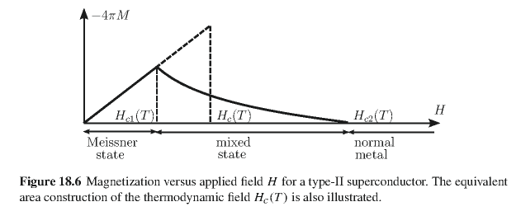
Type II superconductors

Slide 16
Quantization of current flux associated with the superconducting state (Ref: Ashcroft and Mermin, Solid State Physics)

Slide 17
Quantization of current flux associated with the superconducting state -- continued
Suppose a superconducting material has a cylindrical void. Evaluate the integral of the current in a closed path within the superconductor containing the void.
dl
Such “vortex” fields can exist within type II superconductors.

Slide 18
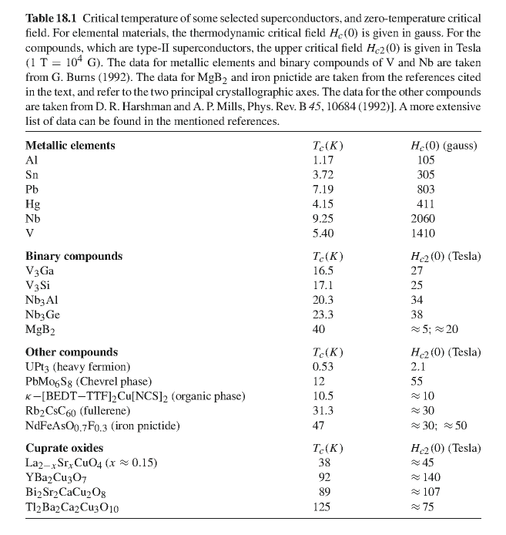

Slide 19
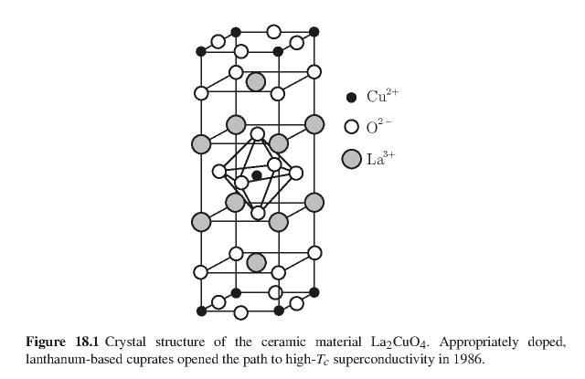
Crystal structure of one of the high temperature superconductors

Slide 20
