Slide 1
PHY 752 Solid State Physics
11-11:50 AM MWF Olin 103
Plan for Lecture 36
Superconductivity (Chap. 18 in GGGPP)
Other references: Schrieffer, Theory of Superconductivity, W. A. Benjamin, Inc. (1964)
Bardeen, Cooper, Scrieffer, Phys. Rev. 108, 1175 (1957)
Cooper pairs
Gap equation
Estimate of T_{c}
Some slides contain materials from GGGPP text.

Slide 2
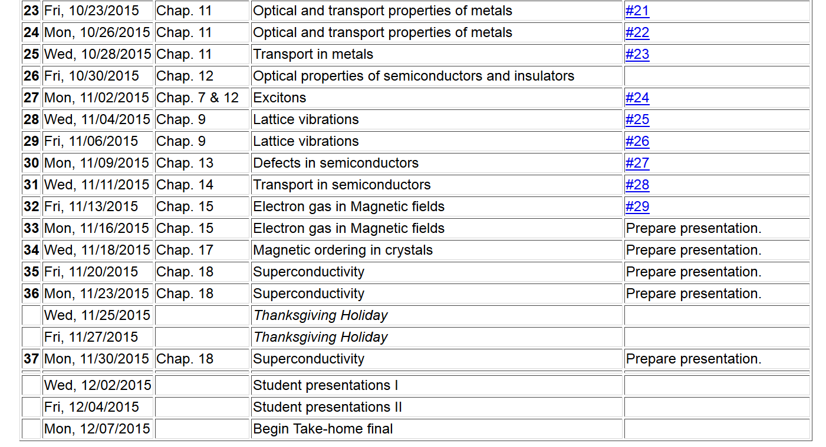
2

Slide 3
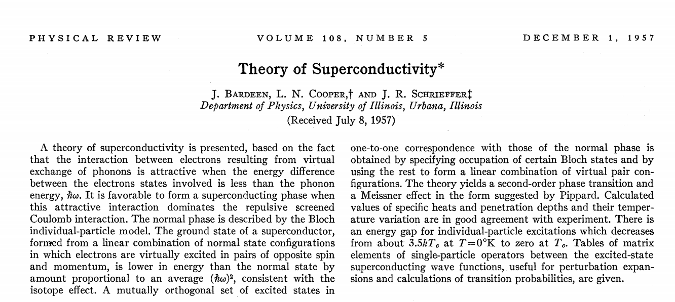

Slide 4
Notion of a Cooper pair
Starting with a material with all the states filled up to the Fermi level, we focus attention on a pair of states which have a net attractive interaction U(r₁,r₂):

Slide 5
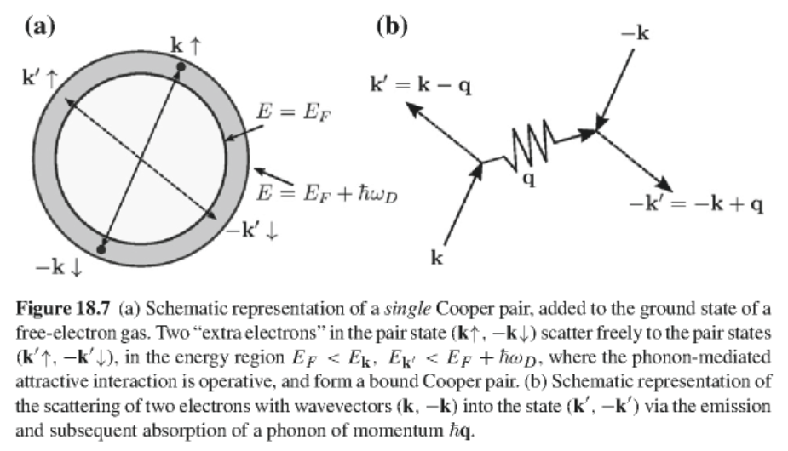

Slide 6
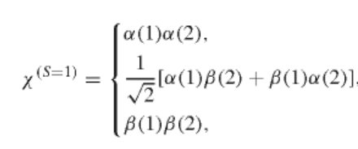
Properties of pair wavefunction
Spin part:
or

Slide 7
Properties of pair wavefunction – continued
Assume that the electron pair can be represented by a linear combination of plane wave states of wavevectors k and -k:

Slide 8
Define Fourier transform of interaction potential:
Equation satisfied by pair amplitude functions:

Slide 9
Cooper pair equations -- continued
Simplified model for interaction:

Slide 10
Cooper pair equations -- continued
Non-trivial solution for singlet state:
E_{pair}
Equation to determine eigenstate energy:
n
Density of states (one electron basis)

Slide 11
Cooper pair equations -- continued
Shows that a singlet Cooper pair is more stable than the independent particle system even for small U_{0.}

Slide 12
Variational determination of the ground-state wavefunction in the BCS model
Second quantization
Note that the Cooper pair singlet state can be written

Slide 13
Variational determination of the ground-state wavefunction in the BCS model -- continued
independent particle states
Cooper-pair interaction
Consider a ground state wavefunction of the form

Slide 14
Variational determination of the ground-state wavefunction in the BCS model -- continued
Need to minimize the expectation value:
After some algebra:

Slide 15
Variational determination of the ground-state wavefunction in the BCS model -- continued
Convenient transformation:
Define:

Slide 16
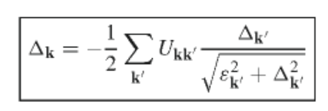
Variational determination of the ground-state wavefunction in the BCS model -- continued
In terms of the “gap parameter” the variational equations become:

Slide 17
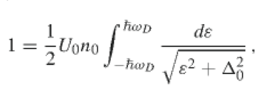
Variational determination of the ground-state wavefunction in the BCS model -- continued
Simplified model
Using DOS:

Slide 18
Variational determination of the ground-state wavefunction in the BCS model -- continued
Solving for the gap parameter:
Estimating the ground state energy of the superconducting state:

Slide 19
Estimating the ground state energy of the superconducting state – continued
Using the variational solution and integrating the DOS:

