Slide 1
PHY 752 Solid State Physics
11-11:50 AM MWF Olin 103
Plan for Lecture 37
Superconductivity (Chap. 18 in GGGPP)
Other references: Schrieffer, Theory of Superconductivity, W. A. Benjamin, Inc. (1964)
Bardeen, Cooper, Scrieffer, Phys. Rev. 108, 1175 (1957)
Review of T=0 analysis
Temperature dependence of superconductivity
Course evaluation forms
Slides contain materials from GGGPP text.

Slide 2
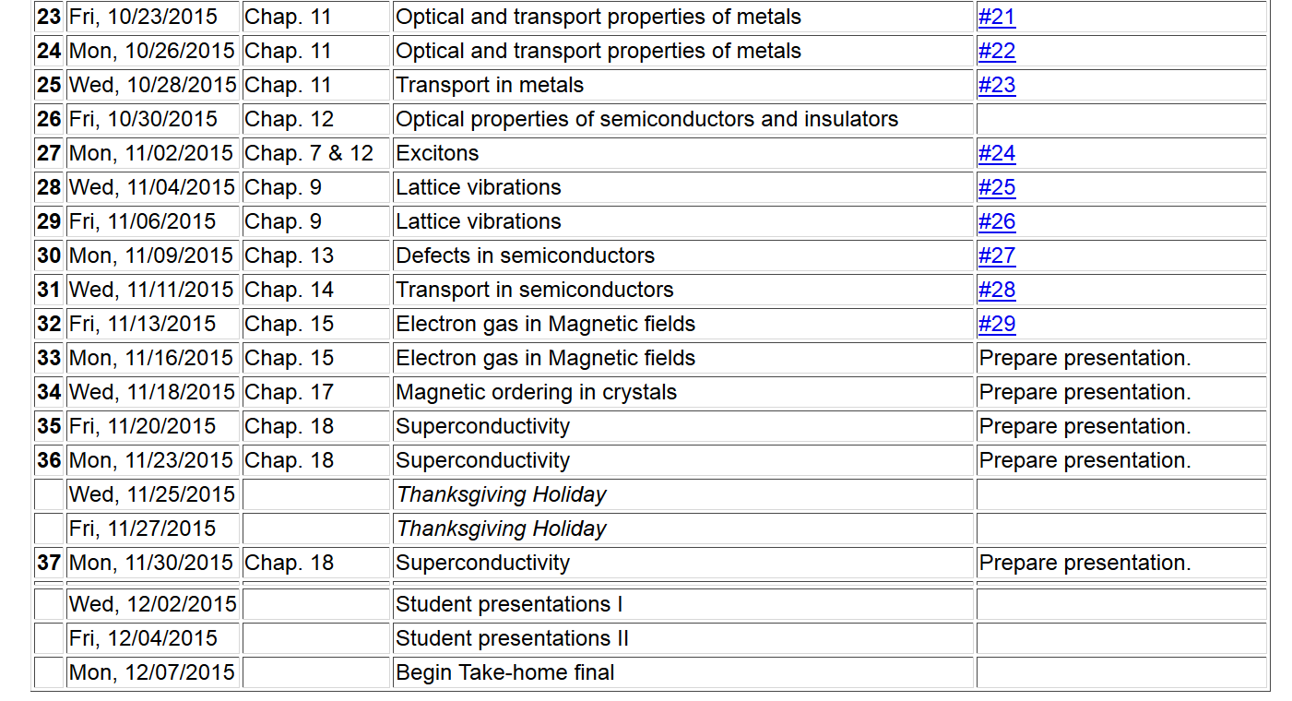
**Note: The final exam has the take-home form similar to that of the mid-term. In order to accommodate your schedules, it will be available on 12/04 and will be due before 9 AM on 12/14.
2

Slide 4
Some guidelines about the presentations
In your presentations, please make sure to acknowledge all of your sources.
We have allotted 25 minutes including questions for each presentation.
In order to encourage participation, points will be awarded for questions from the audience.
For efficiency, you may wish to email me your talk an use my computer for the presentation.
At the end each session, please email me your presentations and any supplementary materials.

Slide 5
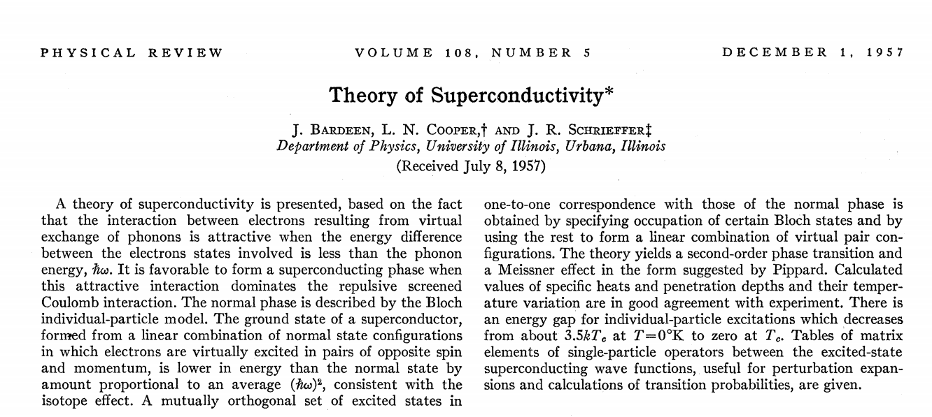

Slide 6
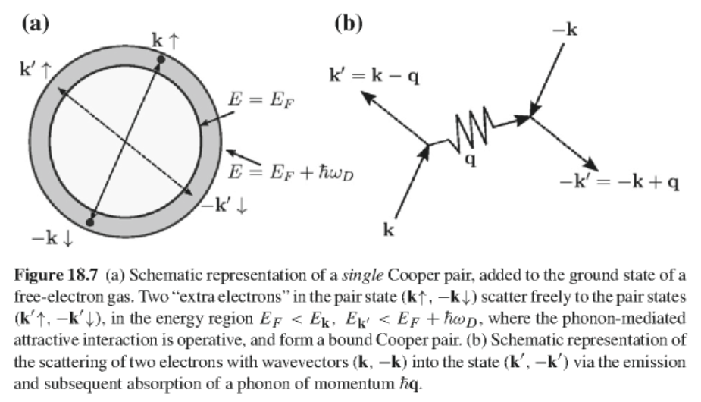
At T=0 K, a pair of electrons with a net attractive interaction are found to be stable:

Slide 7
Variational determination of the ground-state wavefunction in the BCS model
independent particle states
Cooper-pair interaction
Consider a ground state wavefunction of the form
probability amplitude for forming Cooper pair

Slide 8
Variational determination of the ground-state wavefunction in the BCS model -- continued
Need to minimize the expectation value:
After some algebra:

Slide 9
Variational determination of the ground-state wavefunction in the BCS model -- continued
Convenient transformation:
Define:

Slide 10
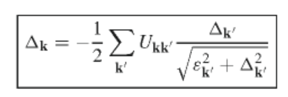
Variational determination of the ground-state wavefunction in the BCS model -- continued
In terms of the “gap parameter” the variational equations become:
Gap equation

Slide 11
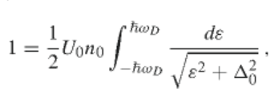
Variational determination of the ground-state wavefunction in the BCS model -- continued
Simplified model
Using DOS:

Slide 12
Variational determination of the ground-state wavefunction in the BCS model -- continued
Solving for the gap parameter:
Estimating the ground state energy of the superconducting state:

Slide 13
Estimating the ground state energy of the superconducting state – continued
Using the variational solution and integrating the DOS:

Slide 14
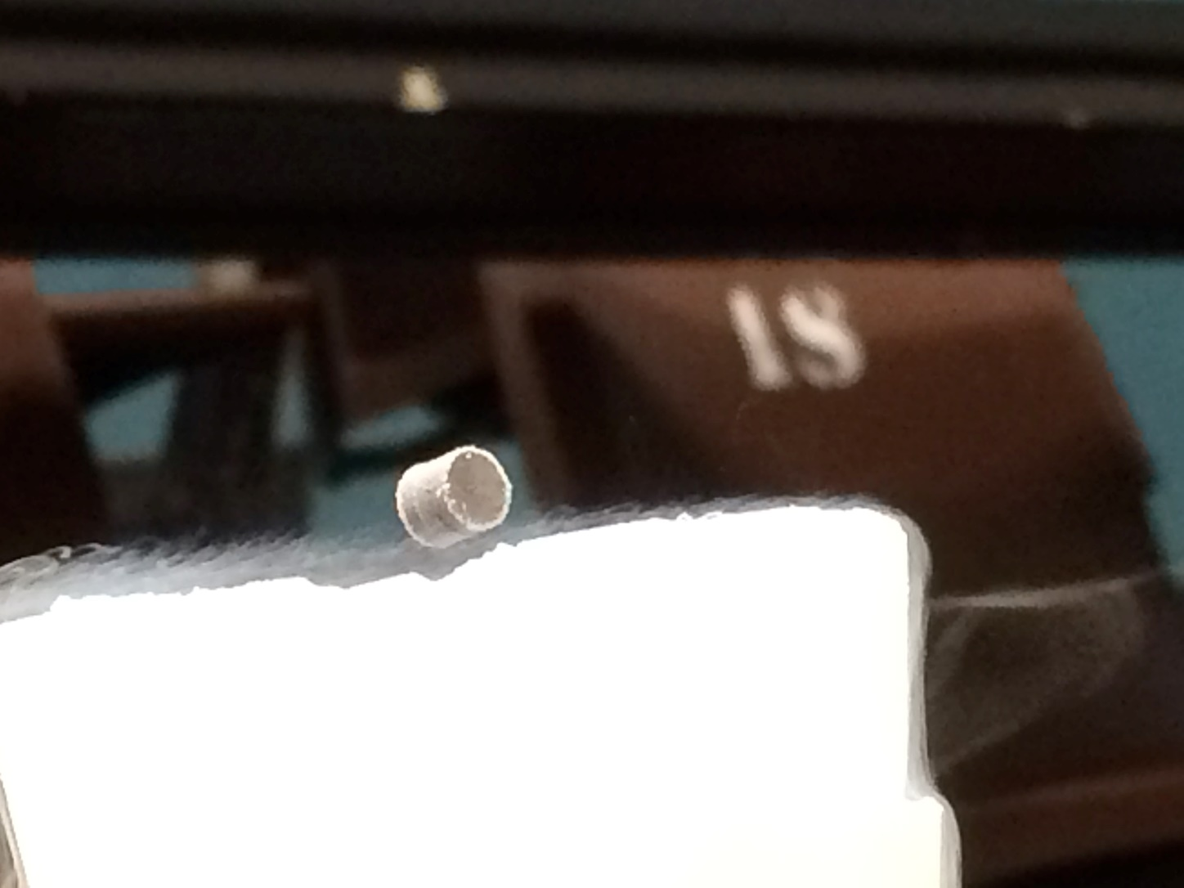

Slide 15
Effects of temperature:
Thermal average of Cooper pair operator:
Define
average
fluctuations

Slide 16
Modified Gap relationship
Fermi-Dirac distribution
Modified Gap equation

Slide 17
Simplified model

Slide 18
Evaluation of the integral

Slide 19
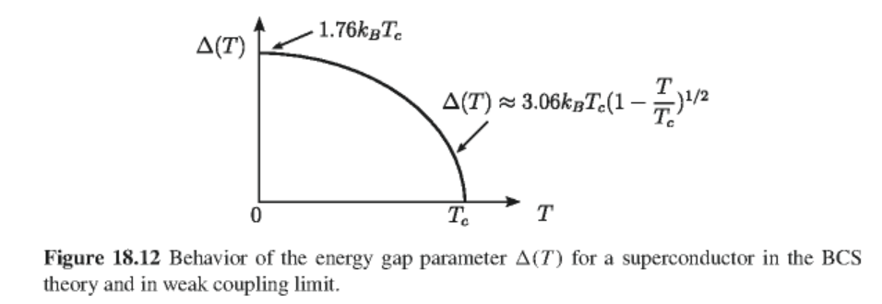
Numerical evaluation of integral:

Slide 20
Estimation of critical magnetic field (BCS paper)
Free energy of normal state
Free energy of superconducting state
After some approximations, etc.:

Slide 21
