Slide 1
PHY 752 Solid State Physics
11-11:50 AM MWF Olin 103
Plan for Lecture 4:
Reading: Chapter 1.6 & 2.1 in GGGPP –electron dynamics in one dimension & introduction to crystal structures
Brief discussion of electron dynamics in one dimension
Bravais lattice structures
Classification of crystal structures

Slide 2
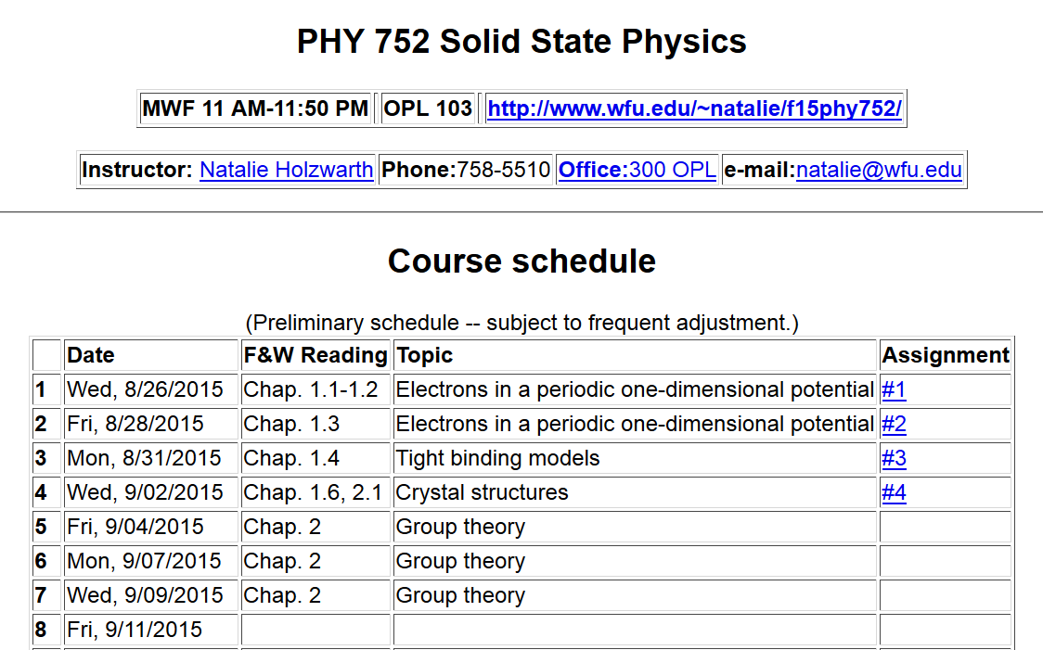

Slide 4
Brief comment on electron dynamics as described by electronic band structure --
Electron velocity:
➔Band dispersion is related to electron velocity

Slide 5
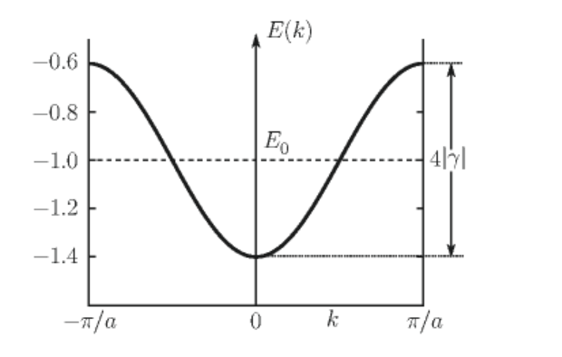
Example of electron band dispersion in one dimension
In practice, electron transport can be well approximated by the Boltzmann equation with the main contributions coming near the Fermi level.

Slide 6
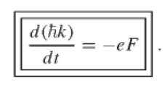
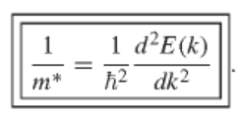
Electron effective mass from semi-classical analysis
For applied force F
1/m*

Slide 7
Classification of crystal structures
14 Bravais lattices
230 space groups

Slide 9
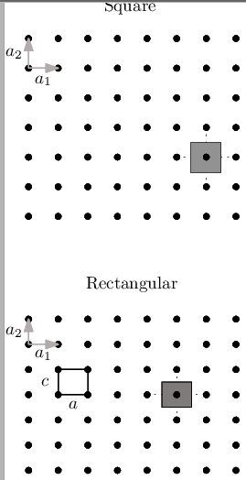
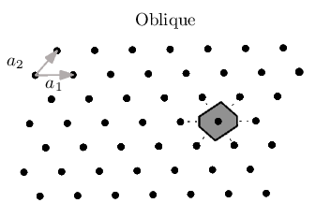
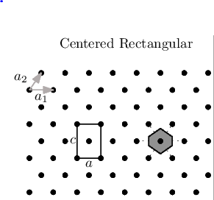
Two-dimensional crystals

Slide 10
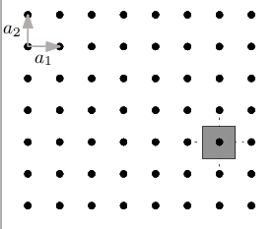
Some details –
square lattice example

Slide 11
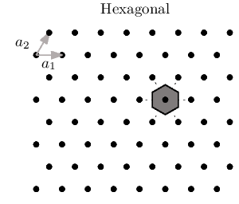
Two-dimensional crystals -- continued

Slide 12
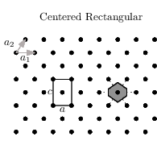
“Conventional” versus “Primitive” unit cell

Slide 13
Primitive translation vectors
Volume of primitive unit cell
| |

Slide 14
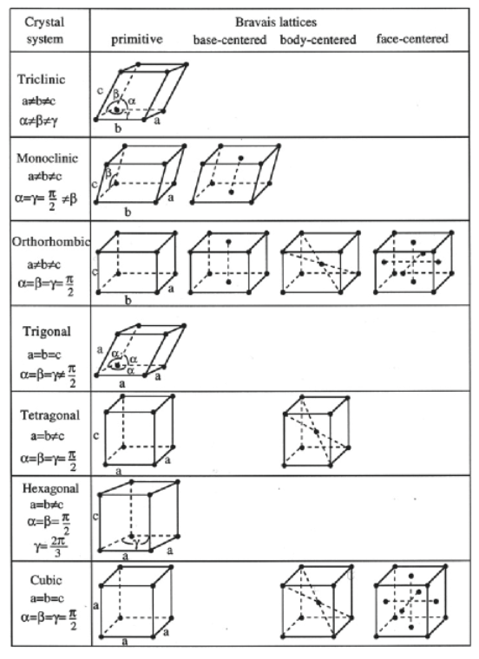

Slide 15
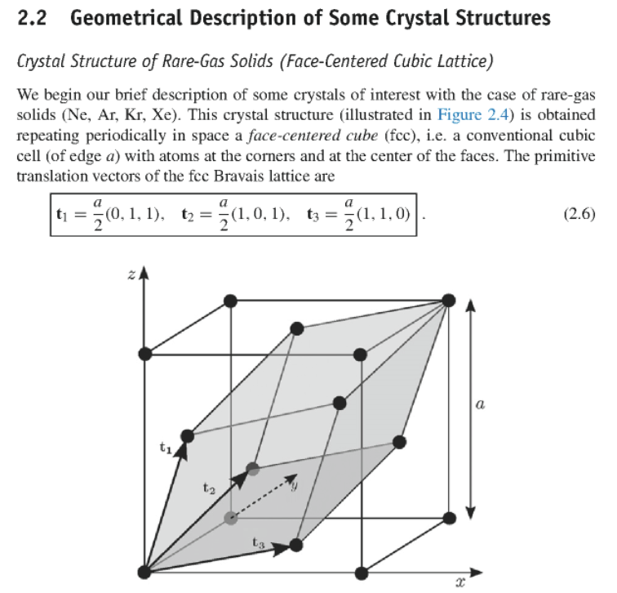
Common examples

Slide 16
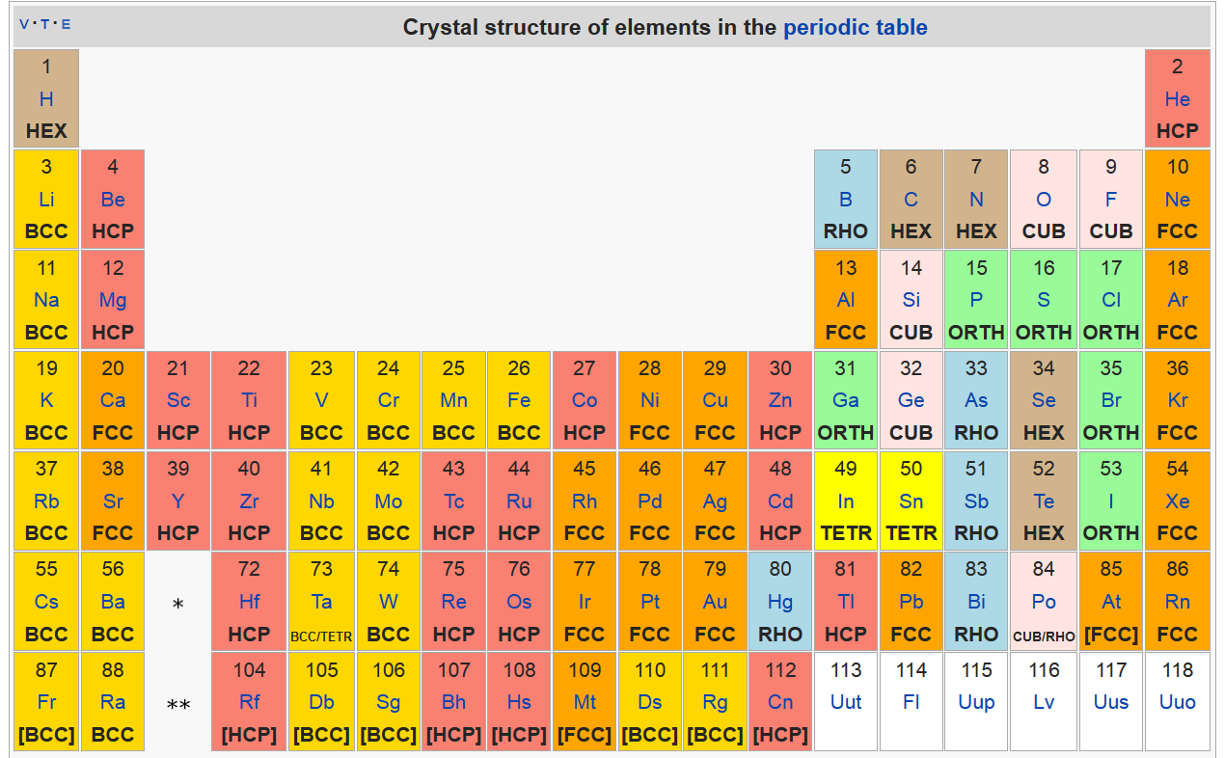
https://en.wikipedia.org/wiki/Periodic_table_(crystal_structure)%29

Slide 17
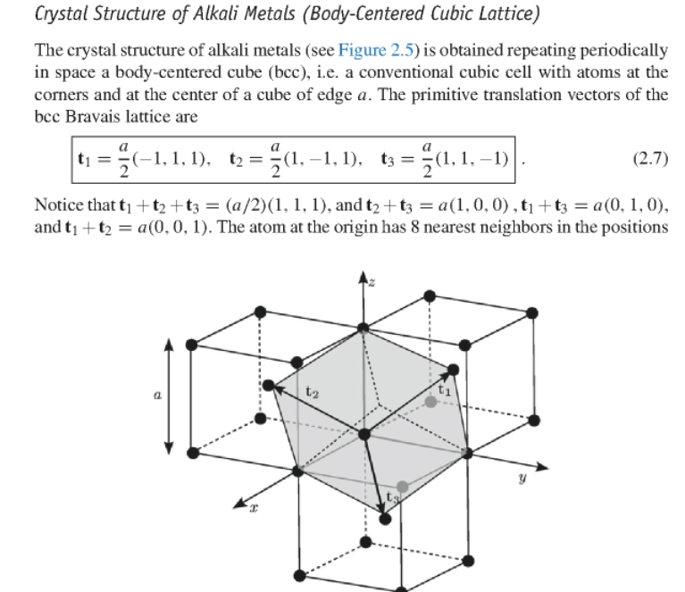

Slide 18
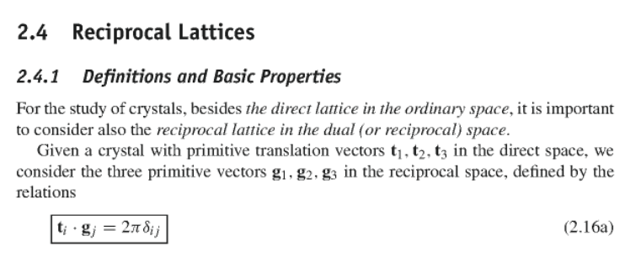
Example: fcc bravais lattice

Slide 19
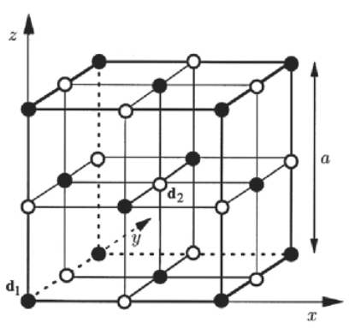
Crystal basis vectors
Example – NaCl having fcc lattice with a basis

Slide 20
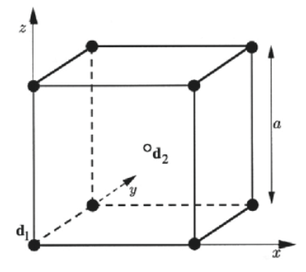
Example – CsCl having sc lattice with a basis

Slide 21
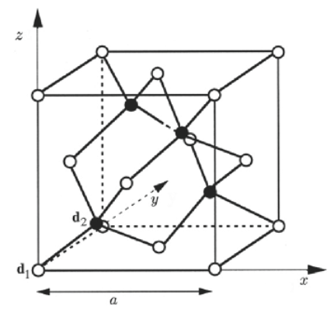
Example – diamond having fcc lattice with a basis

Slide 22
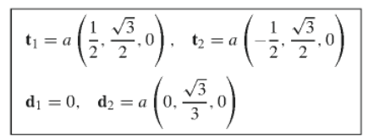
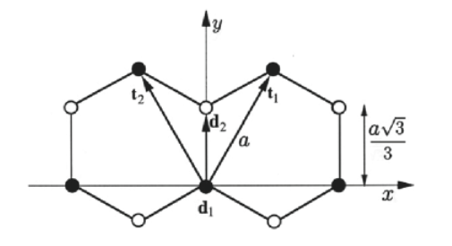
Two-dimensional graphene

Slide 23
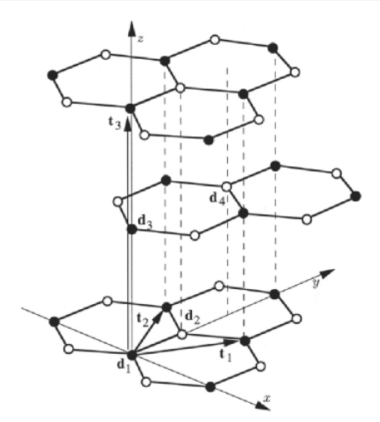
Graphite lattice

