Slide 1
PHY 752 Solid State Physics
11-11:50 AM MWF Olin 103
Plan for Lecture 5:
    Reading: Chapter 2 in GGGPP;
    Crystal structures and brief introduction to group theory
      Survey of crystal structures
      Elements of symmetry
      Some ideas of group theory

Slide 2
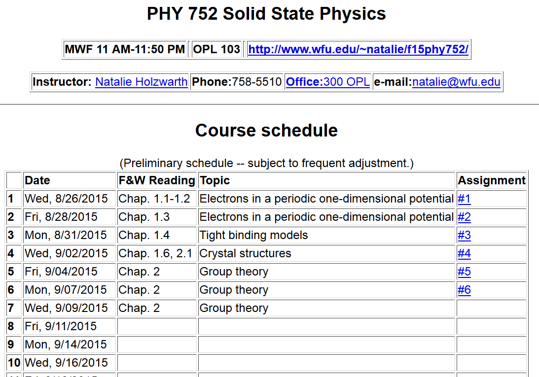

Slide 3
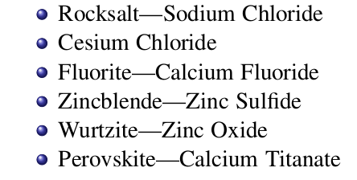
Some common crystal forms found in nature quick review
using some materials from Marder’s text book

Slide 4
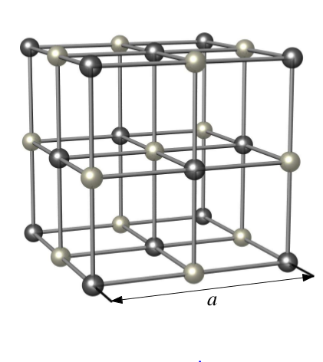
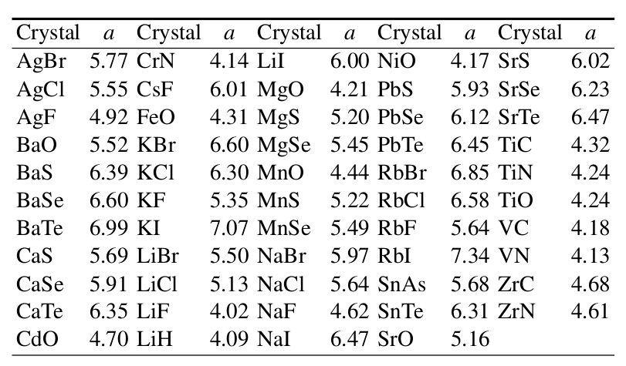
NaCl
Example materials
Face-centered-cubic with basis

Slide 5
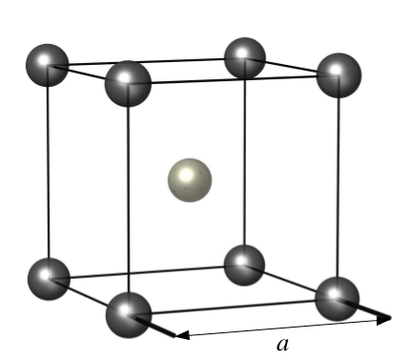
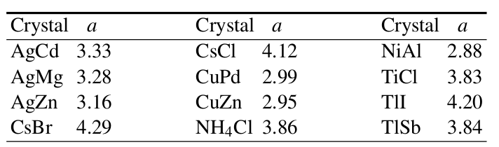
CsCl
Example materials
Simple cubic structure with basis

Slide 6
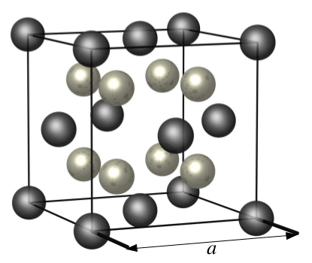
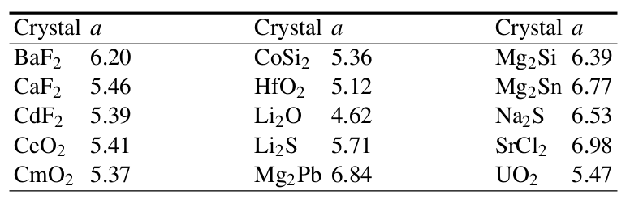
CaF₂
Example materials
Face-centered-cubic with basis

Slide 7
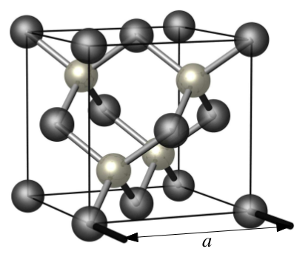
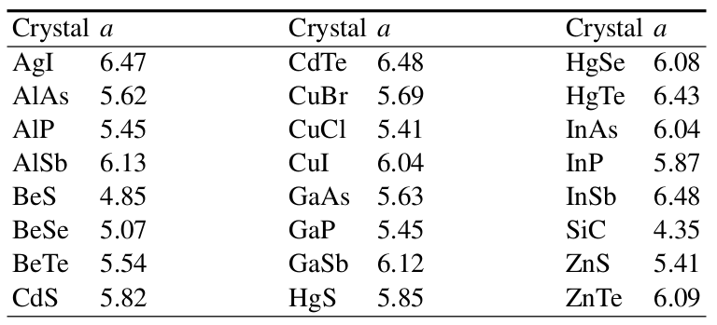
Zincblende
Example materials
Face-centered-cubic with basis

Slide 8
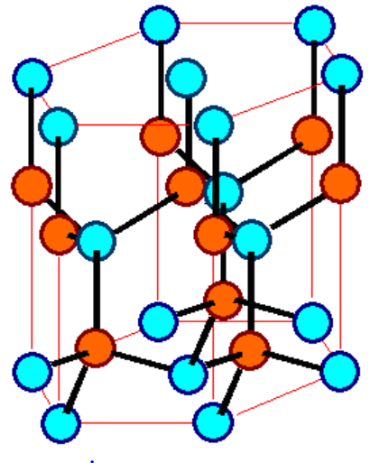
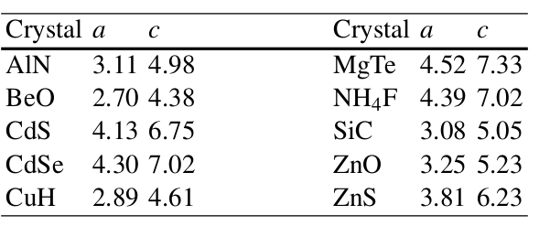
ZnS - Wurtzite
Example materials
Hexagonal structure with basis

Slide 9
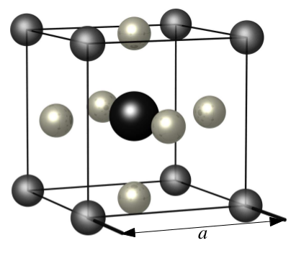
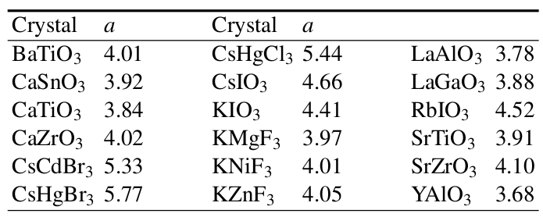
Perovskite
Example materials
Cubic lattice with basis

Slide 10
Systemization of crystal forms
  14 Bravais lattices
  32 Point groups
  230 Space groups
Short digression on abstract group theory
  What is group theory ?
  What is it doing in the course ?

Slide 11
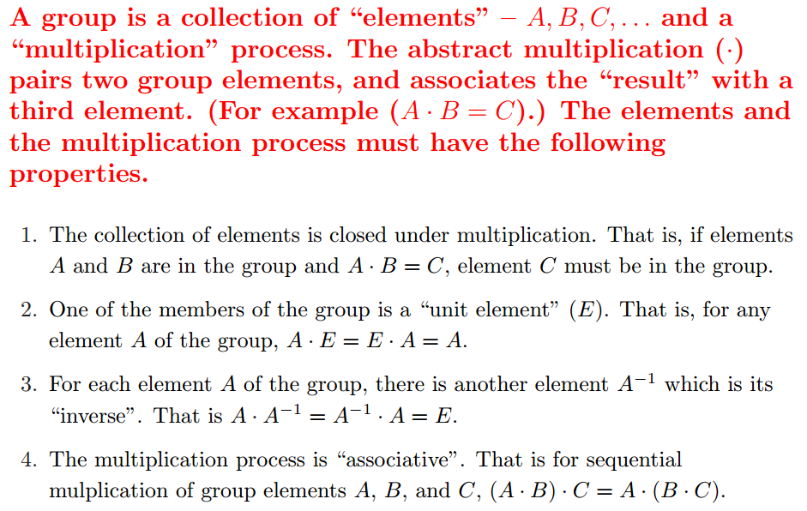
Short digression on abstract group theory
  What is group theory ?

Slide 12
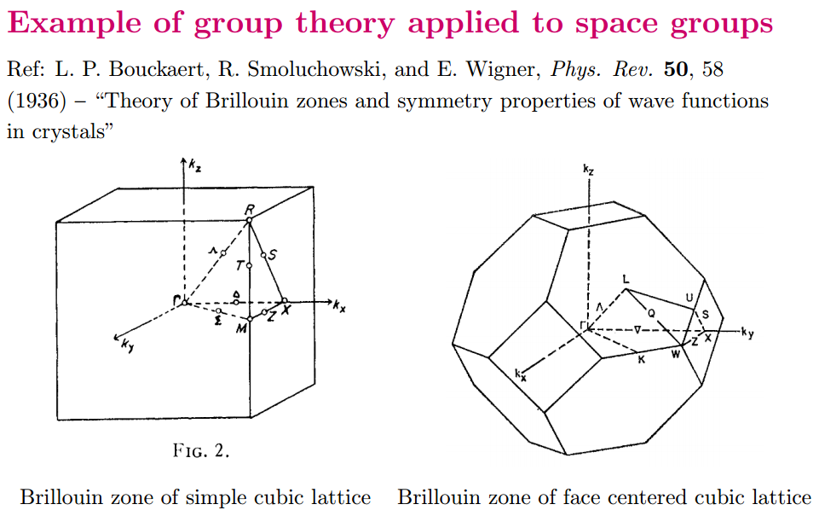
Short digression on abstract group theory
    What is group theory doing in a solid state physics class?

Slide 13
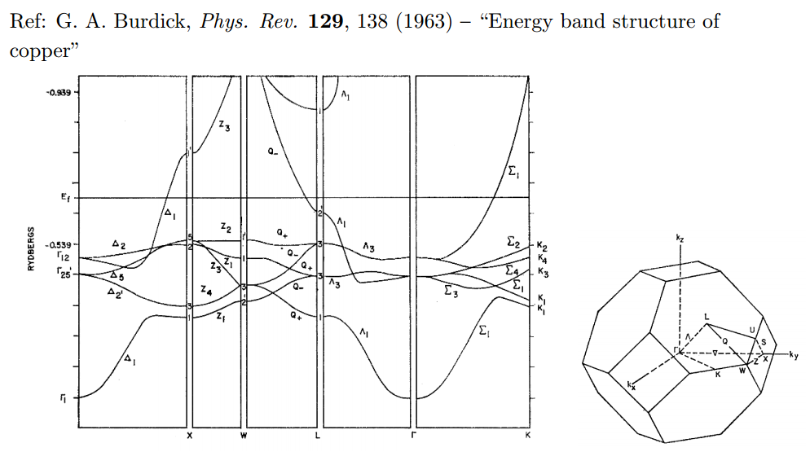
Example of space group theory in band structure analysis

Slide 14
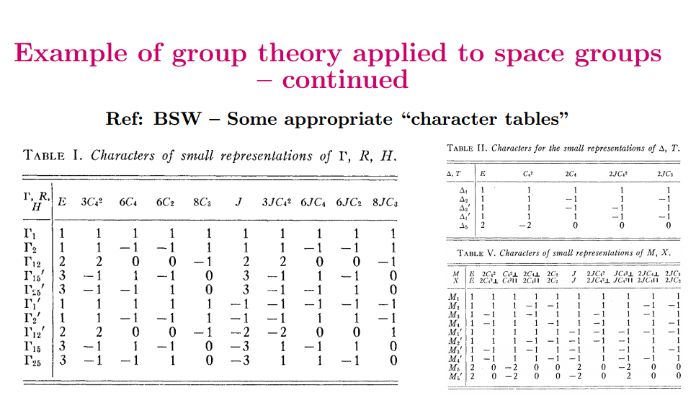

Slide 15
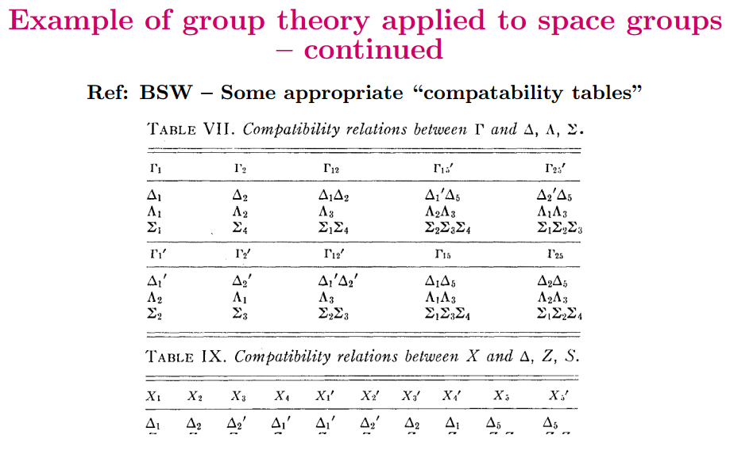

Slide 16
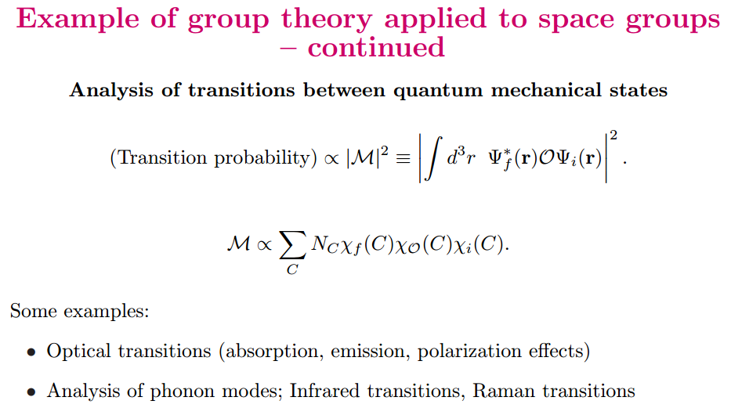

Slide 17
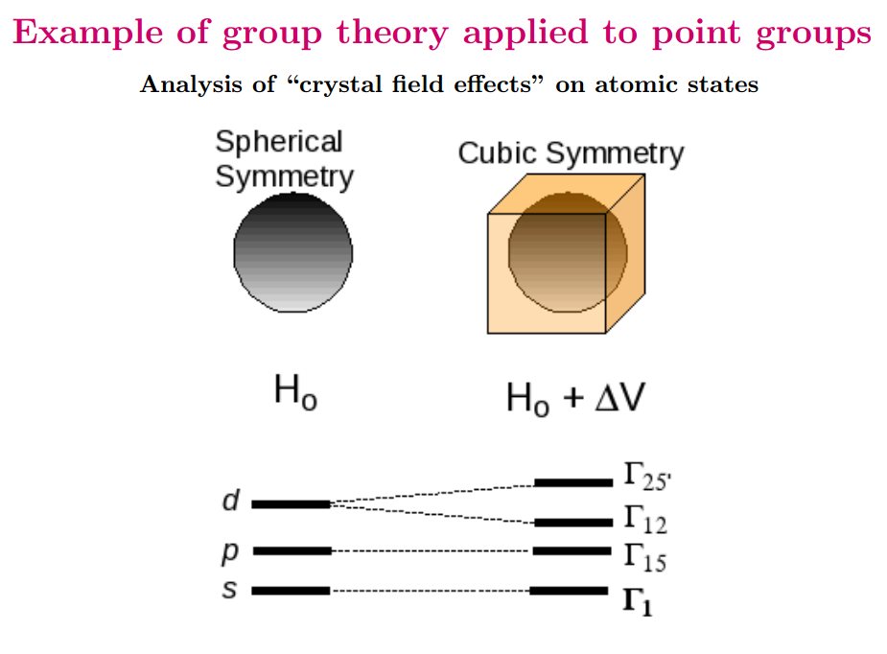

Slide 18
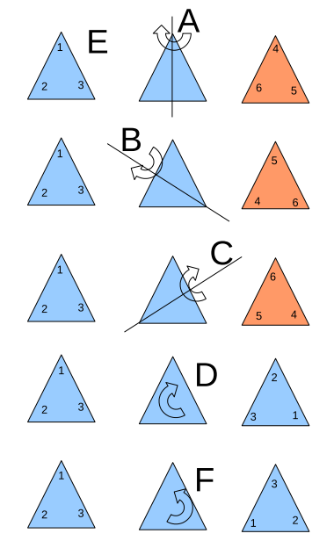
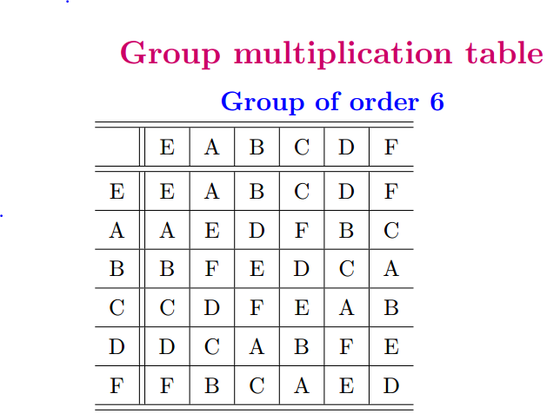
Example of a 6-member group E,A,B,C,D,F,G

Slide 19
Check on group properties:
Closed; multiplication table uniquely generates group members.
Unit element included.
Each element has inverse.
Multiplication process is associative.
Definitions
  Subgroup: members of larger group which have the property of a group
  Class: members of a group which are generated by the construction

