Slide 1
PHY 752 Solid State Physics
11-11:50 AM MWF Olin 103
Plan for Lecture 6:
Reading: Chapter 2 in GGGPP;
Continued brief introduction to group theory
Group multiplication tables
Representations of groups
The “great” orthogonality theorem

Slide 2
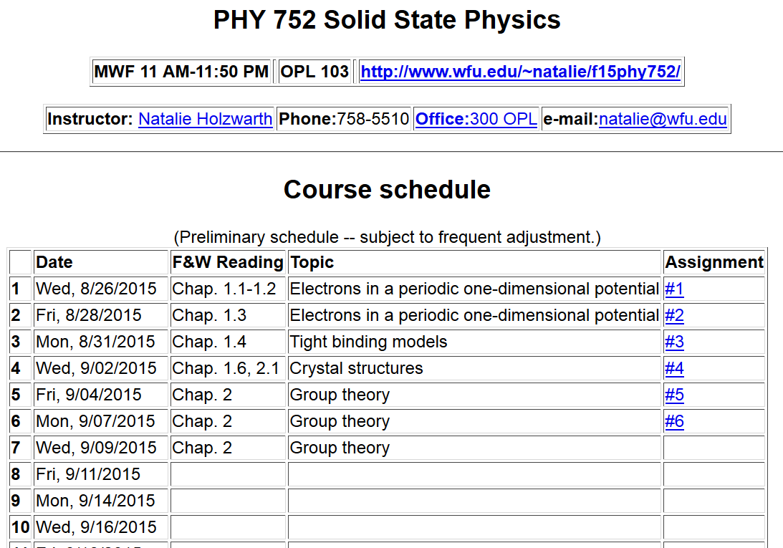

Slide 3
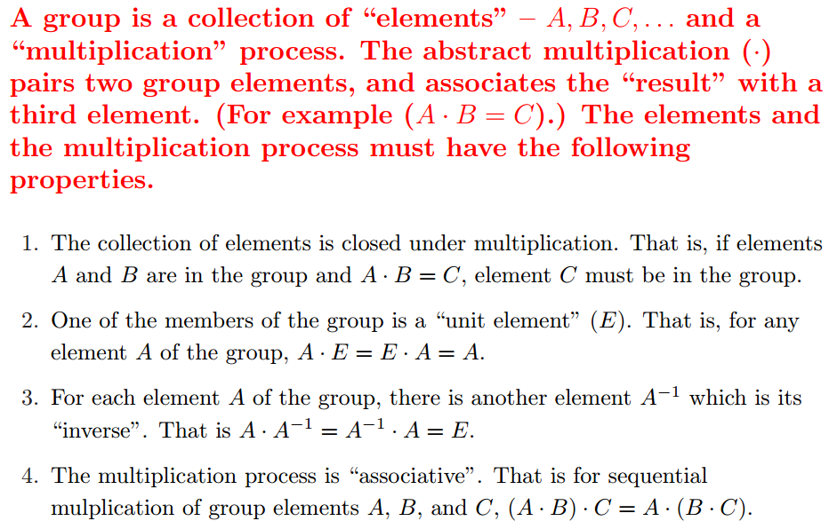
Short digression on abstract group theory
What is group theory ?

Slide 4
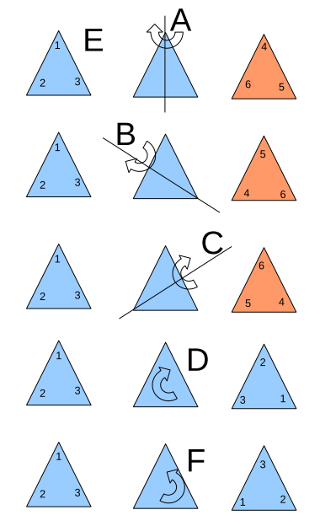
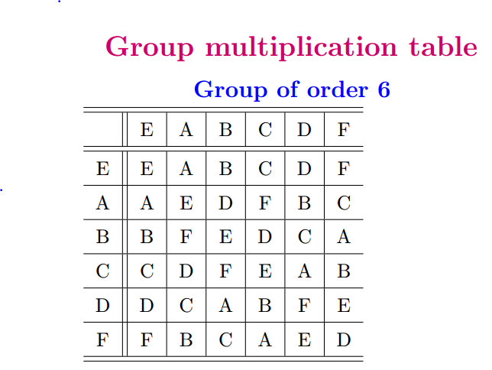
Example of a 6-member group E,A,B,C,D,F,G

Slide 5
Check on group properties:
Closed; multiplication table uniquely generates group members.
Unit element included.
Each element has inverse.
Multiplication process is associative.
Definitions
Subgroup: members of larger group which have the property of a group
Class: members of a group which are generated by the construction

Slide 6
Group theory – some comments
The elements of the group may be abstract; in general, we will use them to describe symmetry properties of our system
Representations of a group

Slide 7
Example:

Slide 8
Example:

Slide 9
What about 3 or 4 dimensional representations for this group?
The only “irreducible” representations for this group are 2 one-dimensional and 1 two-dimensional

Slide 10
Comment about representation matrices
Typically, unitary matrices are chosen for representations
Typically representations are reduced to block diagonal form and the irreducible blocks are considered in the representation theory

Slide 11
The great orthogonality theorem

Slide 12
Great orthogonality theorem continued

Slide 13
Simplified analysis in terms of the “characters” of the representations
Character orthogonality theorem
Note that all members of a class have the same
character for any given representation i.

