Slide 1
PHY 752 Solid State Physics
11-11:50 AM MWF Olin 103
Plan for Lecture 7:
Reading: Chapter 2 in GGGPP;
Continued brief introduction to group theory*
The “great” orthogonality theorem
Character tables
Examples
References: Tinkham, “Group Theory and Quantum Mechanics” (1964)
Dresselhaus, Dresselhaus, Jorio, “Group Theory – Application to the Physics of Condensed Matter” (2008)

Slide 2
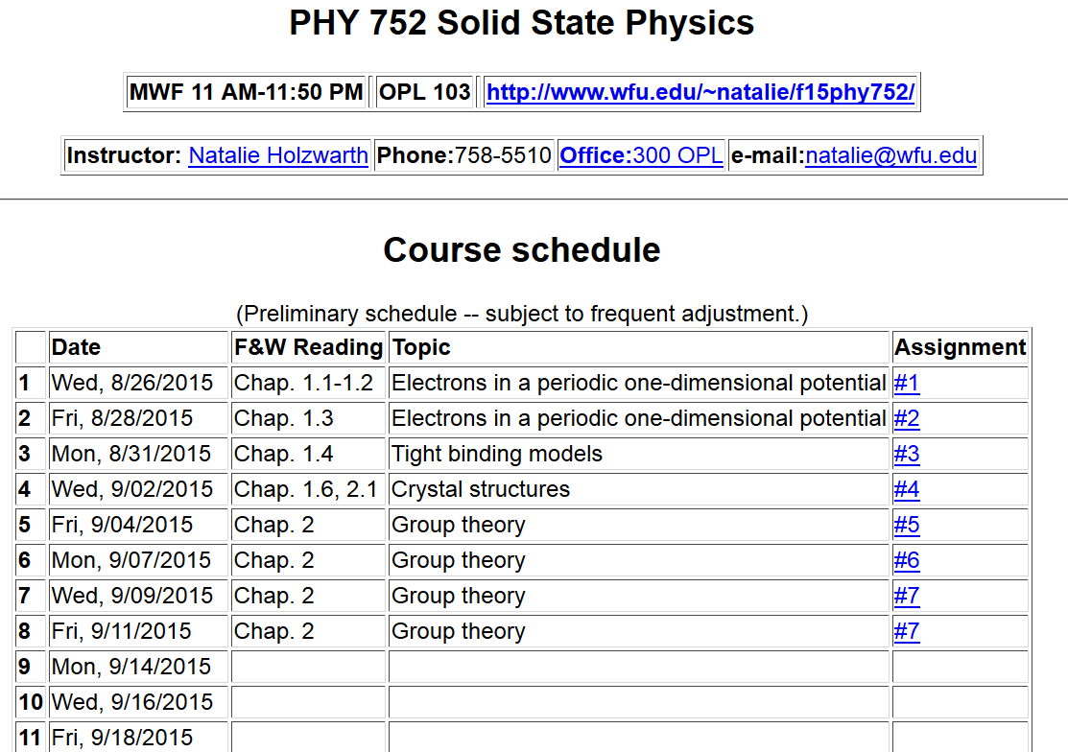

Slide 5
Results from last time --
The great orthogonality theorem

Slide 6
Results from last time -- continued
Character orthogonality theorem:

Slide 7
Example:

Slide 8
Character table for this group:
 | E | A,B,C | D,F
χ¹ | 1 | 1 | 1
χ² | 1 | -1 | 1
χ³ | 2 | 0 | -1
Using the class structure
Let C denote a class in the group with N_{c} members

Slide 9
Character table for this group:
 | E | A,B,C | D,F
χ¹ | 1 | 1 | 1
χ² | 1 | -1 | 1
χ³ | 2 | 0 | -1
Use of character table for analyzing matrix elements:

Slide 10
Matrix element example -- continued
Initial
state
Operator
Final
state

Slide 11
Matrix element example -- continued
 | E | A,B,C | D,F
χ¹ | 1 | 1 | 1
χ² | 1 | -1 | 1
χ³ | 2 | 0 | -1

Slide 12
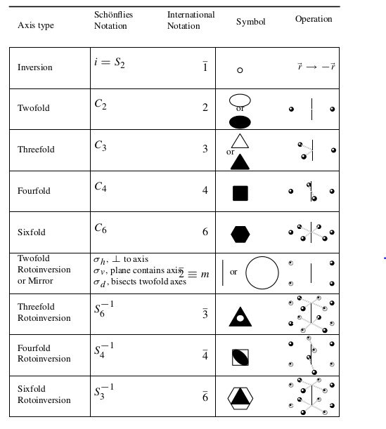
Some crystal symmetries

Slide 13
Some crystal symmetries -- cubic symmetry
Point groups -- 32 in all
Space groups (point groups + translations) – 230 in all

Slide 14
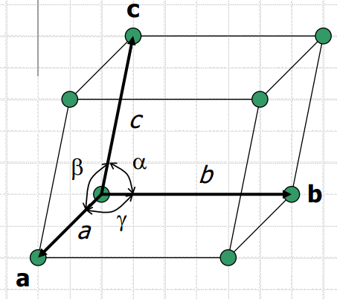
Bravais lattice ⬅➔ Reciprocal lattice

Slide 15
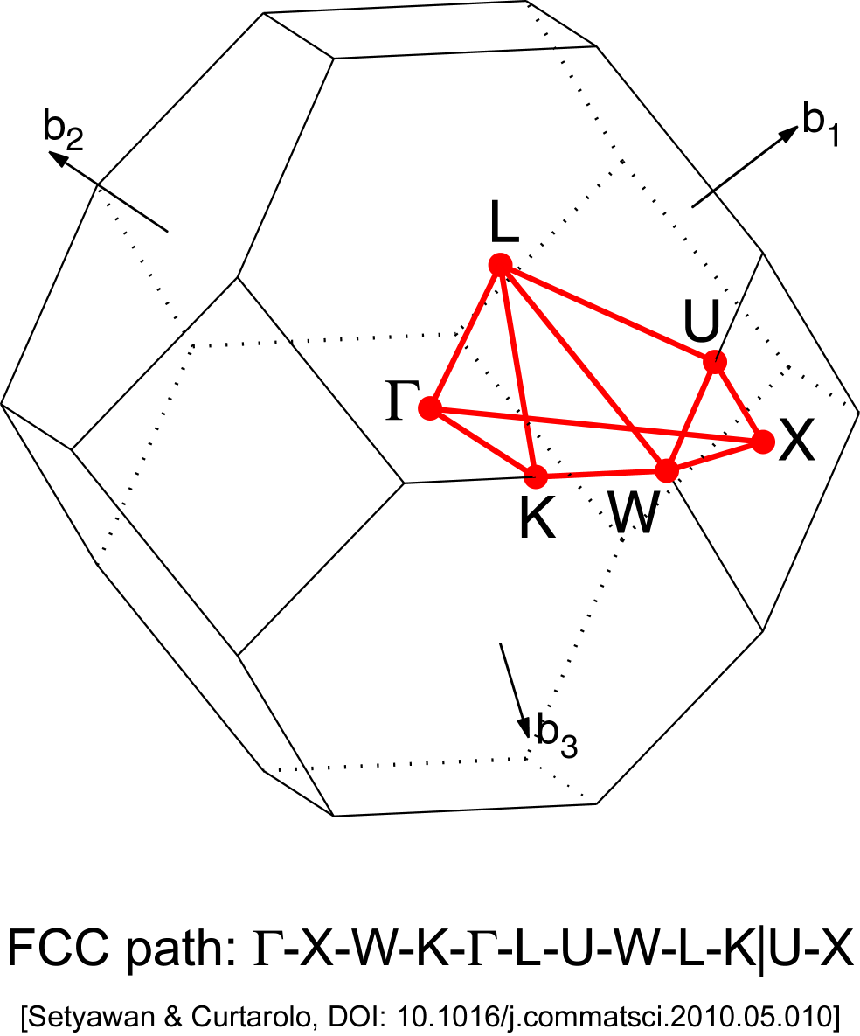
Symmetry associated with wavevector k
Wigner-Seitz cell of the reciprocal lattice exhibits the symmetry of the wavevectors k
Brillouin zone for fcc lattice

Slide 16
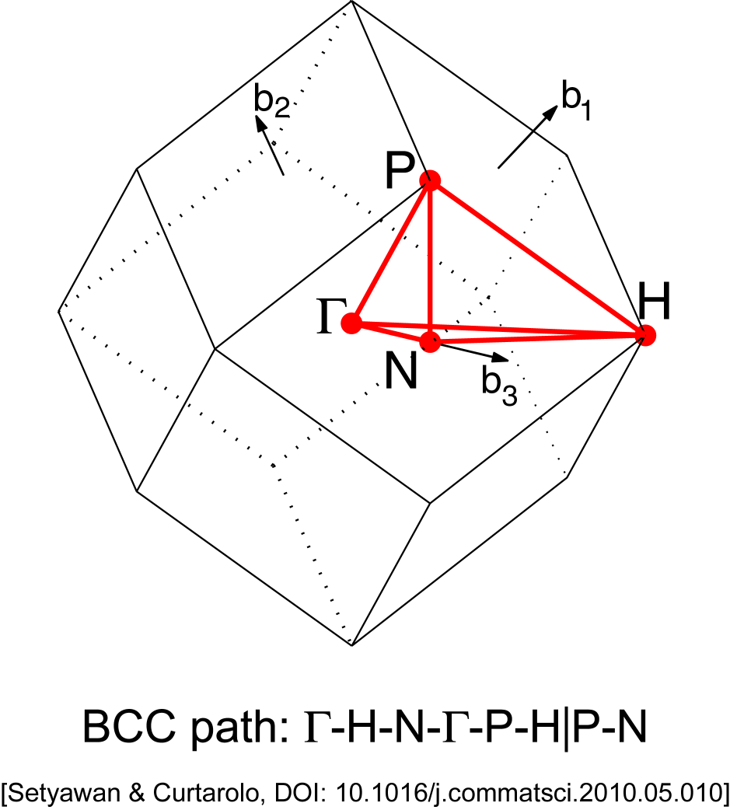

Slide 17
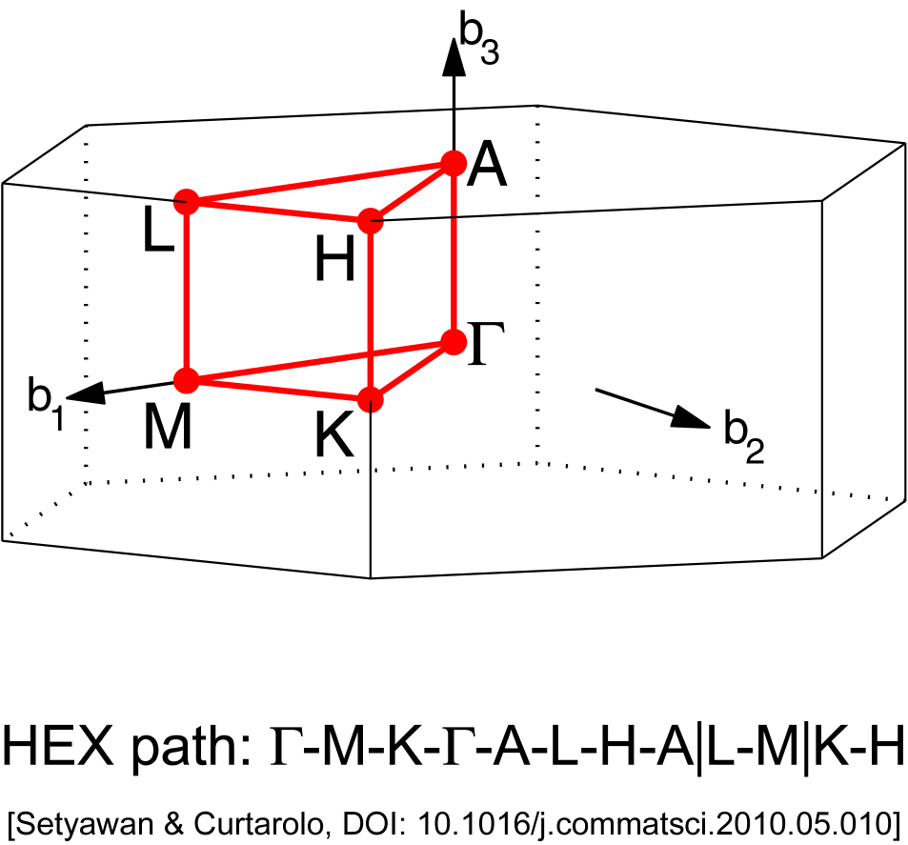
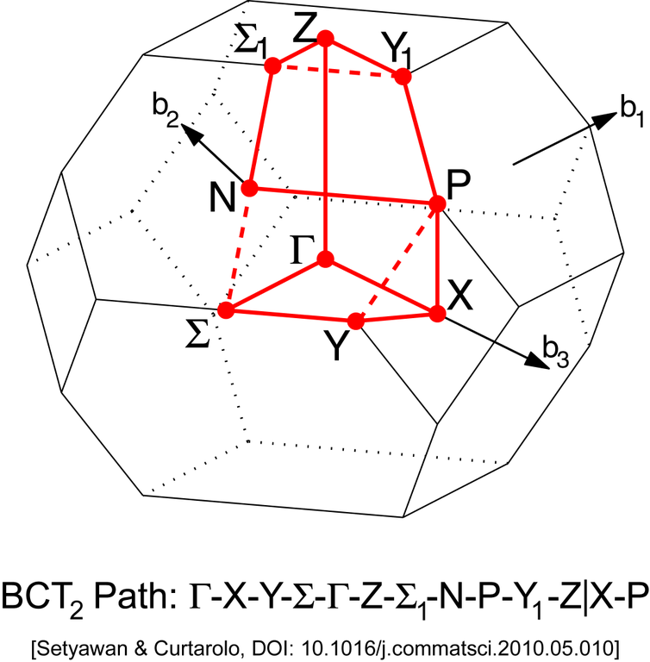

Slide 18
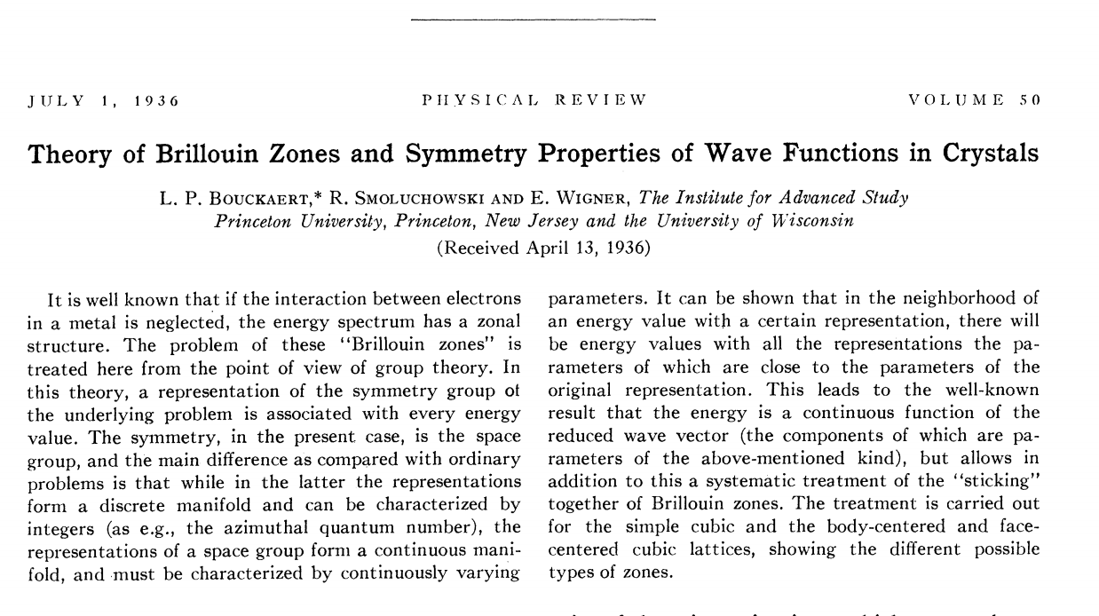

Slide 19
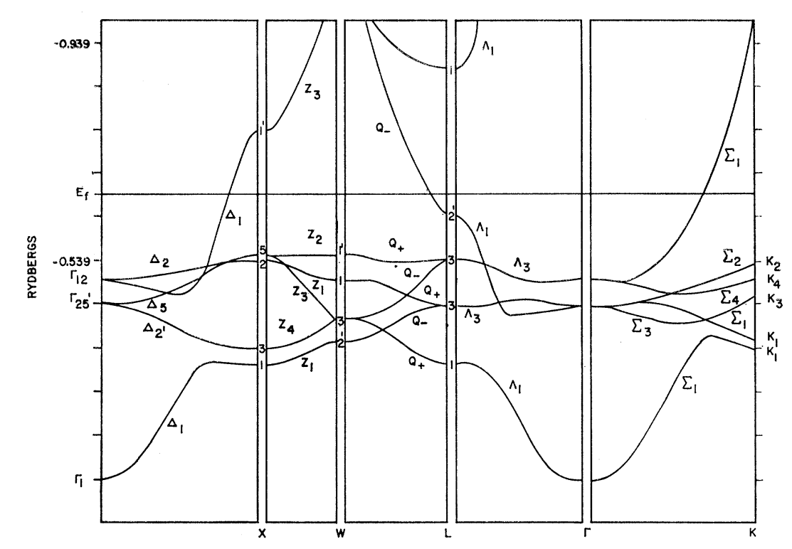
Band structure diagram for fcc Cu (Burdick, PR 129 138-159 (1963))

Slide 20
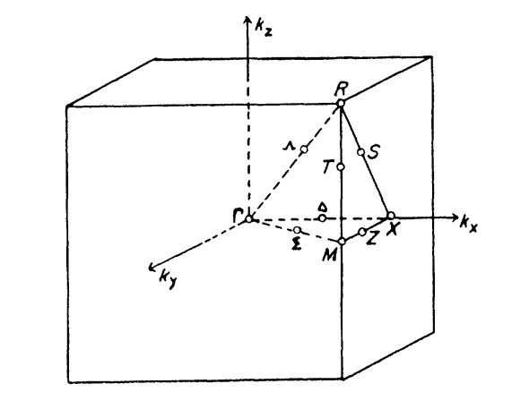
Brillouin zone for simple cubic lattice

Slide 21
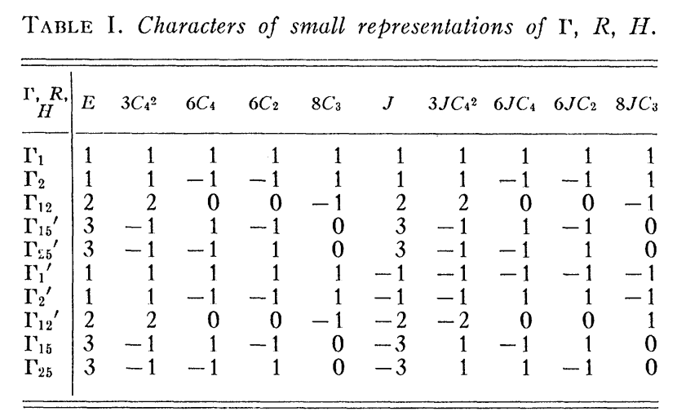
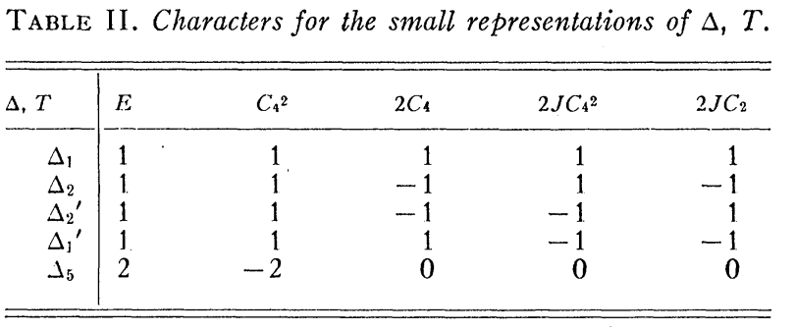

Slide 22
