Slide 1
PHY 752 Solid State Physics
11-11:50 AM MWF Olin 103
Plan for Lecture 8:
    Reading: Chap. 2 in GGGPP;
    Conclude brief introduction to group theory
      Compatibility relations for representations
      Crystal field splitting
      International Tables for Crystallography

Slide 2
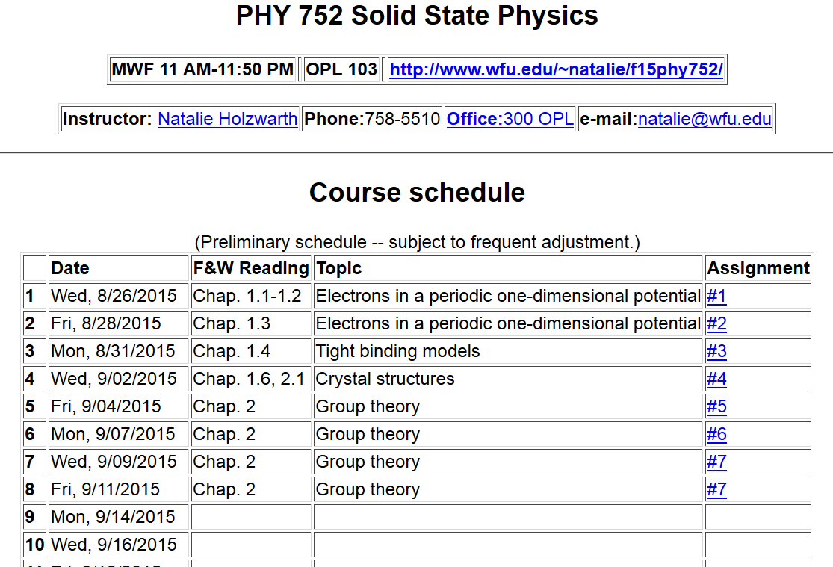

Slide 3
Results from last time --
The great orthogonality theorem

Slide 4
Results from last time -- continued
Character orthogonality theorem:
Number of elements in class C

Slide 5
Summary of relationships between the characters and classes of a group which follow from the great orthogonality theorem
These results also imply that the number of classes is the same as the number of characters in a group.

Slide 6
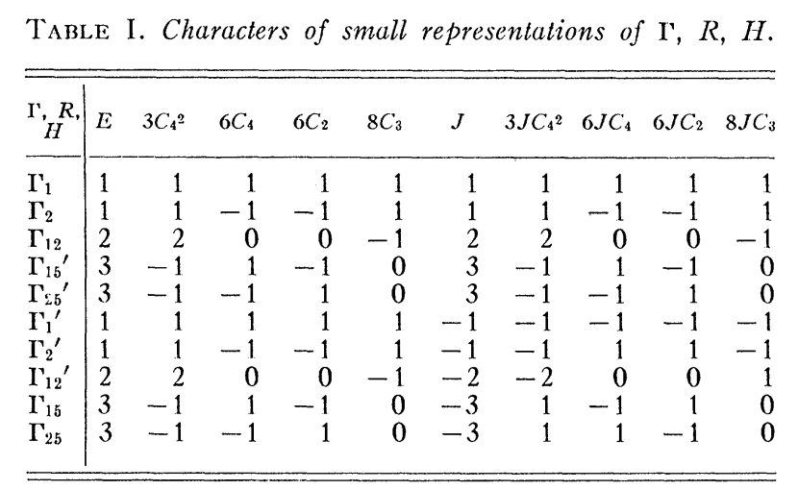
Example character table for cubic group corresponding to point symmetry of Brillouin zone at k=0

Slide 7
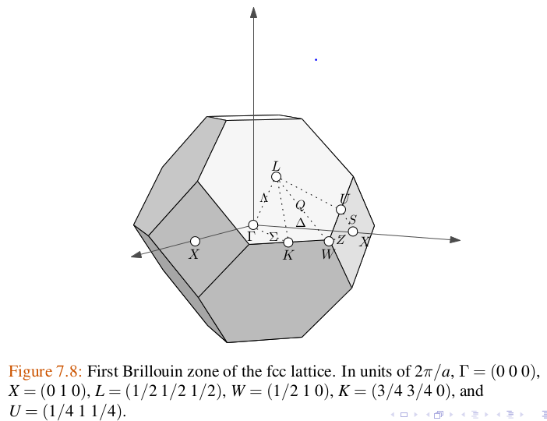
purely periodic

Slide 8
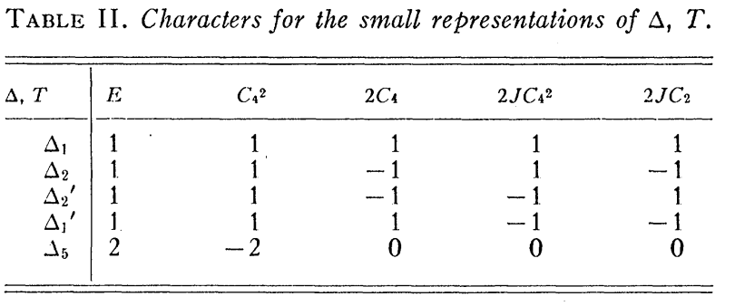
How do states at k=0 “connect” with states with

Slide 9
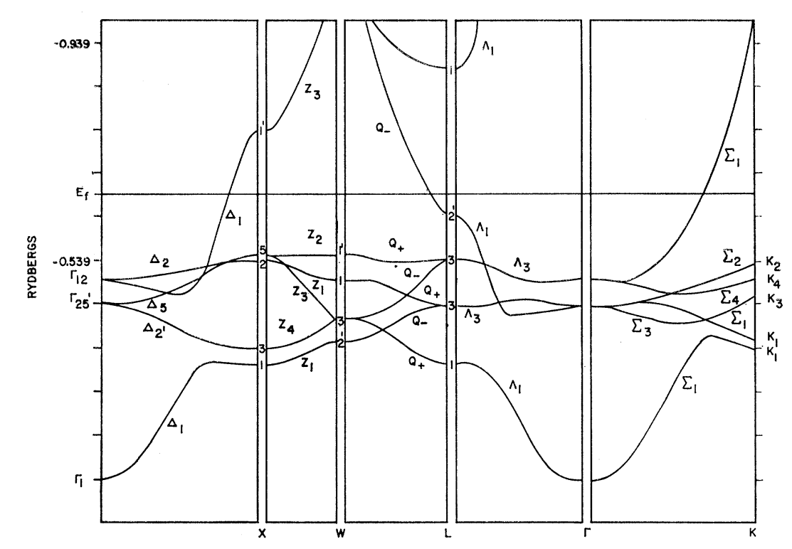
Band structure diagram for fcc Cu (Burdick, PR 129 138-159 (1963))

Slide 10
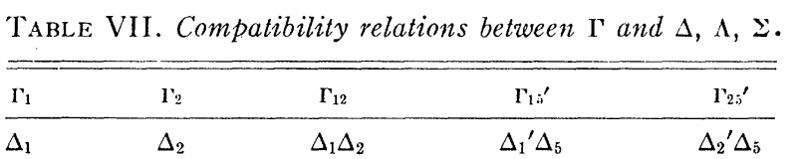

Slide 11
Example
Δ | E | C₄² | 2C₄ | 2JC₄² | 2JC₂
Γ_{25’} | 3 | -1 | -1 | -1 | 1
Δ_{2’} | 1 | 1 | -1 | -1 | 1
Δ₅ | 2 | -2 | 0 | 0 | 0

Slide 12
Use of character table analysis in crystal field splitting
  Question: What happens to a spherical atom when placed in a crystal?
The group which describes the general rotations in 3-dimensions has an infinite number of members, but an important representation of this group is the matrix which rotates to coordinate system about the origin R, transforming

Slide 13
Analysis of the 3-dimensional rotation group -- continued

Slide 14
Compatibility of continuous rotation group with the cubic group:
l=0 1 1 1 1 1 1 1 1 1 1
l=1 3 -1 1 -1 0 -3 1 -1 1 0
l=2 5 1 -1 1 -1 5 1 -1 1 -1

Slide 15
Γ₁
l=0 1 1 1 1 1 1 1 1 1 1
l=1 3 -1 1 -1 0 -3 1 -1 1 0
l=2 5 1 -1 1 -1 5 1 -1 1 -1
Γ₁₅
Γ₁₂+Γ_{25’}

Slide 16
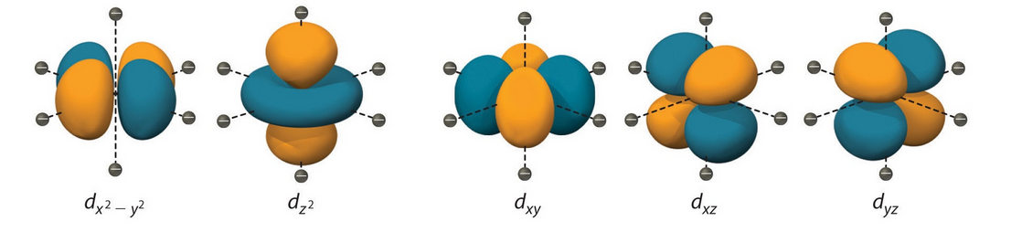
Visualization of l=2 orbitals from http://chemwiki.ucdavis.edu/Inorganic_Chemistry/Crystal_Field_Theory/Crystal_Field_Theory
Γ₁₂
Γ_{25’}
Octahedral symmetry

Slide 17
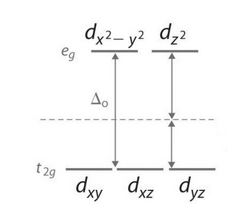
Octahedral symmetry effects on d-orbitals
Γ₁₂ =e_{g}
Γ_{25’}=t_{2g}
Energy diagram

Slide 18
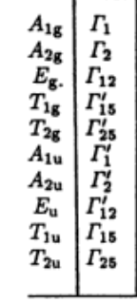
Comment on representation notations for cubic group

Slide 19
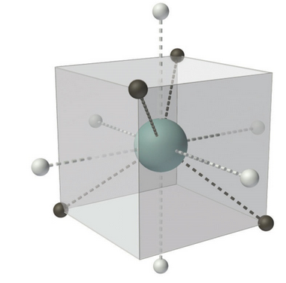
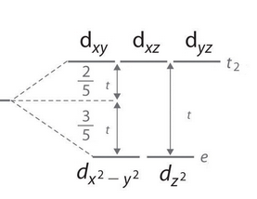
Tetrahedral symmetry effects on d-orbitals
Γ₁₂ =e_{g}
Γ_{25’}=t_{2g}

Slide 20
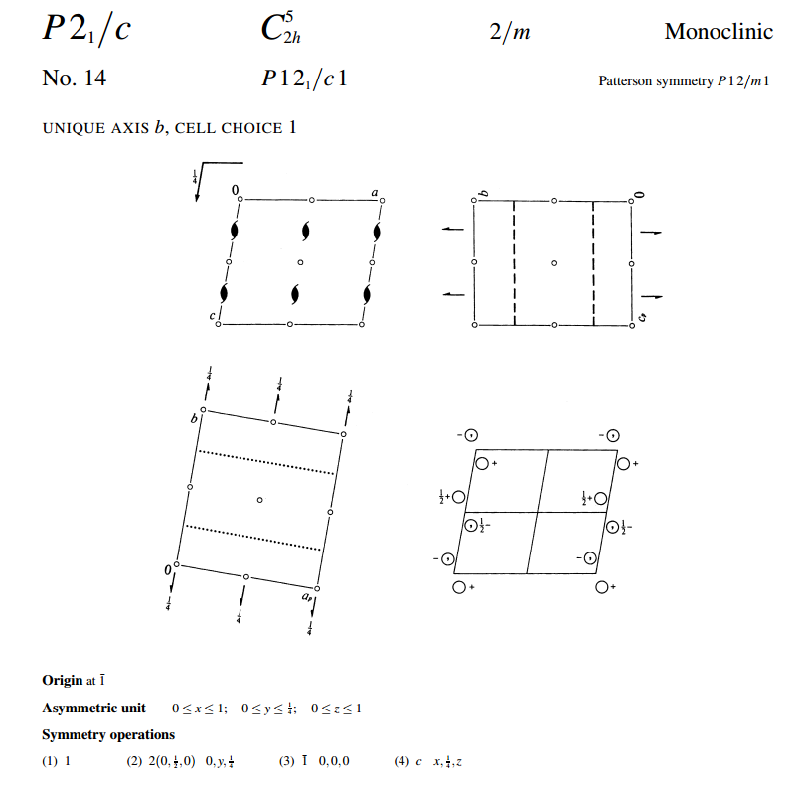
Symmetry information available in the
International Tables for Crystallography
http://it.iucr.org/

Slide 21
