Slide 1
PHY 752 Solid State Physics
11-11:50 AM MWF Olin 103
Plan for Lecture 9:
Reading: Chap. 2.4-2.7 in GGGPP;
Brillouin zones and densities of states
Reciprocal lattices
k·p perturbation theory
Densities of states

Slide 2
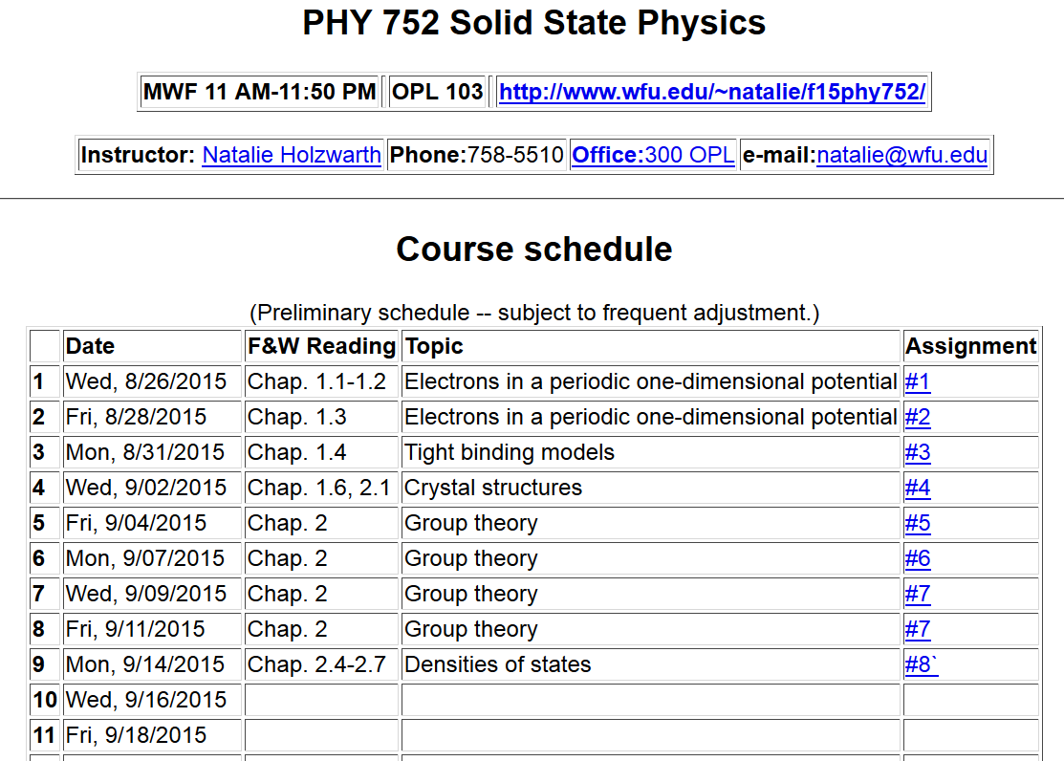

Slide 3
Reciprocal lattice
real lattice
reciprocal lattice
Unit vectors of the reciprocal lattice
General reciprocal lattice vector

Slide 4
Useful relationships between lattice vectors
➔ This implies that the distance between successive lattice planes is given by
Note that:

Slide 5
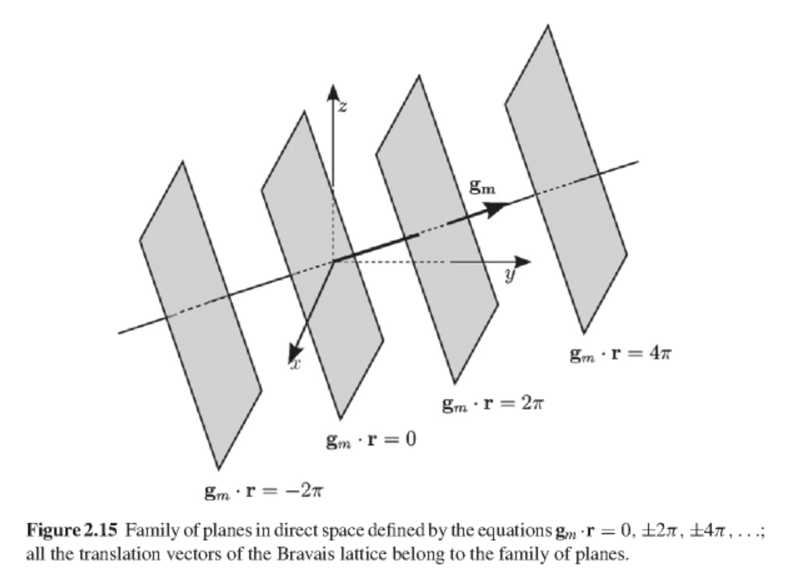

Slide 6
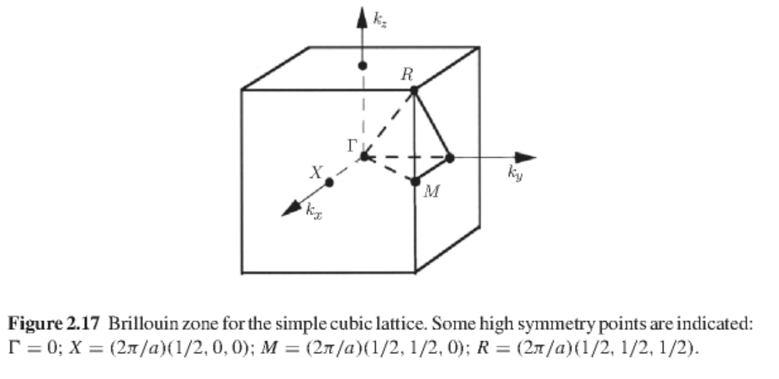
Unit cells of reciprocal space – Brillouin zones

Slide 7
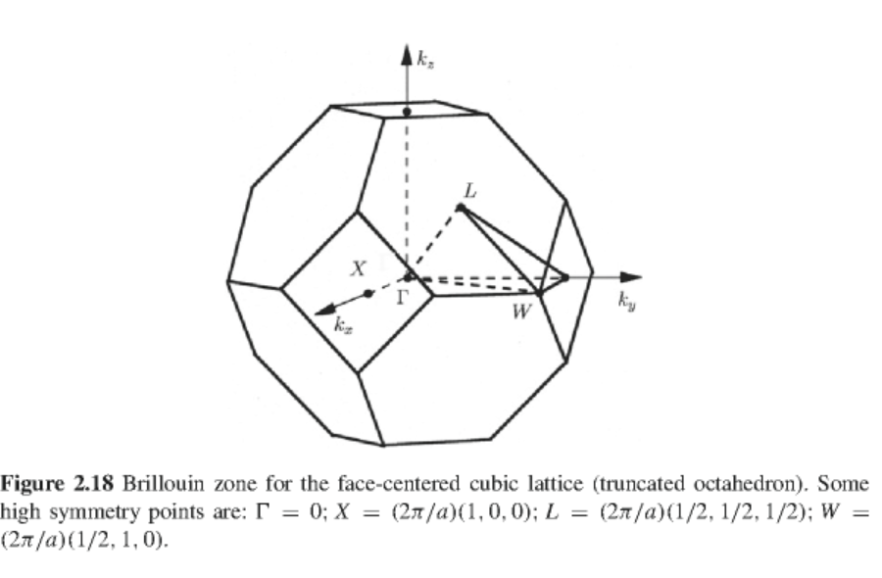

Slide 8
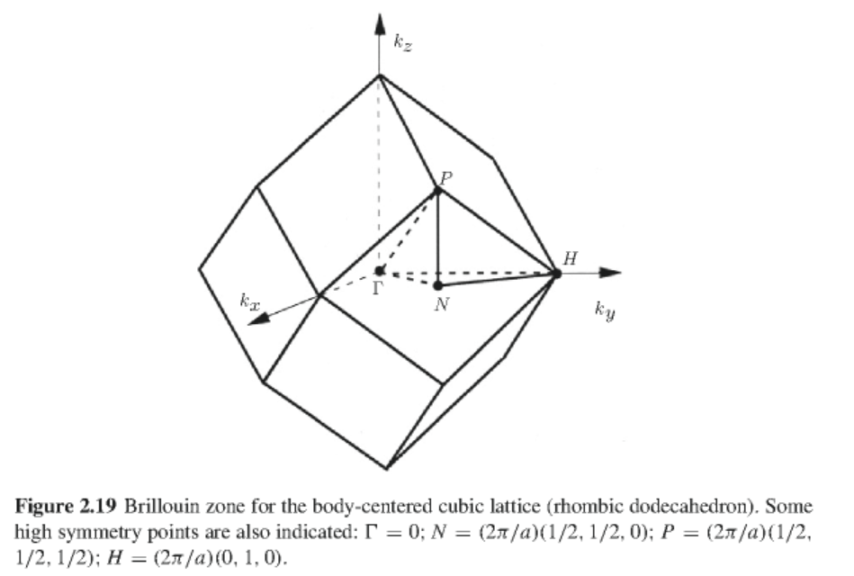

Slide 9
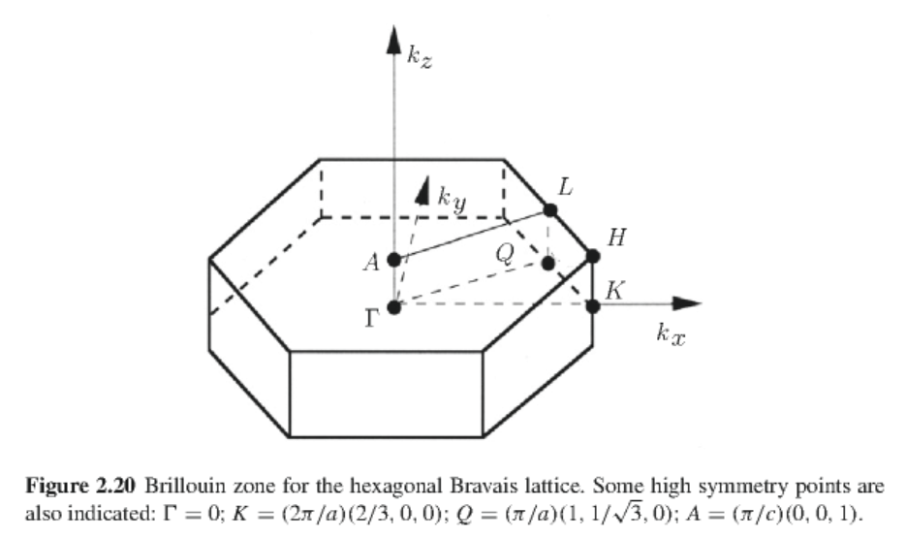

Slide 10
Properties of the wave vector
Consider the Schroedinger equation for an electron in a periodic solid
Wavefunctions with Bloch symmetry

Slide 11
Analysis of the significance of the Bloch wavevector;
Schoedinger equation in terms of periodic part of wavefunction:

Slide 12
Taking the k derivative of the equation:
Diagonal matrix element

Slide 13
Another useful identity

Slide 14
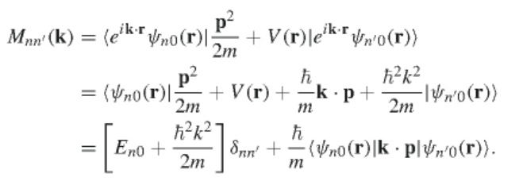
k·p perturbation theory
Second order expansion

Slide 15
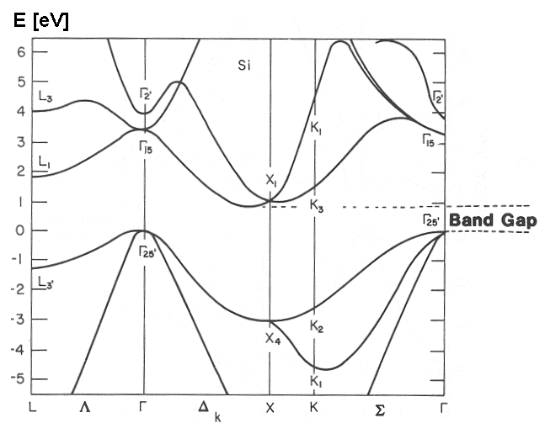
From: http://www.yambo-code.org/tutorials/GW/

Slide 16
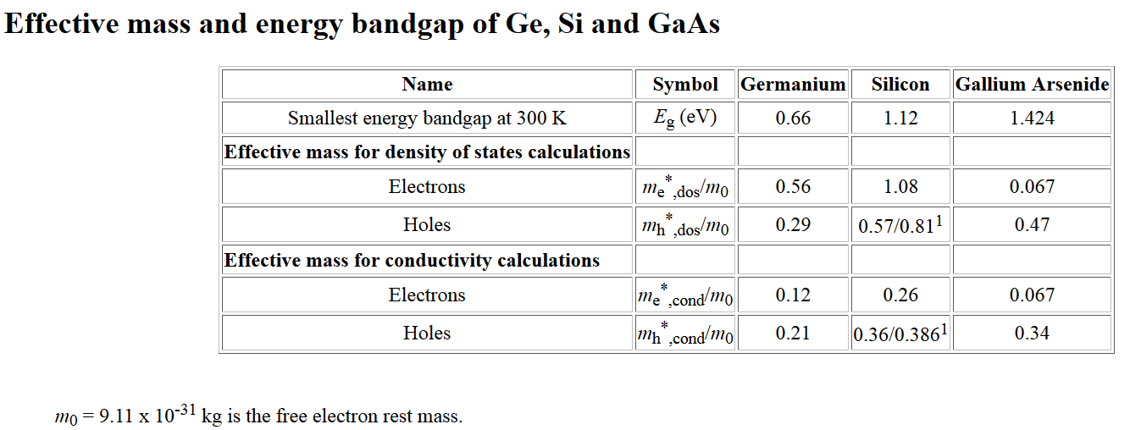
Effective mass tensor
Results from http://ecee.colorado.edu/~bart/book/effmass.htm

Slide 17
Averaging over states; integrating over the Brillouin Zone
Note that in general each band is doubly occupied due to electron spin
Densities of states
For electron spin

Slide 18
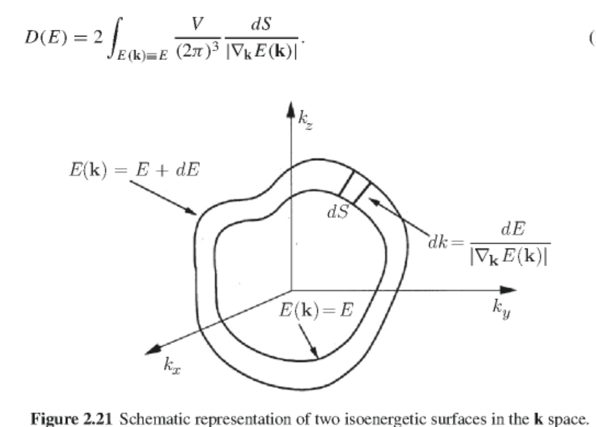
Density of states analysis -- continued

Slide 19
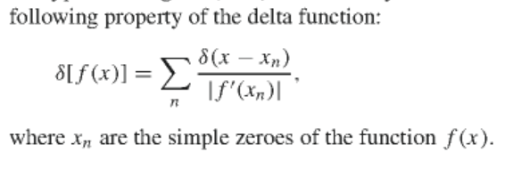
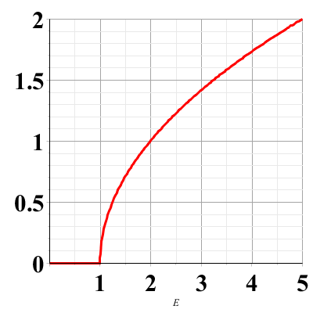
Properties of delta functions
Example in one dimension
D(E)
E

