Slide 1
PHY 711 Classical Mechanics and Mathematical Methods
11-11:50 AM MWF Olin 107
Plan for Lecture 12:
Finish reading Chapter 6
Virial theorem
Canonical transformations
Hamilton-Jacobi formalism

Slide 2
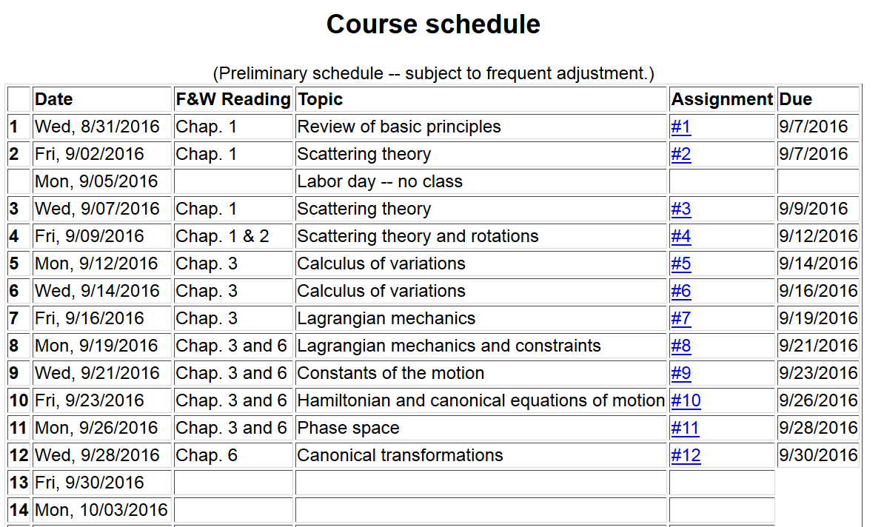

Slide 4
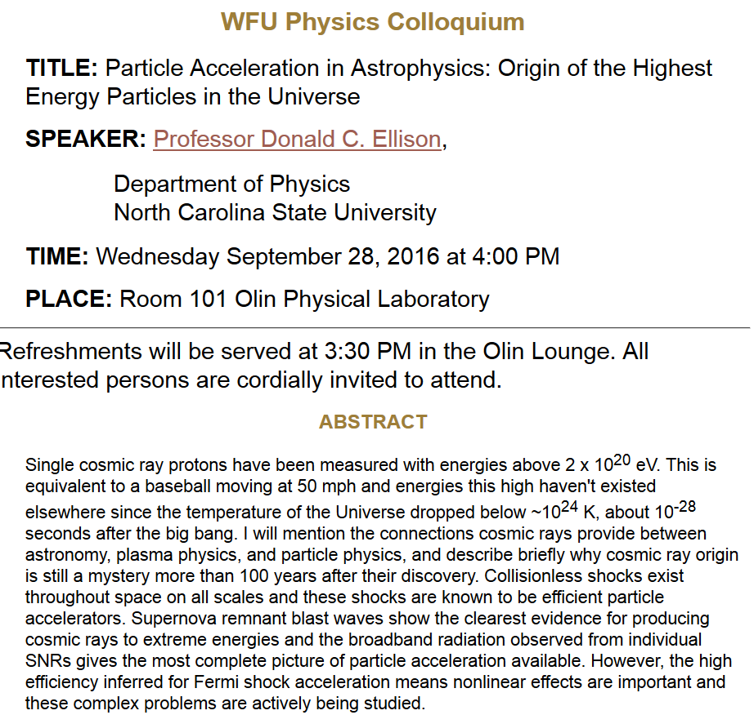

Slide 5
Virial theorem (Clausius ~ 1860)
Note that this implies that the motion is bounded

Slide 6
Examples of the Virial Theorem

Slide 7
Examples of the Virial Theorem

Slide 8
Hamiltonian formalism and the canonical equations of motion:

Slide 9
Notion of “Canonical” transformations

Slide 10
Some relations between old and new variables:

Slide 12
Note that it is conceivable that if we were extraordinarily clever, we could find all of the constants of the motion!
Possible solution – Hamilton-Jacobi theory:

Slide 14
0
0
0

Slide 15
0
0
0

Slide 16
Differential equation for S:

Slide 17
Continued:

Slide 18
Continued:

Slide 19
Another example of Hamilton Jacobi equations

Slide 21
Check action:

Slide 22
Recap --
Lagrangian picture
Hamiltonian picture

