Slide 1
PHY 711 Classical Mechanics and Mathematical Methods
11-11:50 AM MWF Olin 107
Plan for Lecture 5:
    Start reading Chapter 3.17 –
    Introduction to the calculus of variations
    Example problems
    Brachistochrone

Slide 2
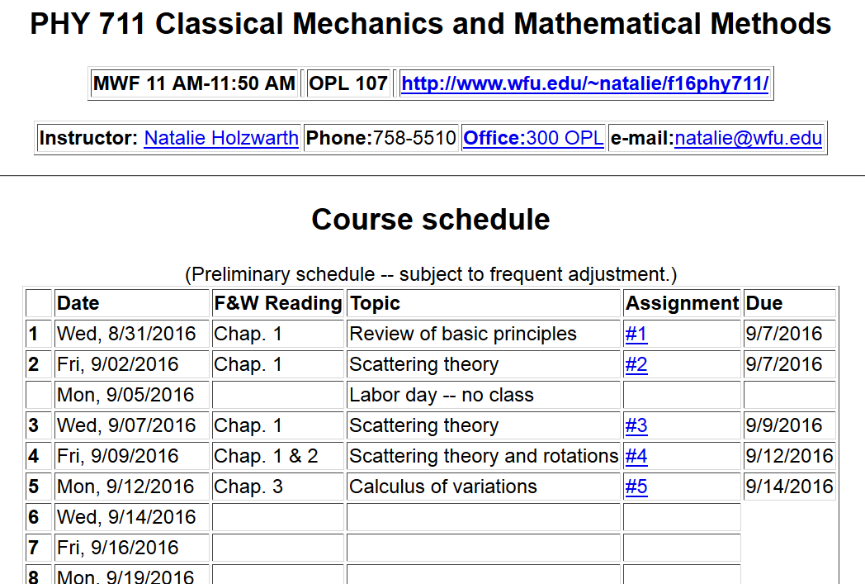

Slide 3
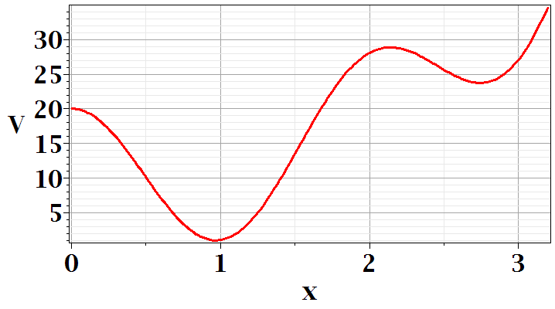
In Chapter 3, the notion of Lagrangian dynamics is developed; reformulating Newton’s laws in terms of minimization of related functions. In preparation, we need to develop a mathematical tool known as “the calculus of variation”.
Minimization of a simple function
local minimum
global minimum

Slide 4
Minimization of a simple function
local minimum
global minimum

Slide 5
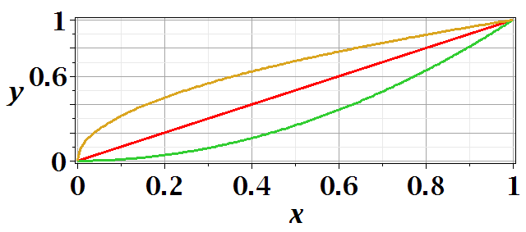
Functional minimization

Slide 7
Calculus of variation example for a pure integral functions

Slide 8
After some derivations, we find

Slide 10

Lamp shade shape y(x)
y
x_{i} y_{i}
x
x_{f} y_{f}

Slide 12
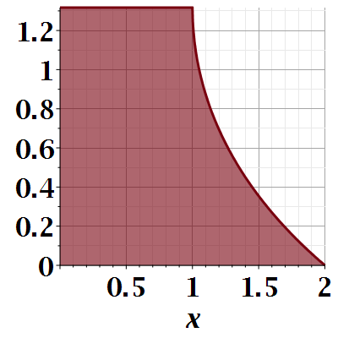

Slide 13
Another example:
  (Courtesy of F. B. Hildebrand, Methods of Applied Mathematics)

Slide 14
Euler-Lagrange equation
Alternate Euler-Lagrange equation

Slide 15
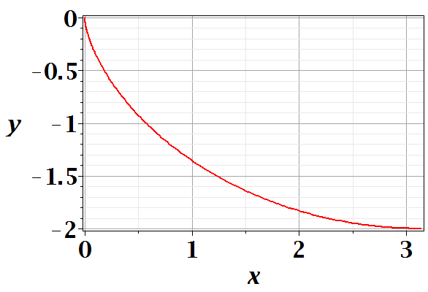
Brachistochrone problem: (solved by Newton in 1696)
http://mathworld.wolfram.com/BrachistochroneProblem.html
A particle of weight mg travels frictionlessly down a path of shape y(x). What is the shape of the path y(x) that minimizes the travel time from
y(0)=0 to y(π)=-2 ?

Slide 18
Parametric equations for Brachistochrone:

Slide 19
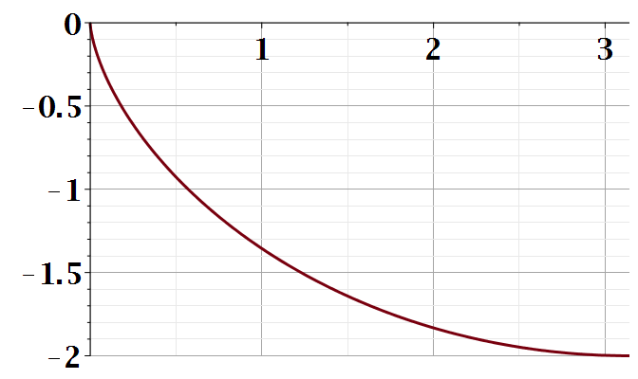
Parametric plot --
plot([theta-sin(theta), cos(theta)-1, theta = 0 .. Pi
y
x

