Slide 1
PHY 711 Classical Mechanics and Mathematical Methods
9-9:50 AM MWF Olin 107
Plan for Lecture 15:
Review Chapters 1-4,6
Scattering of pairs of particles
Physics of rotating reference frames
Calculus of variation
Lagrangian and Hamiltonian formalisms
Small oscillations about equilibrium

Slide 2
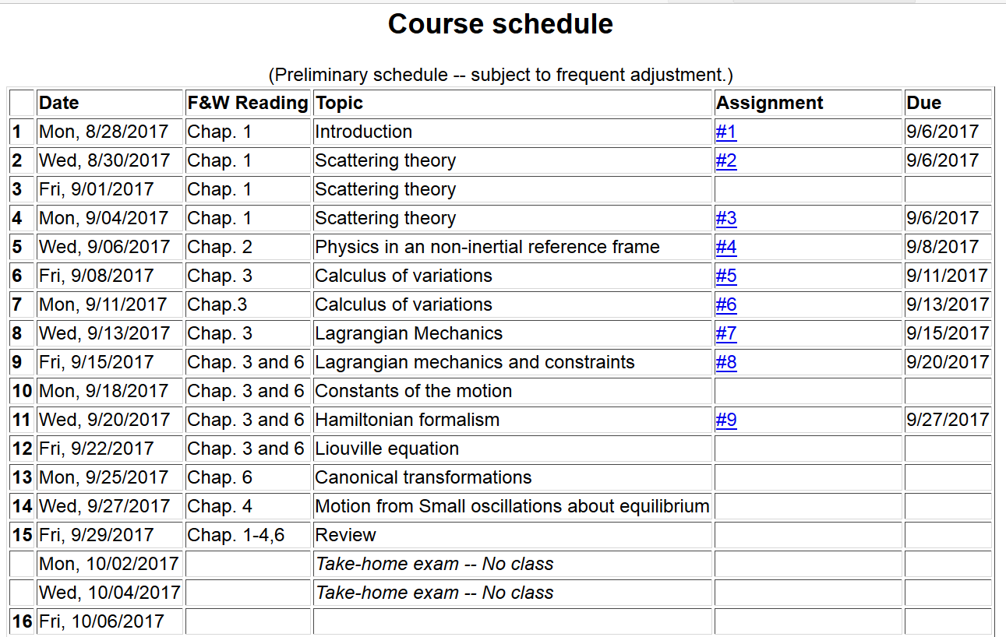
Next class on Fri. Oct. 6th

Slide 3
Scattering of pairs of particles

Slide 4
Scattering theory:
detector

Slide 5
b
Figure from Marion & Thorton, Classical Dynamics

Slide 6
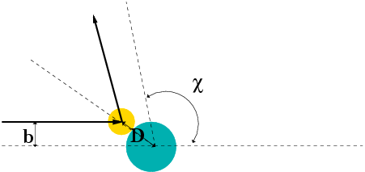
Simple example – collision of hard spheres
Microscopic view:

Slide 7
Relationship between center of mass and laboratory frames of reference – continued (elastic scattering)
V_{CM}
V₁
v₁
ψ
θ

Slide 8
Differential cross sections in different reference frames

Slide 9
Differential cross sections in different reference frames – continued:
For elastic scattering

Slide 10
Example of hard spheres
θ

Slide 11
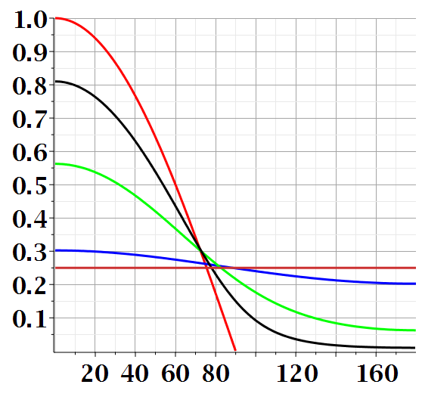
Scattering cross section for hard sphere in lab frame for various mass ratios:

Slide 12
Physics in accelerated reference frames

Slide 13
Physical laws as described in non-inertial coordinate systems
Newton’s laws are formulated in an inertial frame of reference
For some problems, it is convenient to transform the the equations into a non-inertial coordinate system

Slide 14
Comparison of analysis in “inertial frame” versus “non-inertial frame”

Slide 15
Properties of the frame motion (rotation only):
dΩ
dΩ

Slide 16
Properties of the frame motion (rotation only) -- continued
Effects on acceleration (rotation only):

Slide 17
Application of Newton’s laws in a coordinate system which has an angular velocity and linear acceleration
Newton’s laws; Let r denote the position of particle of mass m:
Centrifugal
force
Coriolis
force

Slide 18
Motion on the surface of the Earth:
Earth’s gravity
Support force

Slide 19
ω
y (east)
z (up)
θ
x (south)
Approximate motion of Foucault pendulum

Slide 20
Calculus of variation

Slide 21
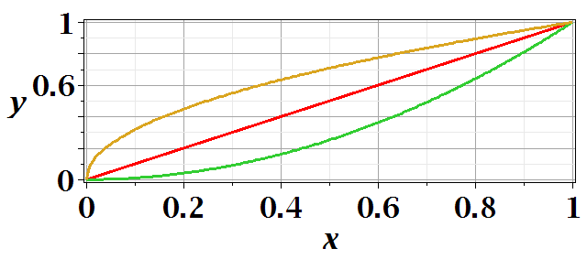
Functional minimization

Slide 22
After some derivations, we find

Slide 23
Hamilton’s principle; application of calculus of variation to mechanical trajectories --
Potential energy
Kinetic energy

Slide 24
Lagrangian picture
Switching variables – Legendre transformation

Slide 25
Hamiltonian picture – continued

Slide 26
Hamilton’s principle continued:
Canonical equations
0

Slide 27
Recipe for constructing the Hamiltonian and analyzing the equations of motion

Slide 28
Lorentz forces:

Slide 29
Lorentz forces, continued:

Slide 30
Hamiltonian formulation in presence of vector potential

Slide 31
Physics of small oscillations about equilibrium; normal modes of coupled oscillators

Slide 32
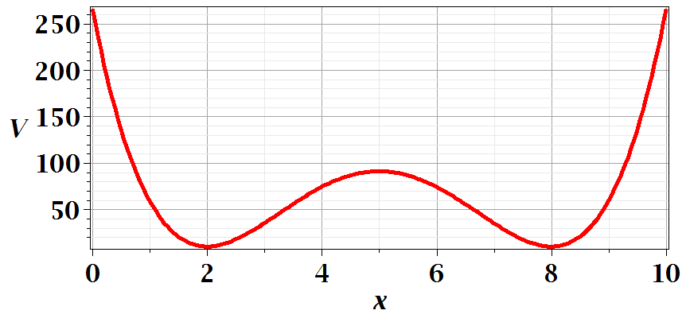
Motivation for studying small oscillations – many interacting systems have stable and meta-stable configurations which are well approximated by:

Slide 33
Consider an extended system of masses and springs:
m
m
m

Slide 38
